Slide 1

New Korean Restaurant Location among 5 major cities in Midwest
Where should I open a new restaurant?

Slide 2
Contents
Introduction
Data
Measures of Competition
Results
Conclusion

Slide 3

Introduction
Candidates
Five Cities in Midwest
St. Paul
Chicago
Indianapolis
Detroit
Columbus
Want to choose a city with lowest competition among Korean Restaurants

Slide 4

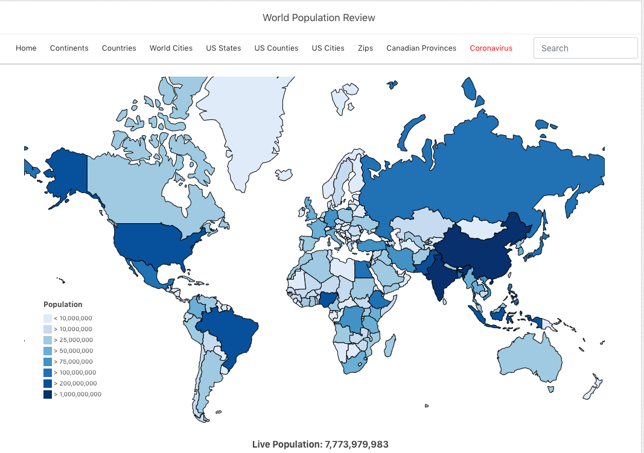
Data
Four Square API
Numbers of Korean Restaurants
Locations of Korean restaurants
World Population Review
https://worldpopulationreview.com/
Asian Populations for each cities
Land areas of each cities

Slide 5
Measures of Low competition
Distance Score
Average Distance from the center / Area
High average distance means wider spread over
But, it depends on how big the city is
Population Score
Number of people per restaurant
High number of restaurant in a city can means high competition only if there are the same number of potential customers.

Slide 6
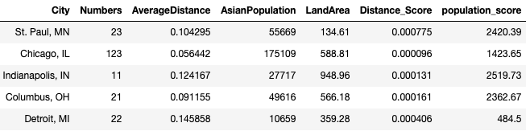
Results – Table

Slide 7
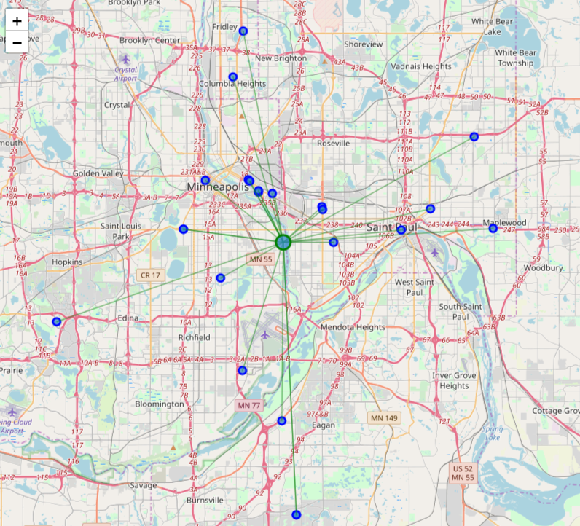
Korean Restaurants in St. Paul

Slide 8
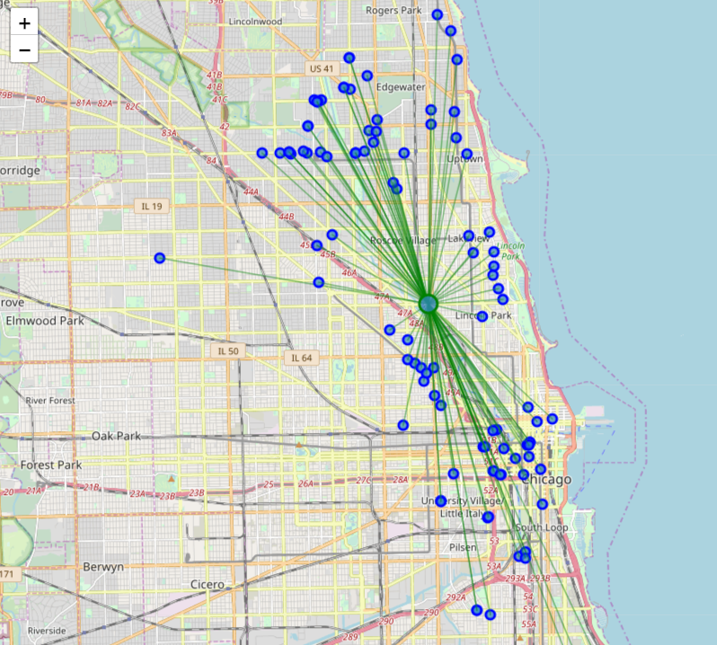
Korean Restaurants in Chicago

Slide 9
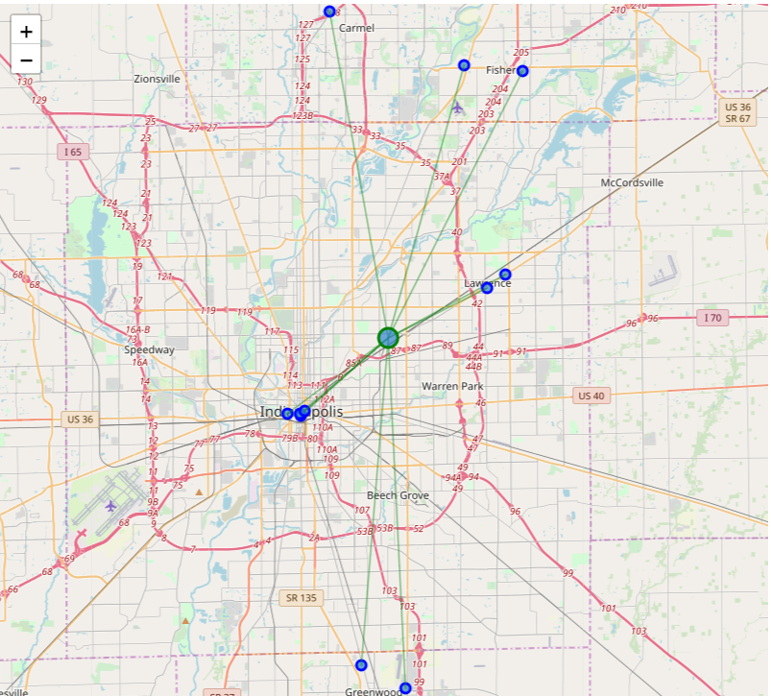
Korean Restaurants in Indianapolis

Slide 10
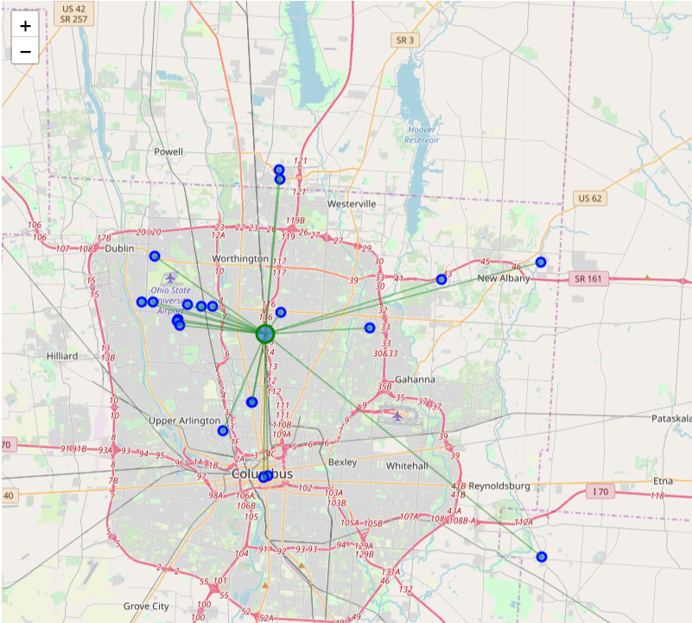
Korean Restaurants in Columbus

Slide 11
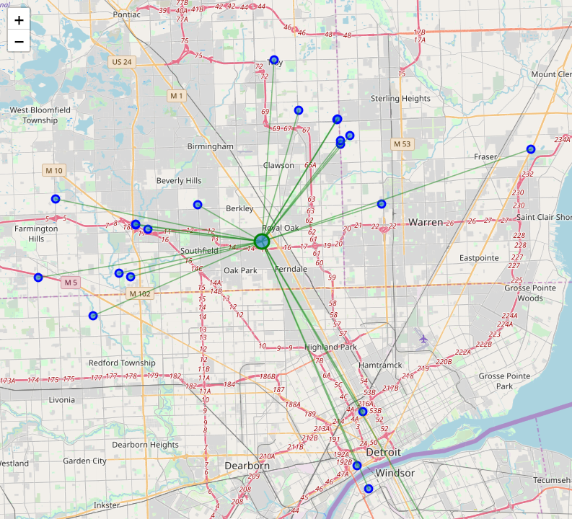
Korean Restaurants in Detroit

Slide 12
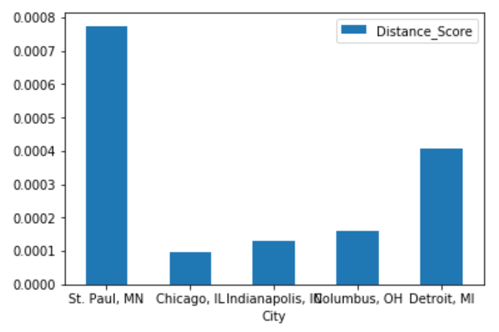
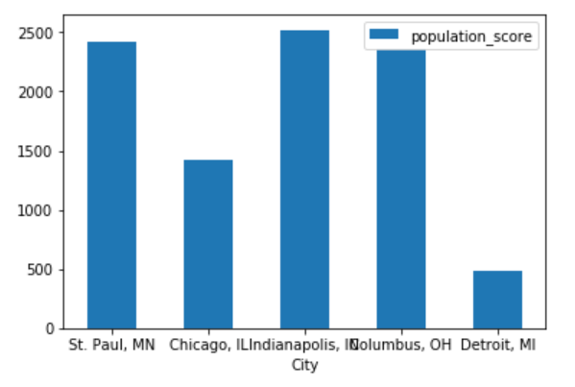
Comparisons of Competition Measures

Slide 13
Conclusion
The Best city – St. Paul
Distance score - St. Paul dominates the others
Population score - St. Paul is the second by less than 5% gap

