Slide 1
Chocolates

Slide 2
AIM
Chocolates products are always in high demand in markets and people of all age groups enjoy this product.
Improving the texture and taste of the product is the need of the hour.
Maintaining the flavour and novelty, especially in hot and humid areas is an important task.
Packaging interferes with the product once it achieves a fluidic state.
Notes:
Chocolate is a smooth suspension of particulate sugar, cocoa and milk solids in a continuous fat phase composed of cocoa butter and a minor portion of milk fat. Upon cooling of a chocolate melt, this continuous fat phase will solidify into an ordered crystalline structure, directly affecting chocolate’s functional and sensory characteristics, ultimately impacting consumer acceptance. Its constituent lipid species will define different levels of structure within its crystal network and determine essential attributes. For example, the chemical composition and crystal habit of cocoa butter dictate the distinctive texture, snap, gloss, and melting character of chocolate. Crystal habit includes polymorphism, crystallite size and shape, and spatial distribution of network mass. Furthermore, heat, mass, and momentum transfer conditions during the tempering process used in the manufacturing/crystallization of chocolate greatly affect the solid fat fraction and crystal habit of cocoa butter.

Slide 3
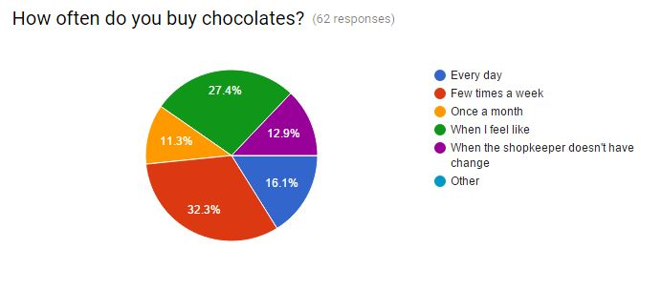
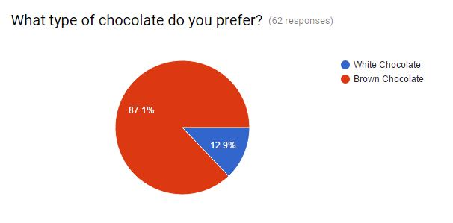
SURVEY
A survey was conducted to gather information on the problems and type of product preferred among the chocolate consumers.

Slide 4
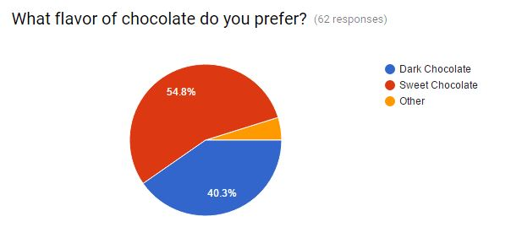

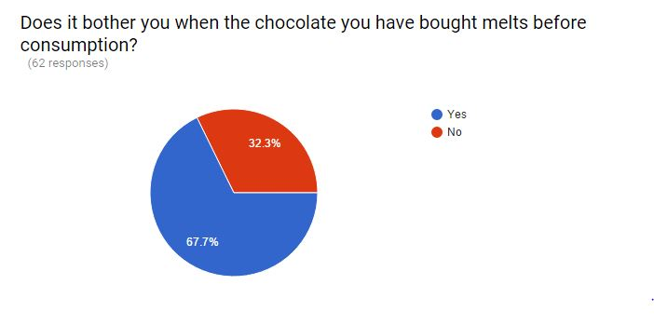
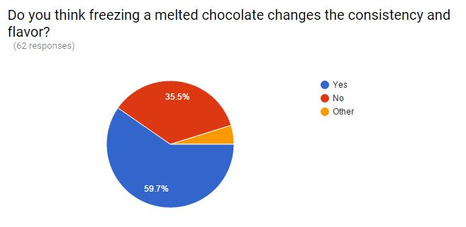

Slide 5
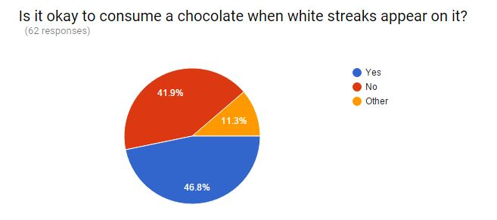
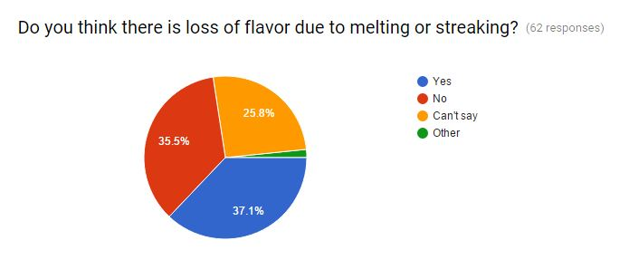
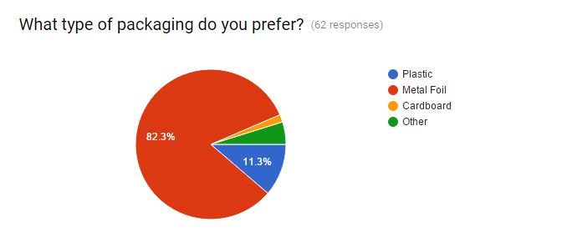
Notes:
It was found that people prefer brown over milk chocolates and sweet over dark chocolates. Most of them consuming it within the same day of purchase and 43.5% people consuming it within 5 minutes after purchase. Melting of chocolate is seen as a major issue affecting 67.7% people. Freezing a melted chocolate is known to change the consistency in texture and flavour by initiating crystallization which is disliked by 59.7% people. People have preferred metal foil for packaging despite of the very fact that chocolate develops a foil texture on melting. It can be seen as a major disadvantage owing to the products which get sold because of texture as one of its U.S.P.
Conclusively, melting and changes in storage cycles is seen as a major hit towards loss of flavour and texture

Slide 6
Melting
White streaks
Flavour
Grainy Streaks
Gritty
Cause: Cocoa butter (Melting point = 34.1°C) and Milk butter
Solution: Adding ingredients that can increase the melting point of butter or using CBEs
Cause: Cocoa butter not being fully integrated.
Solution: Add cocoa butter earlier in the process for longer residence time and mixing.
Cause: Cracked shells allowing mold growth and disruptive cooling cycles.
Solution: Increase shell thickness and examine handling practices and continuous cooling periods at specified temperatures

Slide 7
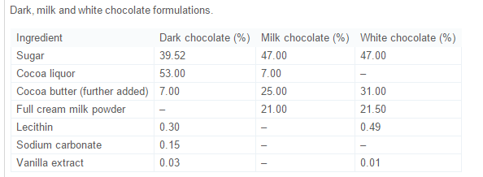
Notes:
After this point, any excessive heating of the chocolate will destroy the temper and this process will have to be repeated.

Slide 8
PROBLEM SOLUTIONS
The ingredient which makes milk and white chocolate melt faster is the cocoa butter which has a melting point of 34.1°C.
Dark chocolates wither less and can sustain in fairly high temperatures without melting.
The replacement of part of the cocoa butter content of chocolate with cocoa butter equivalents (CBEs) improves the heat stability of the chocolate.
In countries with a warmer climate the addition of CBEs may significantly improve the shelf life of a chocolate product.
CBEs are vegetable fats derived from palm and shea oils, which are chemically and physically very close to cocoa butter. CBEs can be made with heat resistant properties superior to cocoa butter.

Slide 9
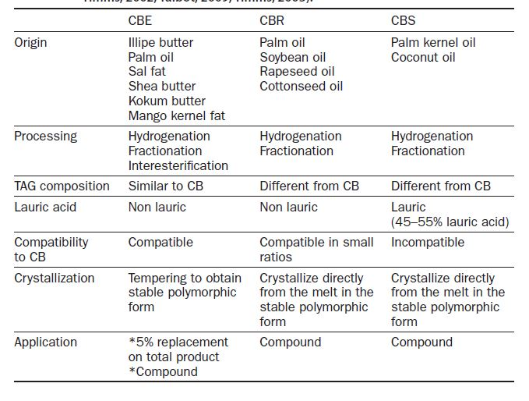

Slide 10
The CBEs have similar physicochemical characteristics as cocoa butter. Chocolates with CBEs have better resistance to softness and fat bloom at higher ambient temperatures, such as in summer or in tropical climates.
CBRs posses good flavor, odour and colour properties and do not need tempering. This gives rise to softer products and provokes loss of gloss and fat bloom formation. The high level of trans fatty acids is a significant disadvantage as it leads to the risk of cardiovascular disease.
CBSs have a sharp melting profile. This melting profile gives a good mouth feel to the compound chocolates. They are miscible in any proportion with cocoa butter, and are compatible with its physical properties (melting point and crystallization temperature, melting rate, need for tempering phase).
The addition of these fats cannot exceed 5% of the finished Chocolate.
Products which contain vegetable fats other than cocoa butter following the EU Directive, may be marketed as chocolate, provided that their labeling is supplemented by a clearly legible statement: ‘contains vegetable fats in addition to cocoa butter’
Notes:
product after deduction of the total weight of any other edible matter used, without reducing the minimum content of cocoa butter or total dry cocoa solids. .

Slide 11
Chocolate consists of VI types of crystals amongst which Type V crystal has the most desirous melting point and is glossy and firm.
Proper tempering involving forming the most of the type V crystals is required. This will provide the best appearance and ensures the texture and appearance doesn’t degrade over time. To accomplish this, the temperature is carefully manipulated during the crystallization. The chocolate is first heated to melt all six forms of crystals (heat dark chocolate to 120°F, milk chocolate to 115°F, and white chocolate to 110°F).
Then the chocolate is cooled to allow crystal types IV and V to form (VI takes too long to form) (cool dark chocolate to 82°F, milk chocolate to 80°F, and white chocolate to 78°F).
At this temperature, the chocolate is agitated to create many small crystal "seeds" which will serve as the nuclei to create small crystals in the chocolate.
The chocolate is then heated to eliminate any type IV crystals, leaving just the type V (heat dark chocolate to 90°F, milk chocolate to 86°F, and white chocolate to 82°F).

Slide 12
Crystal | Melting Temp | Notes
I | 17°C (63°F) | Soft, crumbly, melts too easily.
II | 21°C (70°F) | Soft, crumbly, melts too easily.
III | 26°C (78°F) | Firm, poor snap, melts too easily.
IV | 28°C (82°F) | Firm, good snap, melts too easily.
V | 34°C (94°F) | Glossy, firm, best snap, melts near body temperature (37°C).
VI | 36°C (97°F) | Hard, takes weeks to form.

Slide 13
ECONOMIC ASPECTS
Confectioners are looking for a replacement to save money on cocoa butter with something else.
Cocoa butter prices jumped 28 percent this year to as high as $8,200 a tonne on strong demand and tight supply after global grinders cut processing to reduce inventory.
The world's capacity for making cocoa butter substitutes of all grades is now about 150,000 tonnes per year, up by 25,000 to 30,000 tonnes since 2013, according to an industry source.

Slide 14
The rise in the price of palm oil-based cocoa butter substitutes has come even as palm oil prices have fallen to five-year lows, underlining the increased demand for the product.
According to Euromonitor International. Nutritionists say both products may be equally bad. "They are both high in saturated fat and will raise total cholesterol, and I would expect that there would not be a great difference from a health perspective," said Walter Willett, professor and chairman of the Department of Nutrition for Harvard School of Public Health in Boston.

Slide 15
