Slide 1
Covid-19 Analysis report
Srn – pes1ug20cs186
Assignment id – Covid_9

Slide 2
From the onset of year 2020, the world has been widely affected by the contagious coronavirus, popularly addressed as Covid-19.
Normal life had been crippling since then, nation wide lockdowns, relief measures, donations, and other governmental measures in a systematic way have ensured that today, life is returning to normalcy and our country’s economy is also recovering .
As a part of Internal Assessment, Data Analysis has been performed on WHO’s dataset created during these hard times, which is explained in this presentation.

Slide 3
Data visualizations and conclusions

Slide 4
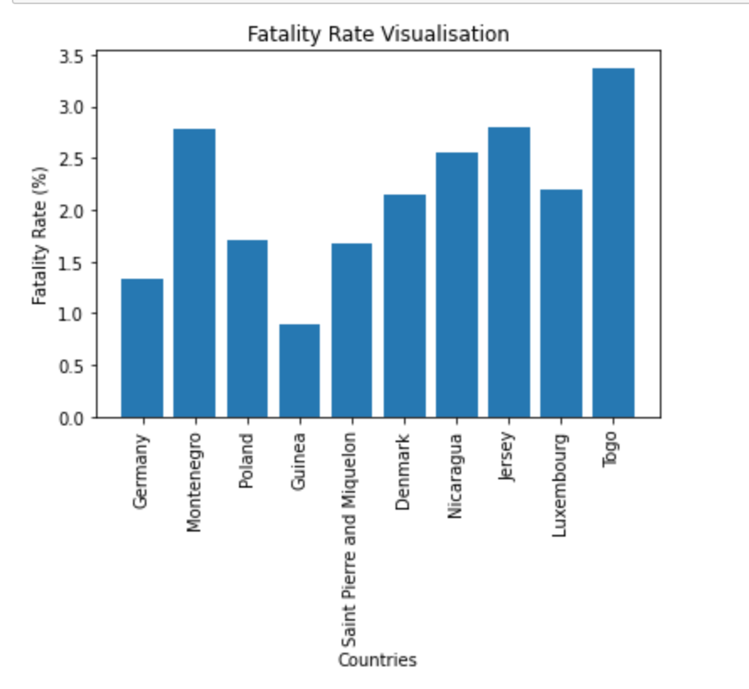
In remote countries like Togo, Montenegro, fatality rate is high compared to other developed countries like Germany and Denmark
This denotes lack of medical facilities in these under-developed countries. There is a correlation between the higher fatality rate and the economic status of these countries.
Need to address where developed countries extend a medical facilities and other services to these underdeveloped countries and fight the covid battle.

Slide 5

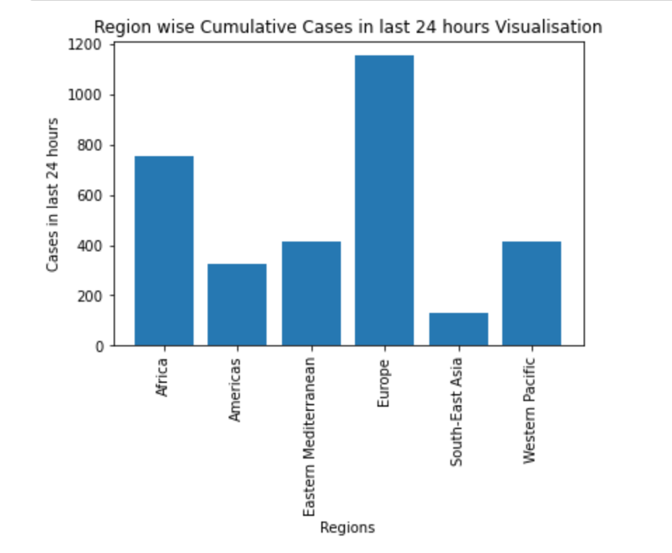
In last 24 hours Europe region is showing a boom in it’s active Covid Cases.
Spread in the Region needs to be controlled – calls for a lockdown in Africa and Europe.
On the brighter side, South East Asia has cases significantly low compared to Europe or Africa. This highlights the quality healthcare workforce in the region.

Slide 6
Europe vs America visualizations

Slide 7
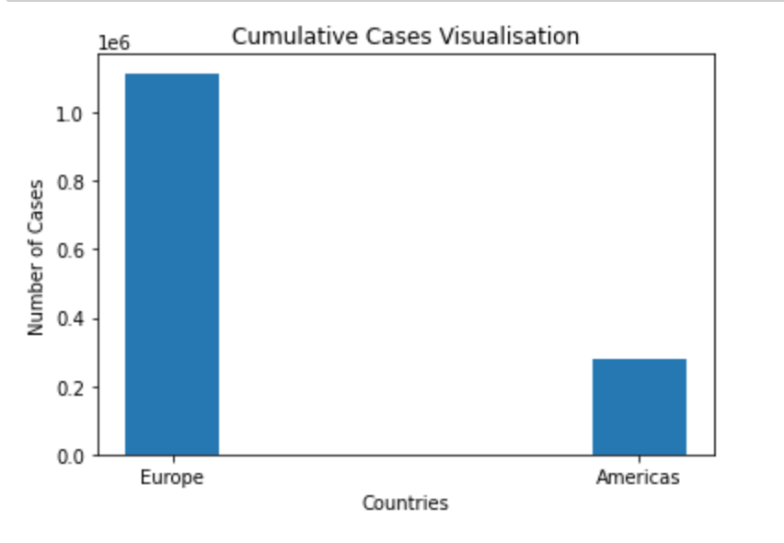
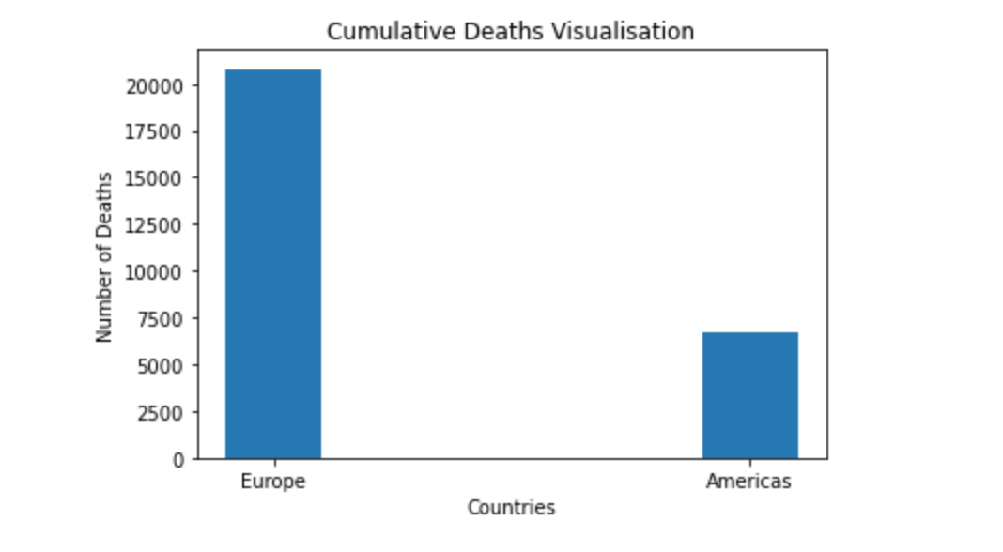
Consider these plots
From from plots we see that there has been an exponential increase in the number of cases in Europe then America.
On the darker side, deaths are also on a greater rate than America, which needs to be addressed.

Slide 8
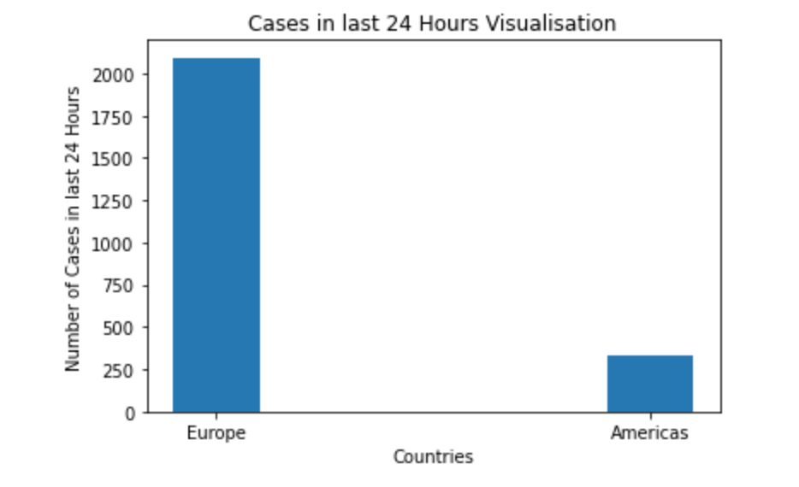
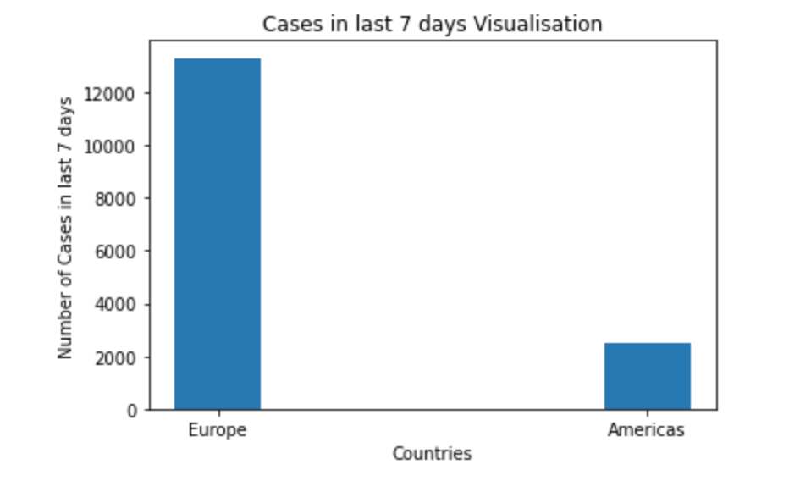
Consider these plots
Clearly there is a boom in the cases in last 24 hours, in Europe than America.
Analysis over the week also show that there is a massive increase in cases of Europe than America – spread is exponential.

Slide 9
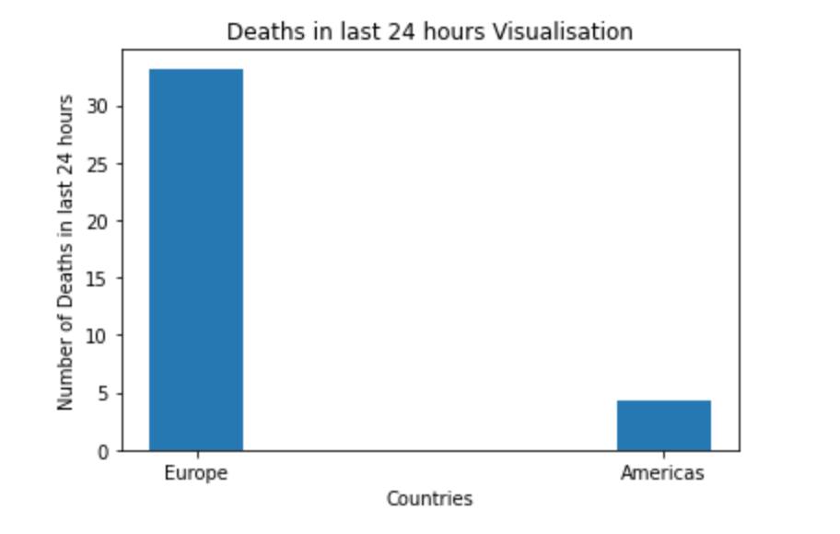
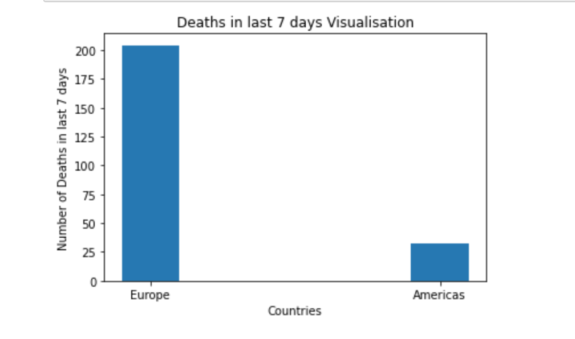
Consider these plots
On the brighter side we can conclude that America has better healthcare facilities than Europe and a quality workforce.
Europe is a matter of concern since death count in spanning in a day or a week is also vast.

Slide 10
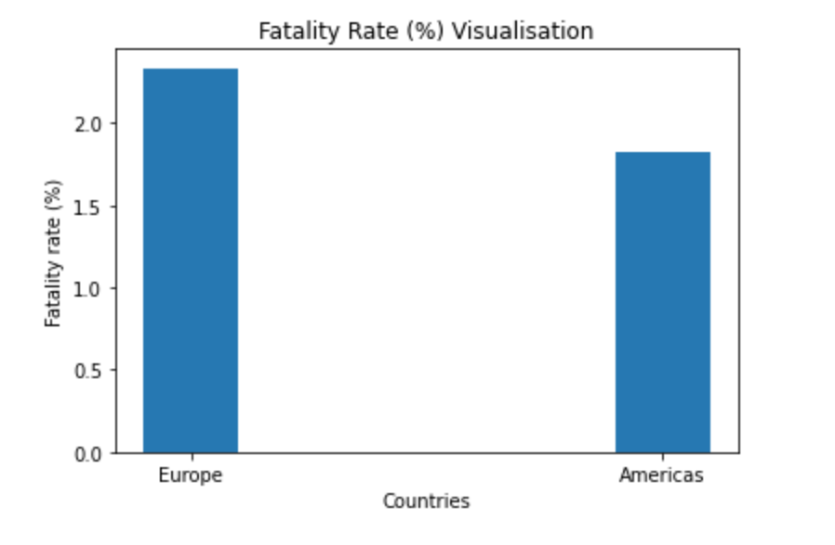
Consider this plot
This plot shows that Europe has a greater fatality rate than America and needs addressal
Based on the previous graphs and the graph beside, we can conclude that the spread of Covid-19 in Europe was massive than America.
IT IS TRUE THAT EUROPE HAS BEEN AFFECTED WORSE THAN AMERICA BY COVID

Slide 11
NOTE – Given the small dataset of only 236 rows, outlier removal would result in extreme reduction of data for analysis, hence data has been treated, instead of dropping outliers.

