Slide 1

DEFCON Level
Using Neural Networks.!
By Ranjith KS
Notes:
To use this title animation slide with a new image simply 1) move the top semi-transparent shape to the side, 2) delete placeholder image, 3) click on the picture icon to add a new picture, 4) Move semi-transparent shape back to original position, 5) Update text on slide.

Slide 2
“The Defense Readiness Condition (DEFCON) is an Alert state used by the United States Armed Forces.”
-- Joint Chiefs of Staff and Unified & Specified Combatant Commands.

Slide 3
INTRODUCTION
What is?
DEFCONs are a subsystem of a series of Alert Conditions, or LERTCONs, that also includes Emergency Conditions (EMERGCONs).
Who Commands?
DEFCONs vary between many commands and have changed over time, and the United States Department of Defense uses exercise terms when referring to the DEFCONs. This is to preclude possibility of confusing exercise commands with actual operational commands.
Revealing key points.
Which Level?
The DEFCON scale is a way of assigning a numerical value to the readiness of the American military. Higher DEFCON values are used for lower levels of readiness (during more peaceful situations), while Lower DEFCON values are used for higher levels of readiness.

Slide 4
PREPARE
As a Data Scientist, I would perform EDA on the Dataset to understand various Features, relations and how to Model it.
“What am I doing with Dataset?”
Given the Dataset of various combinations of Parameters along with it’s DefCon Level, I am going to predict the DefCon Level for a Test set.
“Predict the Target i.e. DefCon Level”
The DefCon Level varies in the range of 1 to 5, hence it’s a Multi Classification Target.
“Apply Deep Learning Techniques”
Using the Neural Networks in Deep Learning, I would prepare a ANN Model that takes inputs from the given Features and predict the Target Feature.

Slide 5
Operations
How I Start?
To Model the Dataset, I have applied Exploratory Data Analysis, Basic Statistics, Visualization and etc.
!
Understand the Dataset
Visualize the Dataset Features and Columns Relations
Perform Data Cleanup and Exploration
Apply Feature Engineering
Figure out the Insights
Modeling using Deep Learning NN

Slide 6
DEFCON Level Reference Chart
1
2
3
4
5
Maximum readiness;
All forces ready for combat; nuclear war imminent or likely
High readiness;
Armed forces ready to deploy in six hours
Armed forces readiness increased above normal levels;
Air Force ready to mobilize in 15 minutes
Increased intelligence-gathering and security measures
Normal peacetime readiness
Reference : The basics you can find anywhere 5 Steps To Successful Storytelling Published on April 5, 2014 Featured in: Marketing & Advertising

Slide 7
5
A very good thing, used to designate normal peacetime military readiness
PEACE TIME
Note that DEFCON 5 isn't necessarily a sign that the world is at peace - conflicts, even major ones, may be occurring around the world during a DEFCON 5.

Slide 8
4
First level of readiness above baseline value of DEFCON 5 and thus constitutes a fairly mild increase in readiness
Heightened Alertness
In the modern world, it is thought that DEFCON 4 is sometimes issued after minor to moderate terrorist attacks and politically-motivated killings, or after would-be plots are uncovered

Slide 9
3
It’s a serious - though they may not pose an immediate threat to existence or stability of American state, they do call for significant vigilance
Tense Military/Political situations
DEFCON 3 has usually corresponded to situations in which military action against the US or one of its allies was a distinct possibility
Notes:
Tip:
When using complex image as full-bleed background add a transparency (70%-90%) fill layer to give contrast to text.

Slide 10
2
Refers to a further increase in force readiness just below maximum readiness
MAJOR THREAT
situations carry a significant risk of major military operations against the United States or its allies, including the use of nuclear weapons

Slide 11
1
It is reserved for absolute most dangerous, severe situations, including ongoing nuclear war involving US or one of its allies
MAXIMUM ALERT
Levels are usually kept classified until after the fact, it is thought that DEFCON 1 has never been issued for a branch of the US military before.

Slide 12
TAKEAWAY
DefCon Level 1 is rarely is given.
LEARN FROM OTHERS
DefCon Level 5 is for Peace, and every Nation should have Friendship and positive Relationship among other Nations.
ACTION
A Common Agreement has to made without any Conflicts and Negative Face.
Notes:
Combine an image and multiple key statements with a strong grid.

Slide 13
Given the Dataset with various Features and Entries, what am I visualizing and predicting?

Slide 14
VISUALIZATION
Variables
Dataset has 10000 Rows with 12 Features where 10 are Independent Features,1 Dependent Feature and an ID Feature which is ignored.
Describe
Dataset has Integer and Floating Point Features, does not have EMPTY values i.e. NaN and most of the Features are range in a limited values expect Troops_Mobilized Feature.
Extracting the valuable Insights from the Dataset.
Features
The DEFCON Level is the Target Feature, is Categorical and Discrete in nature.

Slide 15
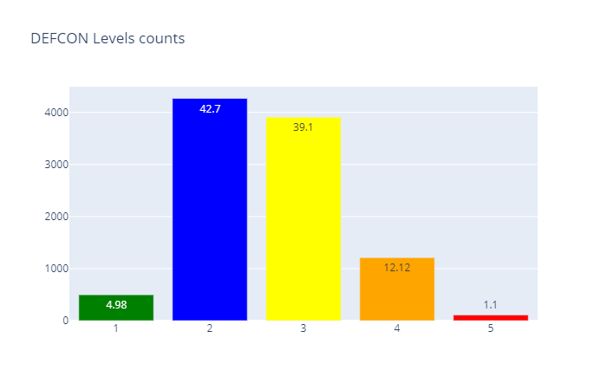
DEFCON Level Value Counts
Insight
DEFCON Level is a Target Feature, it’s Value Counts aren’t spread equally.
The Levels 2 & 3 does exists in majorly of Dataset, i.e. ~81.8%; and Levels 5 & 1 does exists minimally in Dataset, i.e. ~06.1%
Thus, the Target Feature is IMBALANCEd.

Slide 16
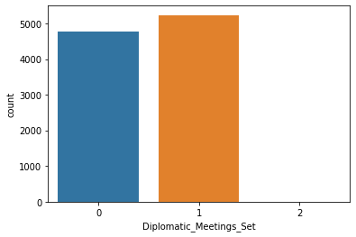
Diplomatic Meetings Value Counts
Insight
The no. of Diplomatic Meetings set among Nations are either 1 or None.

Slide 17
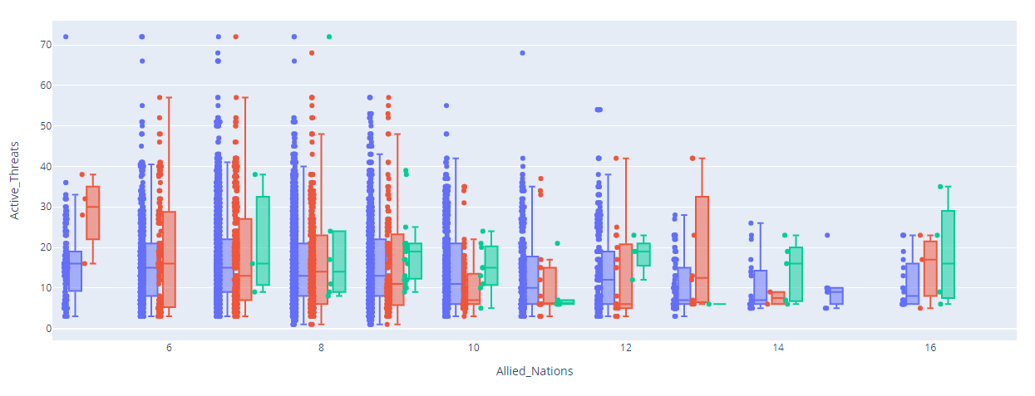
Allied Nations vs Active Threats
As more Nations Allied, the no. of Active Threats gradually reduces.

Slide 18
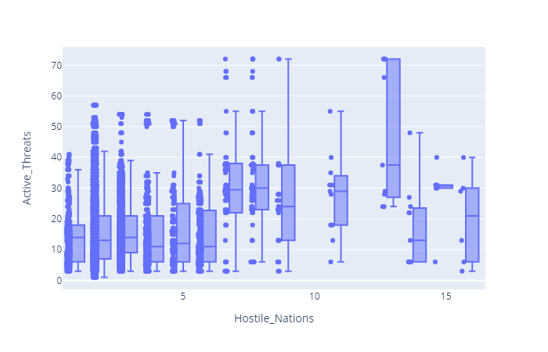
Hostile Nations vs Active Threats
Active Threats gradually increases as the no. of Hostile Nations increases.

Slide 19
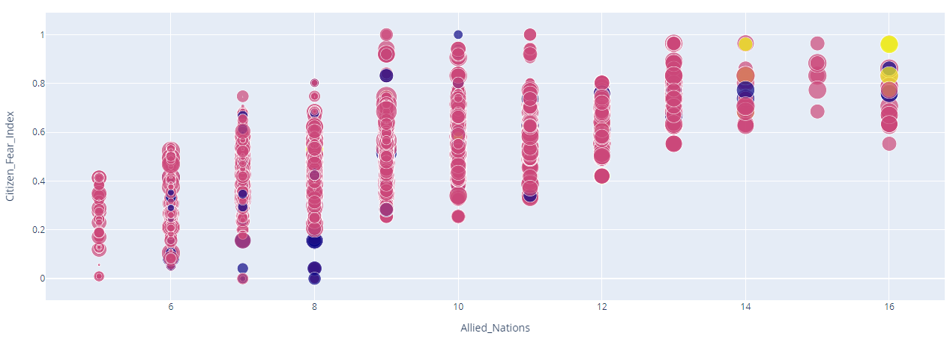
Allied Nations vs Citizen Fear Index
Citizen Fear Index increases as the no. of Nations are Allied together.

Slide 20
Applying Supervised Machine Learning, Deep Learning Modeling techniques on the Dataset to predict the Target Class.
MODEL
In this Project, I am applying Deep Learning Techniques on the Dataset to predict the Multi Class Feature, i.e. DEFCON Level

Slide 21
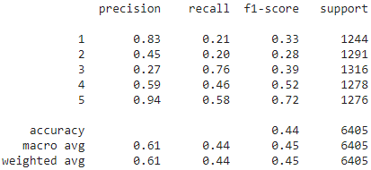
Modeling
Using Keras Tensor Flow Deep Learning APIs, created a Model with Optimizers, Early Stopping, Drop Out, Regularization etc. to predict the Target Feature.
“Base Model”
The Base Model did not perform better in predicting the Multi Class Target Feature.
The Accuracy, Precision and F1 Score did not meet threshold.
The Plot of Loss Function in during Training and Validation is not IDLE.
“Reason for Less Accuracy”
The Dataset Target Class has highly Imbalance in nature. Hence Up Sampling has to be performed to increase the no. of majority values.
“Model – After handling Imbalance”
Applied SMOTE sampling technique to Up Sample the Target Class's Minority values.
Upon handling the Imbalance, the Model Accuracy is bit improved, i.e. 43%
The Plot of Loss Function in during Training and Validation is now IDLE.

Slide 22
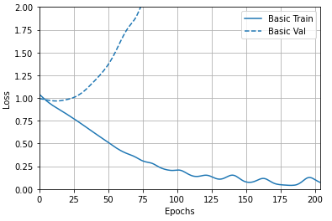
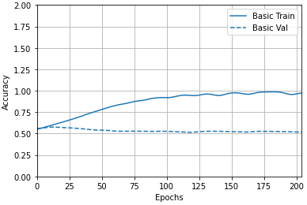
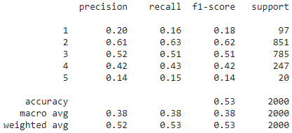
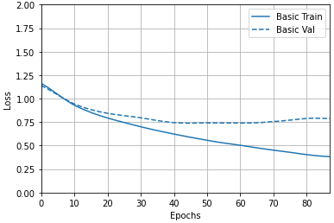
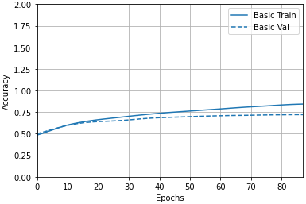
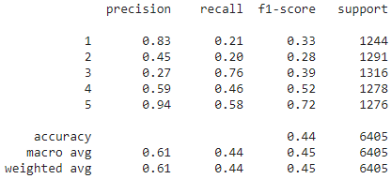
Plot
Plot Loss Function, Accuracy & Confusion Matrix
“Base Model”
“After handling Imbalance”

Slide 23
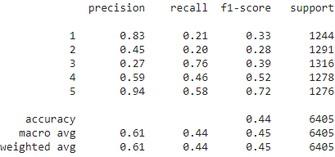
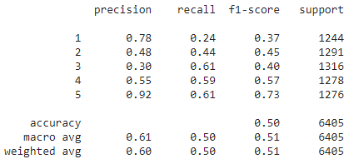
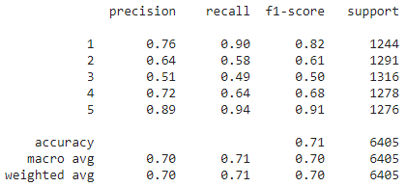
Modeling
Using Keras Tensor Flow Deep Learning APIs, created a Model with Optimizers, Early Stopping, Drop Out, Regularization etc. to predict the Target Feature.
“Label Encoding”
Performed Label Encoding using get_dummies() on multiple features, with which there is observed improvement in the Accuracy
“Using Drop Out”
Used Drop Out in Layers to achieve better Consistency and Fitting.
“Using Regularization”
Did Normalize the Weights in between Layers as the Dataset Inputs are already Normalized in nature.

Slide 24
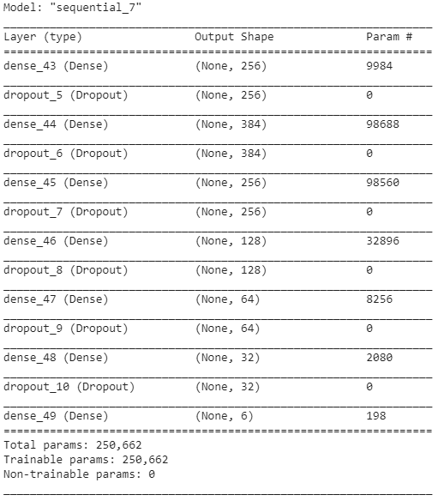
Summary
Model Summary

Slide 25
Accuracy : 71% Precision : 70% Recall : 71% F1 Score : 70%

Slide 26
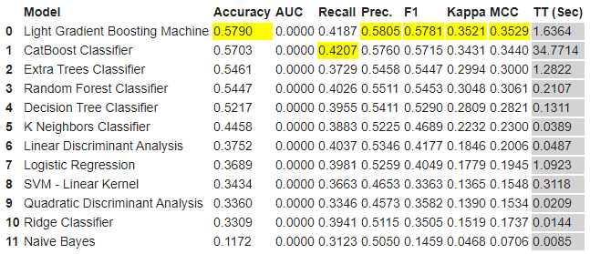
Applied PyCaret
PyCaret
I have applied PyCaret on the Dataset to check how does the Machine Learning Algorithms are performing on the Dataset, but does not beat Deep Learning Neural Network Model.
PyCaret is an open source, low-code machine learning library in Python that allows you to go from preparing your data to deploying your model within minutes in your choice of notebook environment
Light Gradient Boosting Machine Model is the tend to be the Best Model with a Accuracy of ~57.9% and F1 Score of ~57.8%

Slide 27
Thank You!
- Yours Ranjith
Neal Creative | click & Learn more

