Slide 1
Exploratory Data Analysis on Indian Premier league
… By Ranjith KS

Slide 2
Agenda
IPL
DATASETS
TEAMS
SEASONS
MATCHES
INSIGHTS

Slide 3
IPL
The Indian Premier League (IPL) is a professional Twenty20 cricket league in India contested during March or April and May of every year by eight teams representing eight different cities in India. The league was founded by the Board of Control for Cricket in India (BCCI) in 2008.

Slide 4
Datasets
Deliveries
Is in CSV format, contains the ball-by-ball data of all the IPL matches including data of the batting team, batsman, bowler, non-striker, runs scored, etc
Matches
Is in CSV format, contains the details related to the match such as location, contesting teams, umpires, results, etc.

Slide 5
TEAMS
Royal Challengers Bangalore
Kolkata Knight Riders
Kings XI Punjab
Delhi Capitals
Sunrisers Hyderabad
Mumbai Indians
Rajasthan Royals
Chennai Super Kings
Rising Pune Supergiants
Gujarat Lions
Pune Warriors
Kochi Tuskers Kerala

Slide 6
SEASONS
IPL started in 2008, where 12 seasons held till 2019.

Slide 7
MATCHES & Venues
756 Matches held from 2008 to 2019
33 Cities hosted IPL matches
41 Venues hosted IPL matches

Slide 8

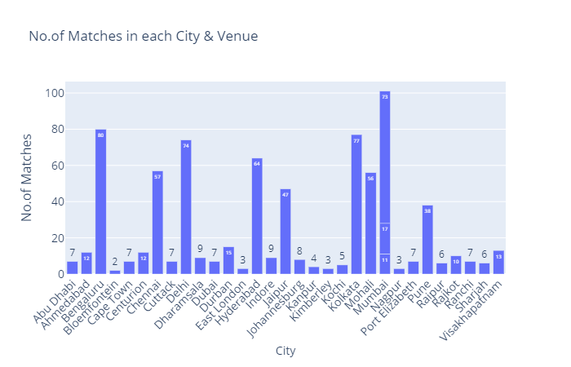
Matches held in each city and venue
101 Matches held in Mumbai, is most among 33 Cities.
3 Venues hosted Matches in Mumbai.

Slide 9
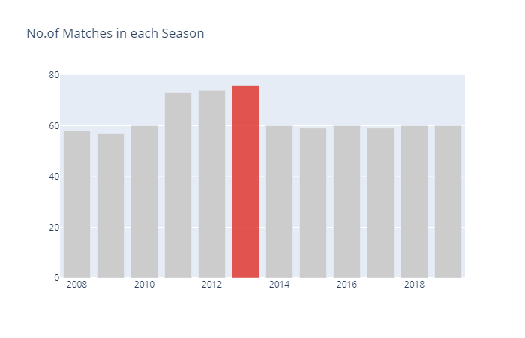
matches played in each season
The Season 2013 has the most no.of Matches held, i.e. 76
The Season 2009 has the least no.of Matches held, i.e. 57

Slide 10
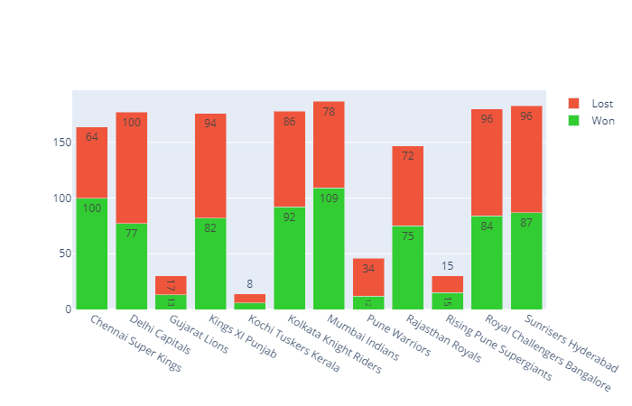
Teams win vs lost
Mumbai Indians Team is considered to be most no.of Wins
Pune Warriors Team is considered to be least no.of Wins

Slide 11

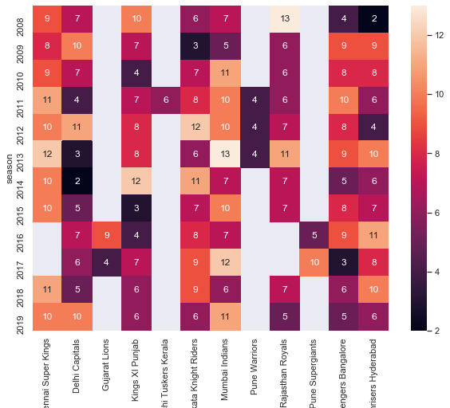



Teams won Matches in each season
Chennai Super Kings Team has consistently WON most of the Matches in a Season

Slide 12
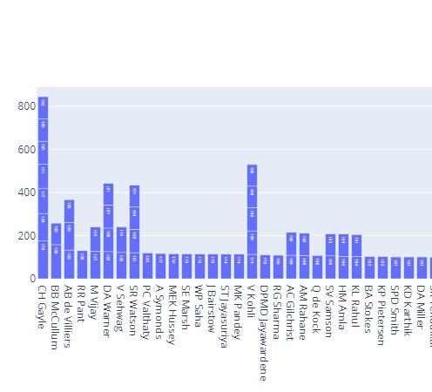
High scores by batsmen
Chris Gayle has scored 175 runs in a Match
Chris Gayle has made 7 Centuries

Slide 13
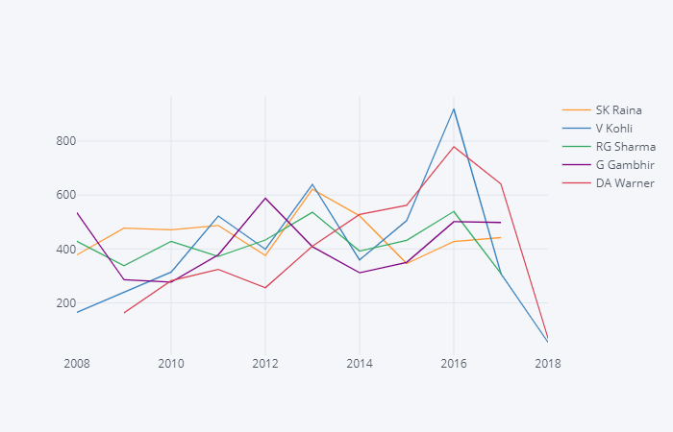
Top batsmen over seasons
V Kohli & DA Warner scored runs increasingly in each Season
Rohit Sharma & SK Raina scored runs consistently in each Season

Slide 14

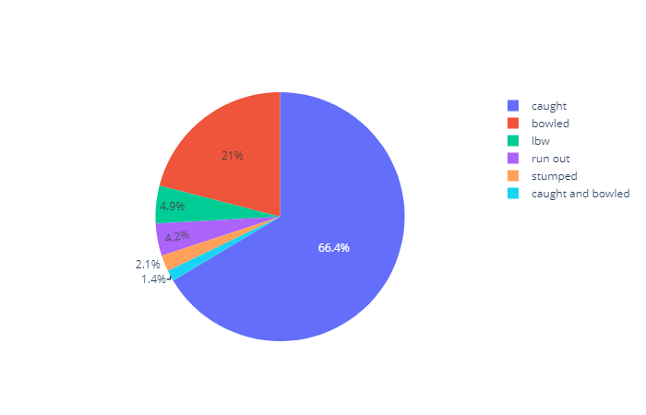
Dismissal types of a batsman
V Kohli has dismissed as CAUGHT mostly
V Kohli has dismissed as CAUGHT by Bowler very few times.

Slide 15
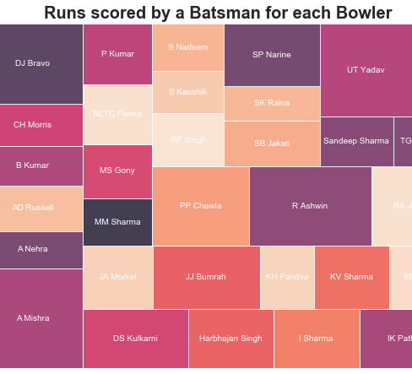
RUNS scored by a batsman with bowlers
V Kohli has faced mostly A Mishra, DJ Bravo, R Ashwin, UT Yadav.

Slide 16
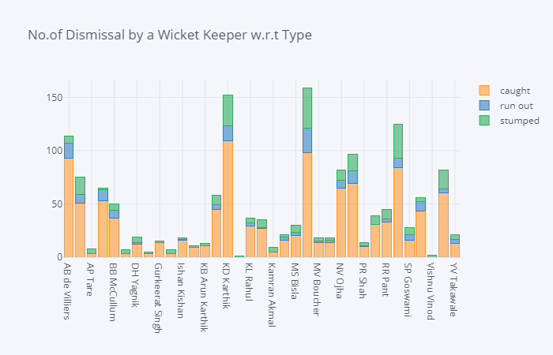
Dismissals by a wicket keeper
MS Dhoni has highest no.of Dismissals
KD Karthik dismissed by Catches most no.of times
MS Dhoni has highest stumpings

Slide 17
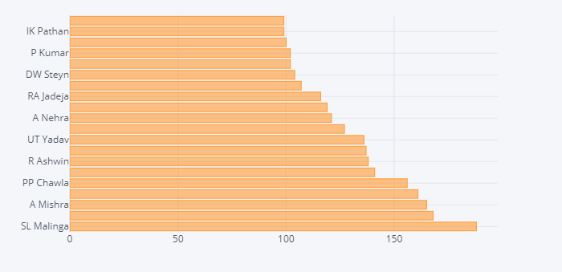
Highest wicket takers
SL Malinga took most Wickets, i.e. 188

Slide 18
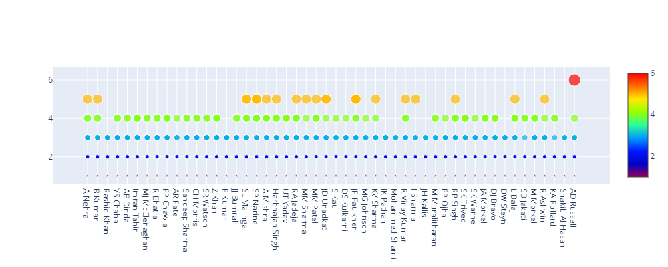
Wickets taken by Bowlers
AD Russel has picked up 6 Wickets

Slide 19
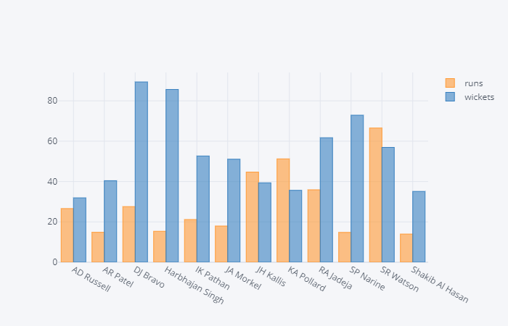
Best allrounders
SR Watson is considered to be best All Rounder

Slide 20
conclusion
Most successful team in IPL is Mumbai Indians
Team whoever wins TOSS would be the WINNER at the most
Highest Runs scored by a Batsman is 'Virat Kohli'
Highest Wickets taken by a Bowler is 'SL Malinga'
Best All Rounder across IPL is 'Shane Watson'
'Chennai Super Kings' is the Team wins consistently in all the IPL Seasons
'Chris Gayle' has scored 7 Centuries in IPL
'Chris Gayle' has received most number of 'Player of the Match'
'MS Dhoni' has dismissed most no.of Batsmen in IPL

Slide 21
THANKS

