Slide 1



TOPOLOGY OPTIMIZATION OF HEAT SINK
PRESENTED BY:
Sai Praneeth 711956
Srikar 711928
Sai Ganesh 711919
Yuvaraj 711961
SUPERVISOR
Dr. Santhosh kumar
Associate Dean,
Dept. of Mechanical Engineering

Slide 2

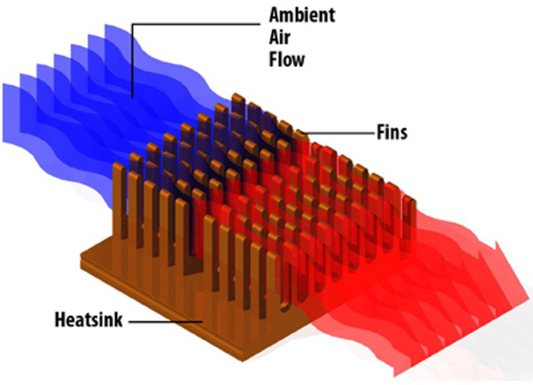
Introduction:
Passive and Active fluid cooled heat sinks are essential to electronic components like CPU, GPU and other power electronics.
With the increase in scale of datacenters & cloud computing, there is an increasing demand for cheap and effective heat dissipation solutions.

Slide 3
Problem Formulation:
A heat source with high heat flux (like a CPU or other sillicon based power electronics) having a planar surface area 'S' for heat rejection is cooled by a heat sink with a base area equal to the "S". ( 2D)
Find the optimal topology for maximising heat transfer, minimising material and manufacturing complexity.
In our project, we divide the phases of optimization by incrementally increasing the number of objectives in order to optimize for a particular purpose.
Initially we start considering maximum heat transfer. After that we also include manufacturing feasibility & turbulent flow heat transfer.

Slide 4
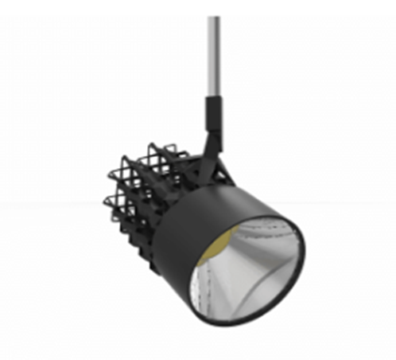
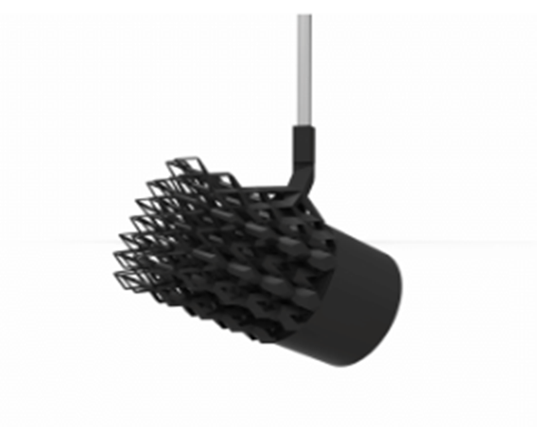
Background Research:
We considered three different designs for heatsinks on the light-emitting diode, where the light is pointing straight down so these designs are optimized for those particular heat outputs.
we see that common to all of them is actually that they don't have circular fins, they don't have circular pin fins. They actually have elongated cross-sections of all the members.
If we look closely, these are there to guide and help accelerate the flow and are common to all the designs no matter which orientation. All three designs have a cavity in the center and this cavity is very essential for lowering the resistance and increasing the acceleration of the flow through the heatsink.

Slide 5
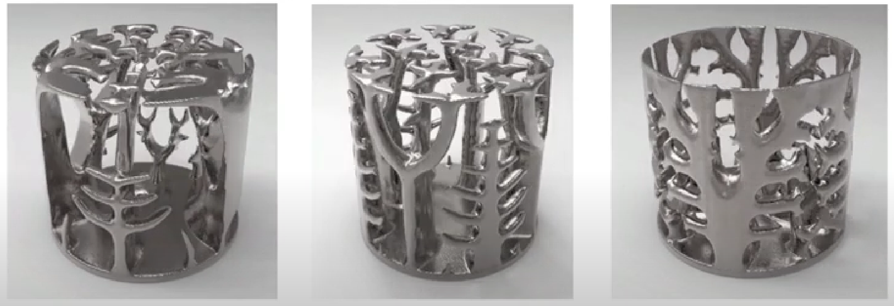

Slide 6
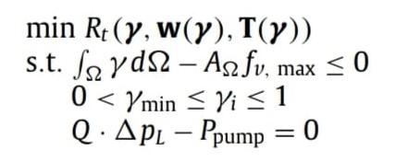
Methodology:
Topology optimization is different from size and shape optimization as it combines both aspects. Topology optimization not only considers geometry also considers how each node is connected to others.
The Governing equations of topology optimization:
Eq-1.Formulation for Topology Optimization

Slide 7
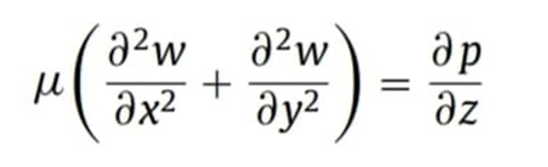
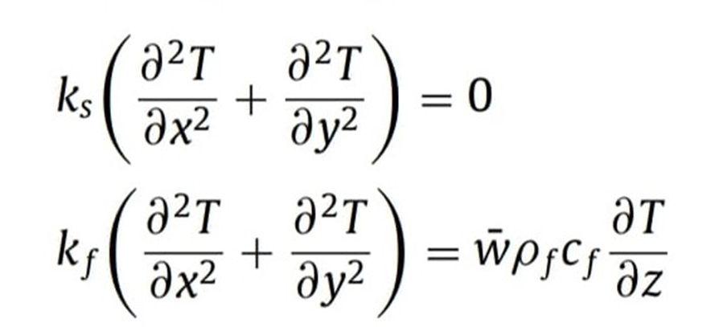
Eq-2.Velocity Governing Equation
Eq-3.Temperature Field

Slide 8
Computing Tools And Techniques:
Tooling:
Initially we are using MATLAB PDE toolbox to start preliminary heat transfer simulations on the three models we designed as a starting point for further implementations.
For further simulations we can use ANSYS or OpenFOAM software for final simulations on the optimized topology.

Slide 9
Computing Tools And Techniques:
Techniques:
The generic topology optimization methods are basically a search space problem with a very large number of possibilities due to high degrees of freedom.
So in order to reduce the time required for computing, we will decrease the accuracy, and degrees of freedom, and have some sort of manual sculpting in order to reduce complexity.
Here we are considering three design models of heat sinks for the optimized analysis, the first design is a normal heat sink model with fins in it, and we use this model for sake of comparisons.
The second design is a heat sink model which has fins upon those fins, these fins are arranged in such a way that the higher temperature point of one fin is connected to a lower temperature point of the adjacent fin.

Slide 10
Techniques:
The third design is based on transient flow analysis, here we are providing a cavity to the heat sink such that the rate of natural convection is higher and heat dissipation is at its maximum. Here even if we reduce the no of fins along the surface of a heat sink, the rate of heat dissipation is higher if we are able to control the flow of the fluid(air) along these fins.
These three designs are used for comparing one another and we try to take the best out of those.

Slide 11
model = createpde('thermal','transient’);
model.Geometry = g;
figurepdegplot(g)

Slide 13
Conclusion:
The topology optimization method for maximizing the thermal performance of a heat sink with an pre optimized uniform cross-section cooled by forced convection under the constraint of fixed pumping power was proposed.
The total thermal resistance, which was used to represent the thermal performance of the heat sink, was suggested as the objective function to be minimized.
The alternative expression for the total thermal resistance will be proposed to reduce the computation time of topology optimization method could reproduce the channel spacing of the heat sink optimized analytically in a rectangular domain.

Slide 14
THANK YOU

