Slide 1
PRODUCT DESIGN AND FUNCTION OVERVIEW

Slide 2
Primary objectives of this presentation
1. Overview of the drone design cycle
2. Defining abstraction layers in a drone
3. Discussing and Comparing possible design Approaches
4. Short term and long term consequences of each design.

Slide 3
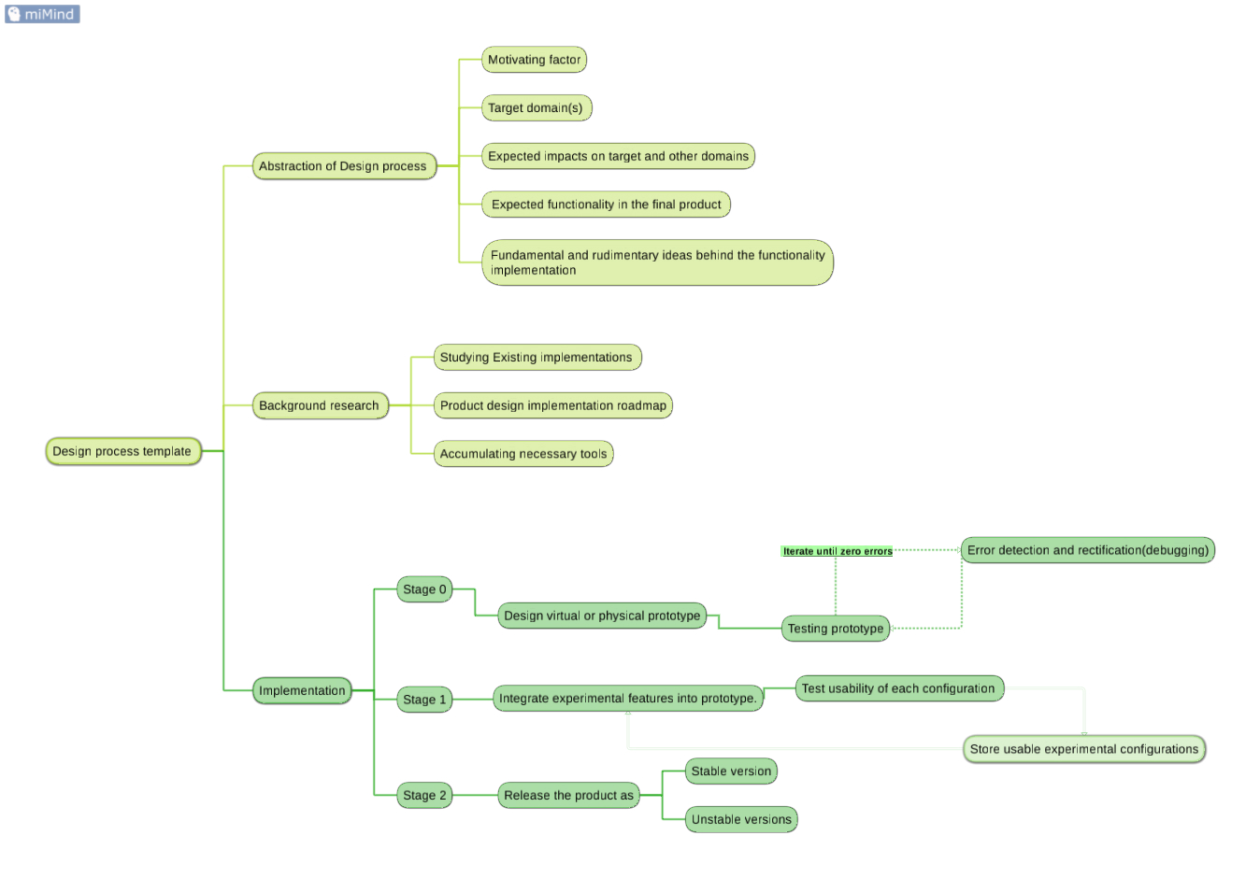
Mind map of Drone design life cycle

Slide 4
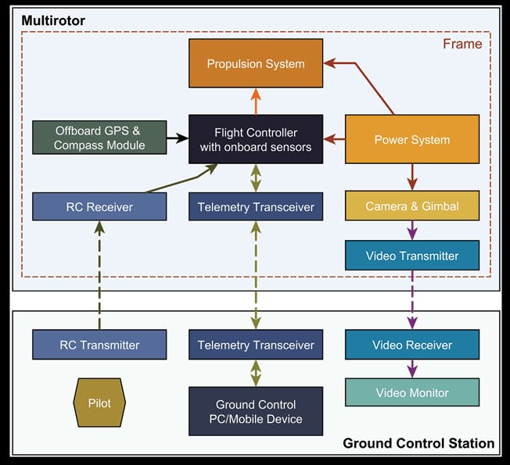
Abstraction layers in drone design

Slide 5
design choices
Propulsion design choices – ok (Quad rotor) Prototype
Power supply and management – ok
Radio flight Control -ok
Telemetry and video feed transmission - TS832
Navigation and mission planning system - PIXHAWK
Collision avoidance system. -OPTICAL FLOW , ???

Slide 6
PROPULSION DESIGN CHOICES
Available options
1. Quad rotor design
2. Hex rotor design
3. Single rotor design

Slide 7
Comparison of propulsion systems
Single rotor design | Multi rotor design
1. Higher lift efficiency 2. Inherent flight stability (Doesnt Require complex and continous Flight adjustments). 3. Large payload capacity per watt 4. Requires larger blades 5. Larger blades can cause high damage on impact but can be mitigated by mesh shielding. 6. Longer ranges and stable operation winds. 7. Lower maneuverability compared to multi rotor design. 2 + 0.5 + 0.5 + 0.5 8. Good for larger capacities | 1. Lower Efficiency 2. Requires active fly-by control System 3. Lower payload capacity per-watt 4. Requires smaller blades 5. Smaller Blades are safer and Cheaper to use 6. Short range and relatively unstable in strong winds compared to large single rotor design 7. High Maneuverable design with 3(TRUE) + 3(PSEUDO (0.5)) degrees of freedom 8. Good for payloads smaller than 15 kg and for surveillence drones

Slide 8
WHY Single rotor propulsion is better in future design?
Advantages
Higher lift efficiency ( due to increased thrust per watt)
Longer range
Higher payload capacity
Reduced cost ( due to less rotors and energy required)

Slide 9

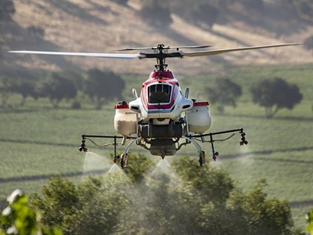
SINGLE ROTOR DESIGN CURRENTLY IN MARKET
YAMAHA RMAX SERIES FARMING DRONES

Slide 10
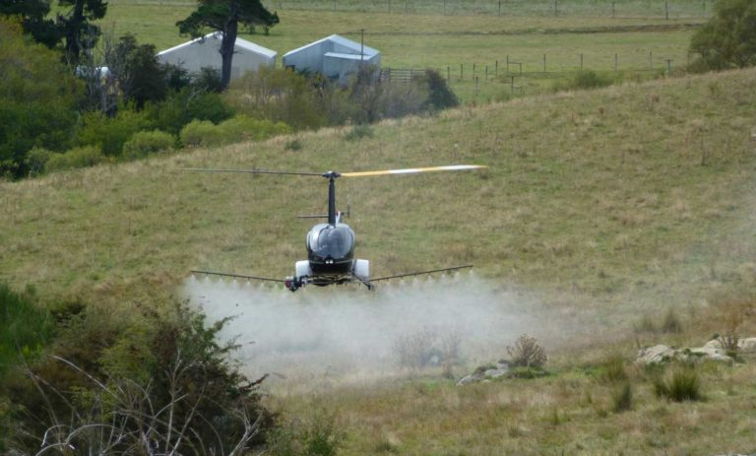
SINGLE ROTOR DESIGN CURRENTLY IN MARKET
R22-UV
PRECISION FARMING DEMONSTRATION
BY UAVOS COMPANY

Slide 11
CHALLENGES IN Single rotor propulsion features
Requires mechanically complex hub design
→ MITIGATION == ??
RESEARCH ON HUB DESIGN --- in future ??
→ (Requires mechanical engineering expertise in transmission design systems and machining techniques.

Slide 12
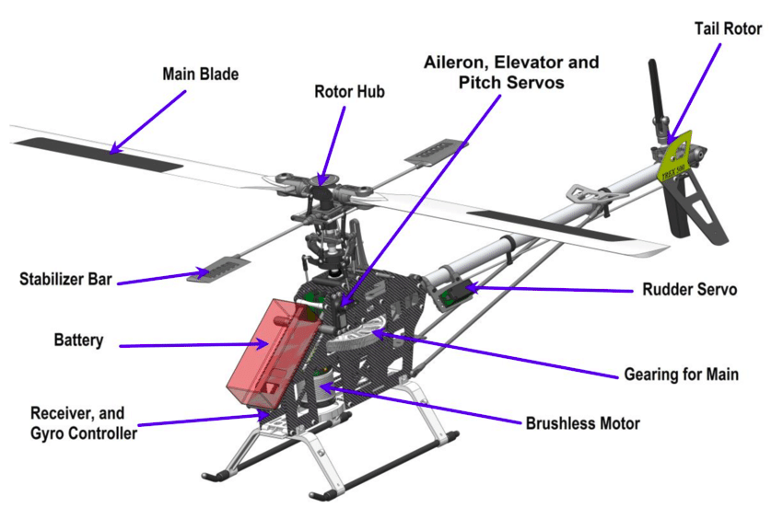
HARDEST PARTS TO DESIGN

Slide 13
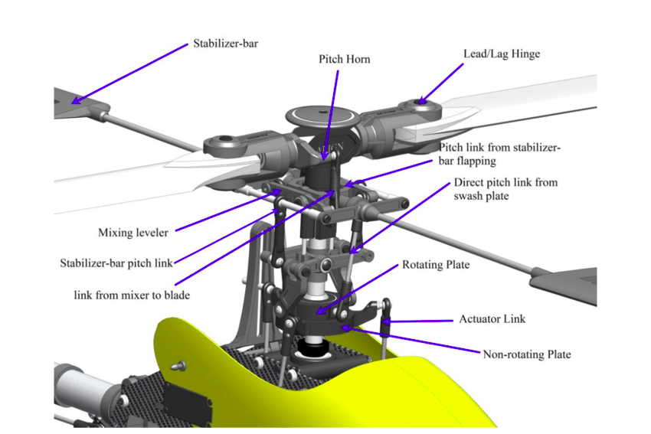

Slide 14
CHALLENGES IN Single rotor propulsion features
→ Larger blades are dangerous to operate
→ MITIGATION --- MESH SHIELDING ???
→ High drift in air flow during spray
→ MITIGATION == Change orientation and
position of sprayer

Slide 15
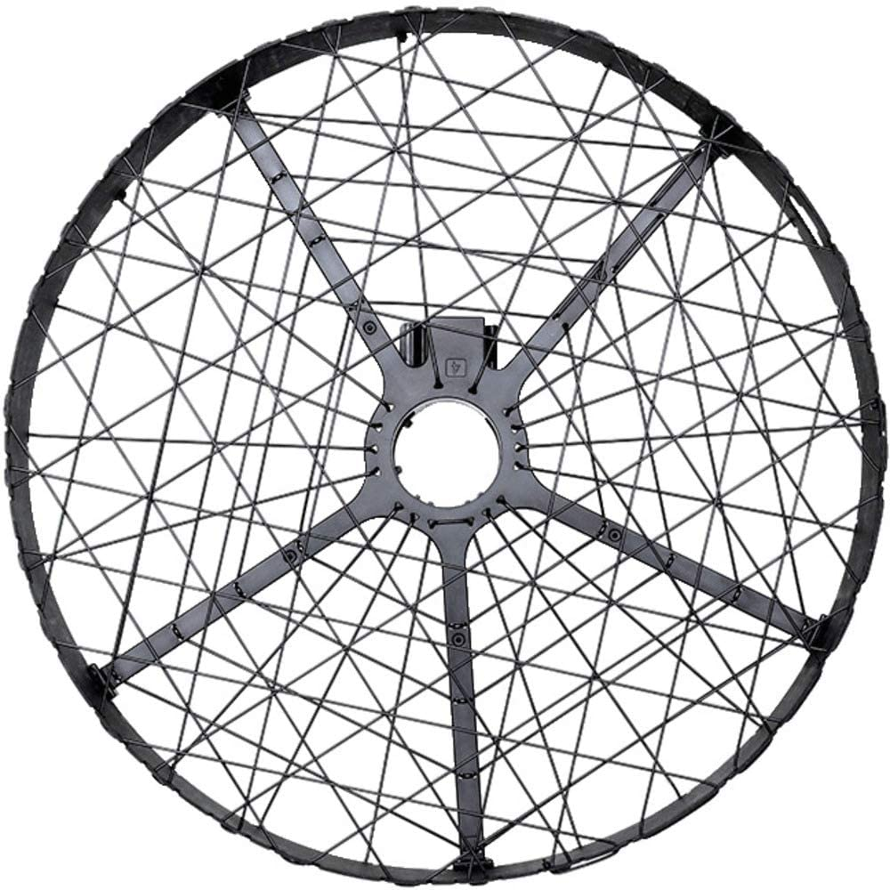
→ Larger blades are
dangerous to operate
→ MITIGATION ---
MESH SHIELDING ???

Slide 16
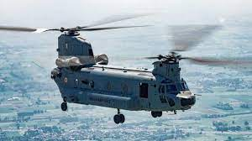
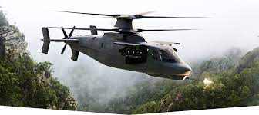
PROPULSION CHOICES SUMMARY
ALTHOUGH SINGLE ROTOR DESIGN IS AN EFFICIENT DESIGN COMPARED MULTI ROTOR DESIGN IN BOTH ECONOMICS , OPERATIONAL RANGES AND CAPABILITIES, IT REQUIRES A LOT OF MECHANICAL EXPERTISE AND WORK (NOT IMPOSSIBLE THOUGH) .
DUE TO THIS ITS BETTER TO SLOWLY DO THE RESEARCH & DEVELOPMENTS DURING THE COURSE OF THE STARTUP
RESEARCH AND DESIGN ON COAXIAL ROTORS DESIGN (Sikorsky S-97 Raider ), DUAL ROTOR DESIGN ( CHINOOK ) FOR INCREASED PAYLOAD REQUIREMENTS

Slide 17
SCHEMATIC DIAGRAM
OF THE PROTOTYPE

Slide 18
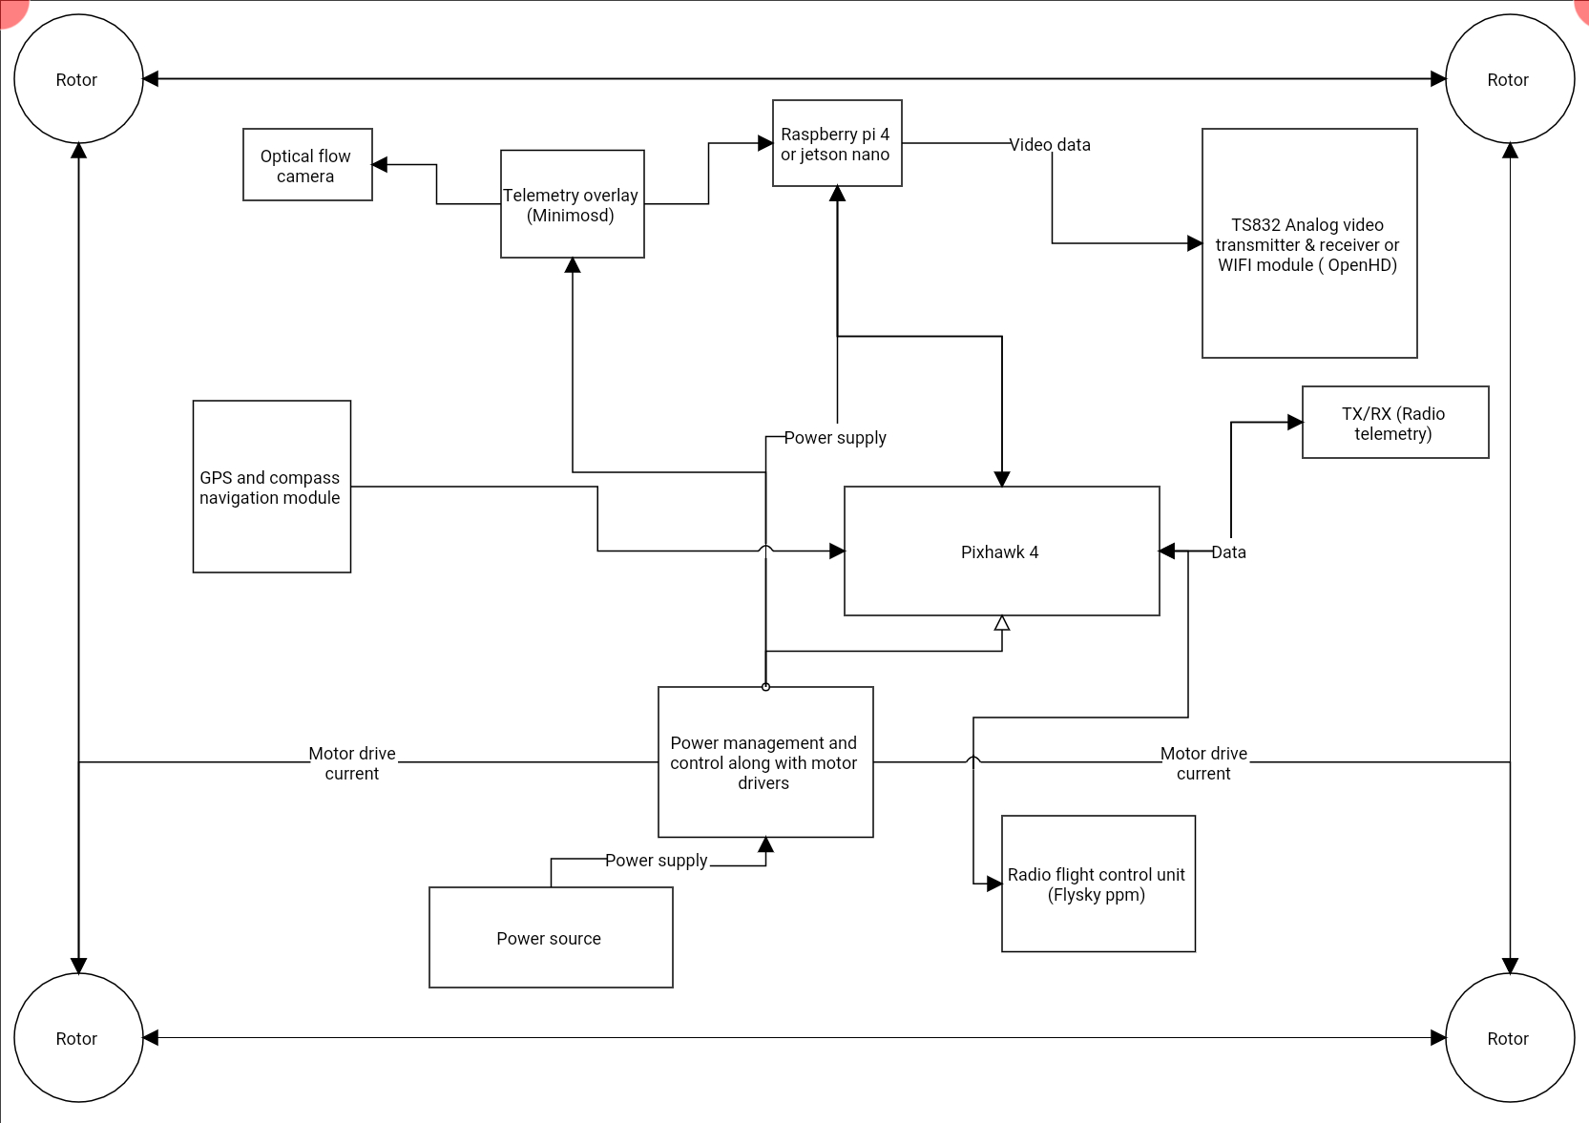

Slide 19
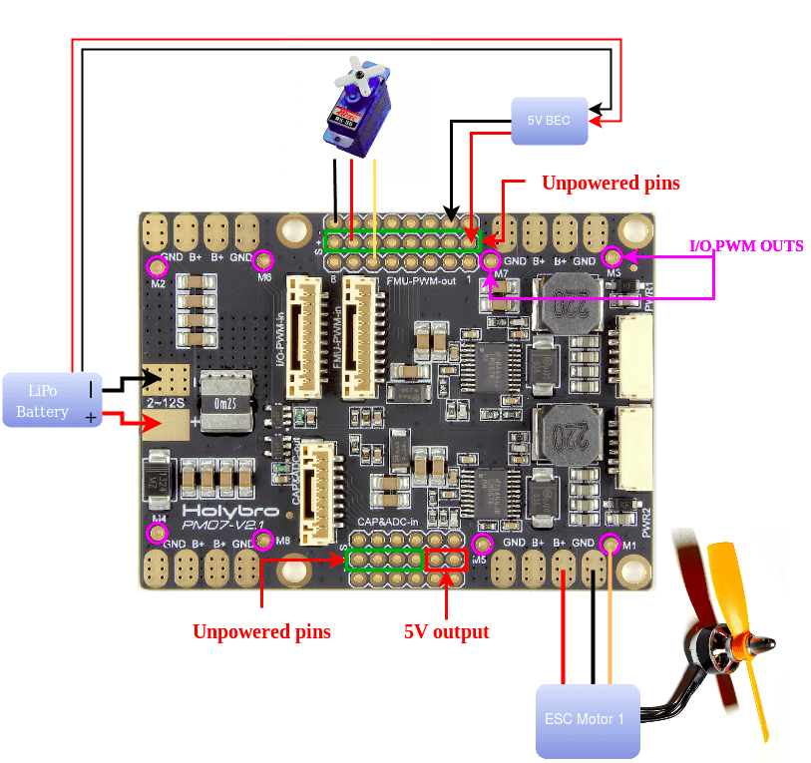
POWER MANAGEMENT UNIT:-
(Pixhawk 4 Power Module (PM07))

Slide 20
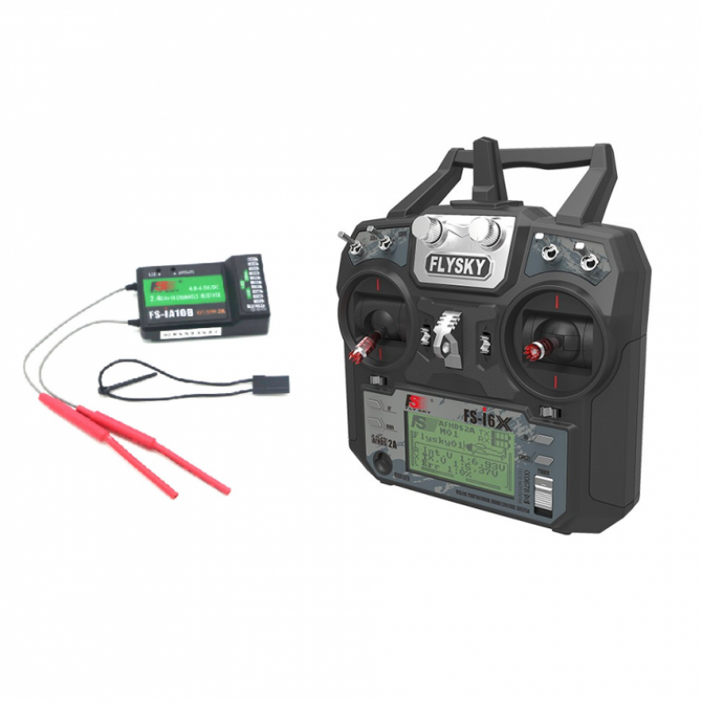
FLIGHT CONTROLLER RADIO TRANSMITTER AND RECEIVER
Fly Sky FS-i6X 2.4GHz 6CH AFHDS 2A RC Transmitter With FS-iA10B 2.4GHz 10CH Receiver
FOR CONTROLLING THE FLIGHT

Slide 21
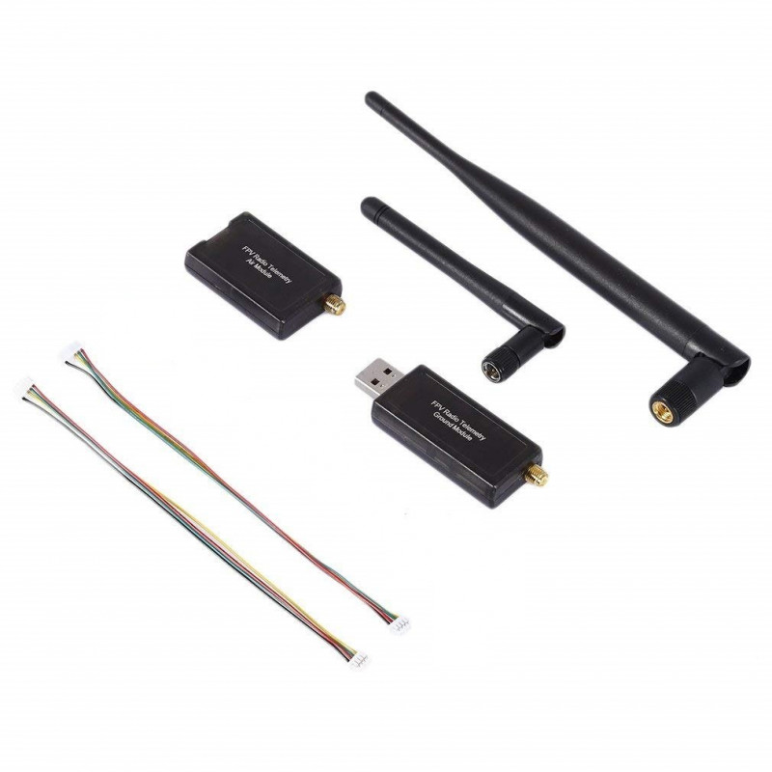
TELEMETRY RADIOS
SiK Telemetry Radio
USED FOR RELAYING TELEMETRY DATA OVER ONG RANGES

Slide 22

VIDEO TRANSMISSION
USING OPENHD FRAMEWORK TO USE WIFI ADAPTER FOR VERY LONG RANGE VIDEO TRANSMISSION.
(ADVANTAGES ) : CHEAPER & ADVANCED FEATURES CAN BE ADDED (LIKE FUSED DATA
LINKS , WIFI TETHERING , CONFIG
FLEXIBILITY)
(DISAVANTAGES ) : HARDER IN SOFTWARE
COMPLEXITY

Slide 23
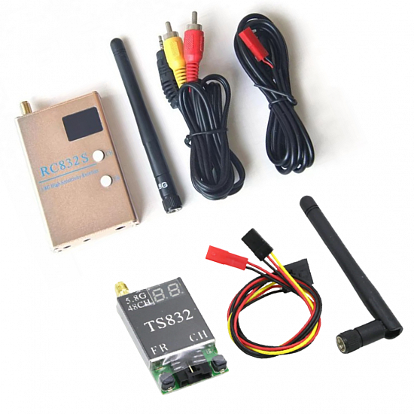
ALTERNATIVE :
TS832 Analogue video transmitter
ADVANTAGES :
1. PLUG AND PLAY
2. GOOD OUT OF THE BOX
EXPERIENCE
3. INDEPENDENT OF PIXHAWK
FLIGHT CONTROLLER
4. GOOD RANGE
5. CAN BE USED WITHOUT
ANY SBC( RASPBERRY PI )
DISADVANTAGES :
1. HIGHER COST
2. CAN ONLY TRANSMIT VIDEO DATA
3. ITS A DUMB TX/RX MODULE
(MEANING HARDER TO
MODIFY AND ADD NEW
FEATURES)

Slide 24
\_0___CAMERA ??!!__0_/
ANYTHING IS OK !!!
As “LONG AS THEY HAVE A CSI OR USB OUTPUT”

Slide 25
SUMMARY
1. SINGLE ROTOR PROPULSION IS TECHNICALLY BETTER BUT FOR INITIAL DESIGN STAGE
MULTIROTOR DESIGN IS BETTER
2. MINIMUM HARDWARE COMPONENTS REQUIRED FOR THE MINIMUM FUNCTIONALITY

