Slide 1
LINUX CONTAINERS
Srikanth Kotakonda

Slide 2
BASICS
What are Containers?
Containers are packages of software that contain all of the necessary elements to run in any environment.
Why Containers?
Containers make it easy to share CPU, memory, storage, and network resources at the operating systems level and offer a logical packaging mechanism in which applications can be abstracted from the environment in which they actually run.
How Containers benefit us?
Separation of responsibility, Workload Portability and Application Isolation.

Slide 3
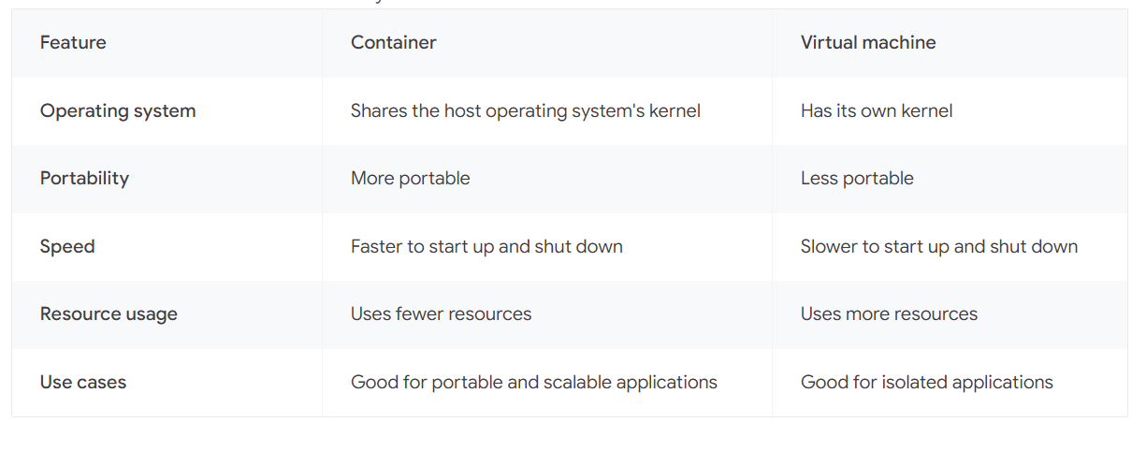
Containers vs Virtual Machines

Slide 4
Common use cases of containers
Web Development
Microservices Architecture
Cloud Computing
Continuous Integration and Delivery (CI/CD)
Containers are a powerful tool that can be used to improve application development, deployment, and management.

Slide 5
Common use cases of Virtual Machines
Testing
Development
Isolation
Cloud Computing
Disaster Recovery
VMs are a cost-effective way to run multiple operating systems and applications on the same computer, and they can be used to test new software in a safe environment.

Slide 6
Installing a new lxc container
Create a Config file which can be used to create a container.
sudo lxc-create -n test-lxc -f ./config -t download
lxc start <container-name>
lxc info <container-name>
lxc stop <container-name>
lxc delete <container-name>
lxc freeze <container-name>
lxc file push <path-to-local-file-on-host> <path-to-container-location>
lxc file pull <path-to-file-on-container-location> <path-to-file-on-host>

Slide 7
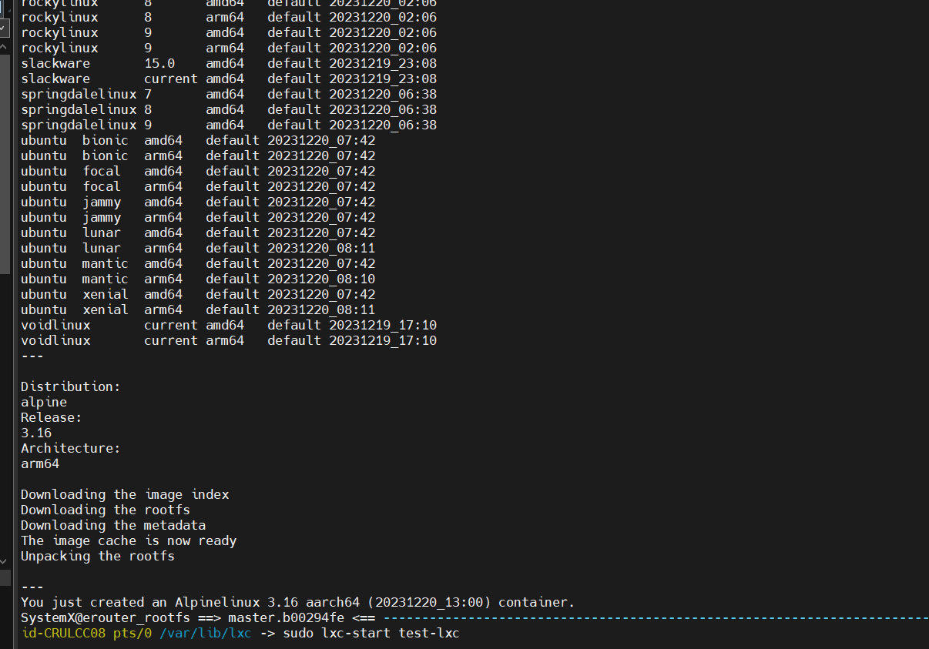
Some examples

Slide 8
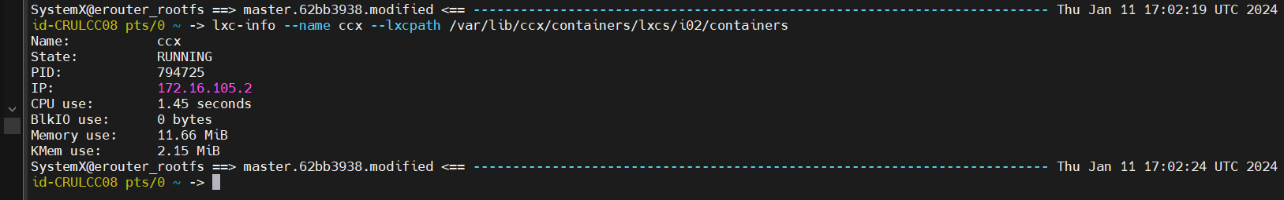
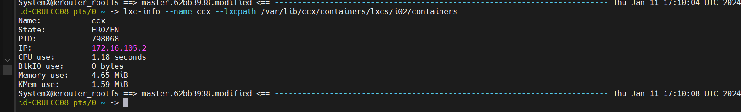
Some examples

Slide 9
SUMMARY
VM's provide complete isolation but they can be resource-heavy as they include not just the application but the entire OS.
Containers on the other hand are light weight and more efficient in terms of resource usage as each container shares the host system's kernel but runs in an isolated user space.
VM's are excellent for running multiple different operating systems or for applications that require full isolation whereas Containers are better suited for microservices, cloud-native applications, and scalable, distributed environments.
For example, from Gmail to Youtube to Search, everything at Google runs in containers because Containerization allows development teams to move fast, deploy software efficiently and operate at an unprecedented scale.

Slide 10
References
https://codilime.com/glossary/linux-container/
https://ubuntu.com/server/docs/containers-lxc
https://ubuntu.com/blog/what-are-linux-containers
https://linuxcontainers.org/lxc/
https://cloud.google.com/discover/containers-vs-vms

Slide 11
THANK YOU

