Slide 1
AVA
Cooking Made Easy
Presented by
Team Friday

Slide 2

Who is it for?
People who are new to cooking
Do not have enough time to search for the best recipe from various websites
Who may have all the ingredients for a particular recipe but has never made it because they never thought to search for a recipe with those specific ingredients
Our main goal is to reduce user’s effort in searching recipes from various sites and display recipes that are most relevant to the ingredients they have
With our system, the user can search for recipes based on his / her mood

Slide 3
Features
Interactive based
Save ingredients in the pantry
Search recipes based on the ingredients added
Save / bookmark / share recipes
Recipe of the day
Feedback / Rating
Keeps track of most viewed recipes by each user and suggests similar recipes later

Slide 4
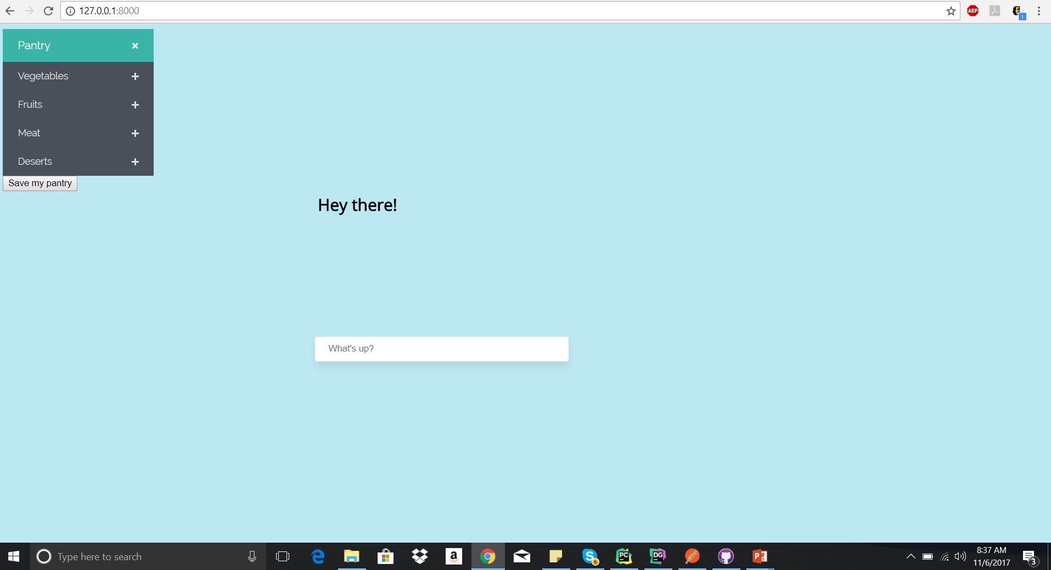
Ava Dashboard

Slide 5
Conversational UI

