Slide 1
Study Space Finder
Group Members
Alex Houy
Travis Keri
Luke Martin
Edward Prokopik
Nick Rentschler
Luis Roman
Tara Ross

Slide 2
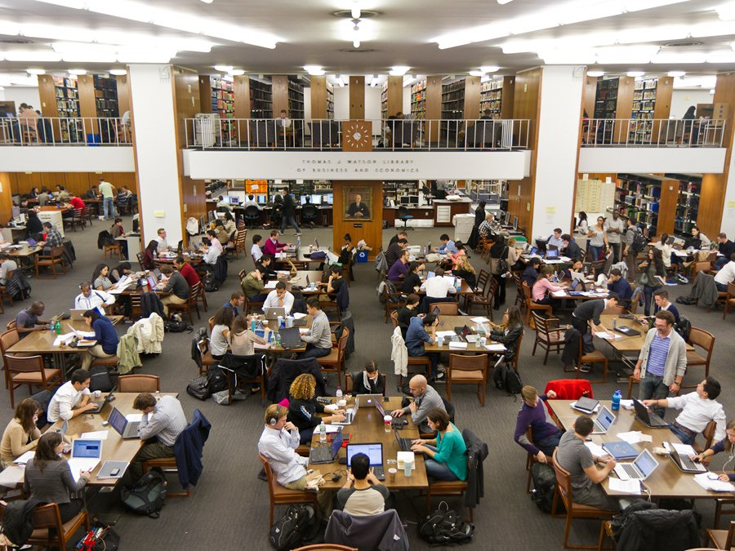
Tired of Looking for a place to study only to find that everywhere is full

Slide 3
Students
Find open places to study
Find accommodations (Dry erase boards, outlets, group study spaces)
Leave comments about areas
See usage trends for an area

Slide 4
Colleges
Track trends
Can use the data to better accommodate students

Slide 5
Check it out!
StudySpotFinder

