Slide 1


Hospital Management System
Presented by
ARUN C
23MIS0445
Software Testing using Selenium WebDriver
SAI CHANDAN K S
23MIS0115
Department: M.Tech Software Engineering, SCORE
Course: Software Testing
Notes:
Good morning. We are Arun and Sai Chandan. Our project is a Hospital Management System, and the main focus is SOFTWARE TESTING: we built a working web application and then tested it automatically using Selenium WebDriver. In the next slides we will show the system, its modules, the Selenium tool, our test cases, and the test results.

Slide 2



Abstract and Objectives
The Problem
Manual hospital records cause data duplication, errors, slow information retrieval and delays in service.
Objectives
Develop and test a Hospital Management System
Automate important hospital operations
Our Solution
A web-based HMS that manages patients, doctors, appointments, medical records and billing in one place.
Verify the correctness of every module
Identify functional errors and unexpected behaviour
Testing Focus
Selenium WebDriver automates real user actions in Chrome and verifies results for valid and invalid inputs.
Automate web testing with Selenium and reduce manual effort
Check correct behaviour for valid and invalid inputs
Notes:
In many hospitals records are still kept manually, which leads to duplicate data, mistakes and delays. Our solution is a single web application for patients, doctors, appointments, medical records and billing. Because this is a Software Testing project, the most important part is testing: we use Selenium WebDriver to automatically open the browser, type data, click buttons and check that the system gives the expected result. These are our objectives, taken from our project document.

Slide 3






HMS Modules
Login
Patient Management
Doctor Management
Username / password check, invalid login message, logout, protected pages
Add, view, update, delete patients and search by Patient ID or name
Add, update, search doctors and mark them Available / Not Available
Appointments
Medical Records
Billing
Select patient, doctor, date and time; book or cancel. No double booking
Diagnosis, treatment and prescription; full history of each patient
Consultation + treatment charges, automatic total, Paid / Unpaid status
Notes:
Our system has the six modules described in the document. Login protects every page. Patient Management supports add, view, update, delete and search by patient ID. Doctor Management supports add, update, search and availability. Appointments lets staff book and cancel, and the system blocks booking the same doctor twice at the same time. Medical Records stores diagnosis, treatment and prescription with history. Billing adds consultation and treatment charges and calculates the total automatically.

Slide 4
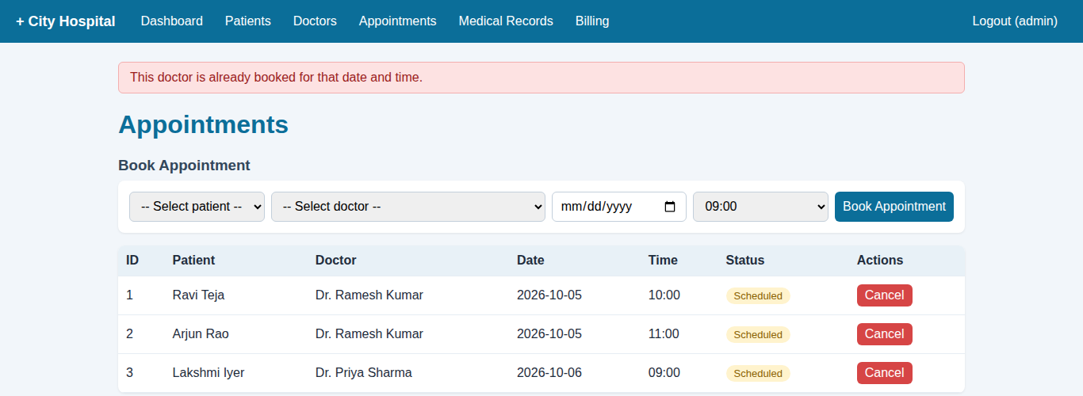




How the System Works
Selenium WebDriver
test_selenium_hms.py
Chrome Browser
HTML pages (templates/)
Flask Web App
app.py - pages and routes
Our running app: booking the same doctor twice is blocked
Technology Used
Validation Rules
validators.py - checks input
Python 3
Flask
SQLite
HTML / CSS
Selenium 4
PyTest
pytest-html
Database Layer
database.py + SQLite
Notes:
This is the structure of our project. The user (or Selenium) works in the Chrome browser. The browser talks to our Flask web app in app.py. Before anything is saved, validators.py checks the input, for example the phone must be 10 digits and age between 0 and 120. database.py saves the data into an SQLite database. At the top, Selenium WebDriver controls Chrome automatically, just like a real user. We used Python, Flask, SQLite, Selenium 4 and PyTest. pytest-html produces the test report.

Slide 5


Selenium: The Testing Tool
Open-source tool that automates web browsers (Chrome, Firefox, Edge, Safari) to test web applications.
Selenium WebDriver
Selenium IDE
Selenium Grid
Controls the browser from code: open pages, find elements, type text, click buttons, read results.
Browser extension that records and replays user actions. Simple tests without much code.
Runs the same tests on many browsers and machines in parallel.
Used in our project
Selenium workflow in our project
1
2
3
4
5
6
7
Launch Browser
Open HMS
Locate Elements
Perform Actions
Submit Data
Verify Result
Record Result
Notes:
Selenium is an open-source tool for automating web browsers. It has three main parts. Selenium WebDriver, which we used, controls the browser from code. Selenium IDE records and replays actions, and Selenium Grid runs tests on many browsers at once. Every one of our tests follows these 7 steps: launch the browser, open the HMS, locate elements by their ID, perform actions like typing and clicking, submit, verify the result with an assert, and record the result in the report.

Slide 6

Selenium Test Cases
ID | Test Case | Input | Expected Result | Actual
TC01 | Login with valid details | Correct username / password | Login successful | PASS
TC02 | Login with invalid details | Wrong password | Error message displayed | PASS
TC03 | Add patient | Valid patient details | Patient added | PASS
TC04 | Empty patient form | Empty fields | Validation message | PASS
TC05 | Book appointment | Valid doctor / date | Appointment booked | PASS
TC06 | Search patient | Patient ID | Patient details displayed | PASS
TC07 | Update patient | Modified details | Details updated | PASS
TC08 | Delete patient | Existing patient | Patient removed | PASS
TC09 | Logout | Click Logout | User returned to login page | PASS
+4 extra tests: TC10 doctor availability, TC11 no double booking, TC12 medical record, TC13 bill total = consultation + treatment
Notes:
These are the nine test cases from our project document, TC01 to TC09. Each covers a valid or an invalid input. For example TC02 enters a wrong password and checks that the error message appears; TC04 submits an empty form and checks that a validation message appears. All nine passed. We also wrote four extra tests for the other modules: doctor availability, double booking prevention, medical records, and checking that the bill total is calculated correctly.

Slide 7
Example Selenium Test (Python)
selenium_login_demo.py
webdriver.Chrome()
opens Google Chrome
import time
from selenium import webdriver
from selenium.webdriver.common.by import By
driver = webdriver.Chrome()
driver.get("http://127.0.0.1:5000")
driver.find_element(By.ID, "username").send_keys("admin")
driver.find_element(By.ID, "password").send_keys("admin123")
driver.find_element(By.ID, "login").click()
time.sleep(2)
assert "/dashboard" in driver.current_url
print("Login test PASSED - dashboard opened")
driver.quit()
get()
opens the HMS web page
find_element(By.ID, ...)
finds an element by its id
send_keys()
types text into a field
click()
clicks a button
assert
checks the expected result: PASS / FAIL
$ python selenium_login_demo.py
Login test PASSED - dashboard opened
quit()
closes the browser
Notes:
This is the same login example as in our document, written in Python. It is in our project as selenium_login_demo.py. webdriver.Chrome opens Chrome, get opens our HMS, find_element finds the username box by its id, send_keys types into it, click presses the login button. The assert line is the actual test: if the dashboard did not open, the test fails. quit closes the browser. Our full test file uses exactly these commands for all 13 test cases, run by PyTest. LIVE DEMO: run 'python -m pytest tests/ui' and Chrome will open and run all tests in front of you.

Slide 8
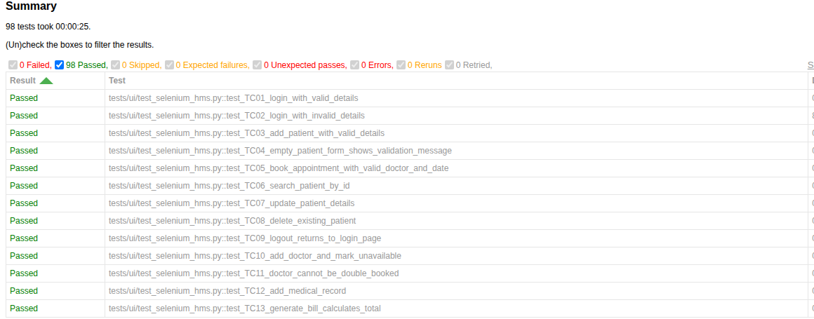

Test Results
13
100%
Selenium UI tests
Pass rate (0 failed)
85
~25 s
Extra PyTest unit and integration tests
To run all 98 tests
HTML test report generated by pytest-html (docs/test-report.html)
9 defects found and fixed: e.g. typing 'nan' as a fee crashed the server, a patient could be double-booked, and flaky Selenium waits. Each now has a regression test.
Business rules verified: invalid phone / age rejected, doctor cannot be double-booked, unavailable doctor cannot be booked, bill total calculated correctly.
Notes:
All 13 Selenium tests passed, and we also have 85 PyTest tests that check the validation rules and database directly, without a browser. All 98 run in about 25 seconds and produce this HTML report. Our testing also FOUND real defects. Using exploratory testing we tried to break the app on purpose: typing 'nan' as a doctor fee crashed the server, infinity was accepted as a bill amount, the same patient could be booked with two doctors at the same time, and deleting a record that does not exist still showed success. We also found that our Selenium tests failed randomly about one run in three, because Selenium checked the page while Chrome was still loading it - a common automation problem called synchronization. We fixed all 9 defects and added a regression test for each one, so they can never come back. The full list is in our README.

Slide 9




Conclusion and Future Scope
We built a working HMS with 6 modules: login, patients, doctors, appointments, medical records and billing
Selenium WebDriver automated every test case from our document, for valid and invalid inputs
Automated tests run again in seconds after every change, giving fast and consistent regression testing
Future Scope
AI-based test case generation
Cross-browser testing with Selenium Grid
CI pipeline: tests run on every code change
Performance and load testing
Mobile app testing with Appium
Security testing of login and data
Thank You
Questions? | Arun C (23MIS0445) | Sai Chandan K S (23MIS0115)
Notes:
To conclude: we built a working Hospital Management System with six modules and tested it automatically with Selenium WebDriver. Every test case from our document passes, for both valid and invalid inputs, and the full suite can be re-run in seconds after any change. In the future we can add AI-based test generation, cross-browser testing with Selenium Grid, a CI pipeline, performance testing, mobile testing with Appium and security testing. Thank you, any questions?

