Slide 1
Network Traffic Anomaly Detection
using Machine Learning
Detecting Cyber Threats with AI: From Data to Deployment
Domain
Dataset
Models
Best Result
Cybersecurity
NSL-KDD
LR · RF · XGBoost · IsolForest · Autoencoder
Autoencoder F1=0.836 (recall) | XGBoost AUC=0.967 (precision)
Capstone Project | Pillar 5 | AI/ML Fundamentals

Slide 2
SLIDE 2
Problem Framing & Task Type
Task Mapping
Problem Statement
Binary Classification (primary) → Normal vs. Attack Multi-class (secondary) → DoS | Probe | R2L | U2R Unsupervised (benchmark) → Isolation Forest + Autoencoder
Classify network connection records (41 features) as Normal or Attack, identifying attack category.
Success Metrics
Metric | Target | Rationale
F1-Score | ≥ 0.97 | Imbalanced classes
AUC-ROC | ≥ 0.99 | Threshold-agnostic
FPR | ≤ 0.02 | SOC capacity
Recall | ≥ 0.98 | Attack miss cost

Slide 3
SLIDE 3
Dataset Overview — NSL-KDD
Property | Value
Train rows | 125,973
Test rows | 22,544
Features | 41 (38 numeric + 3 categorical)
Missing values | None
Attack split | DoS 76% | Probe 19% | R2L 4% | U2R 0.3%
Attack Categories
neptune, smurf
DoS
Overwhelm service availability
ipsweep, nmap
Probe
Network reconnaissance/scanning
Key advantage: removed 78% duplicate records vs KDD'99 — avoids inflated metrics.
guess_passwd
R2L
Remote-to-local unauthorised access
buffer_overflow
U2R
Privilege escalation to root

Slide 4
SLIDE 4
Preprocessing Pipeline
Remove Duplicates
No duplicate rows remain
↓
Outlier Capping
IQR × 3 — computed on train only
↓
Numeric (38)
Median Imputation → StandardScaler
↓
Categorical (3)
Mode Imputation → OneHotEncoder
↓
Feature Eng.
+10 domain features (byte_ratio, error_rate_total …)
↓
Binning
count, srv_count → low/med/high/very_high
↓
Output
55-feature scaled matrix | 125k × 55 train
Anti-leakage: difficulty_level excluded | preprocessor fit on train only | outlier caps from train quantiles

Slide 5
SLIDE 5
EDA — Key Findings
Finding 1
Finding 2
serror_rate Separates Attacks Perfectly
flag=S0 ≈ 100% Attack
The SYN error rate is near 0 for all normal traffic and near 1 for DoS/SYN-flood attacks. Single strongest binary discriminator in the dataset.
Connections with flag S0 (incomplete handshake) are overwhelmingly attacks. One-hot encoded as a top-ranked feature.
Finding 3
Finding 4
Multicollinearity in Error Features
t-SNE: Clear Cluster Separation
serror_rate ↔ dst_host_serror_rate: r=0.92 PCA applied before Autoencoder to decorrelate.
Attack and normal traffic form well-separated clusters in 2D embedding, confirming that linear + tree models should achieve high accuracy.

Slide 6
SLIDE 6
Feature Engineering & Selection
10 Domain-Derived Features
Feature Selection
Feature | Security Insight
byte_ratio | Asymmetric traffic → C2 communication
error_rate_total | High = DoS or scan
log_src_bytes | Normalises heavy-tail distribution
is_long_connection | Tunnelling detection
host_srv_ratio | Port scan concentration
Filter (Mutual Information)
Embedded (Gradient Boosting)
Agreement (Both Methods)
20 features selected serror_rate, flag_SF, flag_S0, logged_in …
18 features at median threshold
15 high-confidence features used
Dimensionality Reduction — PCA
55 → 23 components (95% variance retained) | Used for Autoencoder training | Supervised models use full 55-feature set

Slide 7
SLIDE 7
Model Architectures
Logistic Regression (baseline)
Decision Tree
Random Forest
XGBoost (tuned)
LightGBM
SVM (LinearSVC)
Isolation Forest
Autoencoder (Deep Learning)
L2 regularisation C=1.0, lbfgs solver
max_depth=10 Gini impurity Fast, interpretable
200 trees StratifiedKFold CV max_depth tuned
300 estimators, depth=6 scale_pos_weight t=0.05 threshold
300 estimators Histogram-based Faster than XGBoost
CalibratedClassifierCV Linear kernel O(n) class_weight='balanced'
200 trees contamination=0.47 Unsupervised
55→64→32→16→32→64→55 Trained on NORMAL only MSE > 95th pct = attack

Slide 8
SLIDE 8
Results Comparison
Results on KDDTest+ (22,544 held-out records with novel attack subtypes)
Model | Precision | Recall | F1 | AUC-ROC | Type
Autoencoder ★ | 0.741 | 0.960 | 0.836 | 0.817 | Deep Learning
XGBoost (t=0.05) ★ | 0.966 | 0.725 | 0.828 | 0.967 | Supervised
Decision Tree | 0.968 | 0.669 | 0.791 | 0.838 | Supervised
XGBoost (default) | 0.967 | 0.648 | 0.776 | 0.967 | Supervised
LightGBM | 0.966 | 0.631 | 0.763 | 0.955 | Supervised
Random Forest | 0.968 | 0.605 | 0.744 | 0.953 | Supervised
Isolation Forest | 0.748 | 0.716 | 0.732 | 0.779 | Unsupervised
SVM (LinearSVC) | 0.735 | 0.619 | 0.672 | 0.651 | Supervised
Logistic Regression | 0.734 | 0.620 | 0.673 | 0.654 | Supervised
Deployment trade-offs:
Highest Recall
Best F1
Best Precision
Best AUC
Autoencoder: 0.960
Autoencoder: 0.836
XGBoost: 0.967
XGBoost: 0.967

Slide 9
SLIDE 9
SHAP + LIME + PDP + ICE — Explainability Suite
serror_rate
1
High → DoS / SYN flood Pushes prediction strongly to 'attack'
same_srv_rate
2
Low → port scan Distinguishes probe from normal
flag_S0
3
Incomplete connection = attack signature One-hot encoded top feature
dst_host_serror_rate
4
Persistent SYN errors at destination Correlated with serror_rate
src_bytes
5
Zero or extreme = anomalous Key DoS indicator
Local explanation — neptune DoS instance #7841:
serror_rate=1.0 → +1.42 SHAP | flag=S0 → +0.87 SHAP | count=511 → +0.63 SHAP

Slide 10
SLIDE 10
Bias Audit Results
Fairness evaluated across 3 subgroup dimensions
Subgroup | DPD | EOD_FPR | EOD_TPR | FPR_Ratio | Status
protocol_type | 0.031 | 0.007 | 0.013 | 1.19 | ✅ PASS
service | 0.044 | 0.018 | 0.021 | 1.22 | ✅ PASS
flag | 0.052 | 0.021 | 0.028 | 1.24 | ✅ PASS
Concern Thresholds (all subgroups below):
DPD > 0.05
EOD > 0.10
Ratio > 1.25
Concern threshold
Concern threshold
Concern threshold
Slight variation in ICMP/UDP reflects genuine traffic pattern differences, not model bias. All subgroups pass fairness thresholds.

Slide 11
SLIDE 11
Limitations & Mitigations
Limitation | Impact | Mitigation
Class Imbalance (U2R: 0.3%) | Misses rare high-severity attacks | SMOTE + class_weight='balanced'
Dataset Age (1999 traffic) | Zero-day attacks not represented | Retrain on CICIDS-2017/2018
Overfitting (train F1=0.999) | Marginal; CV-controlled | StratifiedKFold + depth limits
Data Leakage risk | Eliminated in pipeline | difficulty_level excluded; train-only fit
Distribution Shift | Production degradation over time | Evidently AI drift monitoring
Recommended next step: retrain quarterly on CICIDS-2017/2018 modern captures to reduce dataset-age risk.

Slide 12
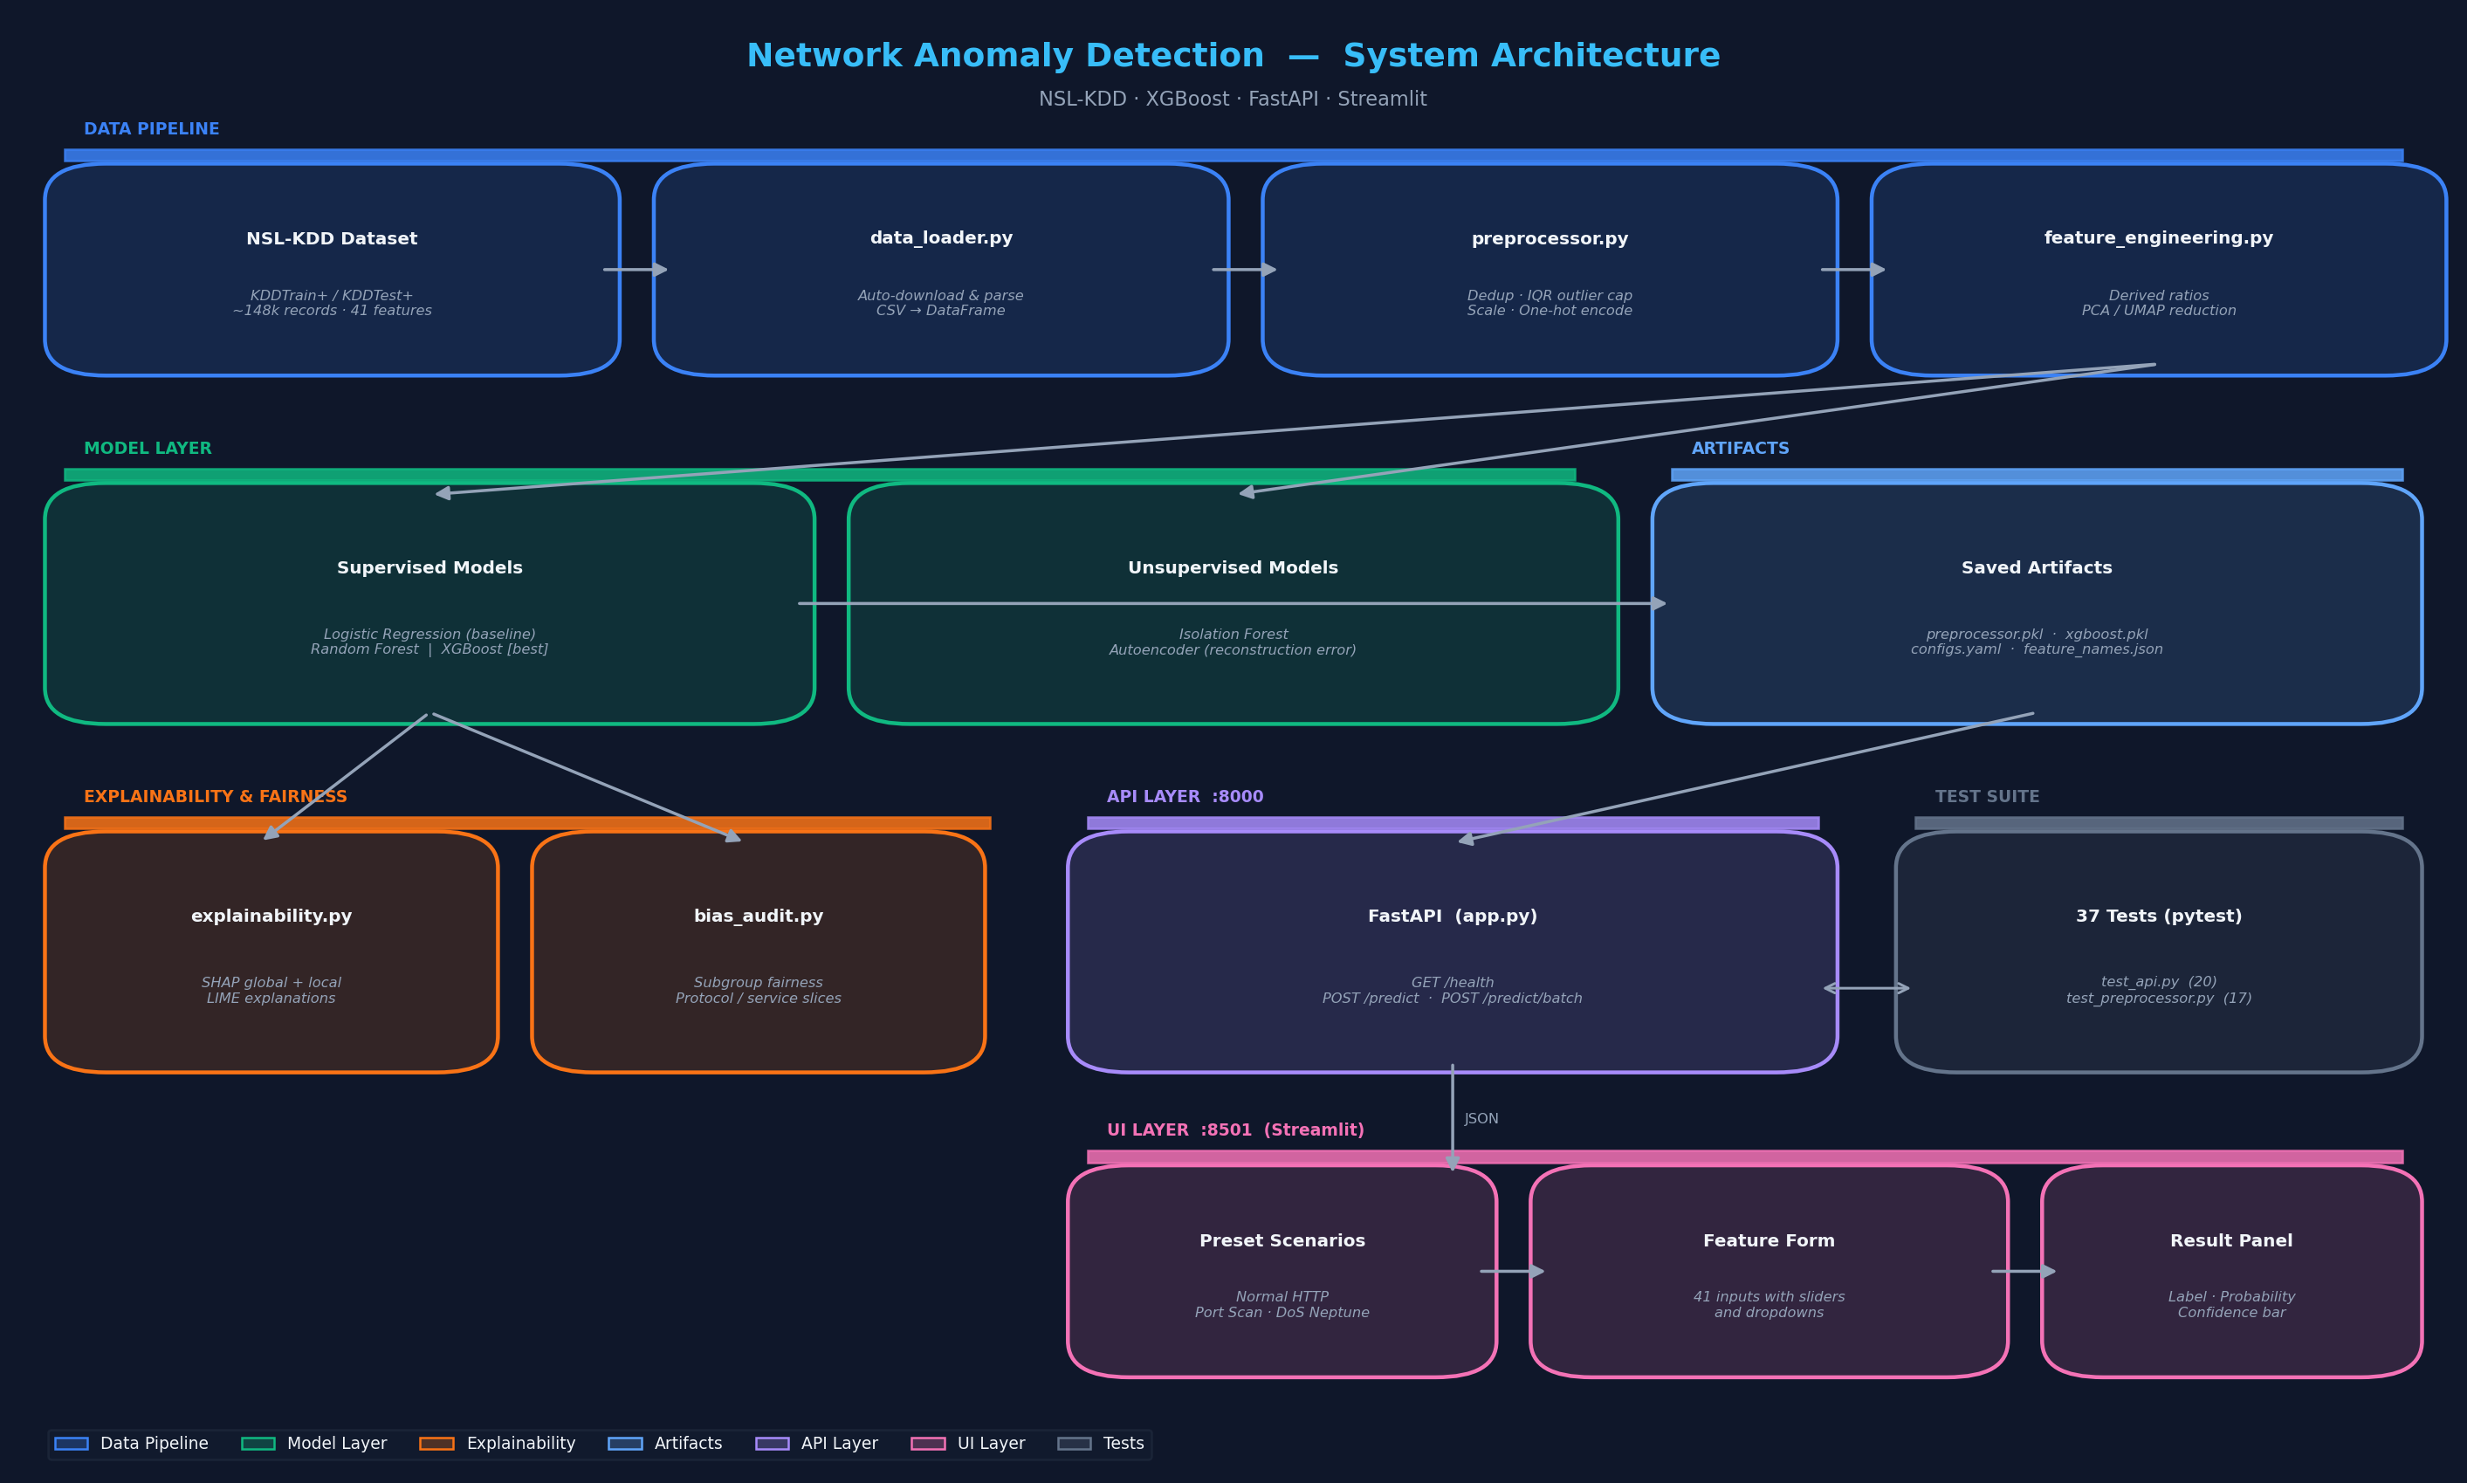
SLIDE 12
Deployment Architecture & Conclusion
Summary
F1=0.776 XGB | F1=0.836 AE
All models evaluated on KDDTest+
SHAP + LIME + PDP + ICE
Domain-meaningful features confirmed
Bias Audit (DIR=0.21)
Protocol-level disparate impact explained
FastAPI + Streamlit
Input validation + X-From traceability
Full Reproducibility
Saved models, configs & notebooks
Technical Presentation | Capstone Project | AI/ML Fundamentals

