Slide 1
StudentShield
Manchester.Ai_IBM Z Datathon 2026 Project
Theme 1: Real-Time AI for Critical Decisions · Event code SSF2026
Real-time money-mule early warning on IBM LinuxONE: warn the student before the money moves on
Thinojen Balakumaresan · Julian Newson · Sshubhan Kammari · Arda Yencer · University of Manchester
Notes:
We're Manchester.Ai. StudentShield spots money-mule payments the moment they land, and warns the student before they send the money on, while the bank's analyst gets an explanation. Everything runs on IBM LinuxONE.

Slide 2
Young people are recruited as money mules, and caught only after the money has gone
23%
64%
£1.28bn
of suspected mule cases on the Cifas database involved people aged 21 and under
involved people aged up to 30
lost to UK payment fraud in 2025
Cifas & UK Finance, H1 2023
Cifas & UK Finance, H1 2023
UK Finance, Annual Fraud Report 2026
Usual approach: the bank finds the mule after the chain is complete. The victim's money is gone; the student loses their account and may be prosecuted.
Our approach: act in the hours between money landing and money leaving.
Notes:
Problem: a mule receives criminal money and forwards it within hours. 23% of suspected mule cases on the Cifas database involved people aged 21 and under, 64% up to age 30. Banks normally catch mules after the money has gone. We act in the window before it leaves.

Slide 3
IBM's own AML data, evaluated the way a bank would
IBM Transactions for AML, HI-Small (synthetic, fully labelled): 5.08M payments, 515k accounts, 1 in 1,000 laundering, 15 currencies converted to USD
Warm-up
Train
Validation
Test
1 Sep
history only
2–6 Sep
2.09M payments
7–8 Sep
945k · cut-offs chosen
9–10 Sep
845k · touched once
1
Split by date, never randomly
A bank trains on last month and scores next month. A random split would leak mule rings into the test set.
2
Point-in-time features
All 25 features use only payments strictly before the one being scored: exactly what the bank knows when money lands. Checked against brute force.
3
Honest cleaning
Dropped 11 Sep onwards (the generator stops making normal payments) and self-transfers (11.6% of rows, almost no laundering).
Notes:
We used IBM's synthetic AML dataset, HI-Small. We split by date: train on 2 to 6 September, choose cut-offs on 7 to 8, and test once on 9 to 10, about 845,000 payments the model never saw. Every feature only uses the past, so the demo is honest.

Slide 4
How it works: one score, two people told
01
02
03
04
Payment lands
25 signals
XGBoost score
Reasons
→
→
→
Each incoming payment is sent to the scoring service
The payment, the receiving account (fan-in, pass-through, age) and the sender (fan-out)
Scored on LinuxONE in under a millisecond
Top 3 SHAP contributions become plain-English reasons
Analyst alert
Student warning
Recall-weighted cut-off (F2). The bank's analyst sees the account, money flow, reasons and rarity ("1 in N payments scores this high"). The student's phone stays normal.
Precision-weighted cut-off (F0.5). A calm question on the phone: "Has someone asked you to move this money?" Payments out are paused and every answer goes to the analyst.
Notes:
Each payment is scored as it lands. Two cut-offs on the same score: the analyst level catches more, the student level only fires when the model is confident, because interrupting an innocent person has a real cost.

Slide 5
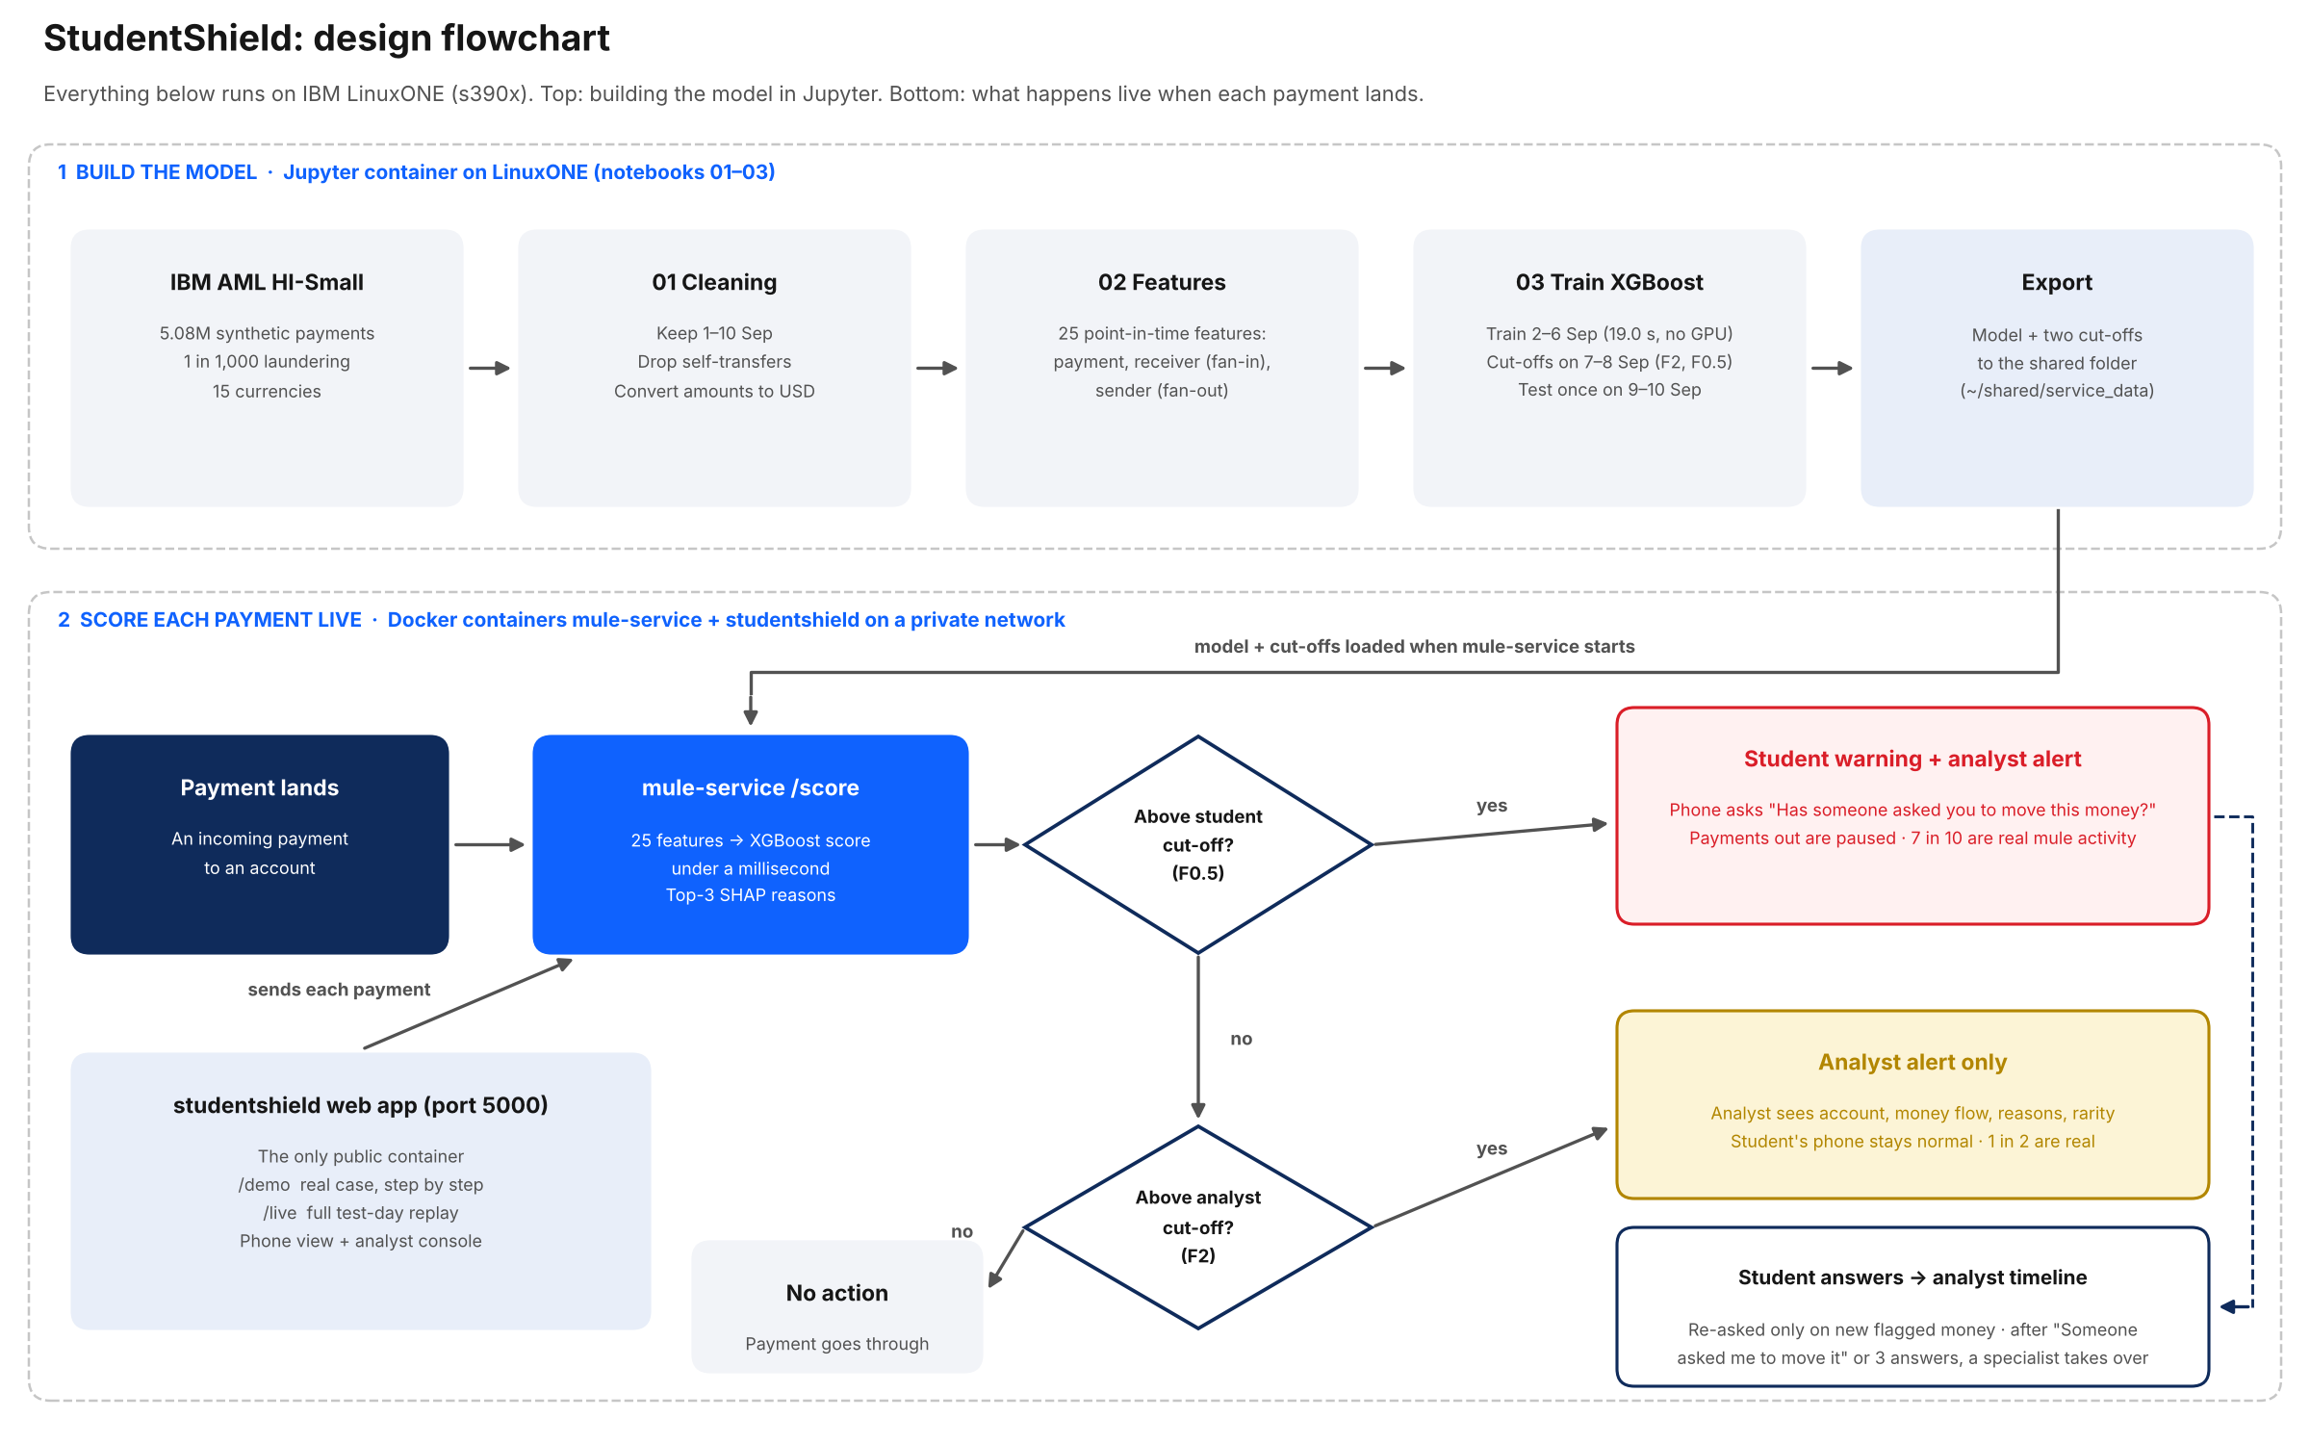
Design flowchart
Notes:
Top: the model is built in Jupyter on LinuxONE and exported. Bottom: each payment is scored as it lands; above the student cut-off the student is warned and outgoing payments paused, above the analyst cut-off only the analyst is alerted.

Slide 6
2.7× more laundering caught than a bank-style rule
Test days 9–10 Sep: ~845k payments the model never saw, at the real 0.1% laundering rate
0.430
PR-AUC, vs 0.024 for the rules (18×)
53.6%
caught within ACH alone, where the rules collapse to 2.0%: it learns mule behaviour, not payment type
19.0 s
to train on 2.09M payments on LinuxONE, no GPU
Notes:
On unseen test days, flagging the riskiest 1% catches 69.5% of laundering versus 25.7% for a hand-written bank rule. Within ACH payments alone the rule collapses to 2% while we catch 53.6%, so the model has learned mule behaviour, not just payment type.

Slide 7
7 in 10 student warnings are real mule activity
Each cut-off maximises F-beta on validation, then is measured once on test. The bank can move along the trade-off curve.
Analyst alert (F2)
Student warning (F0.5)
49.5%
of alerts are real (1 in 2)
69.7%
of warnings are real (7 in 10)
45.2%
of all laundering caught
37.8%
of all laundering caught
~220
false alarms a day, reviewed by a person
~78
wrong warnings a day: about 1 in 5,400 innocent payments
Notes:
Two cut-offs on one score. The analyst level is recall-weighted: about half its alerts are real, and reviewing them is the analyst's job. The student level is precision-weighted: 7 in 10 warnings are real mule payments, because a wrong warning costs a real person.

Slide 8
Live demo: a real case from the unseen test days
http://148.100.108.113:5000 · every score on screen is real model output on LinuxONE
Payment stream
Student's phone
Analyst console
Real payments arrive; account tiles turn amber at analyst level and red at student level
Warning, "Has someone asked you to move this money?", outgoing payments paused, re-asked only when new flagged money arrives
Rarity, money-flow graph with the held transfer, three plain-English reasons, and every answer the student gave
~19 h
In the case played, the student was warned about 19 hours before the money moved out, and the outbound transfer was held.
Notes:
The demo plays the strongest real fan-in case from the test days through the model. The student is warned about 19 hours before the money would have moved out. Only the student persona is illustrative; payments are real rows of IBM's synthetic dataset.

Slide 9
Built and running end to end on IBM LinuxONE (s390x)
LinuxONE Community Cloud VM · s390x · 3 vCPU, 8 GB, no GPU
On-platform AI
Training and scoring both run on s390x; payment data never leaves the platform it lives on
Jupyter container
Notebooks 01–03: cleaning, 25 features, XGBoost trained in 19.0 s
Containerised
Docker images on IBM's s390x base image, --restart unless-stopped: both came back on their own after a VM restart
model + cut-offs
(shared folder) ↓
mule-net ↔
Secure by design
The model API sits on a private Docker network; only the web app is exposed
mule-service
Flask + XGBoost scoring API. Private network only, no public port
studentshield
Flask web app, the only public port (5000)
Real-time
Under a millisecond per payment; stateless scoring scales out with more replicas
Notes:
Everything runs on LinuxONE: data loading, features, training in 19 seconds with no GPU, and live scoring in under a millisecond. Two Docker containers on IBM's s390x base image; the model service is on a private network and only the web app is public. Show the s390x badge and /health here.

Slide 10
Designed to protect students, not accuse them
✓
No tipping off
The phone never shows a score, reason or suspicion: only a safeguarding question banks already ask
✓
A person decides
The model never freezes an account or files a report; an analyst reviews every alert
✓
Strict cut-off for people
Students are contacted only at the precision-weighted level; holds happen only there
✓
No identity features
No age, nationality or ethnicity in the model; currency features flagged for a fairness check before real use
✓
Honest evaluation
Synthetic data labelled as such; test set used once; the failed Isolation Forest result reported
✓
Privacy
Synthetic data, no real customers; scoring stays on the platform, nothing sent to outside services
Notes:
Responsible design: the student is never told they are suspected, a person makes every serious decision, and the model uses only how money moves. Limitations: synthetic data, so real-world accuracy needs real bank data.

Slide 11
A smoke alarm, not a fire investigation
Code: github.com/ksshubhan/manchester-imbz-datathon-2026 · Live: http://148.100.108.113:5000
Open source: XGBoost (xgboost.ai) · pandas (pandas.pydata.org) · NumPy (numpy.org) · scikit-learn (scikit-learn.org) · Flask (flask.palletsprojects.com) · JupyterLab (jupyter.org) · Docker (docker.com)
Data: IBM Transactions for AML, HI-Small (Kaggle; Altman et al., NeurIPS 2023)
Thinojen Balakumaresan · Julian Newson · Sshubhan Kammari · Arda Yencer
Notes:
StudentShield is a smoke alarm, not a fire investigation: it goes off while there is still time. Thank you.

