Slide 1
Motion Clustering using ML
Guided by
Prof.Partha Pratim Das,
PhD Scholar:Himadri Bhuyan
Presentation by
K.S.Satish Kumar
15CS10018

Slide 2
Objective
Clustering of similar motions in the given “Bharatanatyam” dance video.
Input
The video was given in RGB format
Annotation file with motion frame details.
Output
Cluster number for each motion.

Slide 3
DataSet Description
Adavu | Performance1 total frames | Performance 2 total frames | Performance 3 total frames | Total motions | no of unique motions
Natta1 | 1546 | 1590 | 1532 | 32 | 4
Natta2 | 1557 | 1522 | 1545 | 32 | 4
Natta3 | 2680 | 2698 | 2760 | 64 | 8
Natta4 | 5537 | 5531 | 5504 | 128 | 8
Natta5 | 2580 | 2728 | 2748 | 64 | 10
Natta6 | 2781 | 2764 | 2729 | 64 | 12
Natta7 | 2828 | 3022 | 2706 | 64 | 14
Natta8 | 2710 | 2811 | 2752 | 48 | 11

Slide 4
Challenges
All the motions didn’t have same no of frames even the similar ones.
Also the frames of similar motions may be different.
To compare similarity of two motions,need to find a good measure.
The similarity measure should be more for similar motions and less for different motions
It should be able to compare motions with different no of frames.

Slide 5
Overview of Approaches
Unsupervised Learning
Basic Idea:
Used Dense optical flow and obtained the feature vector of each motion.
Tried various variations using HOF
Applied DTW as similarity measure for motions and obtained similarity matrix.
Used Spectral Clustering to cluster the data using the above similarity matrix.
Supervised Learning
Used Dense optical flow to get the features for each motion.
Made all vectors equal size by appending with small value(1e-5)
Used SVM for the classification

Slide 6
Unsupervised Learning Approach

Slide 7
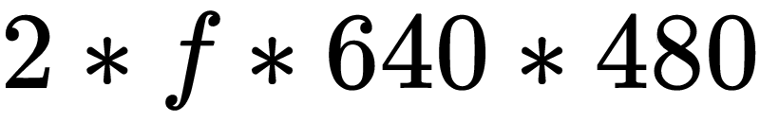
Feature Extraction
Extracting features from motions
Used dense optical flow with to get good similarity measure
If a motion has f frames each of size 640*480
The size of feature vector will be
Since optical flow gives (u,v) for each pixel there is 2 in the above formula.
Since, number of frames is different for each motions,feature vector has different sizes
Each feature vector can be visualized as
fV[1….f] where f is no of frames
Each fV[i] is a 3d matrix fv[640][480][2]

Slide 8


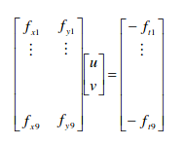
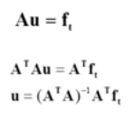
Dense Optical Flow
Optical flow is the pattern of apparent motion of image objects between two consecutive frames caused by the movement of object or camera
The equation is solved by Lucas and Kanade by assuming motion is same in neighbourhood

Slide 9
Similarity Measure
Used DTW (Dynamic Time Warping) to get similarity values(cost) b/w motions
It looks for the most similar frame in second motion for each frame in first.
Used Euclidean distance to compare two frames.
Hence, DTW selects a frame with least euclidean distance from each frame of the given video.
Prepared a similarity matrix between motions using the above approach.

Slide 10
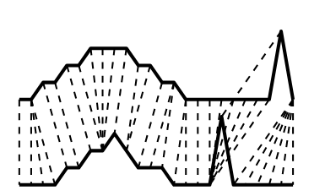
Dynamic Time Warping
It finds an optimal match between two sequences of feature vectors which allows for stretched and compressed sections of the sequence.
Solved using the following dynamic programming approach

Slide 11
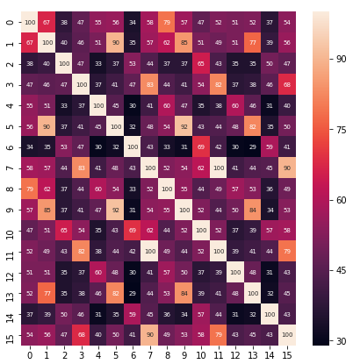
Dancer 1 Natta 1 Similarity Matrix
Similarity Matrix
The fig on the left shows how much similar each motion is to the other
Observations:
Similarity b/w all M2 motions is high(see second row) For some motions the similarity is not so good( for first motion)

Slide 12

Clustering
Spectral Clustering[3] :
Need to specify no of clusters
Worked pretty good for simple motions and when every cluster have nearly same size.
Spectral clustering models the objective function as a graph spectrum problem
Also tried Affinity Propagation for automatically determining no of clusters but didn't worked well.
[3]Hongbin Wang and Hua Lin, ”A spectral clustering approach to motion segmentation based on motion trajectory,” 2003 ICME ’03.

Slide 13

Accuracy Measurement
we compared the results of our algorithm with the manually annotated data to get the accuracy.
we used Rand index as the accuracy measure.
If C is a ground truth class assignment and K the clustering,then let:
a, the number of pairs of elements that are in the same set in C and K
b, the number of pairs of elements that are in different sets in both C and K

Slide 14
Results
Natta | Total motions | Total no of motion pairs | Correctly classified Pairs | Rand_Index
Natta1 | 32 | 992 | 992 | 100%
Natta2 | 32 | 992 | 834 | 84.05%
Natta3 | 64 | 4032 | 3111 | 77.17%
Natta4 | 128 | 16256 | 10840 | 66.68%
Natta5 | 64 | 4032 | 3210 | 79.61%
Natta6 | 64 | 4032 | 3003 | 74.5%
Natta7 | 64 | 4032 | 2163 | 53.66%
Natta8 | 48 | 2256 | 1373 | 60.87%

Slide 15
Different Variations
Natta | Optical flow Accuracy | HOF weighted binning | HOF interval binning
Natta1 | 100% | 100% | 100%
Natta2 | 84.05% | 91.38% | 91.33%
Natta3 | 77.17% | 78% | 78.15%
Natta5 | 79.61% | 62% | 63.15%
Natta7 | 53.66% | 24.8% | 24.6%
Natta8 | 60.87% | 27.3% | 26.7%
Instead of Dense Optical Flow in step 1 we used Histogram of Optical Flow as feature extraction technique.
In HOF technique too, we tried two techniques weighted binning and interval binning

Slide 16
Different Variations
We tried HOF interval binning with varying bin sizes.
HOF(x) -> here x is bin size
Natta | HOF(10) | HOF(20) | HOF(40) | HOF(60)
Natta1 | 100% | 100% | 100% | 100%
Natta3 | 79.66% | 78.15% | 76.7% | 76.7%
Natta5 | 55.55% | 63.15% | 72% | 72.36%
Natta7 | 19.13% | 24.6% | 34% | 38%
Natta8 | 18.19% | 26.7% | 26% | 27%

Slide 17
Reason for low accuracy for Natta7
In Natta7, the number of frames for each motion differs too much.For example M1 contains 62 frames whereas M2 contains 4 frames
Consider three motions M1,M2 and M1 in the next cycle
Since M2 has less frames DTW is assigning less cost to M1 and M2 rather than to M1 and M1 in the next cycle
So the motions with less no of frames are affecting the similarity matrix.
Noisy Motions:
It is highly impractical for a motion to be in such less no of frames(<10)
Hence we treat motions with less frames and removed them andrecalculated accuracy for the above methods

Slide 18
Results after removing noisy frames
Adavu | Optical flow accuracy with noisy images | Optical flow accuracy without noisy images | HOF accuracy with noisy images | HOF accuracy without noisy images
Natta1 | 100% | 100% | 100% | 100%
Natta2 | 84.05% | 84.05% | 91.33% | 91.33%
Natta3 | 77.17% | 77.17% | 78.15% | 78.15%
Natta4 | 66.68% | 66.68% | 60.68% | 60.68%
Natta5 | 79.61% | 79.61% | 63.15% | 63.15%
Natta6 | 74.5% | 85.6% | 74.5% | 80%
Natta7 | 53.66% | 78.67% | 24.66% | 72.64%
Natta8 | 60.87% | 76.67% | 26.7% | 72.6%

Slide 19
Supervised Learning Approach

Slide 20
Approach 1
We have seen that Dense Optical Flow gave good results than HOF.
So we used Dense Optical Flow as features
Since each motion has different sizes we appended each feature vector with zeros to get equal size.
Trained SVM model on D6 P1 Data using these features
Tested on D6 P2 Data

Slide 21
Results
Natta | Accuracy | Accuracy without noisy frames
Natta1 | 100% | 100%
Natta2 | 100% | 100%
Natta3 | 83% | 83%
Natta4 | 60% | 60%
Natta5 | 65% | 65%
Natta6 | 64% | 66%
Natta7 | 23% | 30%
Natta8 | 29% | 40%

Slide 22
Approach 2
Motivation:
Our Similarity measures is not working good always.For example it didn't capture similarity b/w first and fourth motions
But atleast it captured similarity m/w first and eight motions.
Looking at this ,it seems K-nearest neighbour might work.
Approach
Used D6 P1 as training set
For each motion in test set D6P2 similarity was found with every motion in training set and assigned it the label with highest similarity.

Slide 23
Results
Natta | Accuracy with noisy frames | Accuracy without noisy frames
Natta1 | 100% | 100%
Natta2 | 94% | 94%
Natta3 | 80% | 80%
Natta4 | 60.56% | 60.56%
Natta5 | 70% | 70%
Natta6 | 62% | 70%
Natta7 | 18% | 60%
Natta8 | 20% | 58.67%

Slide 24
Summary
Adavu | Dense Optical Flow | HOF (interval binning ) | SVM | KNN
Natta1 | 100% | 100% | 100% | 100%
Natta2 | 84.05% | 91.33% | 100% | 94%
Natta3 | 77.17% | 78.15% | 83% | 80%
Natta4 | 66.68% | 60.68% | 60% | 60.56%
Natta5 | 79.61% | 63.15% | 65% | 70%
Natta6 | 85.6% | 80% | 66% | 70%
Natta7 | 78.67% | 72.64% | 30% | 60%
Natta8 | 76.67% | 72.6% | 40% | 58.67%
Average | 81% | 77% | 68% | 74%
we have presented various approaches for clustering motions efficiently.
All the approaches were able to capture the simple motion details correctly.
Unsupervised methods are better than supervised may be due to less training data
HOF approach runs much faster than Dense Optical Flow.

Slide 25
Future Work
Automate the process of finding no of clusters in the video without taking it as input.
Finding reasons for the misclassification of some motions by the current approach
Extend the approach for skeletal videos too.

Slide 26
References
[1] Feng Zhou, F. D. l. Torre and J. K. Hodgins, ”Aligned Cluster Analysis for temporal segmentation of human motion,” 2008 8th IEEE International Conference on Automatic Face Gesture Recognition, Amsterdam, 2008, pp. 1-7. doi: 10.1109/AFGR.2008.4813468
[2] Kexue Dai, Guohui Li and Defeng Wu, ”Motion clustering for similar video segments mining,” 2006 12th International Multi-Media Modelling Conference, Beijing, 2006, pp. 4 pp.-. Doi: 10.1109/MMMC.2006.1651368
[3] Hongbin Wang and Hua Lin, ”A spectral clustering approach to motion segmentation based on motion trajectory,” 2003 International Conference on Multimedia and Expo. ICME ’03. Proceedings (Cat. No.03TH8698), Baltimore, MD, USA, 2003, pp. II-793. doi: 10.1109/ICME.2003.1221736
[4] A Tutorial to understand DTW.

Slide 27
Thank you

Slide 28
Spectral Clustering

Slide 29
Spectral Clustering
The goal of spectral clustering is to cluster data that is connected but not necessarily compact or clustered within convex boundaries
It very often outperforms traditional clustering algorithms such as the k-means algorithm
Objective : To divide the data points into several groups such that points in the same group are similar and points in different groups are dissimilar to each other.

Slide 30
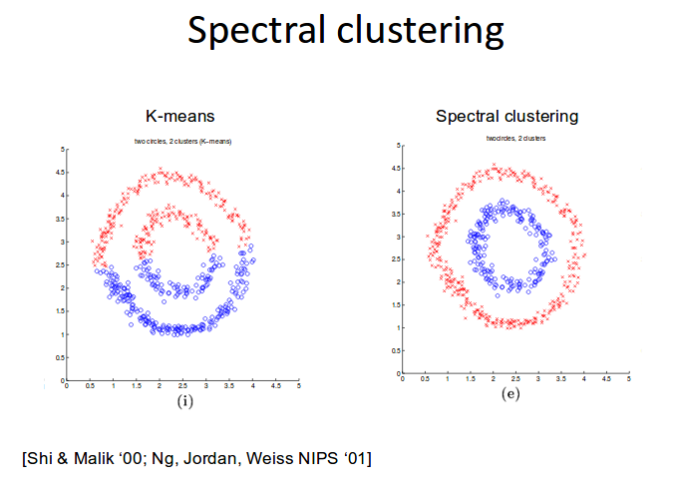

Slide 31

Basic idea
Spectral clustering models the objective function as a graph spectrum problem and solves it with the known linear algebra techniques.
It connects the objective function to one of the following property of graph laplacian and solves it in place of minimizing objective function.
Here L is the unnormalized graph laplacian

Slide 32
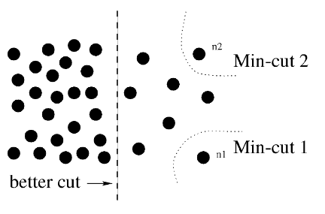
Can we use min cut for
clustering?
Idea :
Partition vertices of graph into K disjoint sets such that the sum of weights of edges between two sets of vertices is minimum.
[Shi & Malik ‘ 00]

Slide 33
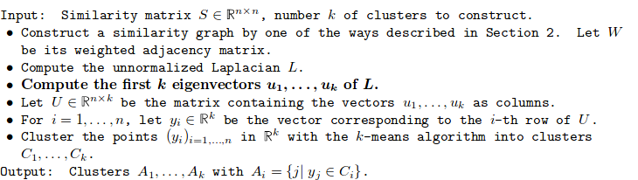
Algorithm

Slide 34

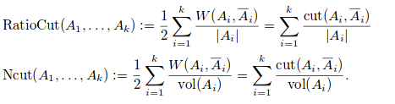
Objective Function
The above was the objective for min cut problem.To overcome the problems as defined earlier, the following modifications are done.

Slide 35

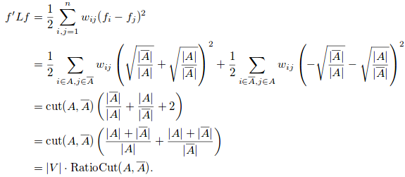

Approximating Ratio Cut for K= 2
Consider any partition A ⊂ V we define
You can see that minimizing f’Lf is same as minimizing RatioCut
Our goal is to solve the optimization problem

Slide 36


Additionally we have,
This means the f vector should be orthogonal to all 1’s vector
Altogether we can see that the problem of minimizing objective function can be rewritten as
This is a discrete optimization problem but it is NP Hard.Relaxing f to take real values makes it solvable.
By the Rayleigh-Ritz theorem, the solution to this is eigenvector corresponding to the second smallest eigenvalue of L

Slide 37






Approximating Ratio Cut for K>2
Given a partition of V into k sets A1,A2…….Ak.we define
The final minimization problem is
By the Rayleigh-Ritz theorem,the solution is given by choosing H as the matrix which contains the first k eigenvectors of L as columns
Our goal is to solve the optimization problem

Slide 38
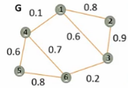
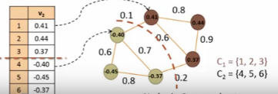
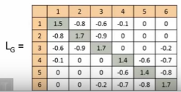
Examples

Slide 39
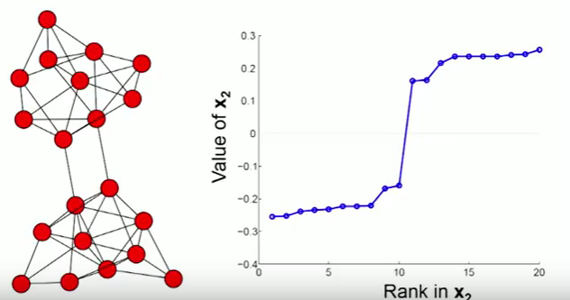
Examples

Slide 40
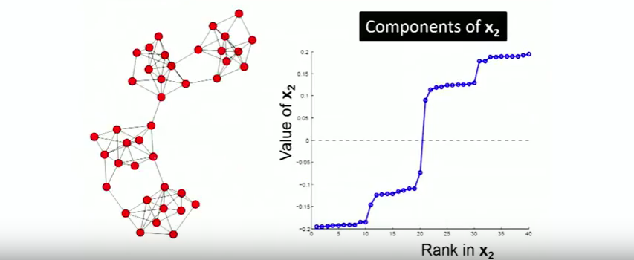
Examples

