Slide 1
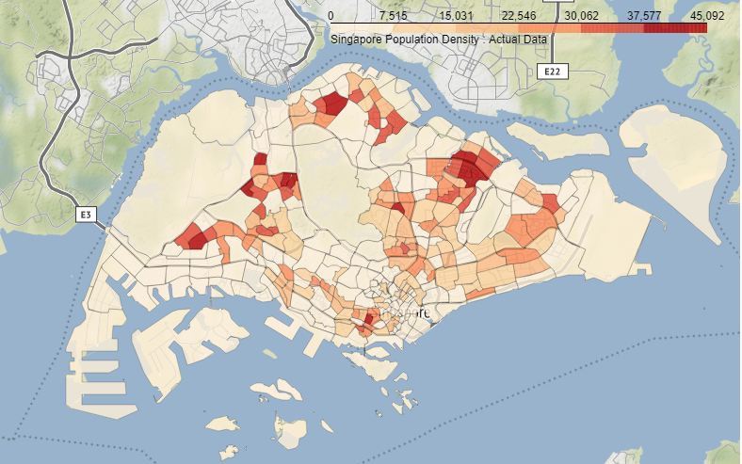
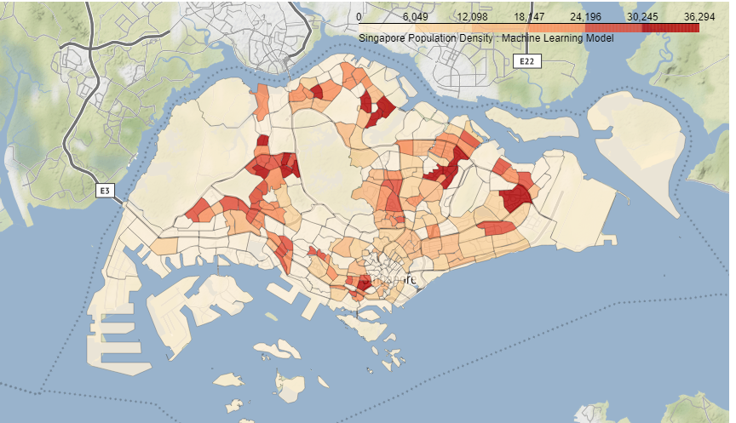
Using Machine Learning to predict population density in Singapore neighbourhoods
Actual Data
My Machine Learning Model

