Slide 1
Email test · 64,000 customers · results over two weeks
Email the whole list with the men's email. If you can only reach half, the men's email still wins, and how you pick that half matters little.
• Both emails worked. The men's email more than doubled the purchase rate (0.57% → 1.25%) and added $0.77 of spend per customer.
• The men's email beat the women's email on visits, purchases and spend.
• Emailing everyone with the men's email: about $49.3k more spend in two weeks than sending nothing. A random half gets about half of that ($24.6k).
• Its effect is broad. No customer group was left out, so a targeting model could not pick a half that clearly beats a random half.
• The women's email is different. Its effect is concentrated, so if it is sent, aim it: the top-ranked half delivers 85% of its extra purchases.

Slide 2
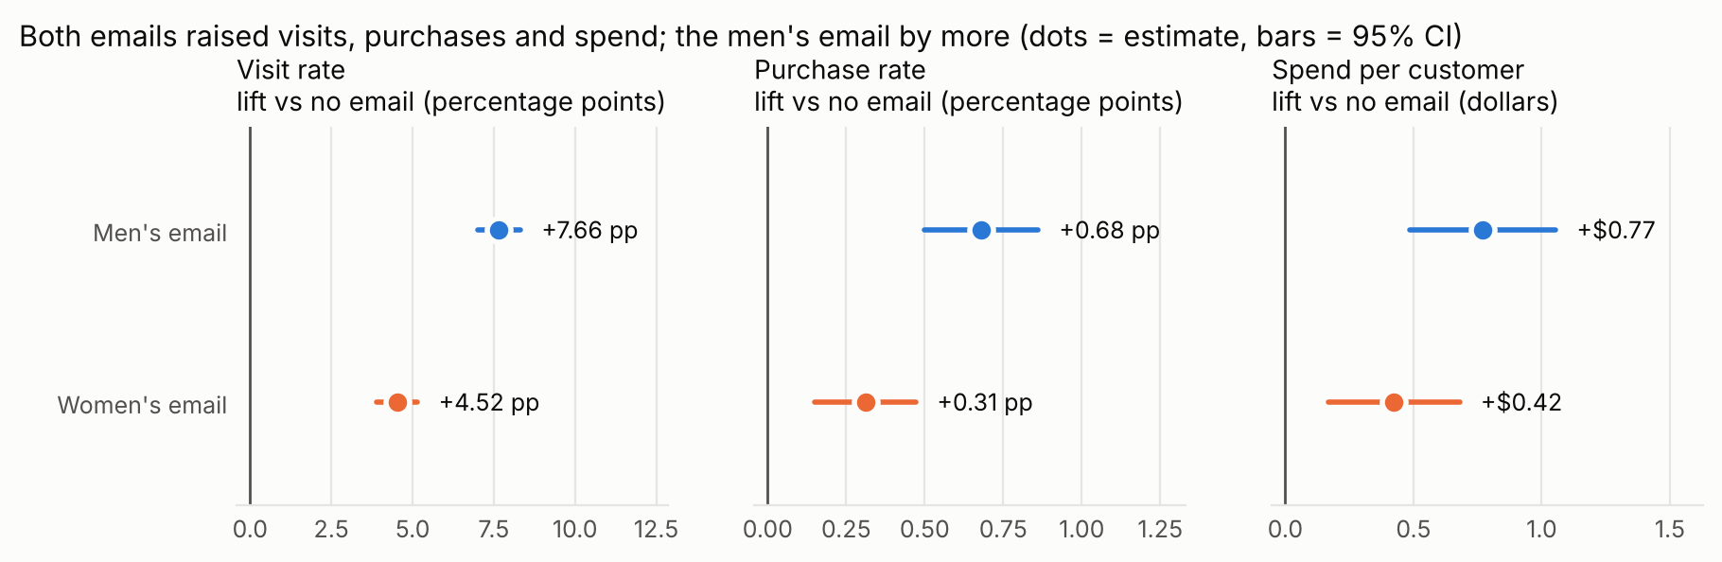
1 · Did it work?
Both emails caused more visits, purchases and spend; it is not chance
Customers were assigned at random, and the three groups looked alike beforehand (largest difference 0.016 standard deviations), so the gaps are caused by the emails. Every lift holds at p ≤ 0.002 after correcting for running nine tests. Men's email: +0.68 pp purchase rate (+119%); women's: +0.31 pp (+54%).

Slide 3
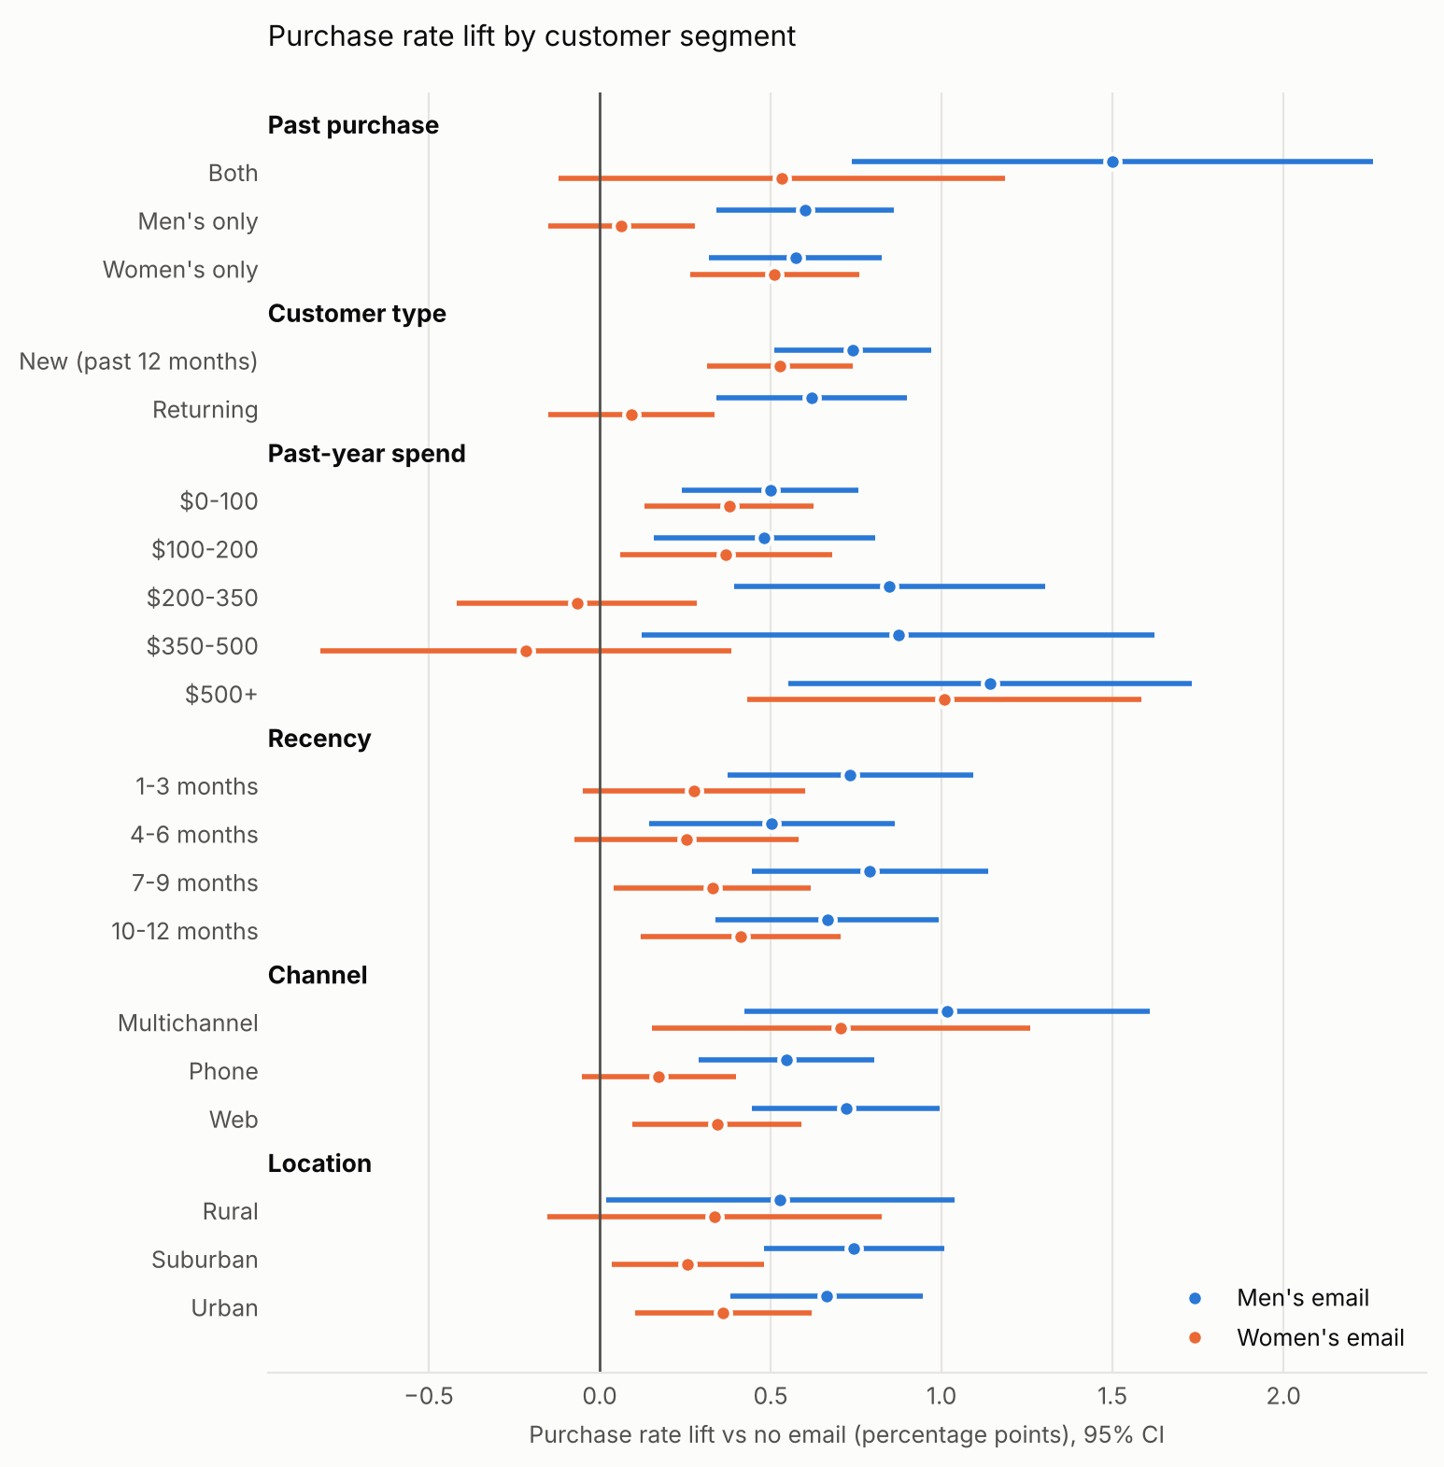
2 · Which email, and for whom?
The men's email won. The women's email did nothing measurable for men's-only buyers or returning customers
• Head to head, the men's email had +0.37 pp higher purchase rate and +$0.35 more spend per customer than the women's email.
• Men's email: positive in every segment we cut, including women's-only buyers.
• Women's email: clear lift for women's buyers, new customers and $500+ spenders; no detectable lift for men's-only buyers, returning customers, or $200–500 spenders.
• Caution: most segment differences are within noise once you account for testing many segments. The one solid difference: the women's email barely moved site visits from men's-only buyers (+1.1 pp vs +7.4 pp for women's-only buyers), while the men's email drew both groups equally and buyers of both categories most.

Slide 4
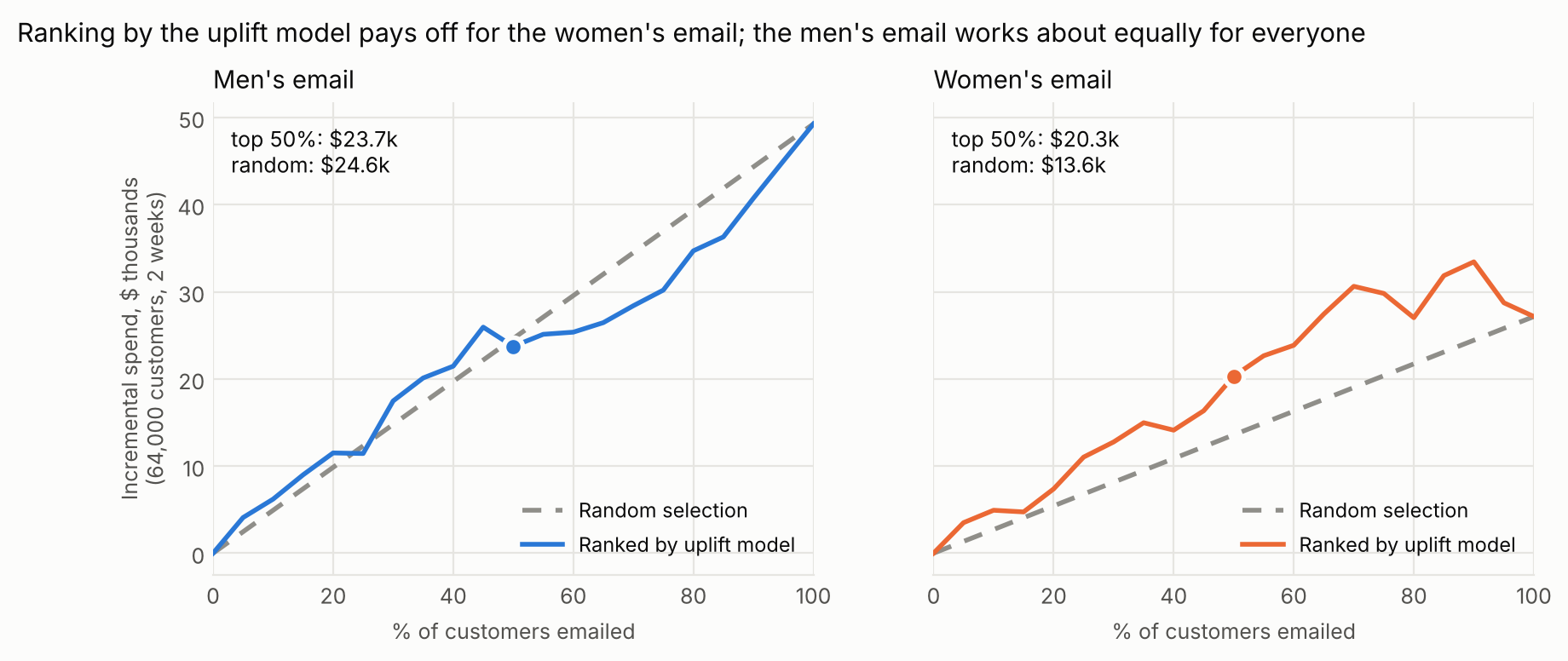
3 · Who should get it?
An uplift model ranks who the email changes, not who buys anyway
Women's email: the model's top half delivers $20.3k of extra spend vs $13.6k for a random half, and 85% of the extra purchases. Men's email: the ranked half does no better than a random half, because the email lifts nearly everyone.

Slide 5
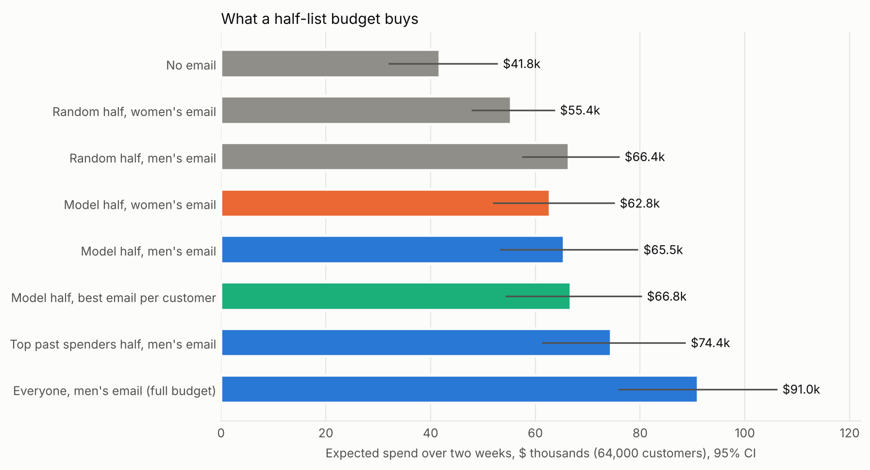
4 · What to do next
Recommendation
1. Default: send the men's email to everyone. Sending costs little, and every segment responded.
2. Half-list budget: send the men's email. A random half earns $66.4k. Picking the top past spenders scored $8.0k more, but that could be chance (95% CI -$1.5k to $16.8k).
3. If the women's email must go out, send it only to the model's top half, mainly women's buyers and new customers.
4. Next test: next send, run past-spend targeting against random selection, and give both groups the men's email, to confirm the extra revenue before rolling it out.

