Slide 1
Graphing Complex survey data
Chapter 7 topics
Math 255

Slide 2
Goal
Use survey data to create a visualization that represents the population.
Self-weighting samples: (SRS)
Just use basic EDA tools: histogram, boxplot, scatterplots, bar graphs
Stratified samples: self-weighting within strata
Basic EDA within each strata: side-by-side boxplots, lattice histograms/scatterplots, grouped bar graphs
Clustered samples: self-weighting within clusters
Basic EDA within each cluster: side-by-side boxplots, lattice histograms/scatterplots, grouped bar graphs
But what if we want to visualize the distribution of a variable for the entire population, not just one strata/cluster?
What if we have a more complex sampling design?

Slide 3
Two-stage Cluster sample: API scores
Recall the two-stage cluster sample of schools in CA
Cluster = district
Elements = schools
Unequal cluster and sample sizes
Goal: understand API scores in 2000 (api00)

Slide 4
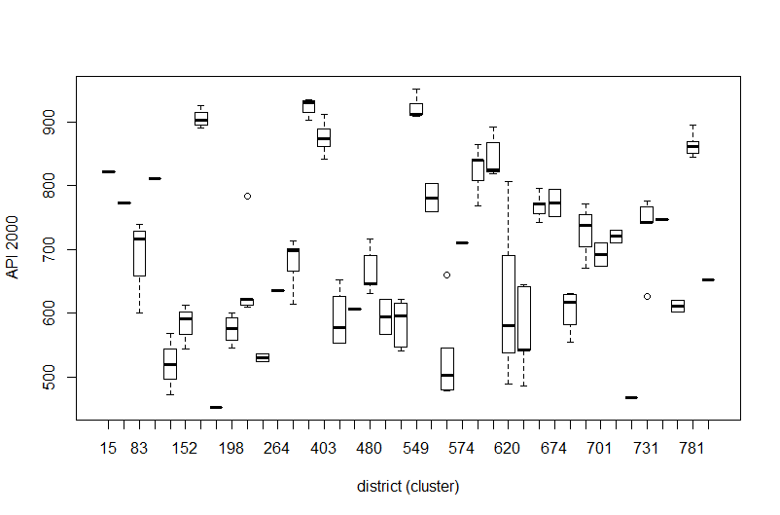
API scores within districts: represents variation in API00 within/between all schools in the population

Slide 5
API scores in all of CA:
What if we want a boxplot that represents API00 scores for all schools in CA, not just the schools in our sample?
Create the usual survey design object
Then use svyboxplot:
svyhist(~y, my.design)
svyboxplot(y~grouping, my.design)

Slide 6
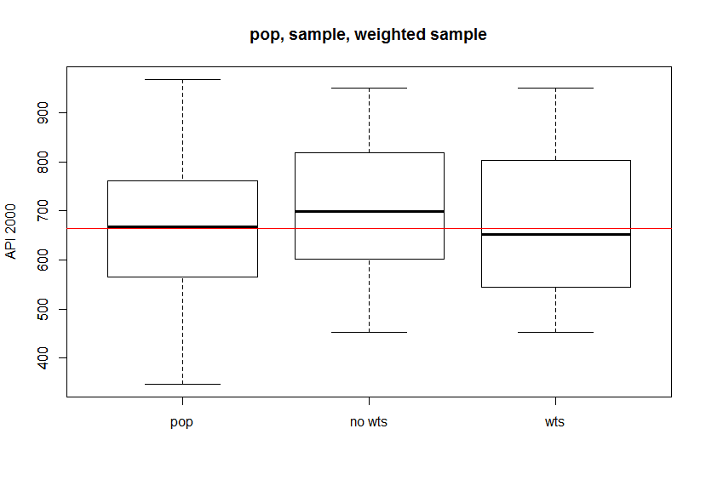
API scores in all of CA: why does the unweighted data misrepresent API00 scores across CA?

Slide 7
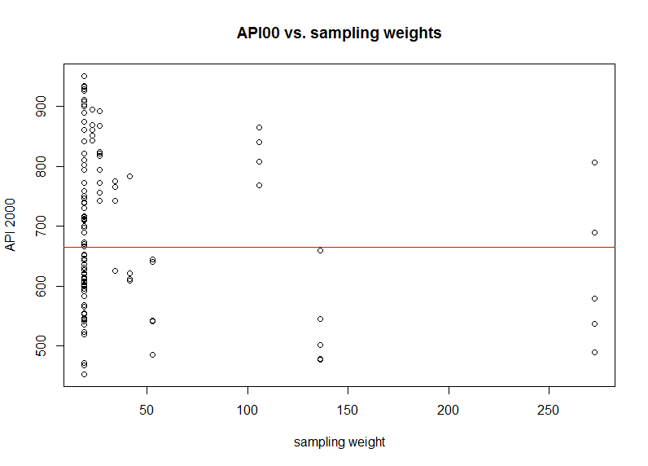
In the sample: schools with high score overrepresented (many schools with high scores but low sampling weights)

Slide 8
Agpps: PPS ag survey data
15 Counties selected with probability proportional to acres87.
Goal: estimate average acres92
Sample mean is 614,764
HT estimate is 342,552
Population mean is 306,677
Graphically:
(unweighted) sample of 15 counties is adequate for EDA for the sample, looking for outliers
(unweighted) sample will not reflect the population distribution of acres92
Solution: use the sampling weights when graphing

Slide 9
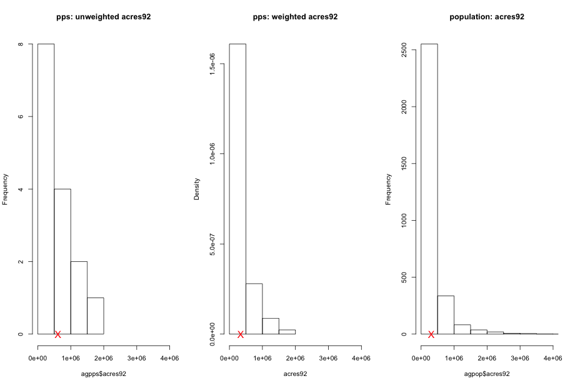

Slide 10
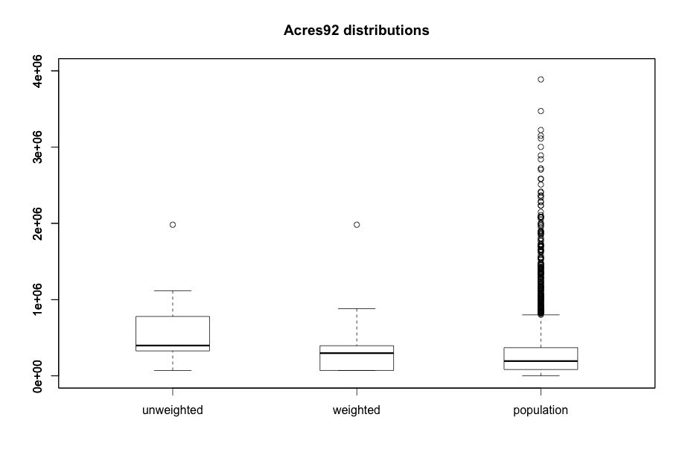

Slide 11
Weighted Histograms
Usual (density) histogram:
Divide data into equal width bins (b=width)
Count the number of data points in each bin
Height = proportion of observations in bin/b
Area of bar = proportion of observations
Weighted (density) histogram
Height is weighted proportion in each bin:

Slide 12
Weighted Boxplots
Usual boxplot:
Find 5 number summary (min,Q1,median,Q3,max)
ID outliers using 1.5 IQR rule
Plot 5 number summary and outliers
Weighted histogram
Find Q1, median, Q3 using the weighted empirical cumulative distribution function (ecdf):
E.g. Q1 is the value “a” where F(a) is about 0.25.

Slide 13
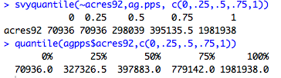
Weighted quantiles for agpps
In the sample, the median is 397,883
The estimated population median is 298,039

Slide 14
Complex Survey Data
Sampling design of large population are often very complex
One or more levels of clustering
One or more levels of stratification
Many publically available survey datasets contain:
Weights constructed using design weights + weighting adjustments for non-response (ch. 8: raking, weight class, post-strat)
Responses at different levels (PSU=household, SSU=person) AND weights for these different levels (HH weight vs. Person weight)
Weights usually represent how many population units (PSU or SSU) that sampled unit represents.
You may also find replicate weights in the dataset that are used to compute SEs (ch.9).
Read the survey documentation for correct use of weights!

Slide 15
Example 7.7: Survey of Youth in Custody
Sampled juveniles and young adults in long-term, state-operated juvenile institutions
PSU: 206 juvenile facilities
Strata: based on size of psu (1=small to 16=large)
Strata 1-5: PSU selected with probabilities proportional to size of psu
Strata 6-16: one PSU per strata, take a “census” from each strata
SSU: residents subsampled in each psu
Final Weights:
Determined by stratum sizes, PSU inclusion probabilities, subsampling fraction
Also adjusted for nonresponse and poststratification

Slide 16
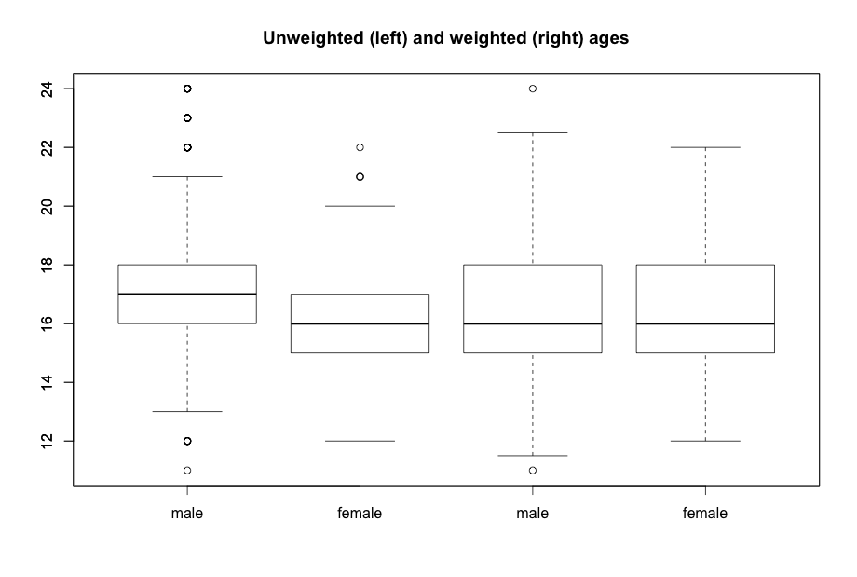
Example 7.7: Survey of Youth in Custody

Slide 17
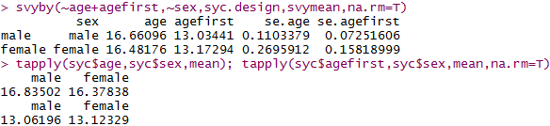
Example 7.7: Survey of Youth in Custody
R survey command:
svyboxplot(age ~ sex, syc.design)
Older males were slightly overrepresented in the sample.

Slide 18
Scatterplots
How are age at first offense and current age related?
Unweighted scatterplot shows this relationship in the data
Weighted plot will reflect how the relationship will look in the population.
In R: svyplot( y ~ x , design)
Default style is a bubble plot where area of the plotting symbol shows total weight of sample at that coordinate.
style = “transparent” uses shading to denote total weight (darker means more weight)
style = “grayhex” uses hexagonal binning and shading to denote total weight, best choice with large data sets.

Slide 19
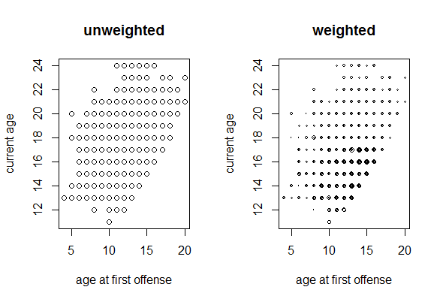

Slide 20
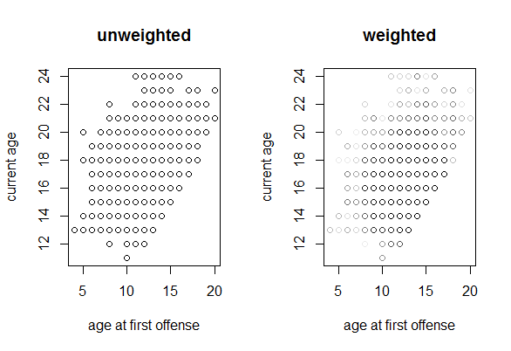

Slide 21
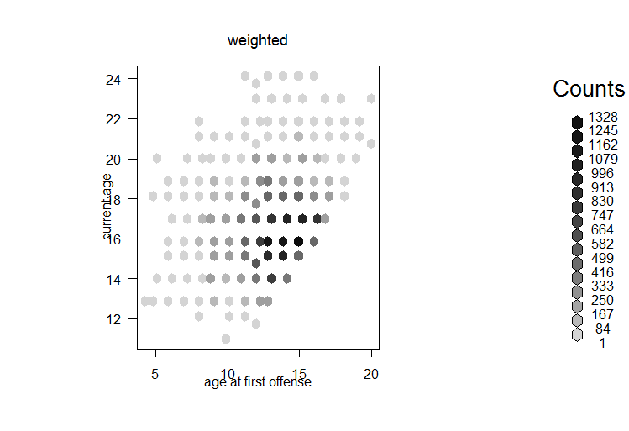

Slide 22
coplots
How are age at first offense and current age related for each sex?
Coplots divide the data into groups according to a third variable, then plots a scatterplot for each group.
In R: svycoplot( age ~ agefirst| sex, design)
Default style is a hex binning
Annoying: any hex binning style requires a “hexbin” package that is not automatically loaded with the survey package.
If your third variable is quantitative, you can use the equal.count command:
svycoplot(age ~ agefirst | equal.count(psusize), design)

Slide 23
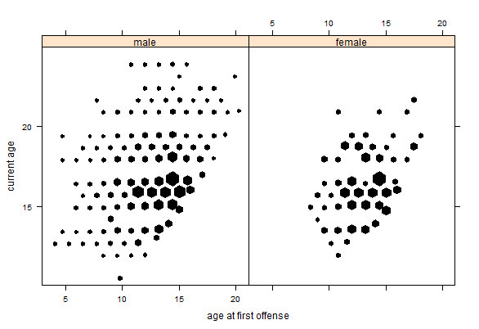

Slide 24
