Slide 1
Variance estimation
Chapter 9 topics
Math 255

Slide 2
Some general methods of variance estimation
Linearization
Approximate the statistic using a 1st order Taylor’s series expansion (linear function)
Get a formula for SE
Replication methods
Replication weights created to generate replicated estimates that mimic the actual variance of the estimate
Often created with replacement so they overestimate SEs.
Computationally intensive

Slide 3
Random Group Method
Survey design is replicated (repeated) independently R times.
Parameter of interest, θ, is estimated R times:
An estimator of θ is
The estimated variance is

Slide 4
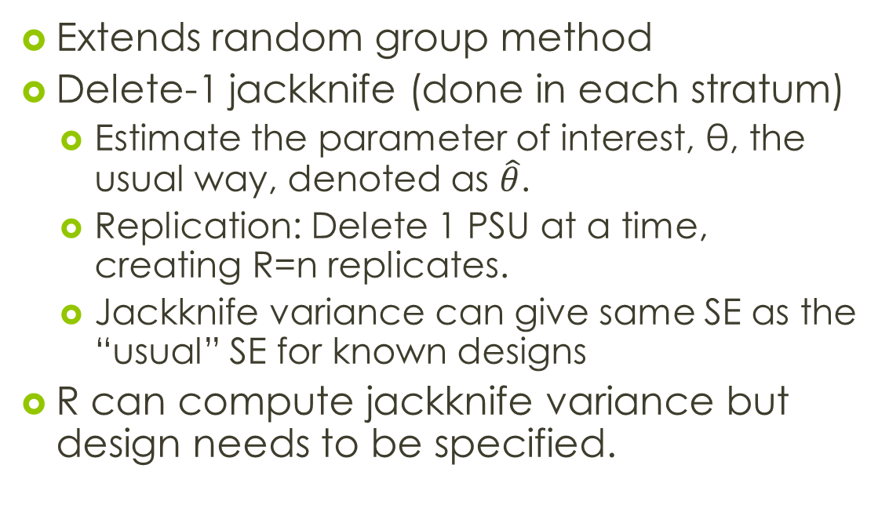
Jackknife
Extends random group method
Delete-1 jackknife (done in each stratum)
Estimate the parameter of interest, θ, the usual way, denoted as $\hat{θ}$.
Replication: Delete 1 PSU at a time, creating R=n replicates.
Jackknife variance can give same SE as the “usual” SE for known designs
R can compute jackknife variance but design needs to be specified.

Slide 5
Jackknife
Some of the mechanics:
When deleting PSU j, recompute weights
When deleting PSU j, use replicate weights to estimate the parameter of interest, θ
The jackknife variance is estimated as

Slide 6
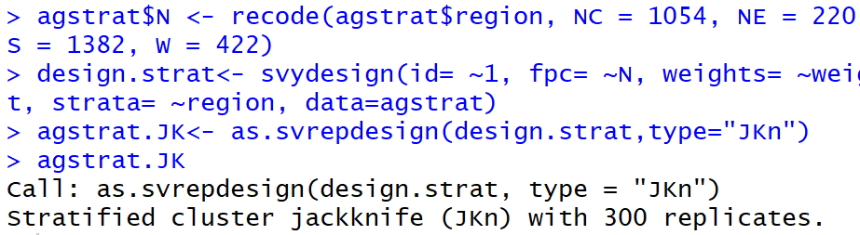
Jackknife in R
Agstat data (n=300, H=4 region strata)
First fit sampling design, then update to a replicated design.

Slide 7

Jackknife in R
Use replicate design to estimate parameters.
Estimating average number of acres in 1992.
Standard SE (formula from ch. 3) and jackknife are equivalent for estimating a mean.

Slide 8
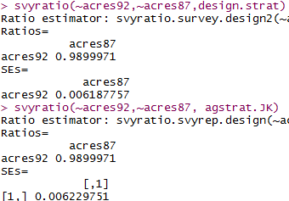
Jackknife in R
Estimating ratio of 1992 total acreage to 1987 total acreage.
Standard SE (formula from ch. 3) and jackknife are not equivalent for estimating nonlinear functions like a ratio.

Slide 9
Why use jackknife SE?
Pro: To simplify SE calculations
You can include jackknife weights, along with sampling weights, in your dataset
Users of your data only need to know basic weighted estimation formulas (HT) and the jackknife SE formula.
E.g. these are values can be computed in spreadsheet software like Excel.
Con: jackknife replication size is large (n)

Slide 10
Jackknife weights
For the jth PSU removal: element-level JK weights:
In a stratified sample, this is done separately for each stratum
In NE, we have n=103 counties sampled
The JK weight adjustment to the sampling weights in NE is about 103/102=1.0098

Slide 11
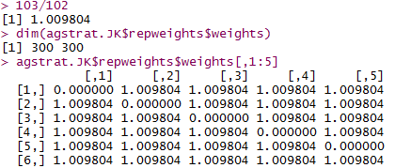
Jackknife in R
The first weight adjustments are for the NE stratum:

Slide 12


Jackknife in R
Replicate weight construction: Multiply sampling weights by the jackknife weight adjustments:
Then use replicate weights to construct an estimate:
This is done a total of n=300 times for this data set.

Slide 13
Bootstrap
Treats sample as the population
Basic idea
Estimate the parameter of interest, θ, the usual way.
Resampling: Randomly sample PSUs with replacement.
Compute the parameter estimate for each resample.
Repeat this R times (R needs to be big!)
Histogram of resampled estimates mimics shape and variability of the sampling distribution of the estimate.

Slide 14
Bootstrap
Mechanics for the rescaling bootstrap:
Take a SRS of n-1 PSUs with replacement
Recompute weights for each resample r
For each resample, use new weights to estimate the parameter of interest, θ
The bootstrap variance is estimated as

Slide 15

Bootstrap in R
First fit sampling design, then update to a replicated design.
Here R=1000 resamples (replicates) are taken

Slide 16

Bootstrap in R
Unlike the jackknife, bootstrap SEs will not be mathematically equivalent to the formula SE for mean:

Slide 17
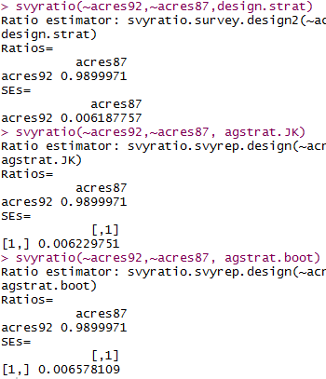
Bootstrap in R
Ratio SE will also be different.

Slide 18
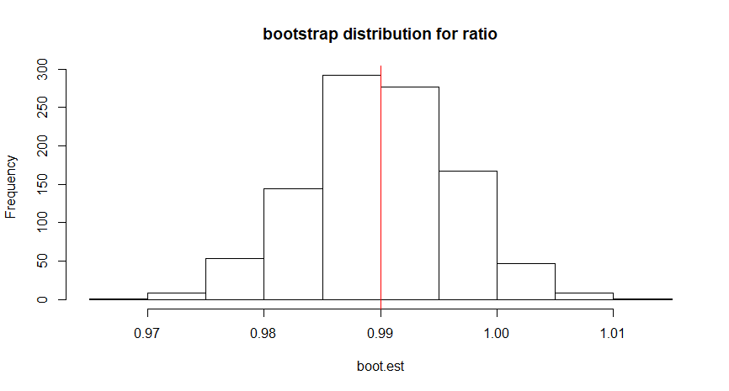
Bootstrap in R

Slide 19
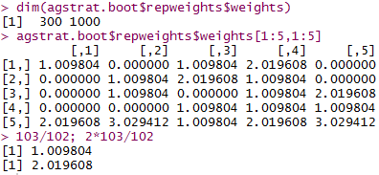
Bootstrap in R
R gives the bootstrap weight adjustments
In the first (column) resample:
Unit 1: (103/102)x 1
Unit 2: (103/102)x 0
Unit 5: (103/102)x 2

Slide 20
Bootstrap
Pros:
All-purpose method that is ok(ish) for quantiles
CIs can be produced from bootstrapped samples . (They mimic both the shape and variability of the sampling distribution.)
Cons:
R (# of resamples) needs to be big to get an accurate estimate of SE
Doesn’t produce the same SE value each time the algorithm is run

Slide 21
Summary
Replication methods can give you SEs for estimators whose (true) SE are hard to derive analytically (formulaically)
Need to know design features (stratification, clustering) to get these SEs in R.
But, for large scale surveys, replicate weights are sometimes given as part of the data set.

Slide 22
American Community Survey (ACS)
Ongoing survey covering entire U.S.
Conducted by Census Bureau
Gives communities and governments information about their populations.
https://www.census.gov/programs-surveys/acs

Slide 23
2009 PUMS
PUMS = Public Use Microdata Sample
Contains actual responses from the ACS
Some responses are adjusted for confidentiality
The 2009 PUMS was designed to sample one percent of the housing units in the United States.
https://www.census.gov/programs-surveys/acs/data/pums.html

Slide 24
2009 PUMS
PUMS is well documented:
Describes sampling weights
Describes replicate weights and SE calculation
http://www.census.gov/content/dam/Census/library/publications/2009/acs/ACSPUMS.pdf

Slide 25

2009 PUMS: sampling weights
Data is give at the household and person level.
http://math.carleton.edu/kstclair/data/ss09pmn.csv
Using the person-level weights allows us to estimate the population size of MN in 2009:

Slide 26
2009 PUMS: estimation
Documentation:
Use HT type estimates for total, mean, or population sizes

Slide 27
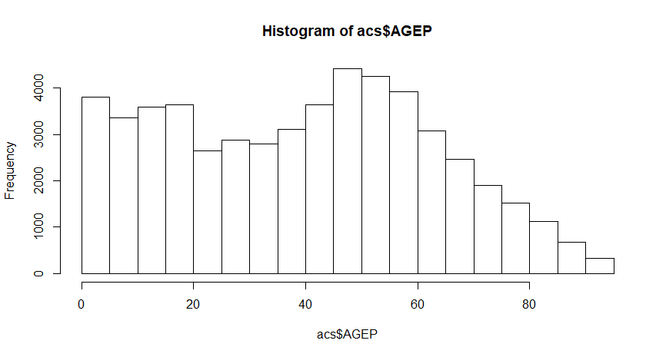

Slide 28
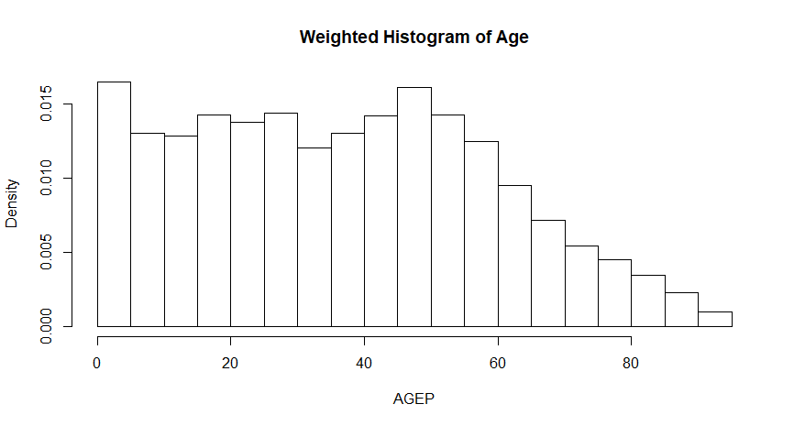

Slide 29

2009 PUMS: estimation
Estimate average age of all people in MN is 37.24 years. (unweighted average is 39.98)

Slide 30
Domain: PUM Area (PUMA) 2100

Slide 31
2009 PUMS: estimation
Estimate average age in PUMA 2100:

Slide 32
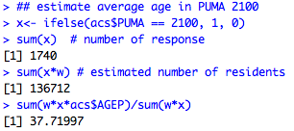
2009 PUMS: estimation
Estimate average age in PUMA 2100 is 37.72 years.

Slide 33
2009 PUMS: replicate weights
Two methods are provided for estimating the standard errors of PUMS estimates: replicate weights and design factors.
The ACS employs the Successive Differences Replication (SDR) method (Wolter, 1984; Fay & Train, 1995; Judkins, 1990) to produce variance estimates.
https://www2.census.gov/programs-surveys/acs/tech_docs/pums/accuracy/2009AccuracyPUMS.pdf?#

Slide 34
2009 PUMS: replicate weights
Documentation:
Let be the population parameter
Let be the estimate based on the sampling weights
Let be the estimate based on the rth replicate weight
The SDR standard error of the estimate is

Slide 35
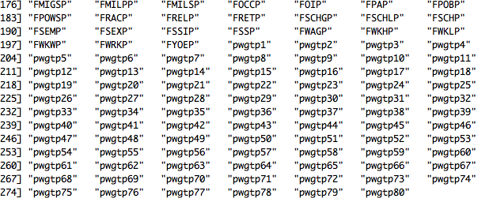
2009 PUMS: SE
Find the replicate weights at the end of the PUMS data set:

Slide 36
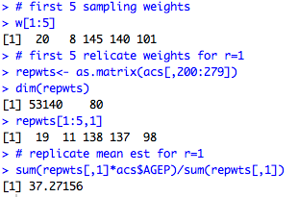
2009 PUMS: SE
First replicated mean estimate is 37.27156

Slide 37


2009 PUMS: SE
The average age in MN is estimated to be 37.24 years (SE=0.02918).
The average age in PUMA 2100 is estimated to be 37.72 (SE=0.1921).

