Slide 1
Neurónové siete
COVID-19

Slide 2

Cieľ
Notes:
Cieľom môjho projektu bolo zostavenie Neurónovej siete pre predikciu nových prípadov ochorenia COVID-19 v jednotlivých krajinách.
Prípadne krátky opis choroby.

Slide 3
01
03
Kód
Vizualizácia
Dataset
Učenie
02
04
Predspracovanie dát
Výstup a výsledné dáta
Porovnania
Vytvorenie neurónovej siete

Slide 4

Dataset

Slide 5
Súbory
01
02
03
train.csv
Trénovacie dáta
Od 22.1.2020 do 17.4.2020
test.csv
Dátumy, ktoré treba predpovedať
Od 2.4.2020 do 14.5.2020
submission.csv
Výsledné dáta
Notes:
train.csv - the training data (you are encouraged to join in many more useful external datasets)
test.csv - the dates to predict; there is a week of overlap with the training data for the initial Public leaderboard. Once submissions are paused, the Public leaderboard will update based on last 28 days of predicted data.
submission.csv - a sample submission in the correct format; again, predictions should be cumulative

Slide 6
Kód – Import základných knižníc na prácu s datasetom
import numpy as np
import pandas as pd
import operator
import matplotlib
import matplotlib.pyplot as plt
from sklearn.linear_model import LinearRegression
from sklearn.preprocessing import PolynomialFeatures, StandardScaler
df_train = pd.read_csv("train.csv", parse_dates=['Date'])
df_test = pd.read_csv("test.csv", parse_dates=['Date‘])

Slide 7
Učenie #1
df_train.head()
x_train = df_train[[]]
# Pre predikciu novych pripadov vyuzijem Linearnu regresiu
for country in df_train['Country_Region'].unique():
# print('Robim model pre krajinu: {}'.format(country))
df_train_country = df_train[df_train['Country_Region'] == country]
df_test_country = df_test[df_test['Country_Region'] == country]

Slide 8
Učenie #2
# zaujima ma, ci ma krajina provinciu, ak ano -> vetva else
if df_train_country['Province_State'].isnull().unique().any():
# indexujem krajiny v csv subore - od a do
x_train = np.array(range(len(df_train_country))).reshape((-1, 1))
#print(x_train)
y_train = df_train_country['ConfirmedCases']
# print(y_train)
# ucenie siete
model = Pipeline([('poly', PolynomialFeatures(degree=2, include_bias=True)), ('linear', LinearRegression(fit_intercept=False))])

Slide 9
Učenie #3
Y = np.array([y_train])
Yr = np.flip(Y, axis=1)
Yr = Yr[0,::-1]
Yrs = Yr.reshape(-1,1)
x_train_scale = StandardScaler().fit_transform(x_train)
y_train_scale = StandardScaler().fit_transform(Yrs)
model.fit(x_train_scale, y_train_scale)
# zacnem indexovat dni od 0
x_test = np.array(range(len(df_test_country))).reshape((-1, 1))
prediction = model.predict(x_test)
# negativne pripady nahradim nulou
prediction[prediction < 0] = 0
# Vramci ConfirmedCases pridam sa novy stlpec v dataframe df_test kam vlozim predikciu k danej krajine
df_test.loc[df_test['Country_Region'] == country, 'ConfirmedCases'] = prediction

Slide 10
Učenie #4
else:
for state in df_train_country['Province_State'].unique():
df_train_state = df_train_country[df_train_country['Province_State'] == state]
df_test_state = df_test_country[df_test_country['Province_State'] == state]
x_train = np.array(range(len(df_train_state))).reshape(-1, 1)
y_train = df_train_state['ConfirmedCases']
model = Pipeline([('poly', PolynomialFeatures(degree=2, include_bias=True)), ('linear', LinearRegression(fit_intercept=False))])
Y = np.array([y_train])
Yr = np.flip(Y, axis=1)
Yr = Yr[0,::-1]
Yrs = Yr.reshape(-1,1)
x_train_scale = StandardScaler().fit_transform(x_train)
y_train_scale = StandardScaler().fit_transform(Yrs)
model.fit(x_train_scale, y_train_scale)
x_test = np.array(range(len(df_test_state))).reshape((-1, 1))
prediction = model.predict(x_test)
prediction[prediction < 0] = 0
df_test.loc[(df_test['Country_Region'] == country) & (df_test['Province_State'] == state), 'ConfirmedCases'] = prediction

Slide 11
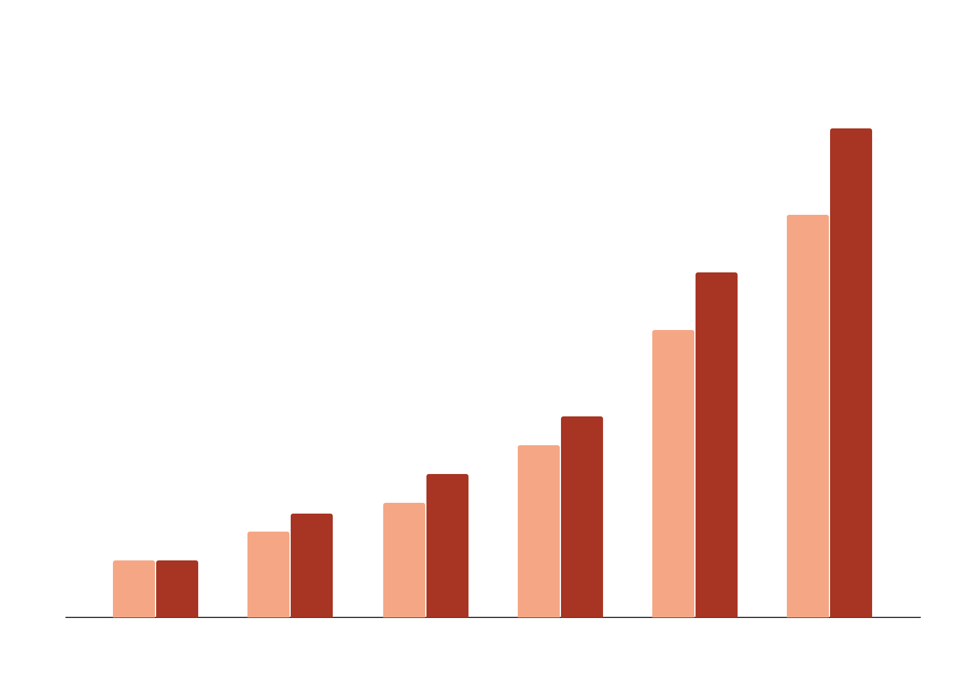
Vizualizácia

Slide 12
Výstup
Vloženie naučených dát do submission.csv
# len vlozim data do pripraveneho csv suboru
df_submit = pd.read_csv('submission.csv')
df_submit['ConfirmedCases'] = df_test['ConfirmedCases'].astype('int')
df_submit.to_csv('submission.csv', index=False)

Slide 13
Graf - kód
if(country == “Slovakia"):
plt.plot(x_train[:70,0], Yrs[:70,0])
plt.xlim(0,10)
#print(prediction)
plt.plot(x_test+45, prediction)
plt.xlim(0,88)
plt.legend(['Potvrdené prípady', 'Predpokladaný počet nových prípadov nakazenia'])
plt.title(country+': graf predikcie nakazení', size=20)
plt.show()

Slide 14
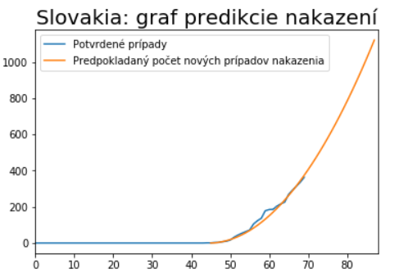
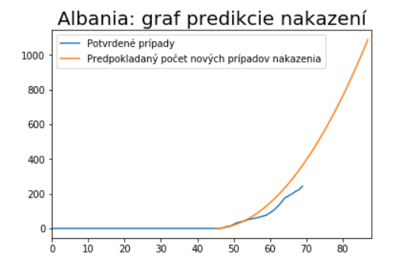
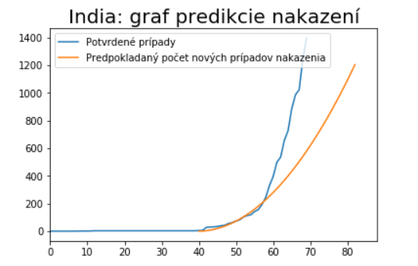
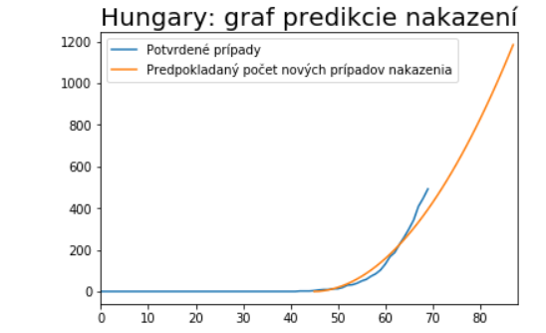

Slide 15
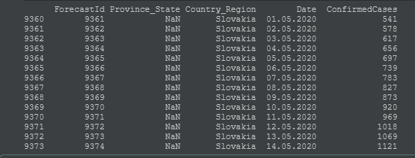
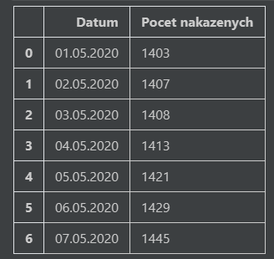
Vizualizázia Slovenska v porovnaní s reálnymi údajmi

Slide 16
Záver

Slide 17
ZDROJE
https://www.researchgate.net/publication/340394734_Neural_network_based_country_wise_risk_prediction_of_COVID-19
https://github.com/aatishb/covid/blob/master/curvefit.ipynb
https://meltingasphalt.com/interactive/outbreak/
https://www.washingtonpost.com/graphics/2020/world/corona-simulator/
https://www.youtube.com/watch?v=BtN-goy9VOY
http://gabgoh.github.io/COVID/index.html

Slide 18

Ďakujem za pozornosť
Please keep this slide for attribution

Slide 19


Diskusia
Notes:
Priestor na diskusiu

Slide 20
Fonts & colors used
This presentation has been made using the following fonts:
Pathway Gothic One
(https://fonts.google.com/specimen/Pathway+Gothic+One)
Roboto Slab
(https://fonts.google.com/specimen/Hind)
#f5a785
#212e73
#eff1ff
#e07a54

Slide 21


