Slide 1
Content for Cnuapp
  Project overview: https://wiki.cashnetusa.com/mediawiki/index.php/tech:CMS
  Content Overview
  Overlays, Fallbacks - Selectors
  What, where, how
    language, country, brand
  Working with and extending Cnu::Content
Notes:
This presentation is intended for developers in cnuapp and its related products to understand the Cnu::Content tools for storing, querying and overlaying content. It explains the difference between content and other artifacts currently worked on by development, and aims to enable developers to work on, utilize, and extend this framework.

Slide 2
Content - What and Where
  Contracts, phrases, email templates, ...
  Business-user controlled
  Per product/country
  Phrases: etc/copy*.yml => etc/content/contenter.yml
  Contracts: etc/contract
Notes:
Think of content as pieces of CNUAPP which a) business users or legal control b) may need different values for different products/brands/languages
Product offerring – product type, lender, program
PPI -

Slide 3
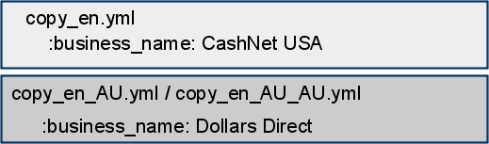
Overlays, Fallbacks, Selectors
  Vary by language, country, brand, MIME type, ..
  Contenter reorganizes, fulfills same purpose
}
Was: Cnu Config-style overlay files
Now: Content for ContentKey :business_name (type :phrase)‏
value
lang
country
brand
application
CashNet USA
*
*
US
*
Dollars Direct
*
*
AU
*
PlataRed (hypothetical)‏
es
*
US
*
Notes:
Copy_en.yml and copy_en_AU.yml both define the key 'loan_amount' to have the value 'Loan Amount' –

Slide 4
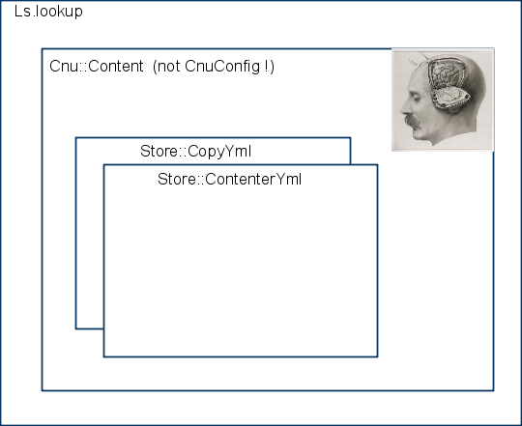
Content (Phrases) - How

Slide 5
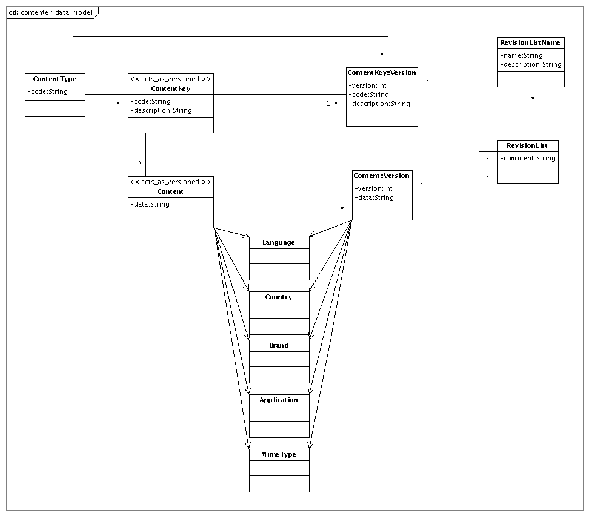
Contenter Data Model

Slide 6
Contenter Workflow Components
  Contenter on Rails/PG (cms.cashnetusa.com)‏
    Point-in-time and explicit collections of content
  Export files CNUAPP_DIR/etc/content
  Cnu::Content underneath LS
  Bulk upload/download/sync API
  Rake tasks content:upload content:download
  P4 still maintaining content history *

Slide 7


















Content
Admin
Contenter
CMS
Fallback
Memcache
App1
invalidate
Content
DB
User
Contenter
API
Contenter
Memcache
App2
Content
Server
AppN
App Content
Large Content (images, static docs)‏

Slide 8
Cnu::Content::Store
  Provides for lookup at exact 'coordinates'
    get(:phrase, :hello, :lang => :en)‏
    get (:phrase, :hello)‏
  (code walkthrough)‏

Slide 9
Cnu::Content
  Implements fallbacks, 'fuzzy' matches
  Provides for selector axis precedence
  Series of attempts to locate suitable content
  Holds registry of content stores
  (code walkthrough)‏

Slide 10
Modfiying Contenter Yaml
  1. Edit existing contenter.yml (e.g. EP)‏
  2. Use temporary additional file (e.g. Canada)‏
  3. CMS app download (once cms.cashnetusa.com live)‏
  (code walkthrough)‏

Slide 11
Q&A
Thank you !

