Slide 1

KYLE STEWART
Case Study Master Deck
Senior Content Designer
Google Ads · Intuit TurboTax Live · Product content that moves people to act
For hiring managers · kstew.co · hello@kstew.co

Slide 2

ABOUT YOU
Content design for products that feel good to use
I'm a Bay Area native and content designer with 10+ years across startups, agencies, Google, and Intuit.
I specialize in product content for complex flows—measurement, migrations, metrics, and expert tools—where the words have to earn trust and finish the job.
My specialty: turning jargon-heavy, skippable steps into clear paths people complete correctly the first time.
About
kstew.co

Slide 3
AGENDA
Four projects. Four different content problems.
I picked these because together they show range: onboarding, migration risk, naming research, and seasonal expert tools—always with judgment, trade-offs, and shipped outcomes.
01
Google Ads · Measurement setup
Shows how content makes a buried, skippable step worth finishing—and moves a real completion metric.
02
Google Ads · Conversion goal updates
Shows reframing a high-stakes migration from manual chores to a clear “does this look right?” review.
03
Google Ads · Certainty of lift
Shows research-backed naming that works for statisticians and everyone else—without tooltips doing the work.
04
Intuit · Expert scheduling
Shows content systems for seasonal experts: less reading, better errors, guidance at the moment of need.
Agenda
kstew.co

Slide 4
CASE STUDY 01 · GOOGLE ADS
Making an easy-to-skip step worth finishing
25% more people measure their ads correctly
Senior Content Designer · UX, PM, Eng, Program Management

Slide 5
01 · MEASUREMENT SETUP
Context
Product: Google Ads conversion measurement setup inside campaign onboarding.
Company & team: Google Ads. Partnered with UX designers, PMs, engineers, and program managers across related product areas.
My role: Senior Content Designer. I owned the language for setup, CTAs, tags/snippets guidance, and stakeholder alignment when measurement language had to change in three other product surfaces.
01 · Measurement setup
kstew.co

Slide 6
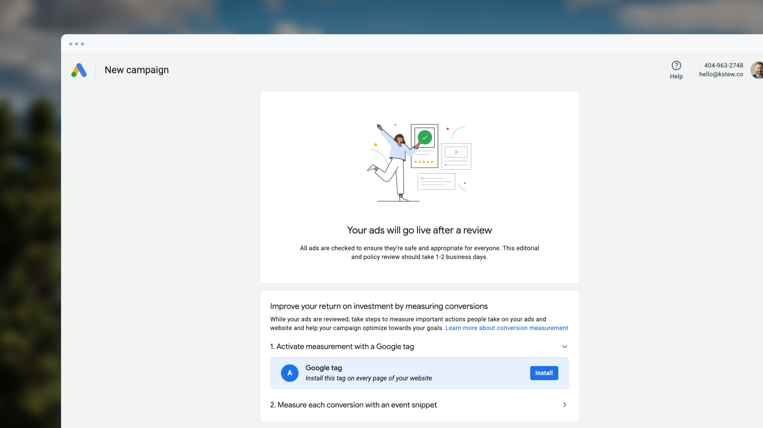
01 · MEASUREMENT SETUP
Problem
Conversion measurement is essential to campaign performance—but setup was buried, jargon-heavy, and easy for first-time advertisers to skip.
Most people skipped it. Campaigns underperformed. Frustration with Google Ads grew.
Why it mattered: without correct measurement, advertisers couldn’t optimize spend, and Google Ads looked broken for the people who needed it most.
01 · Measurement setup
kstew.co

Slide 7
01 · MEASUREMENT SETUP
Process & methods — what each step revealed
Design principles guided every pass: simplify with progressive disclosure, do the work for them, assume they’re new.
Content hierarchy exploration → denser first pass taught us what could leave the page until needed.
Research discussions on celebratory “congrats” copy → revealed false launch impressions; forced a full rethink.
CTA research + pattern audits → “Set up” / action-oriented language kept people moving; jargon stalled them.
Why + what for tags/snippets → advertisers needed purpose, not implementation detail, to act.
Biggest lesson: listing methods isn’t enough—each method changed a specific decision.
01 · Measurement setup
kstew.co

Slide 8
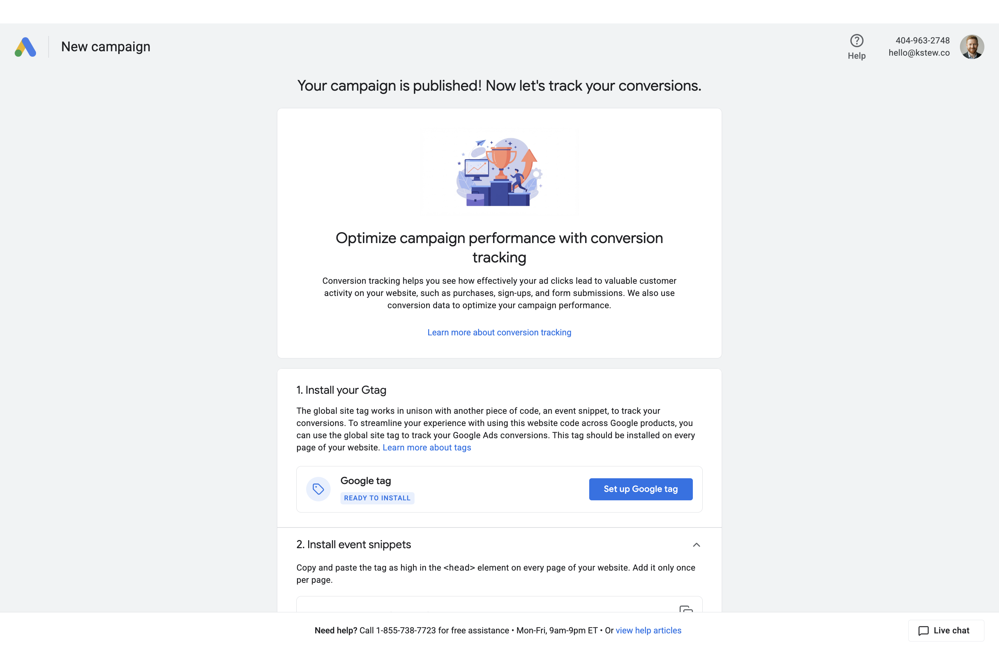
01 · MEASUREMENT SETUP
Exploration: denser first hierarchy
First pass put everything on the page; later cuts revealed detail only when needed.
01 · Measurement setup
kstew.co

Slide 9
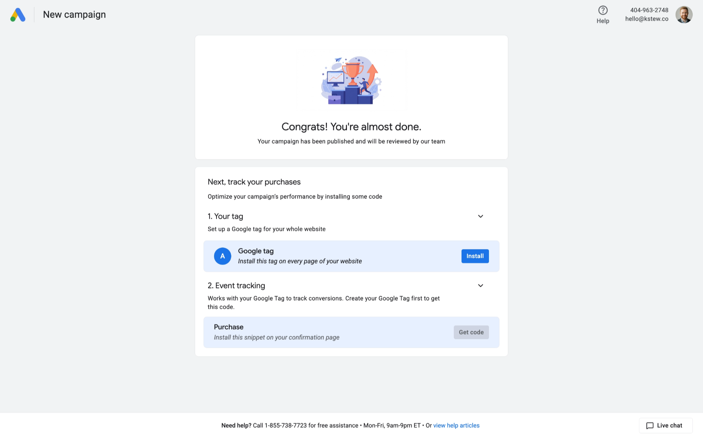
01 · MEASUREMENT SETUP
Celebratory messaging that misled
Research: “congrats” framing implied the campaign had already launched.
01 · Measurement setup
kstew.co

Slide 10
01 · MEASUREMENT SETUP
Key decision: headline & expectation setting
Copy | Status | Why
Congrats! You’re almost done… | Rejected | Vague timeline; mixed congrats vs. “almost done.”
Your campaign is published! Now let’s track… | Rejected | Unclear review process; confused next steps.
Your ads will go live after a review… (1–2 business days) | Final | Clear expectations, transparent process, specific timeline.
01 · Measurement setup
kstew.co

Slide 11
01 · MEASUREMENT SETUP
Key decisions & trade-offs
Decision 01
Decision 02
Decision 03
Cut celebration, add clarity
Action CTAs over tech labels
Explain why, then what
Dropped momentum-building congrats copy after research showed it felt like launch was done.
Chose “Set up” / purpose-led CTAs over “Get event snippet”-style jargon where research allowed.
Tag/snippet copy led with business purpose and sequence (tag before snippets), not code architecture.
Trade-off: Less emotional lift up front for more accurate mental model of the journey.
Trade-off: Slightly less precise for power users; much clearer for first-timers.
Trade-off: Less technical completeness on-page; more completion.
01 · Measurement setup
kstew.co

Slide 12
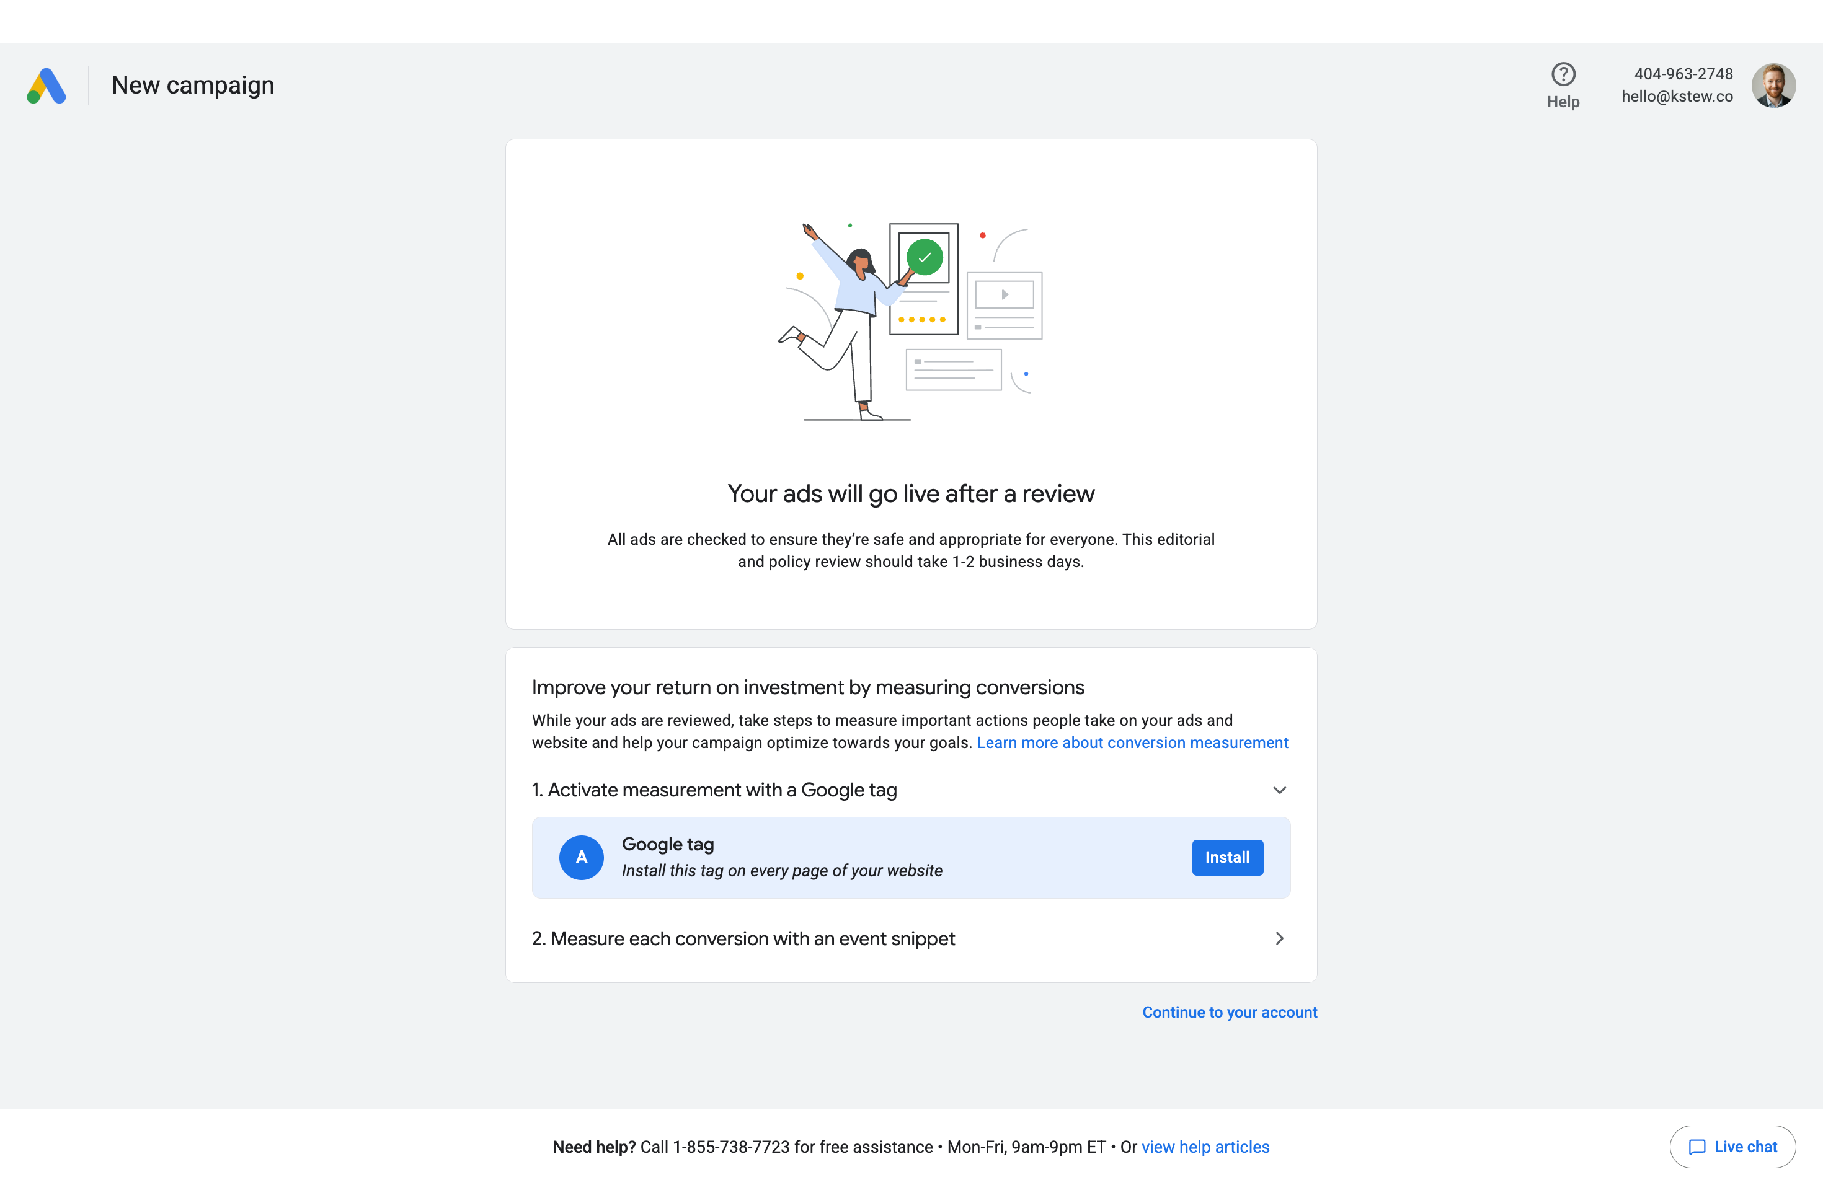
01 · MEASUREMENT SETUP
Solution: clear path through measurement
Final language guides advertisers through setup in plain terms.
01 · Measurement setup
kstew.co

Slide 13
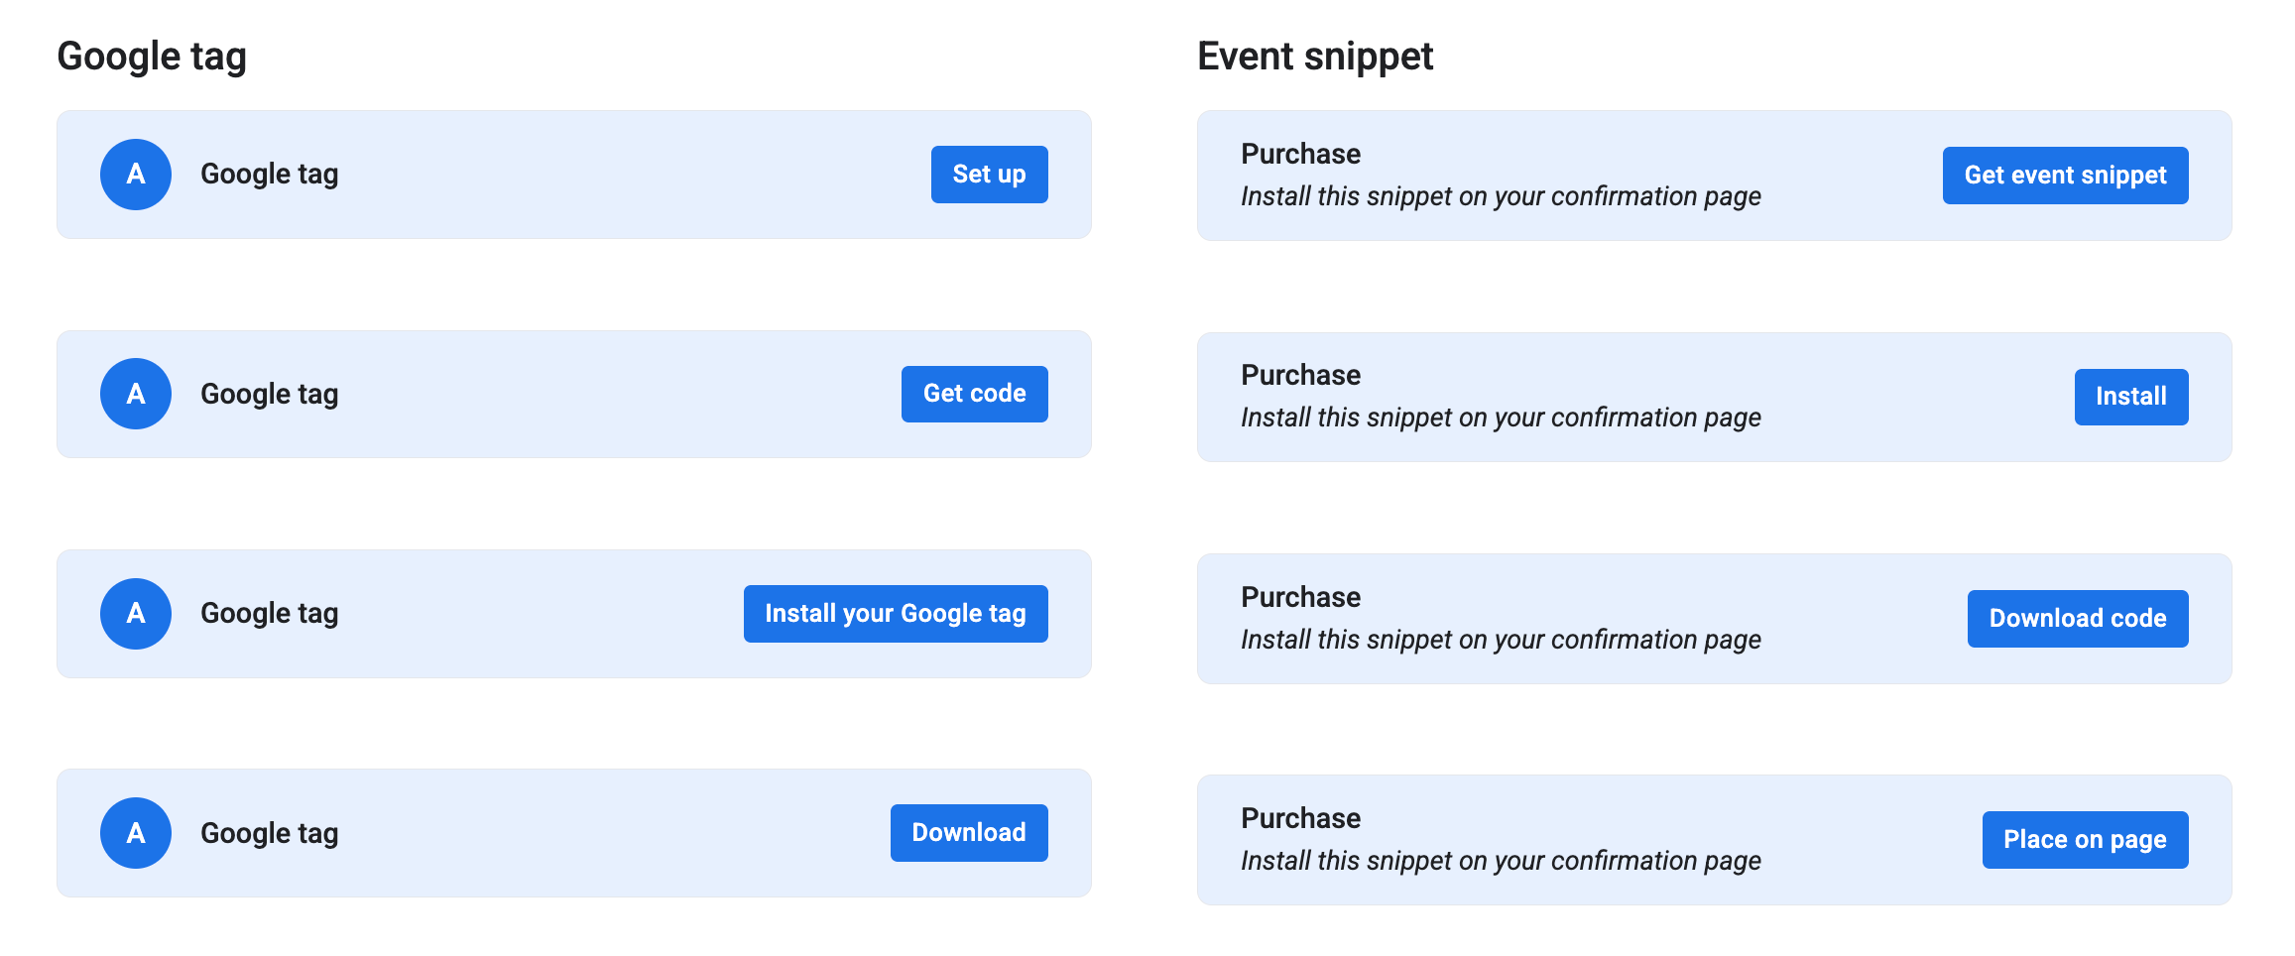
01 · MEASUREMENT SETUP
Solution: CTA & pattern alignment
Explorations revealed inconsistent patterns for Google tags and event snippets.
01 · Measurement setup
kstew.co

Slide 14
01 · MEASUREMENT SETUP
Results & impact
About 25% more people finished measurement setup—and did it correctly.
The useful pressure test that stuck: would this help someone who’s never done this before? That question usually settled what stayed on the page and what got cut.
I also secured stakeholder buy-in so measurement language stayed consistent across three other product areas.
01 · Measurement setup
kstew.co

Slide 15
CASE STUDY 02 · GOOGLE ADS
Turning a migration chore into a clear yes
From flipping each setting to review and approve
Senior Content Designer · UX, PM, Eng, Program Management

Slide 16
02 · CONVERSION GOAL UPDATES
Context
Product: Google Ads conversion goal migration from Universal Analytics to Google Analytics 4.
Company & team: Google Ads cross-functional pod (UX, PM, Eng, PMs, help content).
My role: Senior Content Designer leading content for the flow, notifications, CTAs, and review language—including the shift from manual updates to automated recommendations.
02 · Conversion goal updates
kstew.co

Slide 17
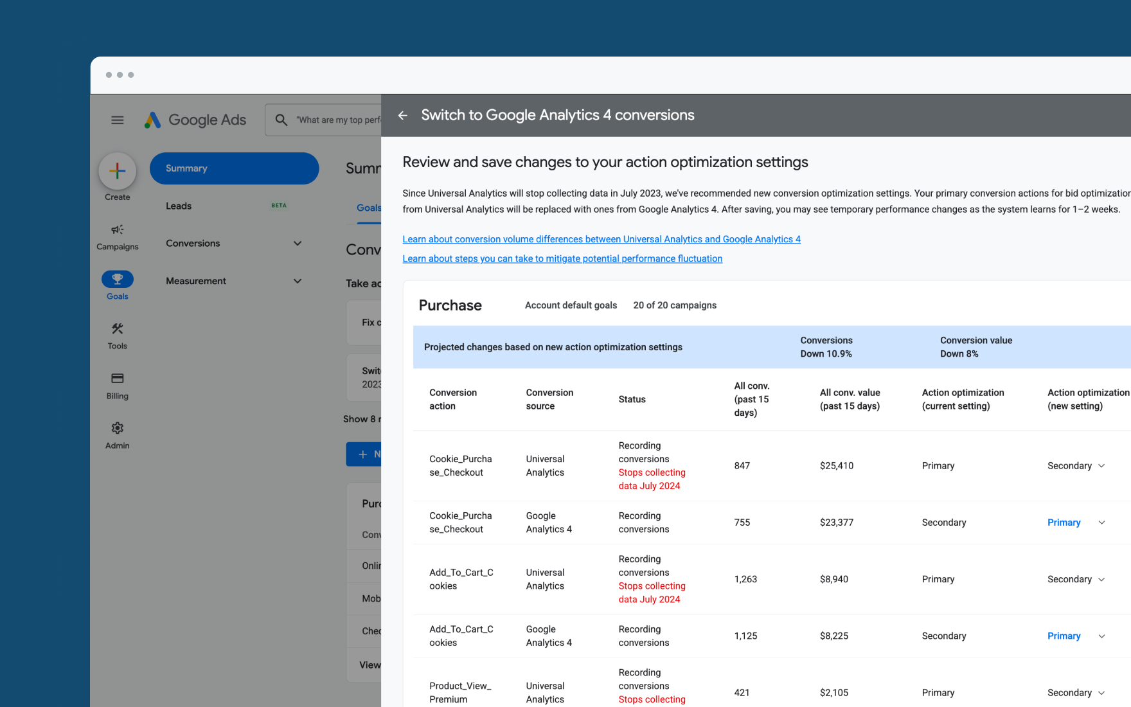
02 · CONVERSION GOAL UPDATES
Problem
Advertisers had to switch conversion goals to a new analytics platform. Those goals tell automated bidding what to optimize for—so they shape how campaigns spend money.
Duplicates and delayed switches meant inaccurate bidding, wasted spend, and not enough historical data before UA shut down.
For large accounts, those errors added up fast. The product needed honesty about trade-offs and a path people would actually finish.
02 · Conversion goal updates
kstew.co

Slide 18
02 · CONVERSION GOAL UPDATES
Process & methods — what each step revealed
Partner mock audit → headlines were technical, non-actionable, jargon-heavy.
Past research + research partners → advertisers thought in “switch,” not “update goals from UA to GA4.”
Usability on row-by-row Primary/Secondary → clearer CTAs still caused stalling; choice ≠ confidence.
Eng feasibility check → recommendations + impact could be calculated before commit.
Help-content partnership → tooltips and consolidated help closed remaining gaps without flooding the UI.
Principles: be upfront about change, automate where possible, be honest about short-term pain vs. long-term benefit.
02 · Conversion goal updates
kstew.co

Slide 19
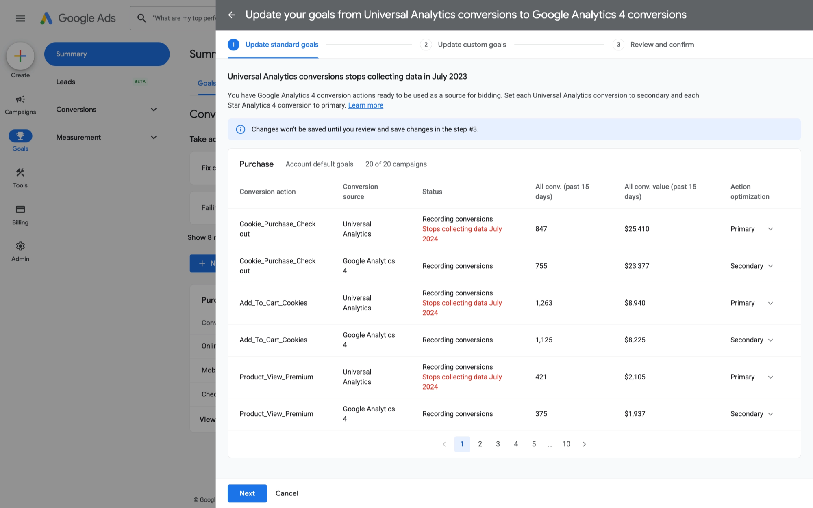
02 · CONVERSION GOAL UPDATES
Early hierarchy: partner content (iteration 1)
Technically correct, but too complicated for a headline.
02 · Conversion goal updates
kstew.co

Slide 20
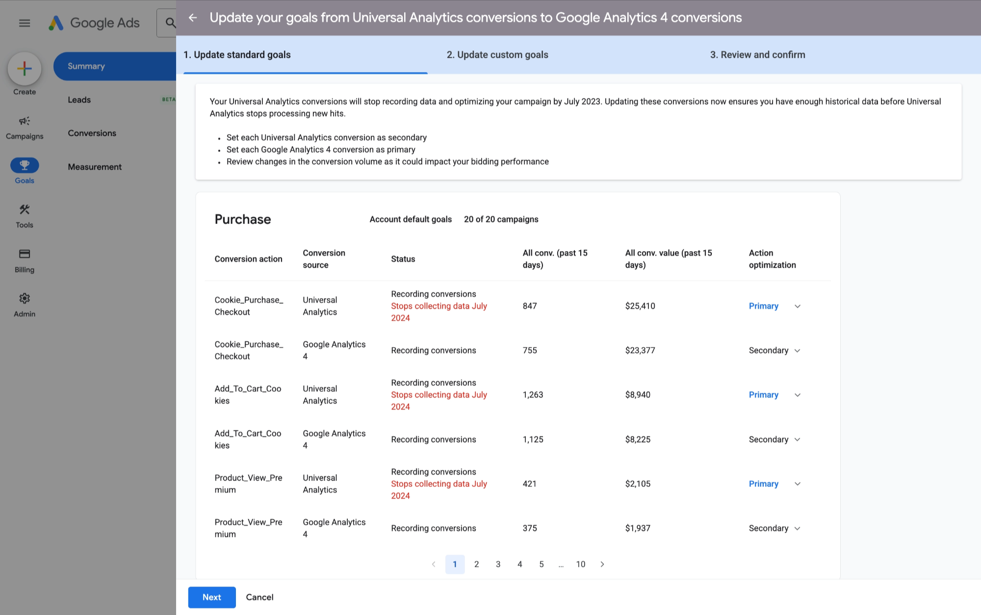
02 · CONVERSION GOAL UPDATES
Reframe: exact tasks, clearer action
Second iteration outlined the tasks advertisers needed to complete.
02 · Conversion goal updates
kstew.co

Slide 21
02 · CONVERSION GOAL UPDATES
Key decision: headline language
Copy | Status | Why
Update your goals from Universal Analytics conversions to Google Analytics 4 conversions | Rejected | Too much jargon; assumed goals↔conversions knowledge.
Change your Universal Analytics conversions to Google Analytics 4 conversions | Rejected | Redundant; unclear what type of change.
Switch to Google Analytics 4 conversions | Final | Simple action matching advertisers’ mental model.
02 · Conversion goal updates
kstew.co

Slide 22
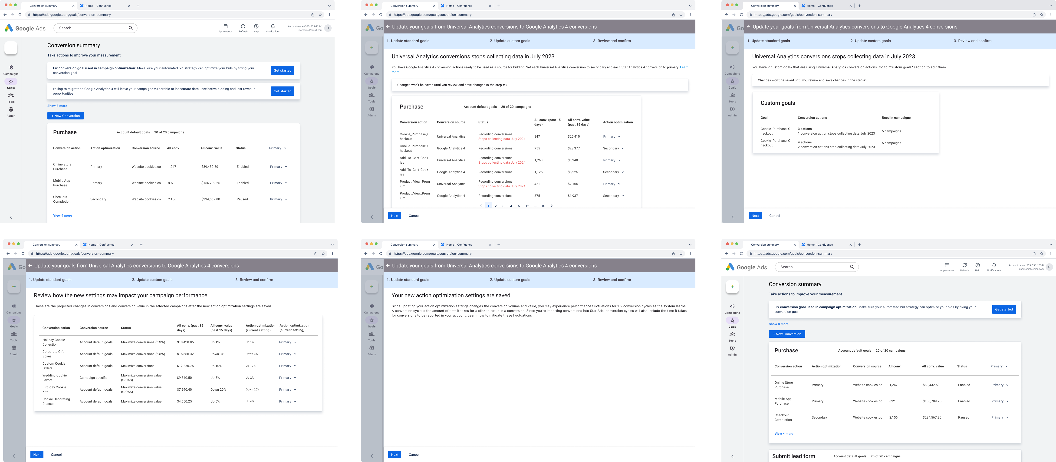
02 · CONVERSION GOAL UPDATES
Process artifact: six-screen manual flow
Early complete user flow before automation—too much work at the moment of change.
02 · Conversion goal updates
kstew.co

Slide 23
02 · CONVERSION GOAL UPDATES
Key decisions & trade-offs
Decision 01
Decision 02
Decision 03
“Switch,” not migration jargon
Stop row-by-row decisions
Show impact before approve
Reframed the job in advertiser language after research, then tested for hesitation.
Moved from dropdowns → labeled actions → automated primary/secondary recommendations with review.
Partnered with eng to surface performance impact on the review step instead of after the fact.
Trade-off: Less platform-precision in the headline for faster comprehension.
Trade-off: Less advertiser control per row; more confidence and completion.
Trade-off: More engineering scope; far less blind commitment.
02 · Conversion goal updates
kstew.co

Slide 24
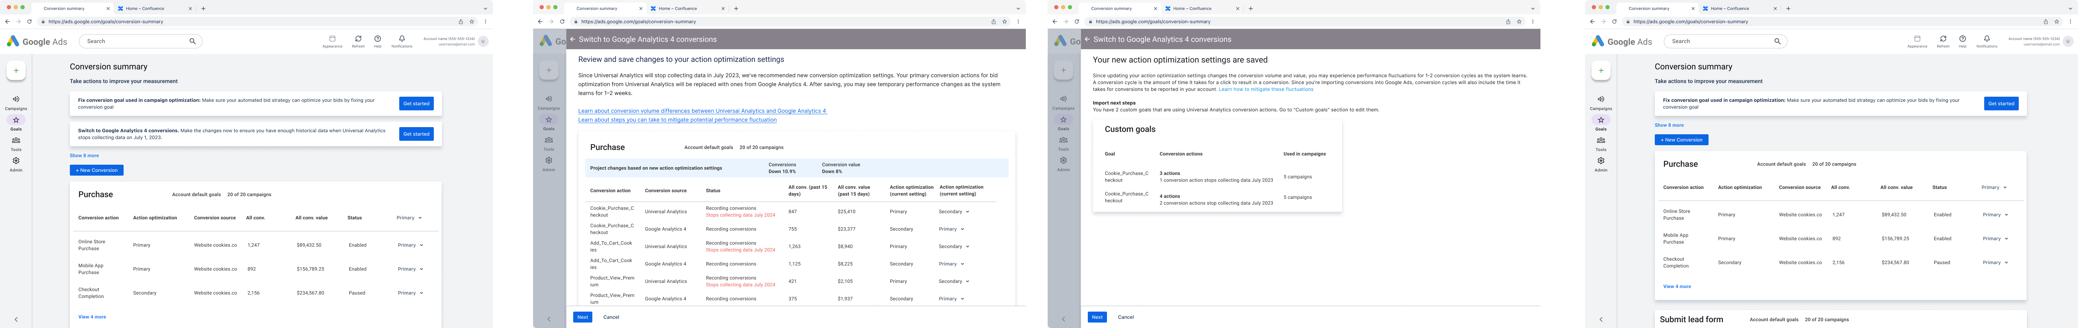
02 · CONVERSION GOAL UPDATES
Solution: review & approve recommendation
Final flow: three screens. See what changes, then save.
02 · Conversion goal updates
kstew.co

Slide 25
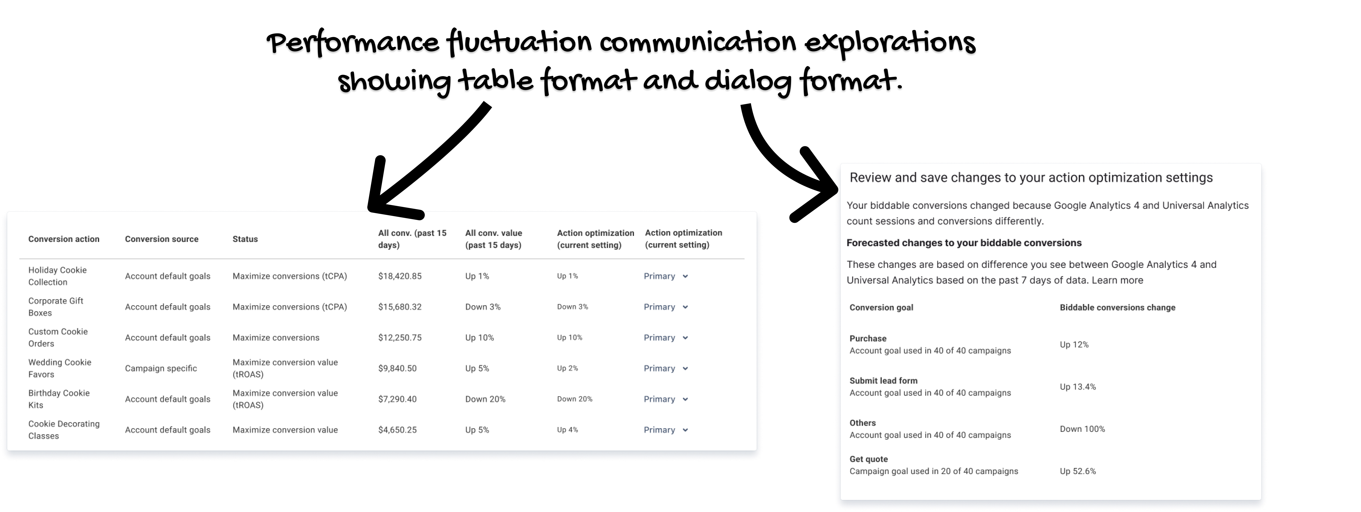
02 · CONVERSION GOAL UPDATES
Solution: performance impact on review
02 · Conversion goal updates
kstew.co

Slide 26
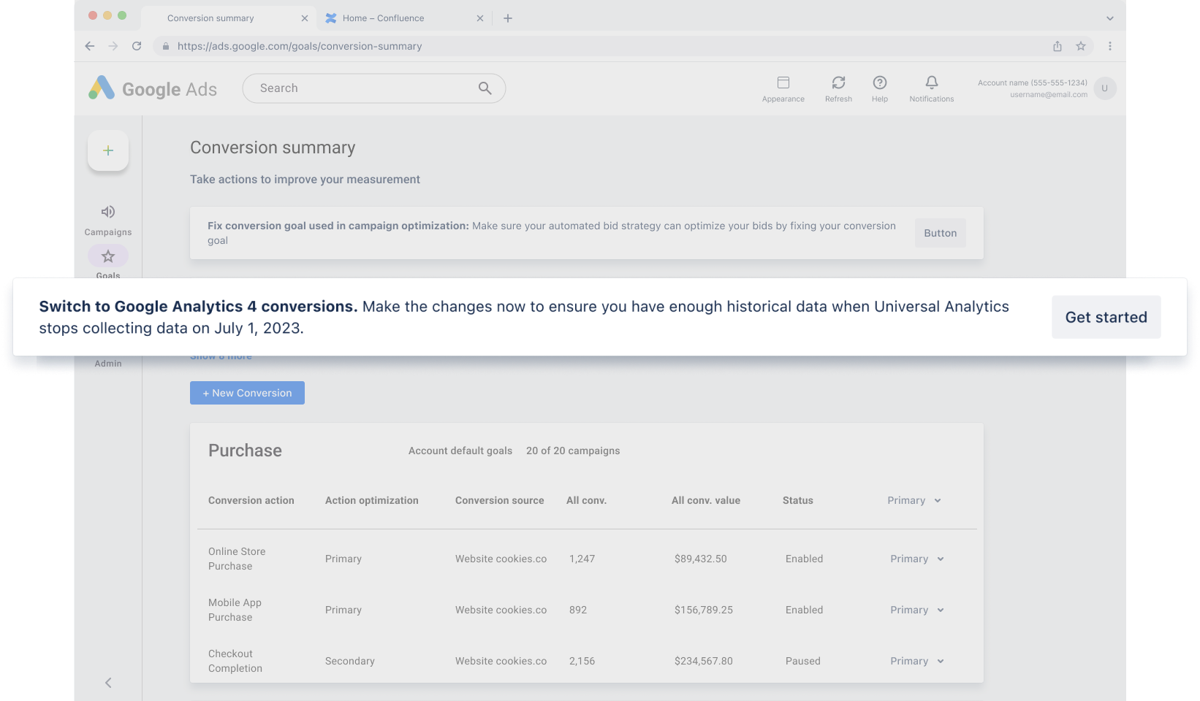
02 · CONVERSION GOAL UPDATES
Solution: notification that drives action
02 · Conversion goal updates
kstew.co

Slide 27
02 · CONVERSION GOAL UPDATES
Notification copy decisions
Copy | Status | Why
Failing to migrate… vulnerable… lost revenue… | Rejected | Fear-based; anxiety over motivation.
Migrating ensures campaigns remain functional… | Rejected | Vague urgency; no timeline or next step.
Switch to GA4… now… enough historical data… July 1, 2023. | Final | Clear CTA, concrete date, proactive benefit.
02 · Conversion goal updates
kstew.co

Slide 28
02 · CONVERSION GOAL UPDATES
Results & impact
We cut the flow from six screens of manual updates to a shorter path: review the recommendation, then approve.
Advertisers could see what would change before they committed—instead of flipping each setting themselves.
Content didn’t just label the chore. It reframed the job from “change every conversion” to “does this look right?”
02 · Conversion goal updates
kstew.co

Slide 29
CASE STUDY 03 · GOOGLE ADS
A metric name that works for statisticians and everyone else
90% got the name, no help needed
Senior Content Designer · UX, PM, Eng, Research, Data Science

Slide 30
03 · CERTAINTY OF LIFT
Context
Product: Brand lift results in Google Ads—specifically naming and explaining a confidence/certainty metric.
Company & team: Google Ads with UX, PM, Eng, program managers, UX research, and data science stakeholders.
My role: Senior Content Designer leading naming, evaluation framework, research partnership, and tooltip/guidance language so novices and experts could understand the concept from the product itself.
03 · Certainty of lift
kstew.co

Slide 31
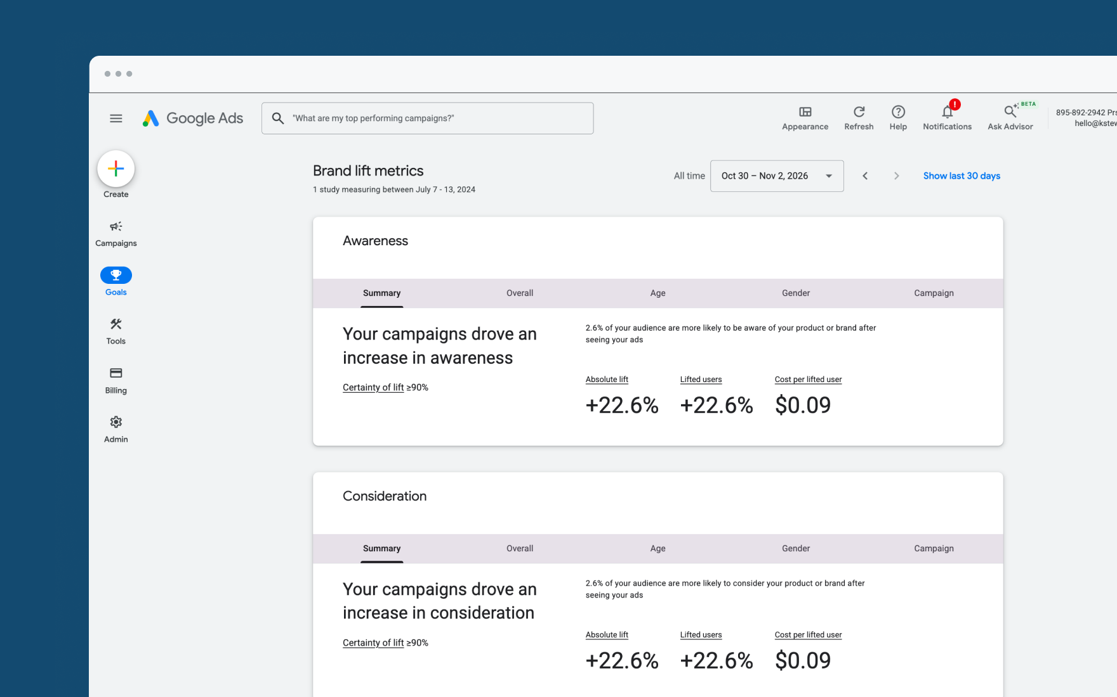
03 · CERTAINTY OF LIFT
Problem
Brand lift campaigns rarely hit classic statistical significance, so advertisers got vague insights like “Your campaign drove an increase in awareness.”
The team proposed lowering the threshold and showing confidence levels in-product—making more campaigns actionable, with honest reliability.
The naming problem: one term had to work for stats experts and stats novices without tooltips doing the real work.
03 · Certainty of lift
kstew.co

Slide 32
03 · CERTAINTY OF LIFT
Process & methods — what each step revealed
Dual-audience framing (stats expert vs. novice) → clarified competing success criteria.
Literature + brand/naming review → patterns, but no definitive name.
Evaluation matrix vs. guidelines & plain language → narrowed to two candidates; de-personalized debate.
Comparative UX research study → “Certainty of lift detection” beat “statistical significance,” even for experts in this context.
Pre-launch quantitative survey → de-risked comprehension before market release.
Tooltip iterations + stakeholder plain vs. technical versions → launched balanced plain language.
Principle: ground language in research, not convention—or internal preference.
03 · Certainty of lift
kstew.co

Slide 33
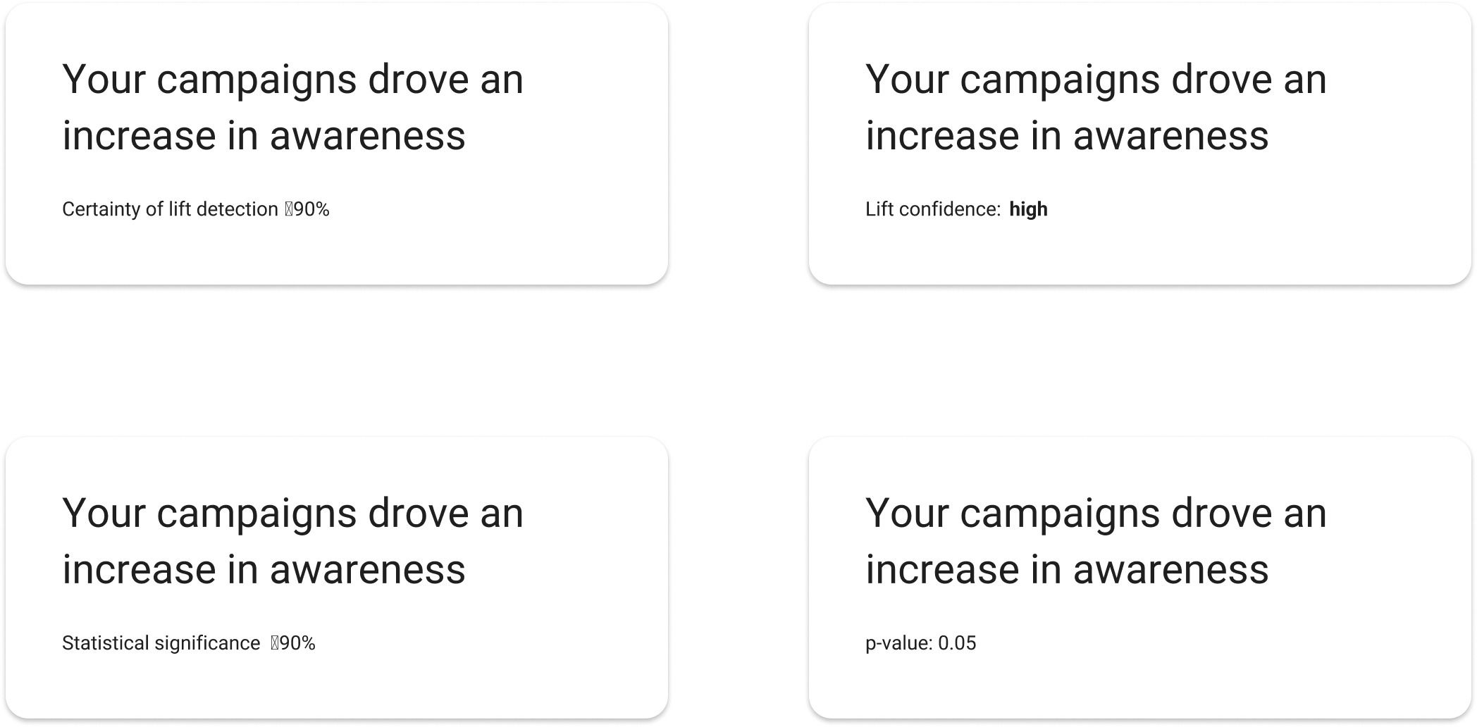
03 · CERTAINTY OF LIFT
Naming options on the table
03 · Certainty of lift
kstew.co

Slide 34
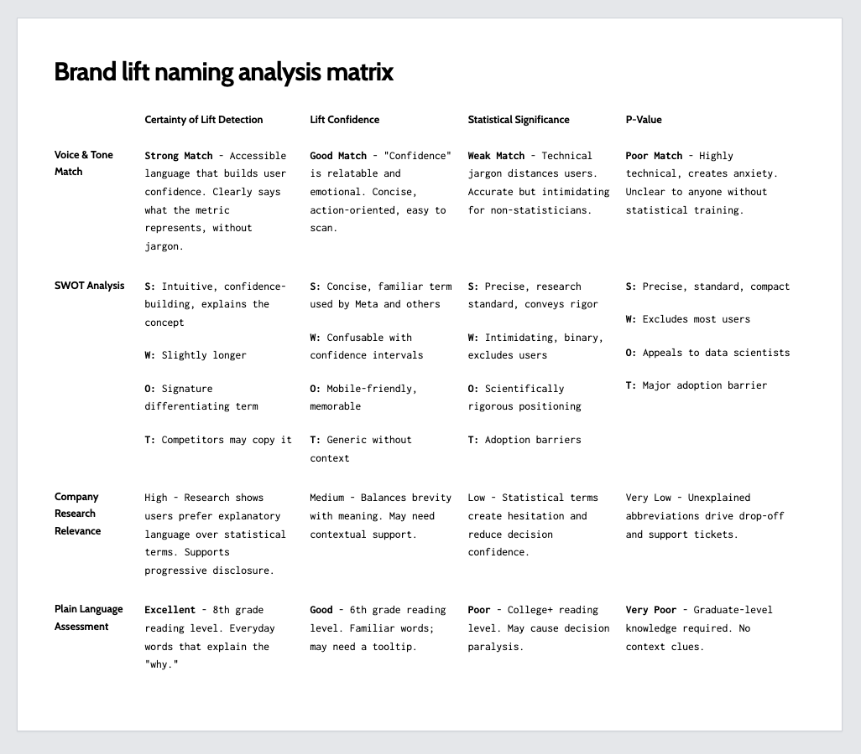
03 · CERTAINTY OF LIFT
Evaluation matrix: judgment with criteria
Structured scoring beat subjective stakeholder preference.
03 · Certainty of lift
kstew.co

Slide 35
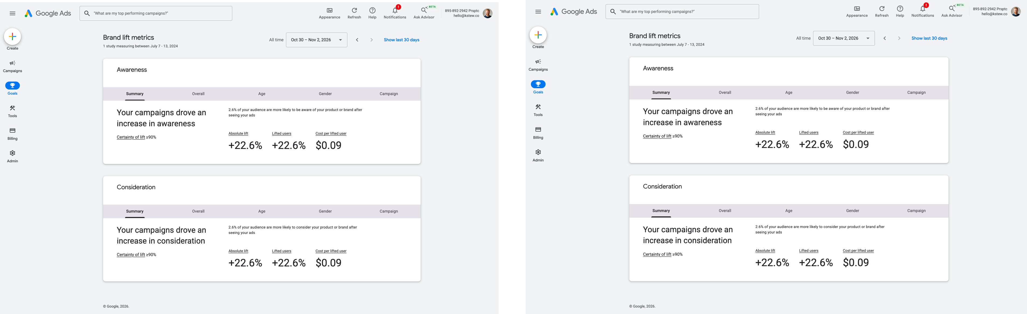
03 · CERTAINTY OF LIFT
Research design: two terminology groups
03 · Certainty of lift
kstew.co

Slide 36
03 · CERTAINTY OF LIFT
Key decisions & trade-offs
Decision 01
Decision 02
Decision 03
Framework before preference
Research over convention
Plain-language tooltip
Built a scoring matrix so “Certainty of lift” could compete fairly against data-science-favored terms.
Even stats-savvy users found “statistical significance” ambiguous here. We shipped “Certainty of lift.”
Showed stakeholders a plain vs. technical tooltip pair; launched the plain version once accuracy was proven.
Trade-off: Slower alignment early; stronger, defensible decision later.
Trade-off: Less familiar academic label; higher unaided comprehension.
Trade-off: Less formula detail in UI; more actionable interpretation.
03 · Certainty of lift
kstew.co

Slide 37
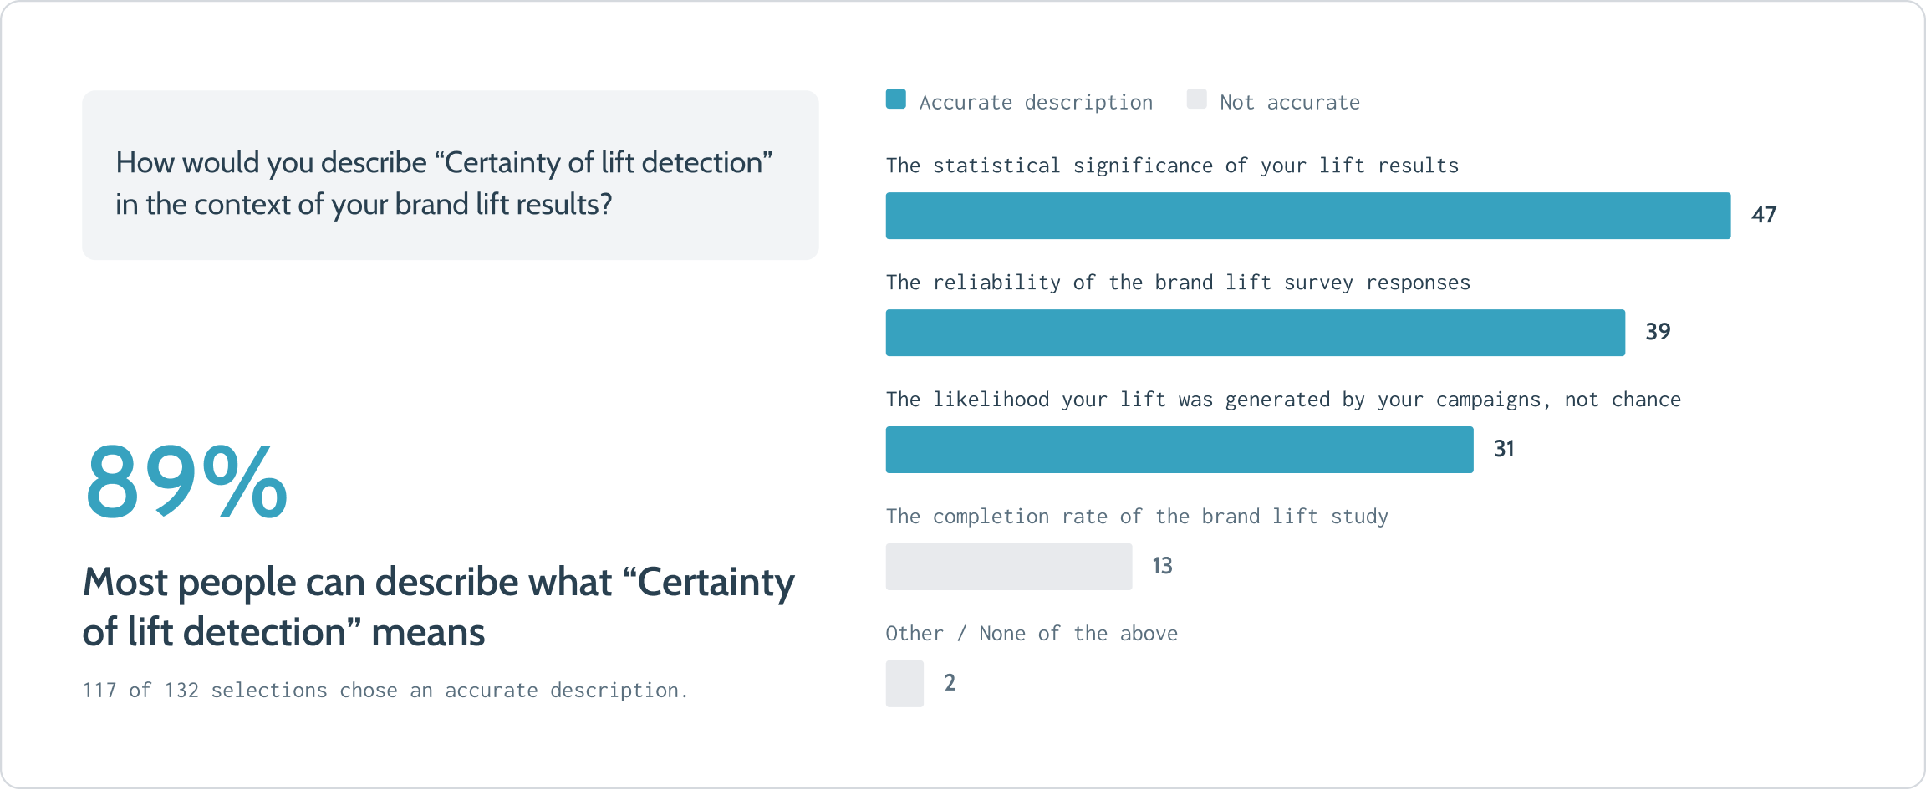
03 · CERTAINTY OF LIFT
Solution: survey confirmation
03 · Certainty of lift
kstew.co

Slide 38
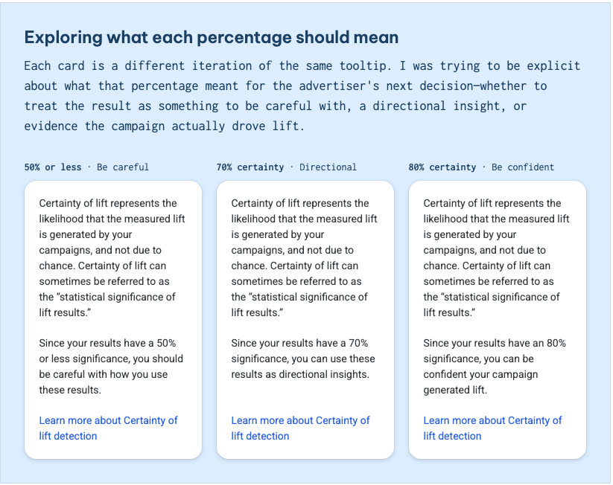
03 · CERTAINTY OF LIFT
Solution: tooltip iterations
03 · Certainty of lift
kstew.co

Slide 39
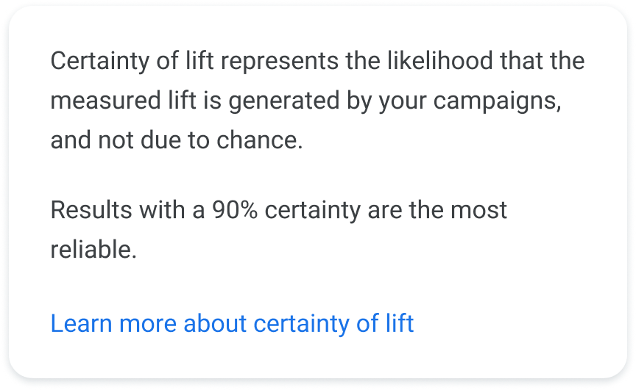
03 · CERTAINTY OF LIFT
Solution: launched plain-language tooltip
The plain language version—this is the one we launched with.
03 · Certainty of lift
kstew.co

Slide 40
03 · CERTAINTY OF LIFT
Results & impact
Over 50% found brand lift easier to use.
90% understood “Certainty of lift” from the name alone—no help needed.
Research beat internal preference: what felt “oversimplified” to stakeholders was what users could actually use.
03 · Certainty of lift
kstew.co

Slide 41
CASE STUDY 04 · INTUIT
Less reading, easier scheduling
Plain guidance so tax pros can set their own schedules
Content Designer · Virtual Expert Platform · UX, PM, Eng

Slide 42
04 · EXPERT SCHEDULING
Context
Product: TurboTax Live expert base-schedule tool on Intuit’s Virtual Expert Platform.
Company & team: Intuit. Partnered with UX designers, PMs, engineers, and program managers ahead of tax season.
My role: Content Designer leading a content redesign of self-service scheduling—audit, onboarding instructions, in-product guidance, and error messaging—so seasonal experts could set 12 weeks of availability with confidence.
04 · Expert scheduling
kstew.co

Slide 43
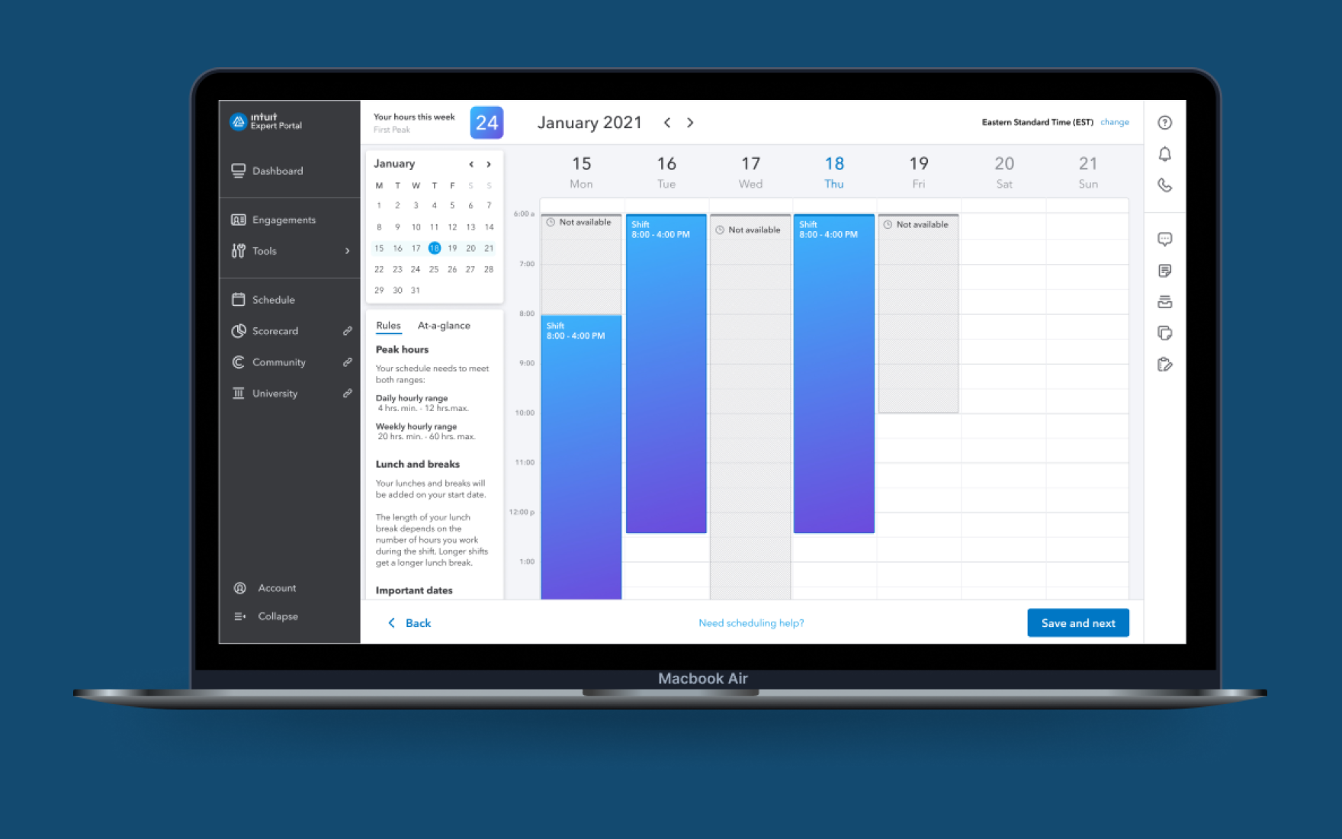
04 · EXPERT SCHEDULING
Problem
Every year Intuit onboards thousands of TurboTax Live experts. Before they help customers, they must set a base schedule staffing depends on.
A prior self-service tool was overwhelming: too much information, confusing instructions, experts stuck on a “simple” task.
With tax season approaching, the content needed to turn a frustrating hurdle into something that helped experts feel ready for the role.
04 · Expert scheduling
kstew.co

Slide 44
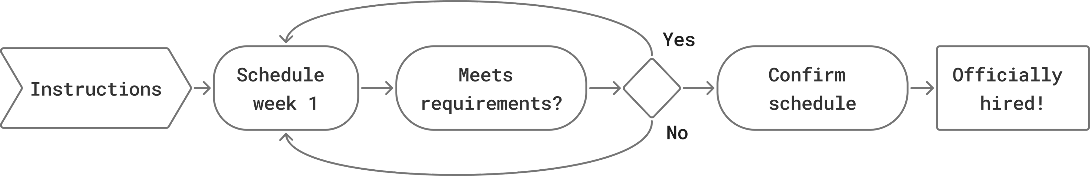
04 · EXPERT SCHEDULING
Expert journey: 12 weeks of availability
04 · Expert scheduling
kstew.co

Slide 45
04 · EXPERT SCHEDULING
Process & methods — what each step revealed
End-to-end content audit (screenshots, strings, designs, data) → wall-of-text onboarding and unhelpful errors across the journey.
Team review of audit deck → aligned on where content should work harder before UI polish.
Usability on chunked onboarding → easier to scan than original, still too much retained at once.
Stakeholder cuts + progressive disclosure → keep only essentials on first screen; move detail to moment of need.
Error inventory with eng/PM → many errors preventable with better upfront guidance; remaining errors needed directive fixes.
Principles: information exactly when needed, celebrate progress, break intimidating tasks into smaller pieces.
04 · Expert scheduling
kstew.co

Slide 46
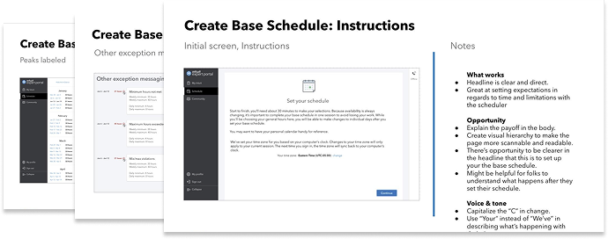
04 · EXPERT SCHEDULING
Audit artifact: base-schedule workflow
04 · Expert scheduling
kstew.co

Slide 47
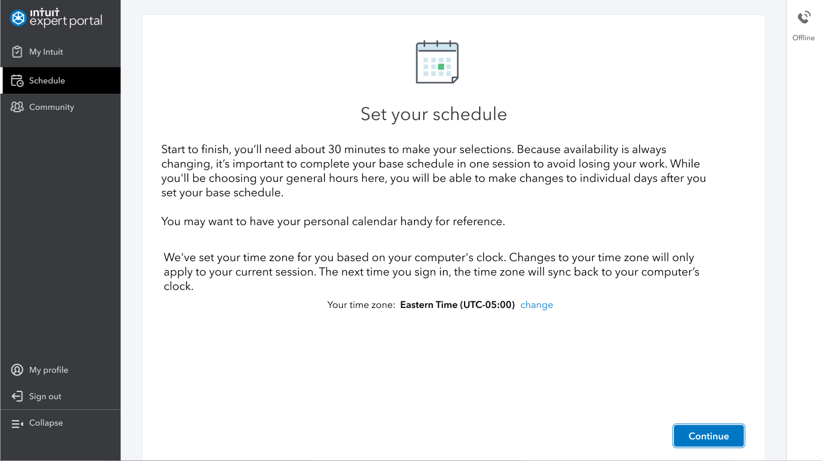
04 · EXPERT SCHEDULING
Before: onboarding wall of text
Experts were expected to read and retain everything while creating a schedule.
04 · Expert scheduling
kstew.co

Slide 48
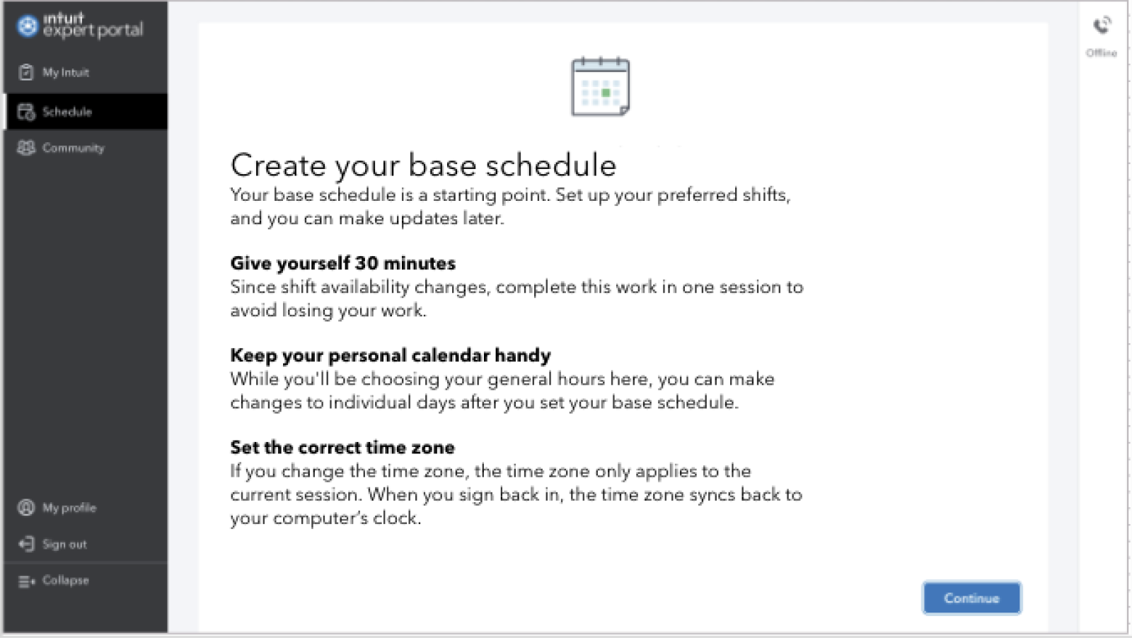
04 · EXPERT SCHEDULING
Iteration: chunked, still heavy
Clearer headings helped scanning—but volume was still too high.
04 · Expert scheduling
kstew.co

Slide 49
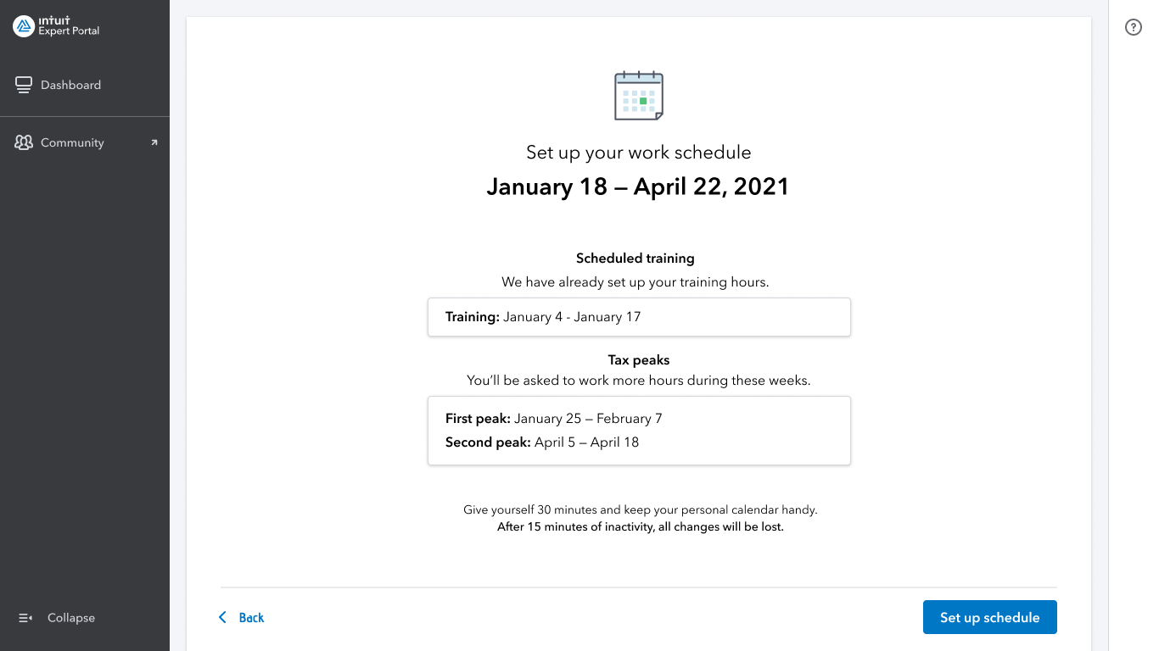
04 · EXPERT SCHEDULING
Refined: only what’s needed to start
04 · Expert scheduling
kstew.co

Slide 50
04 · EXPERT SCHEDULING
Key decisions & trade-offs
Decision 01
Decision 02
Decision 03
Cut the upfront wall
Errors that teach the fix
Human constraints in the system
Moved rules off the first screen into the scheduling UI at the moment experts needed them.
Rewrote errors to start with the action, after mapping every failure mode with engineering.
Launched messaging that acknowledged skipped weeks (life happens) while meeting staffing needs.
Trade-off: Less “complete” orientation doc; higher completion and less overwhelm.
Trade-off: Longer strings in places; far more recoverable states.
Trade-off: Softer enforcement tone; more realistic expert behavior.
04 · Expert scheduling
kstew.co

Slide 51
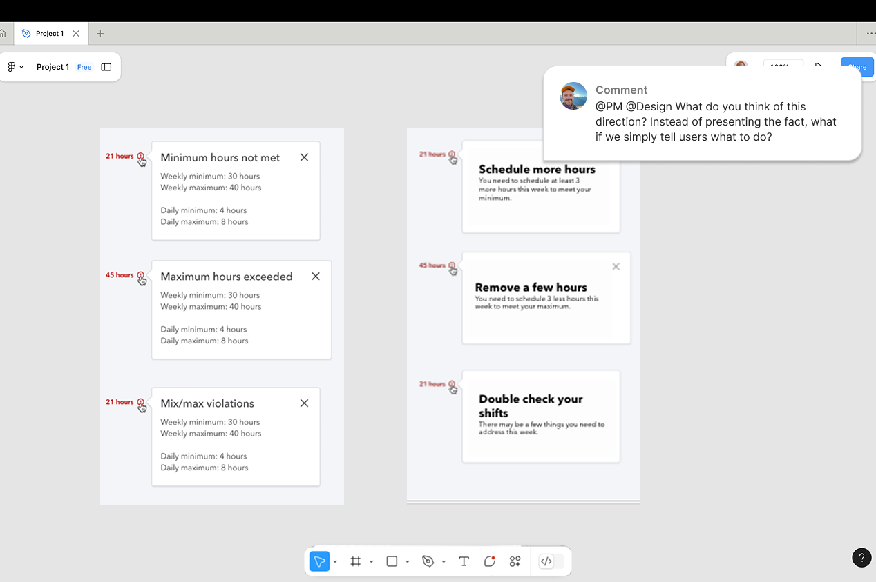
04 · EXPERT SCHEDULING
Solution: error messaging before → after
04 · Expert scheduling
kstew.co

Slide 52
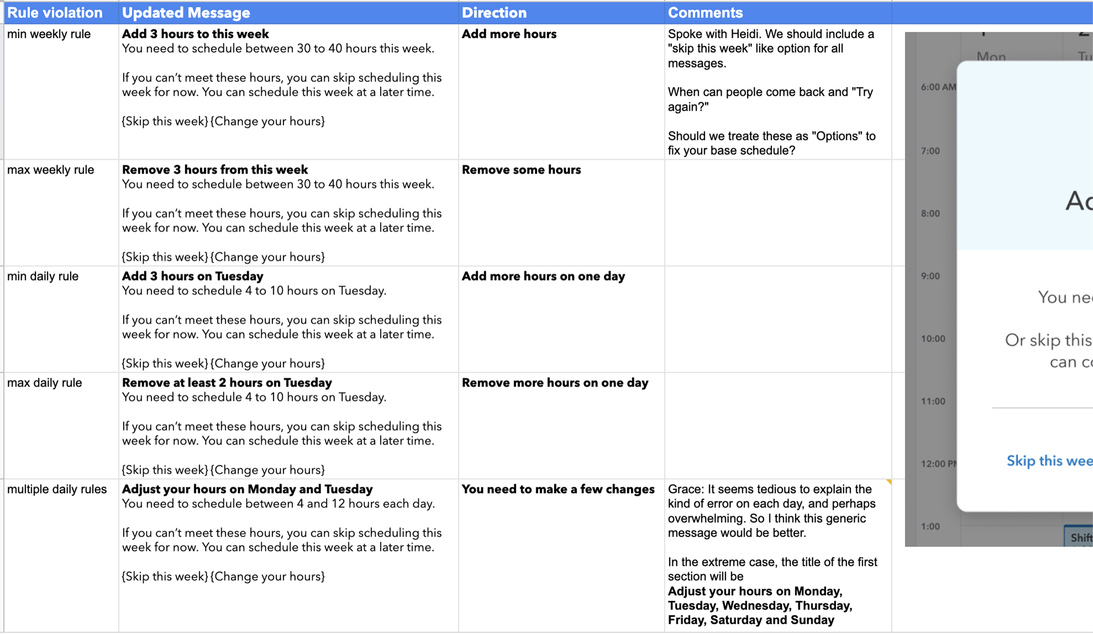
04 · EXPERT SCHEDULING
Solution: error inventory spreadsheet
04 · Expert scheduling
kstew.co

Slide 53
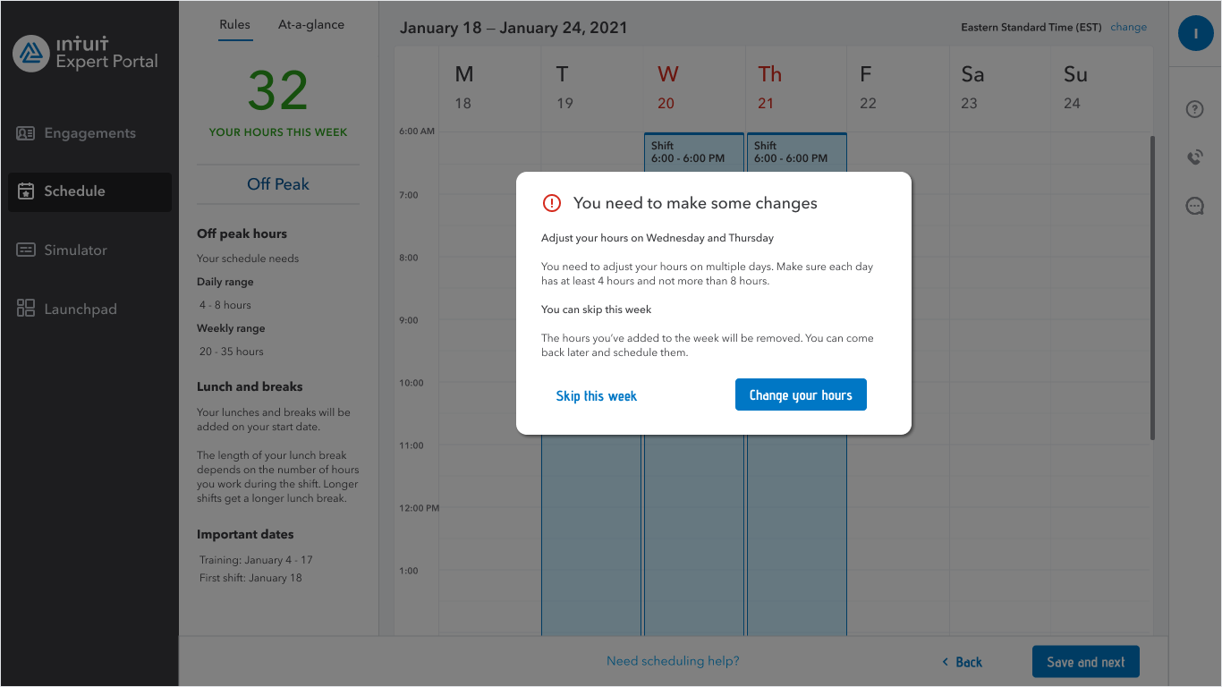
04 · EXPERT SCHEDULING
Solution: launched directive error
Accounts for unseen use cases while guiding schedule approval.
04 · Expert scheduling
kstew.co

Slide 54
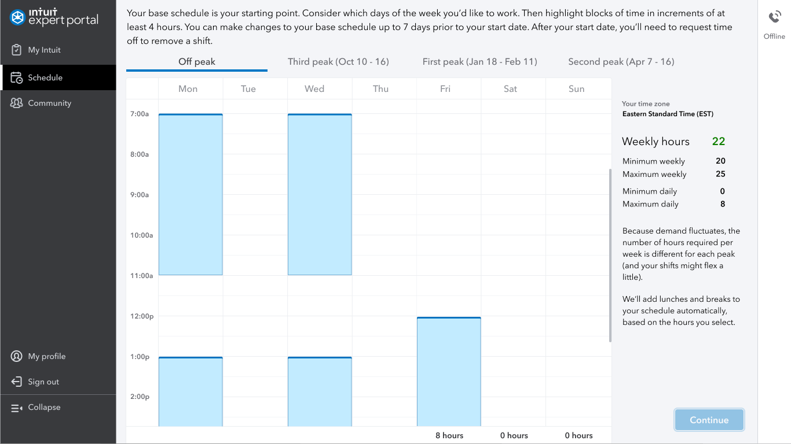
04 · EXPERT SCHEDULING
Solution: scheduling UI — original
04 · Expert scheduling
kstew.co

Slide 55
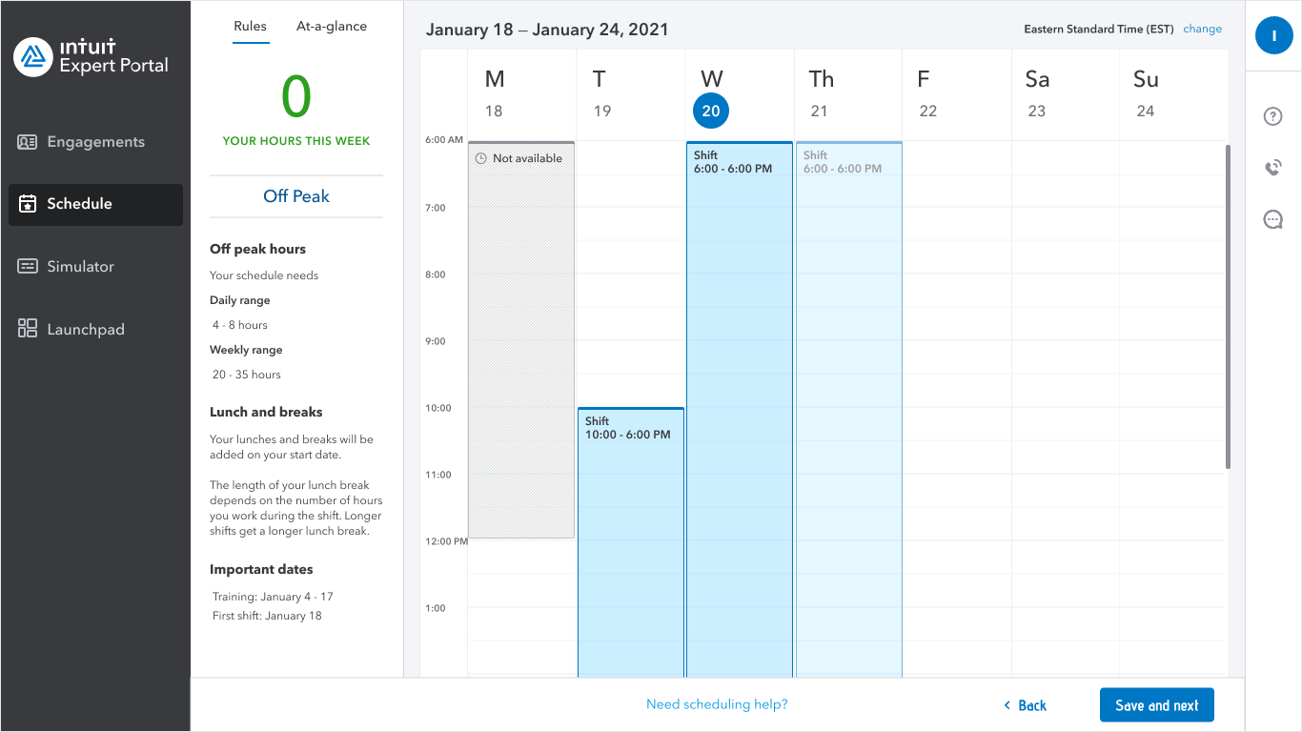
04 · EXPERT SCHEDULING
Solution: guidance moved into the task
Requirements content moved from instructions to the scheduling interface.
04 · Expert scheduling
kstew.co

Slide 56
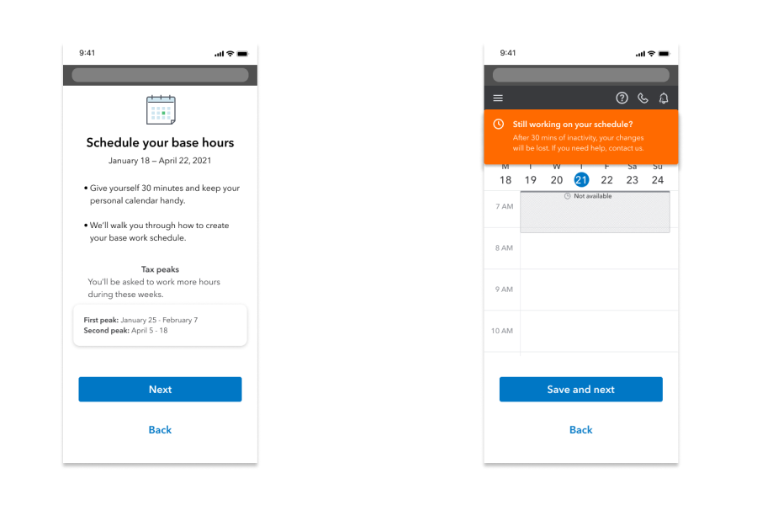
04 · EXPERT SCHEDULING
Future-state concept
Post-launch exploration: tighter headline, clearer hierarchy, help on demand.
04 · Expert scheduling
kstew.co

Slide 57
04 · EXPERT SCHEDULING
Results & impact
Hard to isolate content from the broader redesign—but experts got a clearer experience: guidance that told them what to do, information in smaller pieces, and errors that explained how to fix the problem.
By replacing an upfront wall of instructions with focused guidance at the moment it mattered, we made scheduling easier—and helped experts feel more confident starting their new role.
04 · Expert scheduling
kstew.co

Slide 58
WRAP-UP
What I want you to remember
Judgment over decoration
Copy tables and naming matrices show how I decide—not just what shipped.
Methods tied to insight
Research, audits, and partner loops each changed a concrete product decision.
Outcomes that matter
+25% correct measurement setup · review-and-approve migrations · 90% name comprehension · clearer expert scheduling.
Wrap-up
kstew.co

Slide 59
Q&A
Thanks for your time. Happy to go deep on any project, artifact, or decision.
Kyle Stewart · Content Designer · hello@kstew.co · linkedin.com/in/kylestewart100 · kstew.co

