Slide 1
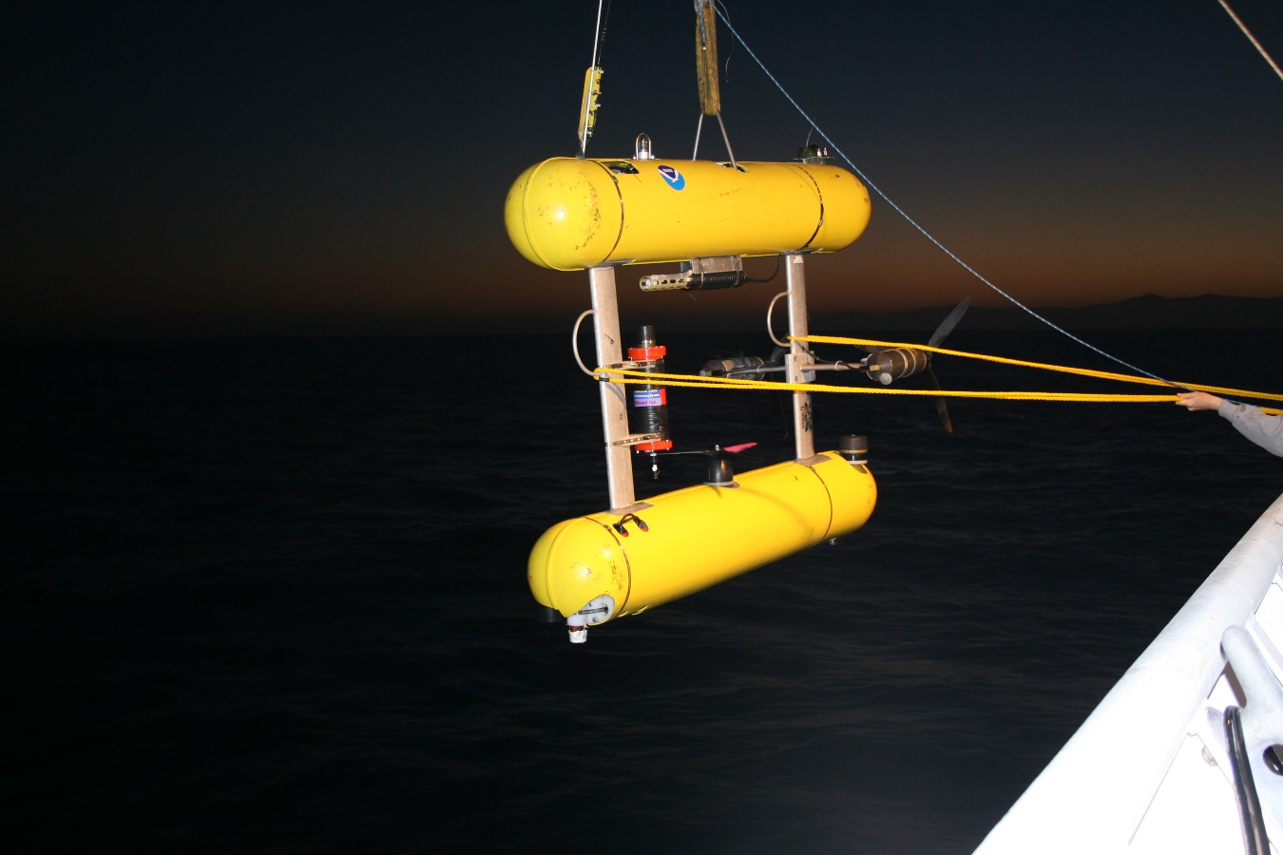
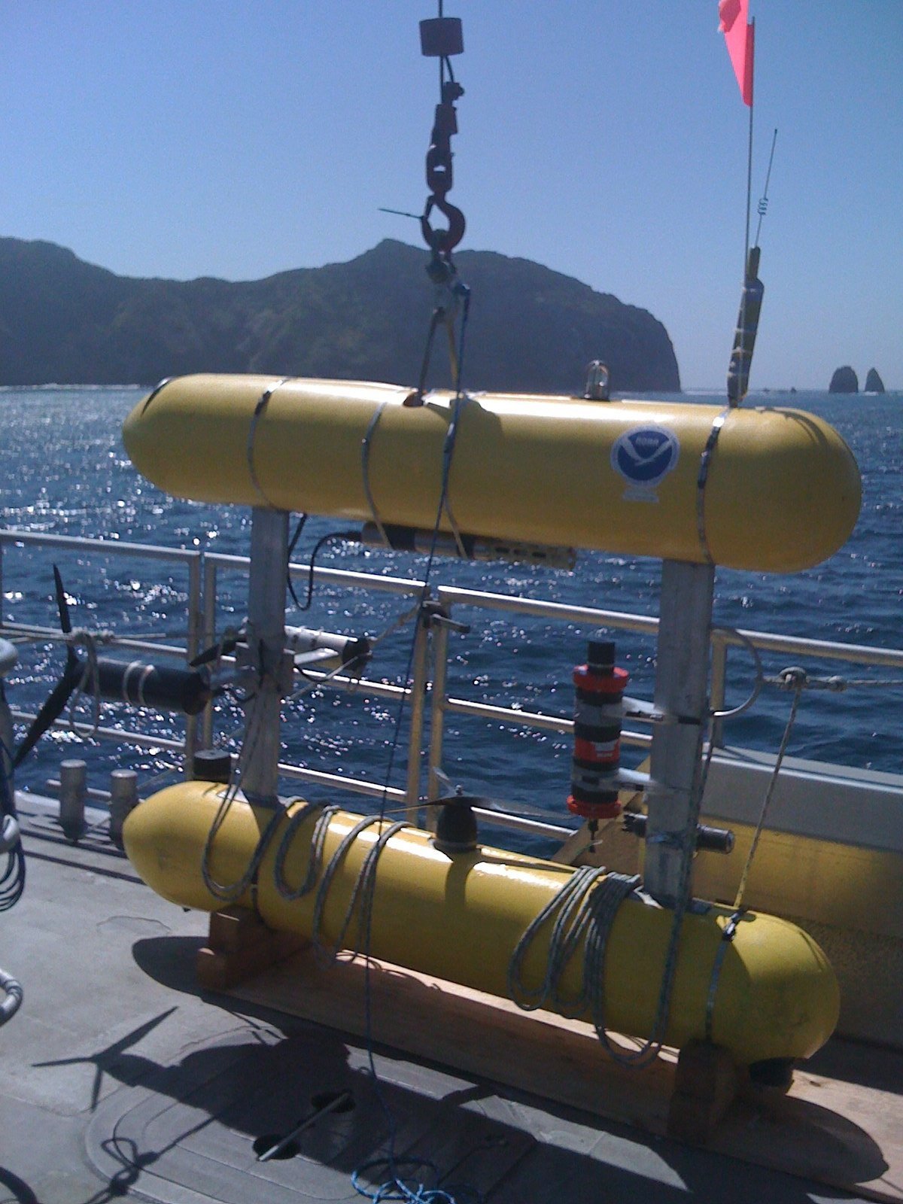
NWFSC PIFSC SeaBED AUV
2010
2016

Slide 2
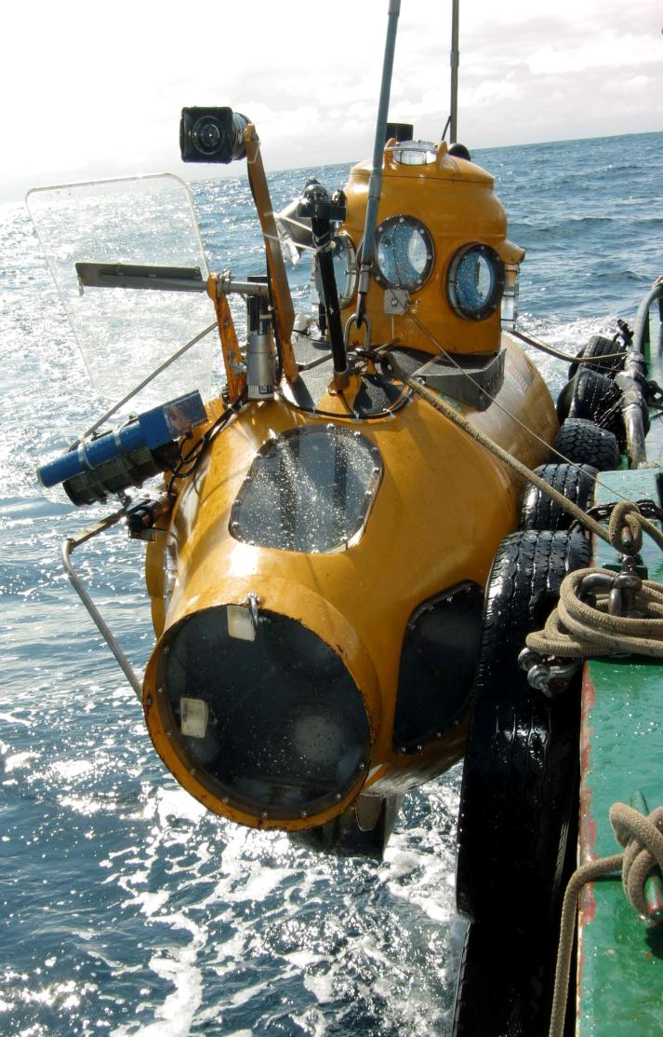
Delta Submersible
One scientific observer and
one pilot
Low-light B&W camera
Paired lasers
Survey color video camera
Observer’s viewing ports
150 watt lights
1 forward + 2 on starboard side
Notes:
The Delta is an occupied submersible that holds two people; one pilot and one observer. It is equipped with a forward-facing lowlight Black and white camera, A starboard side color video camera that is used for surveys. There is a pair of 20 cm lasers used to help in estimating fish sizes, and observer viewing ports. The sub uses 3- 150w lights during surveys; one forward and 2 starboard. It is equipped with a 24v propeller
MMY: what about thrusters?

