Slide 1
Databases Using R
Kevin Stierhoff

Slide 2
What is a Relational Database?
From Wikipedia: A relational database is a digital database based on the relational model of data, as proposed by E. F. Codd in 1970. A software system used to maintain relational databases is a relational database management system (RDBMS). Virtually all relational database systems use SQL (Structured Query Language) for querying and maintaining the database.

Slide 3
What is a Relational Database?
From Wikipedia: Relational model organizes data into one or more tables (or “relations”) of columns and rows, with a unique key identifying each row. Rows are called records; columns are called attributes. Generally, each table/relation represents one “entity type” (such as customer or product). The rows represent instances of that type of entity (such as “Lee” or “chair”) and the columns representing values attributed to that instance (such as address or price).

Slide 4
Relational Database Management Systems (RDMS)
MS Access
MS SQL Server
Oracle
SQLite
MySQL
PostgreSQL
Several others available at (http://db.rstudio.com/databases/).

Slide 5
Why put data in a database?
Avoid static, flat files with multiple copies/versions
Centralize data storage with access to many users simultaneously
Improve data quality (i.e., referential integrity)
Store large amounts of data
But how to you access it once it’s in there?!? 😮

Slide 6
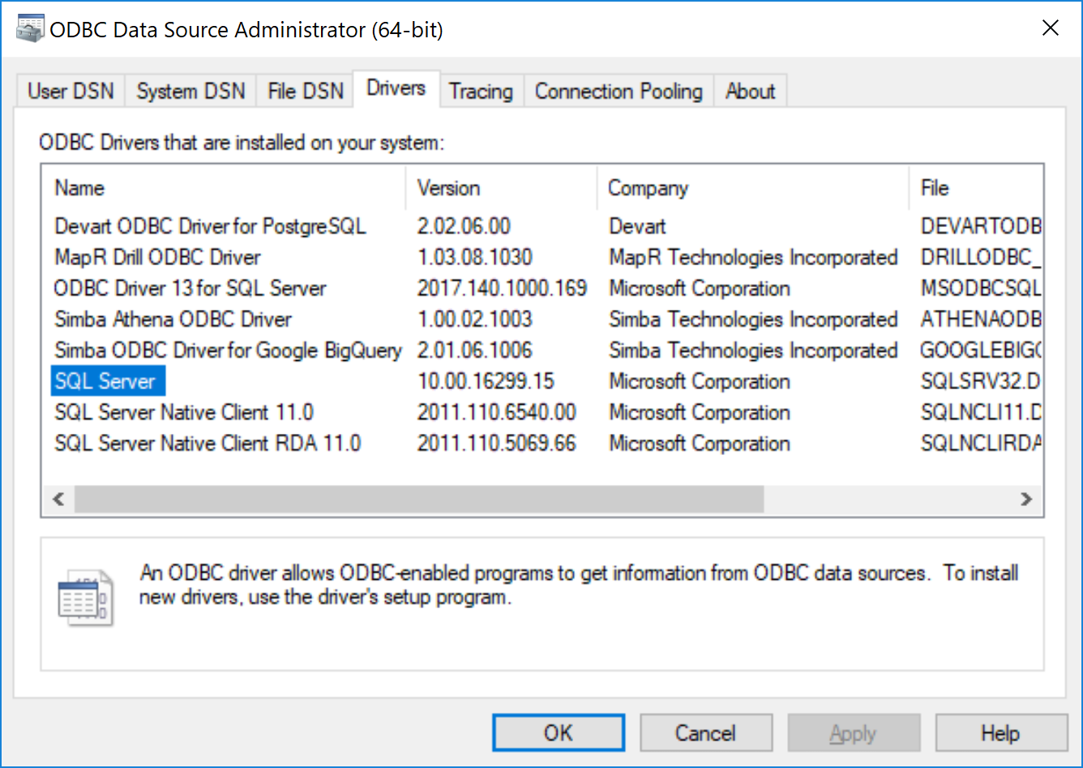
Open Database Connectivity (ODBC)

Slide 7
Open Database Connectivity (ODBC)
library(odbc) # Show installed ODBC drivers tibble(sort(unique(odbcListDrivers()[[1]])))
## # A tibble: 5 x 1 ## `sort(unique(odbcListDrivers()[[1]]))` ## <chr> ## 1 Microsoft Access dBASE Driver (*.dbf, *.ndx, *.mdx) ## 2 Microsoft Access Driver (*.mdb, *.accdb) ## 3 Microsoft Access Text Driver (*.txt, *.csv) ## 4 Microsoft Excel Driver (*.xls, *.xlsx, *.xlsm, *.xlsb) ## 5 SQL Server

Slide 8
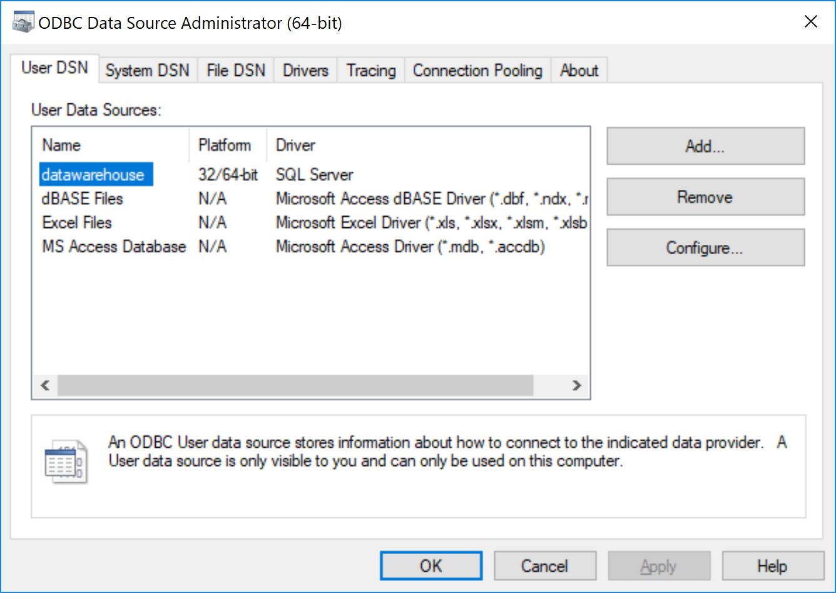
Data Source Name (DSN)

Slide 9
Data Source Name (DSN)
library(odbc) # Show installed ODBC drivers tibble(sort(unique(odbcListDataSources()[[1]])))
## # A tibble: 7 x 1 ## `sort(unique(odbcListDataSources()[[1]]))` ## <chr> ## 1 CalCOFI ## 2 CUFES ## 3 Excel Files ## 4 MS Access Database ## 5 ROV2 ## 6 training ## 7 TRAWL

Slide 10
Data Source Name (DSN)
Configure a DSN in code.
# Configure the connection con <- dbConnect(odbc(), Driver = "SQL Server", Server = "161.55.235.187", Database = "ROV2", Trusted_Connection = "True") # Show connection details con
## <OdbcConnection> dbo@SWC-ESTRELLA-S ## Database: ROV2 ## Microsoft SQL Server Version: 12.00.5214
# Disconnect from database dbDisconnect(con)

Slide 11
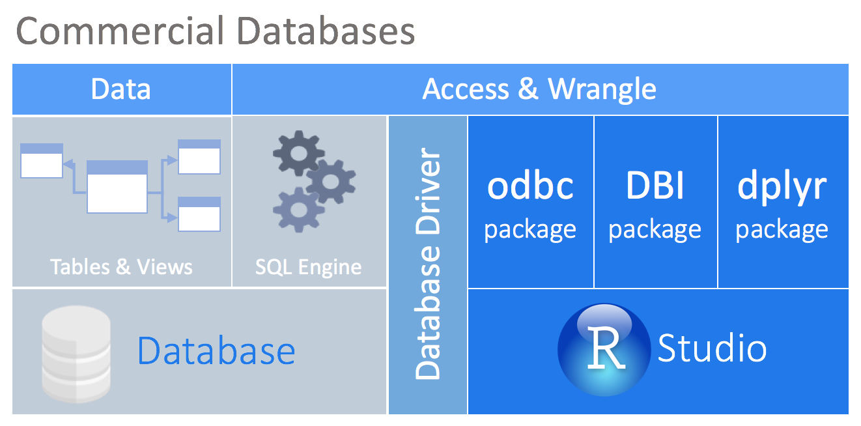
Accessing databases using R

Slide 12
Motivation for this presentation?
The materials in this presentation have been largely adapted from the Rstudio Webinar by Edgar Ruiz entitled: Best practices for working with databases.
A great resource for tools and best practices when working with databases in R can be found here: db.rstudio.com.

Slide 13
Inspiration for this talk
Stay within your R workflow
Use database engines (e.g., SQL Engine) to speed workflow by analyzing data in place
Taking advantage of more intuitive tidyverse tools (e.g., dplyr) and the pipe operator (%>%)
Never have to learn SQL, thanks to dbplyr 😉
Encourage reproducible research by linking data to analysis

Slide 14
Recent developments
DBI package is faster than the legacy RODBC package
dplyr and dbplyr packages have a generalized SQL backend for talking to databases
dbplyr package translates R code into database-specific variants
odbc package standardizes database connections and is DBI-compliant
Rstudio IDE (>v1.1) now includes a Connections pane for connecting to, exploring, and viewing data in a variety of databases

Slide 15
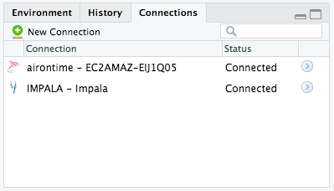
Connections pane in Rstudio

Slide 16
Extras

Slide 17
🚧 Drivers on Mac 🚧
Install homebrew
Install UnixODBC (required for all)
brew install unixodbc
Install common DB drivers (optional)
SQL Server ODBC Drivers (Free TDS)
brew install freetds --with-unixodbc
PostgreSQL ODBC ODBC Drivers
brew install psqlodbc
MySQL ODBC Drivers (and database)
brew install mysql
SQLite ODBC Drivers brew install sqliteodbc

