Slide 1
Databases Using R
Kevin Stierhoff

Slide 2
What is a database

Slide 3
Why put data in a database?
Getting away from working with static flat files with multiple copies/versions
Centralize data storage to use by many at once
Enforce data integrity
Working efficiently with large amounts of data

Slide 4
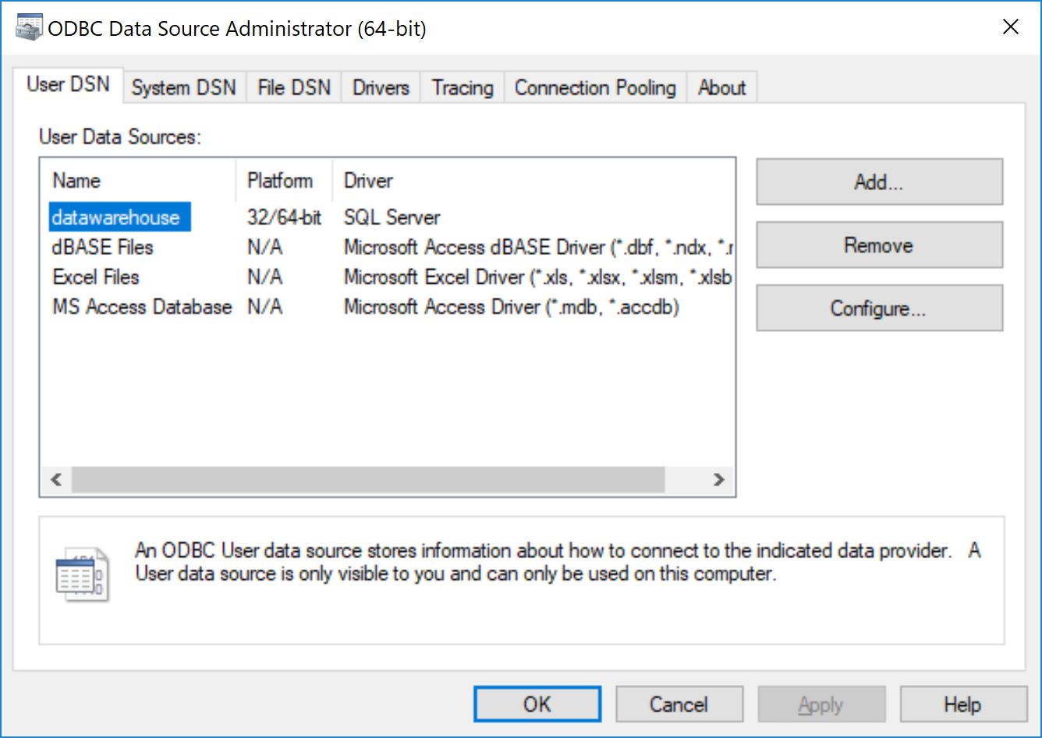
ODBC (Open Database Connectivity)

Slide 5
How do we get data from databases?
DSN ()

Slide 6
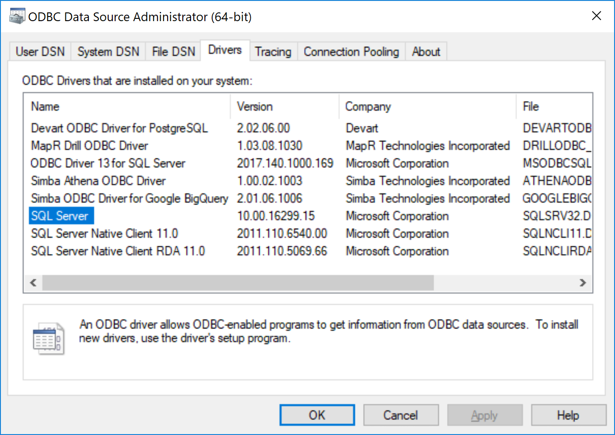

Slide 7
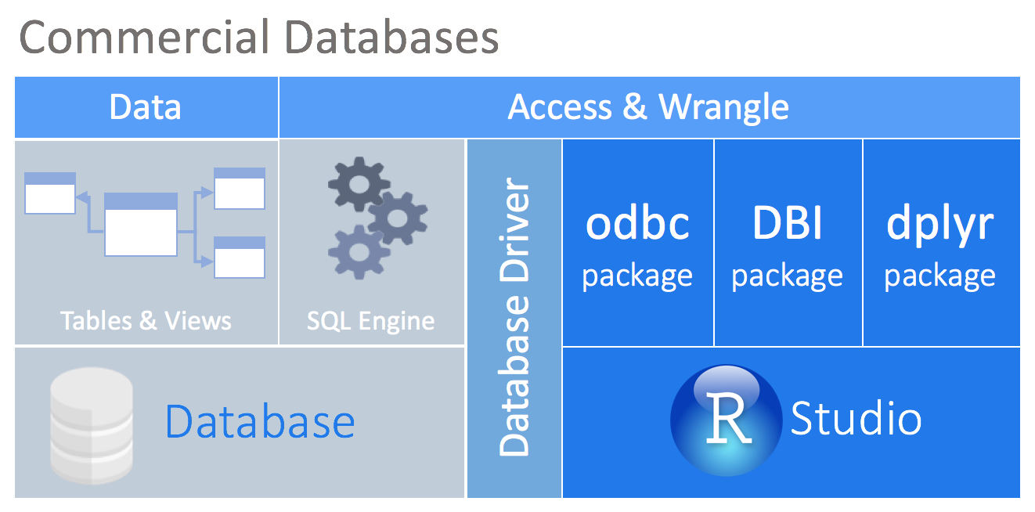
How can we get data from a database using R?

Slide 8
Motivation for this presentation?
The materials in this presentation have been largely adapted from the Rstudio Webinar by Edgar Ruiz entitled: Best practices for working with databases.
A great resource for tools and best practices when working with databases in R can be found here: db.rstudio.com.

Slide 9
Goals of this talk
Take advantage of database engines to speed workflow by analyzing data in place (e.g., using SQL Engine)
Taking advantage of tidyverse tools (e.g., piped code using %>%) to facilitate data access rather than SQL
Encouraging reproducible research by linking data to analysis
New: Connections Pane in Rstudio IDE (>v1.1)

Slide 10
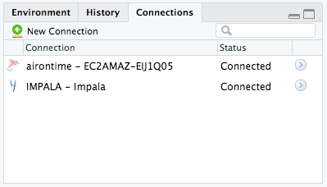
Connections pane in Rstudio

