Slide 1

Stigma and Autism Spectrum Disorder in Higher Education
Kayden Stockwell & Dr. Jennifer Gillis
Department of Psychology
Binghamton University

Slide 2
Autism in Higher Education
Individuals with Autism Spectrum Disorder (ASD) can and do attend college
  A national survey found that 34.7% of young adults with ASD had attended college within six years of graduating high school
A time of change for all students, not just those with ASD
  Transitioning to a different, often reduced, level of support
    Social, emotional, academic
Shattuck, P. T., Narendorf S. C., Cooper, B., Sterzing, P. R., Wagner, M., & Taylor, J. L. (2012). Postsecondary education and employment among youth with autism spectrum disorder. Pediatrics, 129(6), 1043.
Notes:
Survey from 2011, reports from SSD offices suggest increasing numbers of ASD in college, so low estimate
Many ASD have difficulty with transitions anyways
Increased expectations, of independence, of self advocacy, of living skills, of social problem solving skills

Slide 3

Attrition
As with all college students, some students with ASD are very successful and others have more difficulty
  41% of college students with a disability (including ASD) graduate compared to 59% of college students without a disability
Crucial to establish social support networks
  Empathy
  Peers may serve as models for how to respond to transition related challenges
Newman, L., Wagner, M., Knokey, A. M., Marder, C., Nagle, K., Shaver, D., & Wei, X. (2011). The Post-High School
Outcomes of Young Adults with Disabilities up to 8 Years after High School: A Report from the National Longitudinal Transition Study-2 (NLTS2). NCSER 2011-3005. National Center for Special Education Research.
Notes:
Attrition, often referred to as “dropping out” is defined as not re-enrolling for a consecutive semester
What are factors that are contributing to this % difference
One is social support

Slide 4

Barriers to Social Support
Being perceived as a member of a stigmatized group may make people not want to interact with you
Student resource programs and acquaintances not enough
Notes:
Barrier to having social support is stigma, being member of stigmatized group may make people not want to interact with you
Where are you going to get that social support? Even if SSD and counseling, need peer support

Slide 5
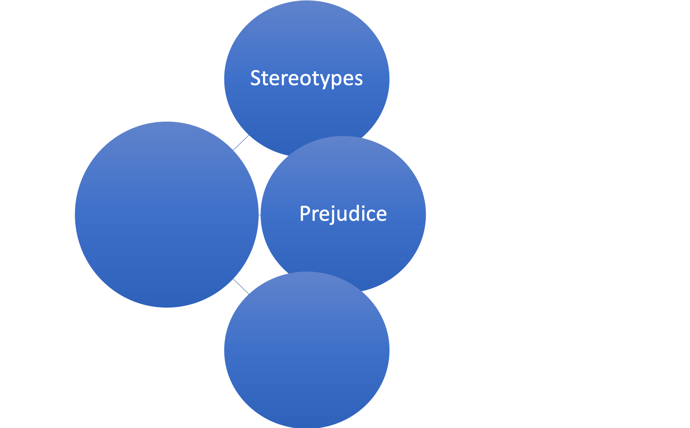
Cognitive
Beliefs about individuals that are generalized to a group
Affective
Negative evaluations about individuals who are perceived to belong to a particular group
Action
Different and negative treatment of individuals who are perceived belong to a particular group
Stigma
Discrimination
Allport, G. W. (1954). The nature of prejudice. Cambridge, MA: Addison-Wesley.
Notes:
Mentioned stigmatized group, but what is stigma?
Stigma is the disapproval of a person or group based on a characteristic they are perceived to have
Action
Different and negative treatment of individuals who are perceived belong to a particular group

Slide 6
Impacts of Stigma
Stigma can lead to negative outcomes such as decreased employment opportunities, fewer social relationships, and negative self-concept
“Us” vs “Them” categorization: labeling can lead to loss of social status and discrimination
Ben-Zeev, D., Young, M. A., & Corrigan, P. W. (2010). DSM-V and the stigma of mental illness. Journal of Mental Health, 19(4), 318-327.
Link, B.G., & Phelan, J.C. (2001). Conceptualizing stigma. Annual Review of Sociology, 27, 363-385.
Notes:
Impact of stigma is Us vs Them categorization, can reduce your place in the social hierarchy, leave you vulnerable to discrimination (different and negative treatment) and make it hard to ”break in to” a social group to make friends and establish peer support

Slide 7
Stigma and Mental Illness Research
Mental illness stigma research clearly indicates that individuals with a variety of mental illnesses are stigmatized
Specific behaviors become associated with the mental illness label, which leads to stereotypes
Griffiths, K. M., Christensen, H., & Jorm, A. F. (2008). Predictors of depression stigma. BMC Psychiatry, 8(1), 25.
Lee, S., Lee, M. T., Chiu, M. Y., & Kleinman, A. (2005). Experience of social stigma by people with schizophrenia in Hong Kong. The British Journal of Psychiatry, 186(2), 153-157.
Notes:
Chose MI Stigma research because of background of labels vs behavior
Schizophrenia, depression, bipolar, PTSD
Some common negative evaluations involved are, it’s their fault they have a mental illness, they’re dangerous, they’re unpredictable
Overt, observable behaviors become associated with mental illness group
If see someone behaving in a way that triggers one’s idea of what mental illness is, may place those negative evaluations on that person
ie. See person talking to oneself, reminds of mental illness, that person is unpredictable, I’m going to cross the street to avoid them

Slide 8
Stigma and Autism
Findings of mental illness stigma research extend to the developmentally disabled population, including those with ASD
  Is ASD more or differently stigmatized than other disorders with similar symptoms?
We know that behavior is very involved in stigmatization, but what else contributes to the stigmatization of college students with ASD?
Notes:
Extend to ASD because both mental illness and ASD have overt, observable behaviors
Limited research on stigma and ASD and what exactly is contributing to the stigmatization
Some work looking at if having a diagnostic label is stigmatizing, but we don’t wear our diagnostic labels on our foreheads
but from behavior, people can associate you with a group or a diagnosis

Slide 9
Special Interests in ASD
A characteristic of ASD is restricted, repetitive behaviors and interests
  One manifestation is a special interest (SI), or an intense, focused interest and/or in-depth knowledge in a narrow subject area
  Some examples include: American Revolution, anime, astronomy, chemistry, clocks, computer hardware, deep-fat fryers, elevators, famous people, food labels, game shows, geography, Legos, light bulbs, locations of pay phones, military equipment, Shakespearian plays, smoke detectors, sports, Star Trek, train schedules, telephone pole insulators, video games, virology, weather patterns, zip codes...
American Psychiatric Association. (2013). Diagnostic and statistical manual of mental disorders (DSM-5®). American Psychiatric Pub.
Klin, A., Danovitch, J. H., Merz, A. B., & Volkmar, F. R. (2007). Circumscribed interests in higher functioning individuals with autism spectrum disorders: An exploratory study. Research and Practice for Persons with Severe Disabilities, 32(2), 89-100.

Slide 10
Special Interests in ASD
Many individuals with ASD are reported to have at least one SI
  Results of several studies report a range of percentages, from a low of 49% to a high of 100%
Neurotypical (NT) SIs fall into different categories than ASD SIs and are reported less frequently
  Individuals with ASD: machines and technology, vehicles, factual information, and sciences
  NTs: sports and games, food, belief systems, and creative arts
Bodfish, J. W., Symons, F. J., Parker, D. E., & Lewis, M. H. (2000). Varieties of repetitive behavior in autism: Comparisons to mental retardation. Journal of Autism and Developmental Disorders, 30(3), 237-243.
Szatmari, P., Georgiades, S., Bryson, S., Zwaigenbaum, L., Roberts, W., Mahoney, W., Goldberg, J., & Tuff, L. (2006). Investigating the structure of the restricted, repetitive behaviours and interests domain of autism. Journal of Child Psychology and Psychiatry, 47(6), 582-590.
Jordan, C. J., & Caldwell-Harris, C. L. (2012). Understanding differences in neurotypical and autism spectrum special interests through internet forums. Intellectual & Developmental Disabilities, 50(5), 391-402.
Notes:
These are seen across the lifespan, may change over time
More often reported in those we would term ”higher functioning”
Some NT interests socially normative or advantageous
sports

Slide 11
Special Interests and ASD
A common fear of family members of children with ASD is that the time spent investigating the interest and talking about the interest would limit social relationships and job opportunities
  Could SIs limit social opportunities in college?
Notes:
If SI is a fear of caregivers, which may translate into intervention targets, we want to know is this really important in how others are evaluating the individual with ASD

Slide 12
Present Study
We examined the relationship of behaviors associated with ASD and SI topic with degree of stigmatization in college students
Results may help to better understand factors involved in stigmatization and influence how we prepare high school students to transition to college
Notes:
We had a sample of 243 undergraduate students, 72% female

Slide 13
Behaviors & Special Interests Vignettes
 | Special Interest
Behavior | Neurotypical No Interest | Neurotypical Common Interest | Neurotypical Uncommon Interest
 | Social Anxiety No Interest | Social Anxiety Common Interest | Social Anxiety Uncommon Interest
 | Autism No Interest | Autism Common Interest | Autism Uncommon Interest
Notes:
Created a total of 9 vignettes/short stories that varied the behavior by special interest.
behaviors included those associated with ASD, social anxiety (given the overlap in social skills deficits sometimes observed in ASD) and neurotypical. Based on DSM 5 criteria
Special interest that is more common in NTs, uncommon in NTs (but more prevalent for ASD) and vignettes with no special interests described. Mean chit chat, but no particular interest category
Rated using several questions how willing they would be to interact with the story character (examples)

Slide 14
Hypotheses
Hypotheses
Hypothesis 1 Effect of Behavior | Behavior conditions (ASD or SA) will elicit higher rates of stigmatization than the neurotypical behavior condition
Hypothesis 2 Effect of Special Interest | Special interest conditions (common or uncommon) will elicit higher rates of stigmatization than the no interest condition
Hypothesis 3 The Least and Most Stigmatized | The combined NT behavior and no special interest condition will have the lowest rate of stigmatization and the combined ASD behavior and uncommon special interest condition will have the highest rate of stigmatization

Slide 15
Behaviors & Special Interests Vignettes
Behavior conditions (ASD or SA) will elicit higher rates of stigmatization than the neurotypical behavior condition
 | Special Interest
Behavior | Neurotypical No Interest | Neurotypical Common Interest | Neurotypical Uncommon Interest
 | Social Anxiety No Interest | Social Anxiety Common Interest | Social Anxiety Uncommon Interest
 | Autism No Interest | Autism Common Interest | Autism Uncommon Interest
Notes:
Higher stigma, less likely to want to interact with these characters

Slide 16
Behaviors & Special Interests Vignettes
Special interest conditions (common or uncommon) will elicit higher rates of stigmatization than the no interest condition
 | Special Interest
Behavior | Neurotypical No Interest | Neurotypical Common Interest | Neurotypical Uncommon Interest
 | Social Anxiety No Interest | Social Anxiety Common Interest | Social Anxiety Uncommon Interest
 | Autism No Interest | Autism Common Interest | Autism Uncommon Interest
Notes:
Higher stigma, less likely to want to interact with these characters

Slide 17
Behaviors & Special Interests Vignettes
The combined NT behavior and no special interest condition will have the lowest rate of stigmatization and the combined ASD behavior and uncommon special interest condition will have the highest rate of stigmatization
 | Special Interest
Behavior | Neurotypical No Interest | Neurotypical Common Interest | Neurotypical Uncommon Interest
 | Social Anxiety No Interest | Social Anxiety Common Interest | Social Anxiety Uncommon Interest
 | Autism No Interest | Autism Common Interest | Autism Uncommon Interest
Notes:
Lowest stigma, most likely to want to interact with NT NI
Highest stigma, least likely to want to interact with ASD UI

Slide 18
Vignettes: Neurotypical No Interest
You walk into the first club meeting of the year and take a seat next to another member. You take your coat off and put it on the back of your chair, just like the other member has done. After taking a seat, you introduce yourself and hold out your hand. The other student turns their chair towards you, shakes your hand, and says “I’m C”. You ask what year C is in, and they answer with the same year as you. C asks what you’re interested in and you talk about that for a while. C starts telling you about a TV show they watch and ask if you’ve seen it. You talk for a while about shows you both like. Eventually C notices the sports logo on your shirt and asks you about the team.
Notes:
General chit chat, small talk

Slide 19
Vignettes: Social Anxiety Common Interest
You walk into the first club meeting of the year and take a seat next to another member. You take your coat off and put it on the back of your chair, just like the other member has done. After taking a seat, you introduce yourself and hold out your hand. The other student grins nervously at you, shakes your hand, and says “I’m E” in a quiet voice. They look away quickly. You ask what year E is in, and they answer with the same year as you before looking away. After a few minutes of silence you ask what they’re interested in. E starts telling you about a level of a popular video game. You look bored and E quietly says “I should probably talk about more interesting things” before asking what you like to do.
Notes:
Lack of knowledge of what ASD looks like, some behavioral overlap with ASD and SA
Common interest, video games

Slide 20
Vignettes: Social Anxiety Common Interest
You walk into the first club meeting of the year and take a seat next to another member. You take your coat off and put it on the back of your chair, just like the other member has done. After taking a seat, you introduce yourself and hold out your hand. The other student grins nervously at you, shakes your hand, and says “I’m E” in a quiet voice. They look away quickly. You ask what year E is in, and they answer with the same year as you before looking away. After a few minutes of silence you ask what they’re interested in. E starts telling you about a level of a popular video game. You look bored and E quietly says “I should probably talk about more interesting things” before asking what you like to do.
Notes:
Lack of knowledge of what ASD looks like, some behavioral overlap with ASD and SA
Common interest, video games

Slide 21
Vignettes: ASD Uncommon Interest
You walk into the first club meeting of the year and take a seat next to another member. As you take your coat off, you notice the member is wearing shorts and a t-shirt, even though it is winter. After taking a seat, you introduce yourself and hold out your hand. The other student does not look up from the book they are reading and says “I’m G” without shaking your hand. You ask what year G is in, and they answer with the same year as you, and quickly begins telling you about the deficits in the design of a newly released computer motherboard. You try to tell G about some of your interests, but they always return the conversation to computer hardware. You look bored, but G doesn’t seem to notice.
Notes:
Uncommon NT interest, more common ASD interest
Interest intensity, missed social cues

Slide 22
Vignettes: ASD Uncommon Interest
You walk into the first club meeting of the year and take a seat next to another member. As you take your coat off, you notice the member is wearing shorts and a t-shirt, even though it is winter. After taking a seat, you introduce yourself and hold out your hand. The other student does not look up from the book they are reading and says “I’m G” without shaking your hand. You ask what year G is in, and they answer with the same year as you, and quickly begins telling you about the deficits in the design of a newly released computer motherboard. You try to tell G about some of your interests, but they always return the conversation to computer hardware. You look bored, but G doesn’t seem to notice.
Notes:
Uncommon NT interest, more common ASD interest
Interest intensity, missed social cues

Slide 23
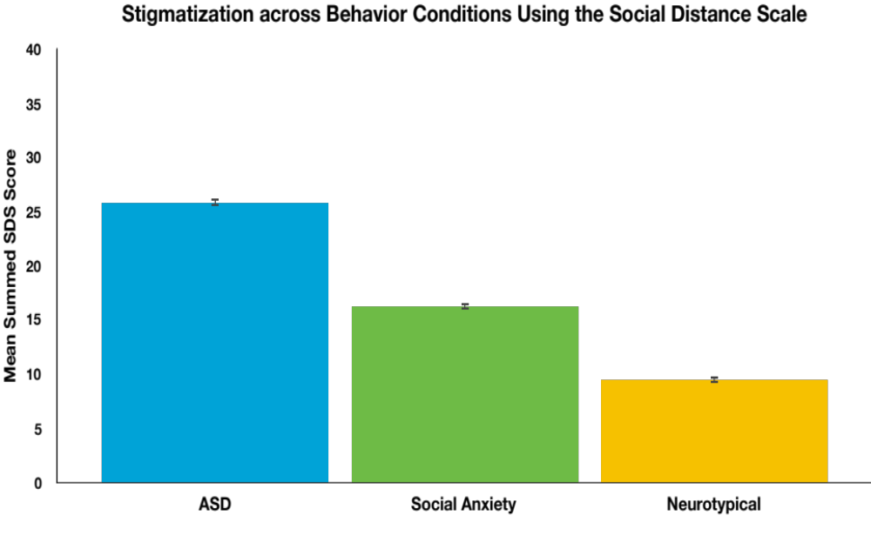
Stigma Differs Depending on Behavior
*
Behavior is a highly salient factor in stigmatization and behavior associated with ASD is more stigmatized than behavior associated with SA
Both behavior associated with ASD and behavior associated with SA are more stigmatized than NT behavior
**
Figure 1. Stigmatization Varies by Behavior Condition. Mean summed SDS scores across all behaviors conditions (i.e. summed ASD NI, ASD CI, and ASD UI SDS scores). Error bars represent +/- calculated standard error. * = significant difference from all (p < 0.01); ** = significant difference from NT (p < 0.01).

Slide 24
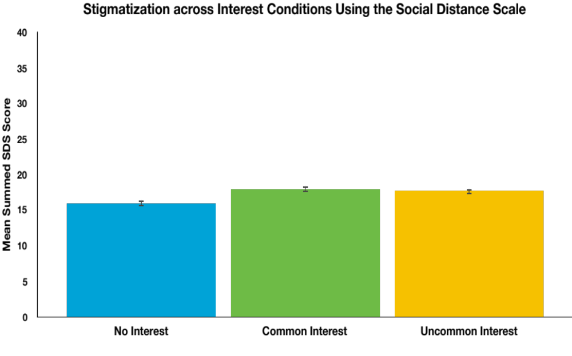
Stigma Differs Depending on Presence of Interest
Having a SI, either common or uncommon, is more stigmatizing than not having a SI
Commonness of SI topic did not alter amount of stigma
*
Figure 2. Stigmatization Varies by Presence of Special Interest. Mean summed SDS scores across all interest conditions (i.e. summed ASD NI, SA NI, and NT NI SDS scores). Error bars represent +/- calculated standard error. * = significant difference from all (p < 0.01).
Notes:
Not nearly as large of a difference as behavior, but still a contributing factor
Presence is important, topic might not be

Slide 25
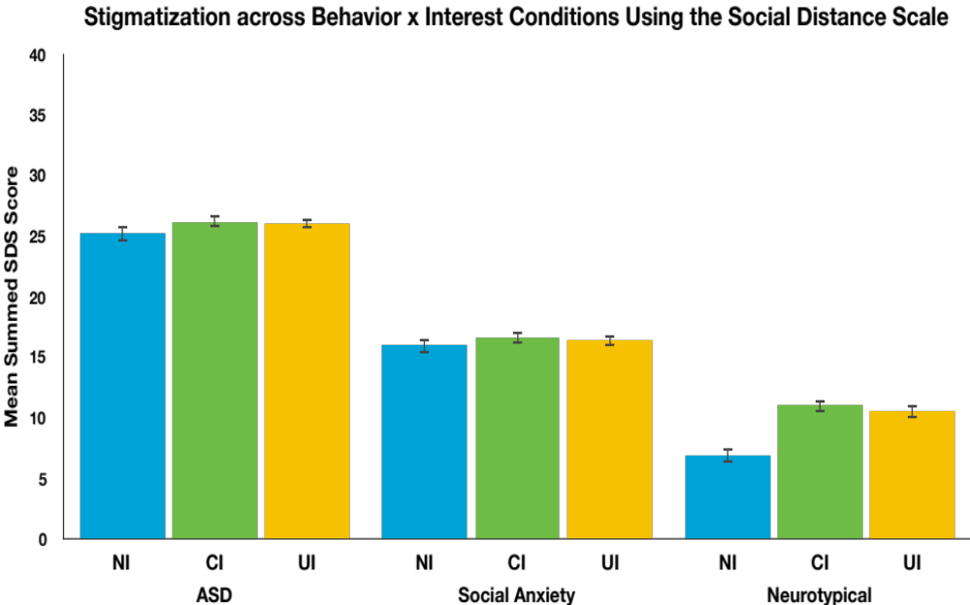

Interest is Only Relevant if Behavior is Typical
*
**
Behavior is the more salient factor in stigmatization
Commonness of SI topic was not a differentiating factor in level of stigmatization
***
Figure 3. Presence of Special Interest only Stigmatizing when Behavior is Typical. Mean summed SDS scores across all conditions. Error bars represent +/- calculated standard error. * = significantly different from all (p < 0.01); ** = significantly different from NT x all interest conditions (p < 0.01); *** = significantly different from NI CI and NI UI (p < 0.01).
Notes:
Showing behavior is really the key factor in stigmatization, what you’re talking about is not
If you’re behaving in a way that someone evaluates negatively, might not even get the chance to talk
If behavior is typical, having an interest is stigmatizing, but still doesn’t reach the level of stigmatization found in behavior conditions

Slide 26
Limitations and Future Research
Results may be impacted by social desirability bias
  Future studies should evaluate how results extend to real life scenarios
Next steps may involve investigating stigmatization using video scenarios, role playing, and real life interactions
Notes:
Before I transition to implications, I want to talk about a few limitations to these results

Slide 27
Implications
SI topic may not a salient intervention target if it is not a significant factor in the stigmatization of individuals with ASD
  Caregiver fears of SIs limiting social opportunities may not be accurate in the context of stigma
In individuals with ASD who are behaviorally indistinguishable from NT peers, presence of a SI may contribute to stigmatization

Slide 28
Implications
Teach skills to cope with negative effects associated with stigmatization
  Mental health support
  Self advocacy skills
Support for individuals with ASD to form and maintain social networks
Notes:
Coping skills for people with ASD to address stigmatization when it occurs
Support to create social networks

Slide 29
What Can We Do?
Reducing stigmatizing beliefs in NT peers
  Education programs
  Opportunities for inter-group contact
  More integrated Office of Student Resources
Findings highlight the importance of creating programs to foster inclusive attitudes towards neurodiversity
  Not only bringing individuals with ASD into NT activities, but a meeting in the middle that both parties can learn from and enjoy
Notes:
Spend lot of time preparing youth with ASD to graduate high school and to interact with others, spend little time teaching NT peers how to interact with those who are different from them
Education programs for NT people, ideally starting early in childhood; need to go beyond education says research
Opportunities to interact with people with ASD
In college, more integrated SSD offices, larger presence on campus

Slide 30
References
Allport, G. W. (1954). The nature of prejudice. Cambridge, MA: Addison-Wesley.
American Psychiatric Association. (2013). Diagnostic and statistical manual of mental disorders (DSM-5®). American Psychiatric Pub.
Ben-Zeev, D., Young, M. A., & Corrigan, P. W. (2010). DSM-V and the stigma of mental illness. Journal of Mental Health, 19(4), 318- 327.
Bodfish, J. W., Symons, F. J., Parker, D. E., & Lewis, M. H. (2000). Varieties of repetitive behavior in autism: Comparison to mental retardation. Journal of Autism and Developmental Disorders, 30(3), 237-243.
Griffiths, K. M., Christensen, H., & Jorm, A. F. (2008). Predictors of depression stigma. BMC Psychiatry, 8(1), 25.
Jordan, C. J., & Caldwell-Harris, C. L. (2012). Understanding differences in neurotypical and autism spectrum special interests through Internet forums. Intellectual & Developmental Disabilities, 50(5), 391-402.
Klin, A., Danovitch, J. H., Merz, A. B., & Volkmar, F. R. (2007). Circumscribed interests in higher functioning individuals with autism spectrum disorders: An exploratory study. Research and Practice for Persons with Severe Disabilities, 32(2), 89-100.
Lee, S., Lee, M. T., Chiu, M. Y., & Kleinman, A. (2005). Experience of social stigma by people with schizophrenia in Hong Kong. The British Journal of Psychiatry, 186(2), 153-157.
Link, B. G., & Phelan, J. C. (2001). Conceptualizing stigma. Annual Review of Sociology, 27, 363-385.
Newman, L., Wagner, M., Knokey, A. M., Marder, C., Nagle, K., Shaver, D., & Wei, X. (2011). The Post-High School
Outcomes of Young Adults with Disabilities up to 8 Years after High School: A Report from the National Longitudinal Transition Study-2 (NLTS2). NCSER 2011-3005. National Center for Special Education Research.
Shattuck, P. T., Narendorf S. C., Cooper, B., Sterzing, P. R., Wagner, M., & Taylor, J. L. (2012). Postsecondary education and employment among youth with autism spectrum disorder. Pediatrics, 129(6), 1043.
Szatmari, P., Georgiades, S., Bryson, S., Zwaigenbaum, L., Roberts, W., Mahoney, W., Goldberg, J., & Tuff, L. (2006). Investigating the structure of the restricted, repetitive behaviours and interests domain of autism. Journal of Child Psychology and Psychiatry, 47(6), 582-590.

