Slide 1
Student CRM
Review of the current work
11.10.2022
Kosta Stojanovski

Slide 2


Tech-Stack Description
Which technologies/tools were selected?
Why those technologies/tools were selected?
Architectual Description
Repository, Service, Controller
Persistence Layer
Decision on the M-N Relation implementation manner (why?)
Persistence Implementation layer (why? First CRUD then JPA)
Validation (also for the other layers)
Testing (presentation and situations -how?)

Slide 3
Service Layer
Entity / DTO transformation (why and where?)
Exceptions
Testing (presentation and situations -how?)
Controller Layer
Validation (also for the other layers)
Testing (presentation and situations -how?)
Dockerisation

Slide 4
Tech-Stack Description
Technologies/Frameworks | Selection | Why, What?
Programming Language | Kotlin | The Novatec way
Build Tool | Gradle | Kotlin and Gradle are best friends
Architecture | Classic MV(S)C (Model-View-(Service)-Controller) | Learning Spring from the roots
Database | Postgres | Another Relational Database
Code Formatting | klind and detekt | Used in IntelliJ
Testing | Junit5, Mockk, Mockito, Testcontainers | Mockk, @WebMvcTest, @DataJpaTest, @SpringBootTest
Documentation | Asciidoctor | RestDocs as requirements
Frontend | React | Next step
Frontend Testing | Jest | Next step

Slide 5
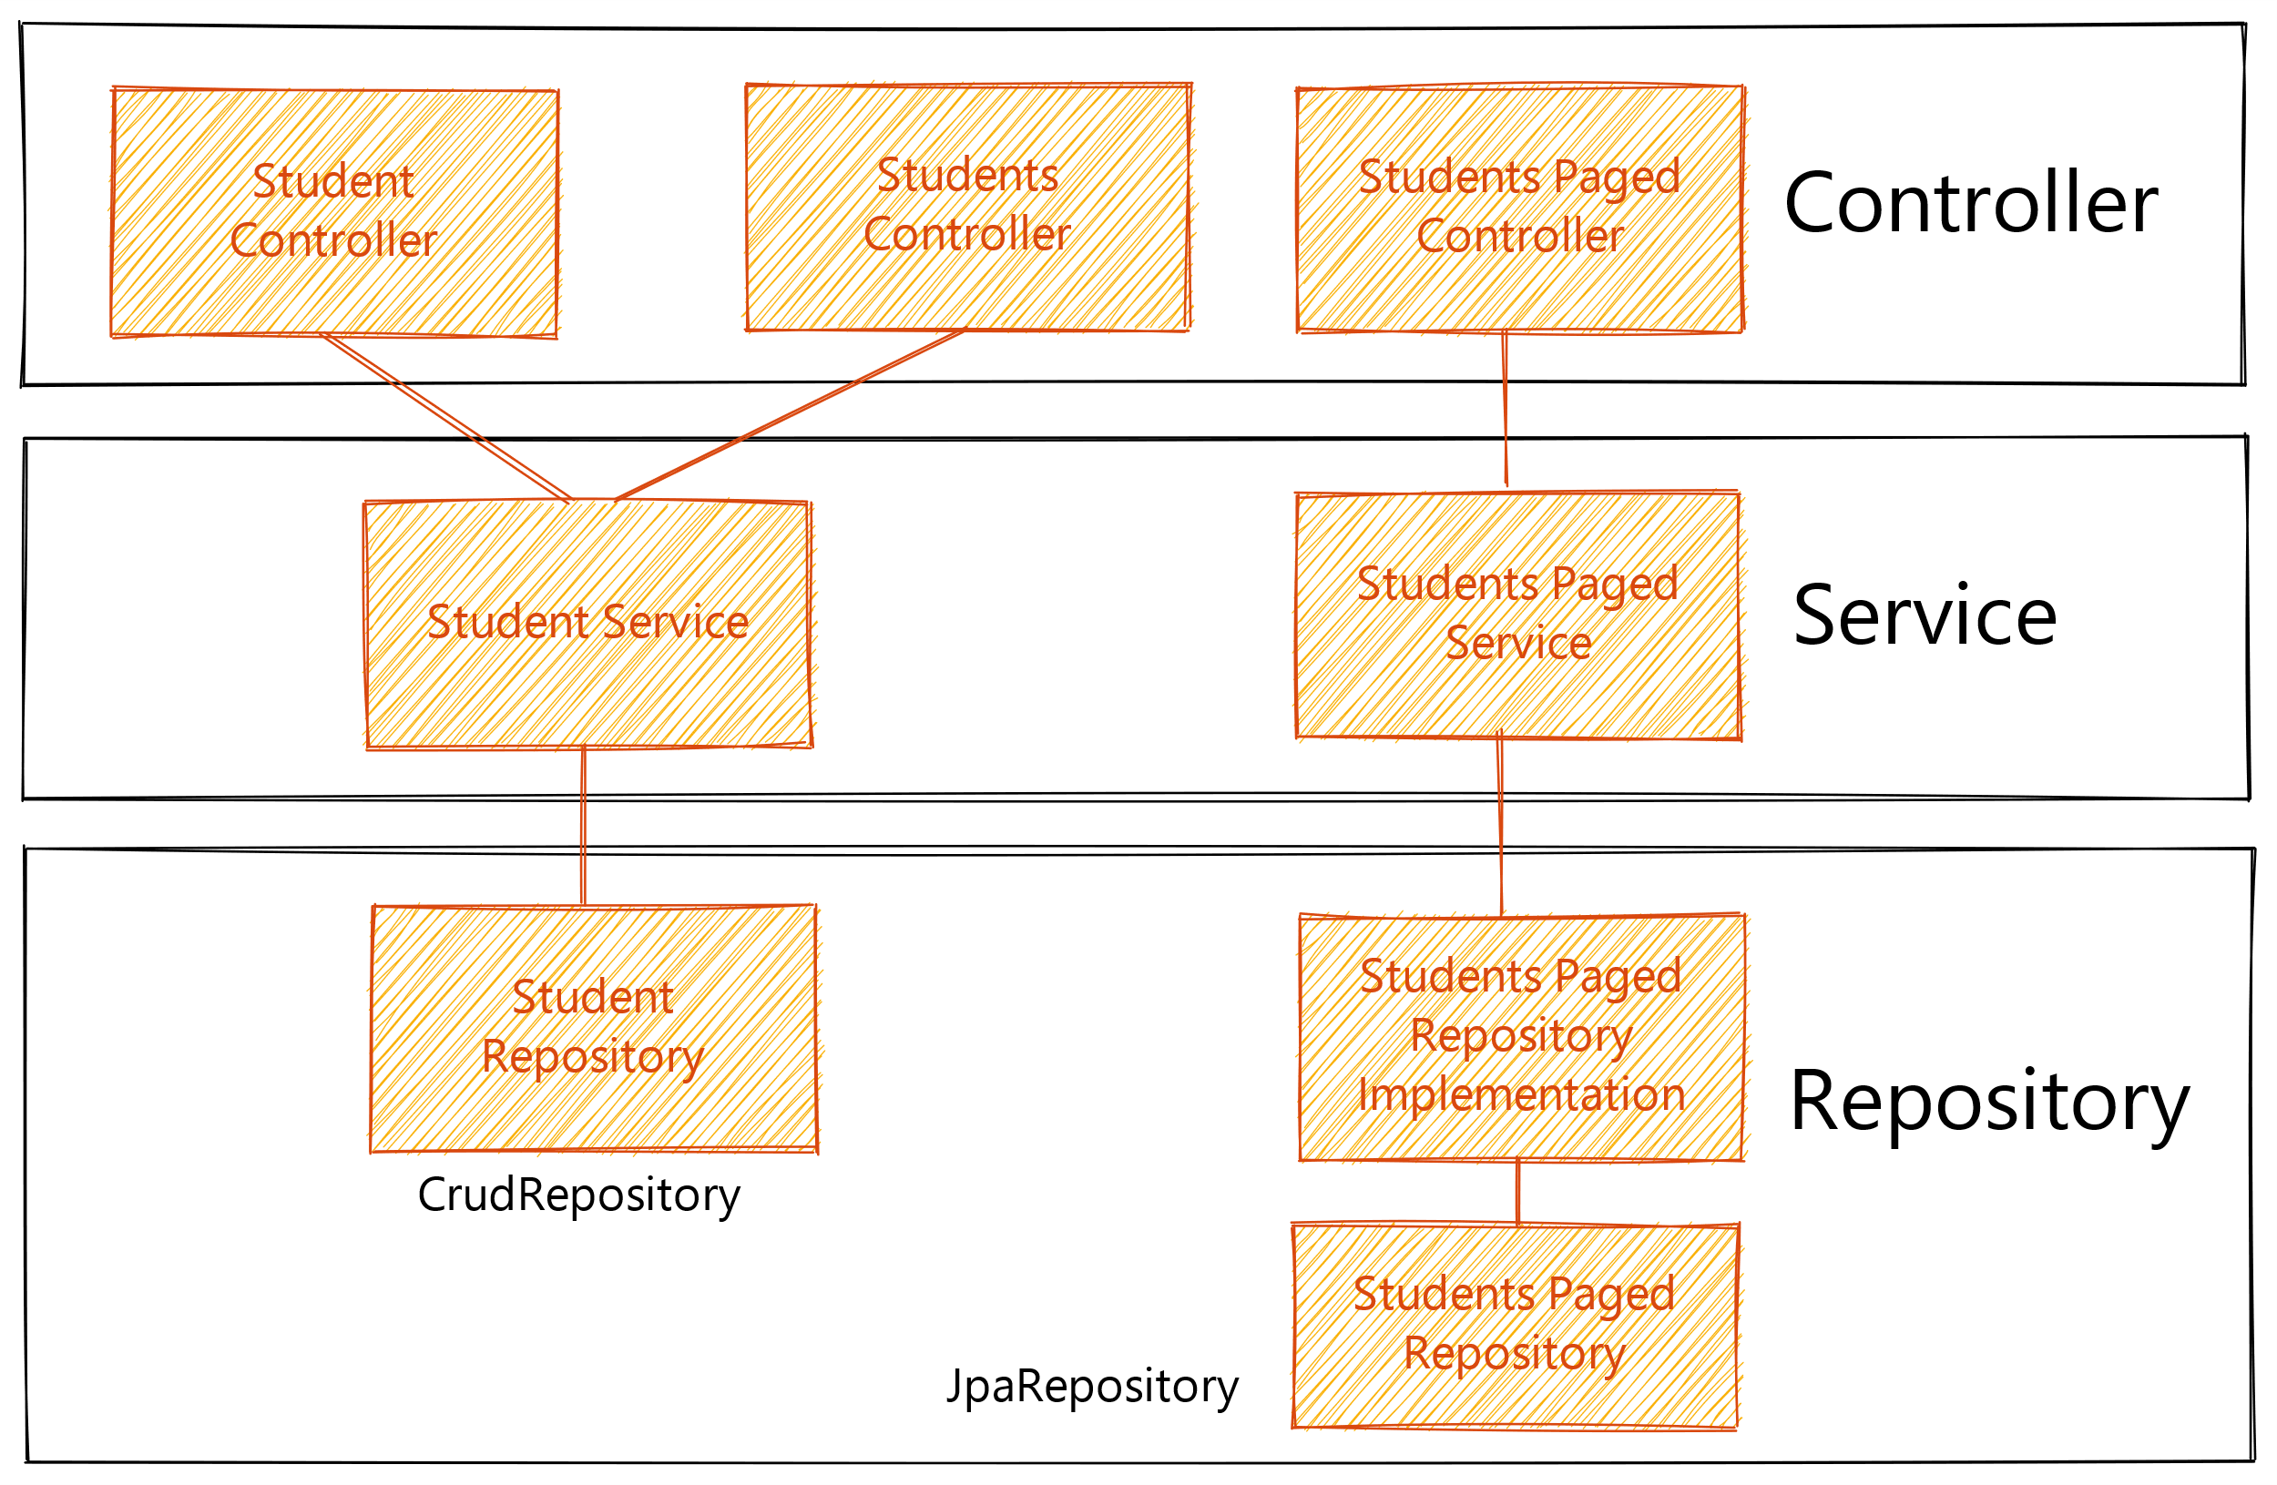
Architectual Description
Spring Boot Application
@Component
@Persistence
DB
Interface
HQL, SQL
@Service
Business Logic
@Controller
End-points definition
Application configuration file
Structure of the Student CRM

Slide 6
Persistence Layer
Decision on the M-N Relation implementation manner
Modeling a Many-to-Many Relationship with the „owner“-side
Advatages: easy and less code
Disadvatages:
does not reflect the DB schema
Updating and deleting the relation have to be done by the owner‘s side
Website: www.baeldung.com/jpa-many-to-many
Persistence Implementation Layer
The Repositories are interfaces that inherit from:
CrudRepository
JpaRepository (inc. Pagination)
Extra layer was added for the JpaRepositores (query creation):
Because of PageRequsts creation
The classes could not have the suffix „Impl“ due to cyclic loading exception
Website: docs.spring.io/spring-data/jpa/docs/current/reference/html/#repositories.query-methods.query-creation

Slide 7
Persistence Layer
Validation
Validation as annotation is implemented on the DB entities
Same validation approach is used on the controller level
Website: reflectoring.io/bean-validation-with-spring-boot/
Testing
Integration testing with test containers
for testing the native SQL (@DataJpaTest)
Flyway test for approving the DB schema creation @SpringBootTest () by invoking:
Programmatically
Via annotations
Website: SWE-Talent-Hub - Flyway - All Documents (sharepoint.com)
Unexpected handling of invalid state
The cause was found as part of the nature of the save- vs. saveAndFlush-method. Note: CrudRepository have only the save methods.

Slide 8
Service Layer
Transformation of the DB entity with DTO
The transformation of the entities should happen in the service layer. In this Student, CRM to-methods was created on the DB entity and DTO objects.
In some cases the service layer should have also its own model presentation. In this case, this was not necessary.
Exceptions
Custom exception classes were added for several cases, i.e. when the entity wrongly is not found or found.
@ControllerAdvice and @ExceptionHanlder are used for catching and returning the exception through the endpoint.
Website: medium.com/@jovannypcg/understanding-springs-controlleradvice-cd96a364033f

Slide 9
Service Layer
Testing
For the service laye unit test with Junit5 and Mockk were written. Some of them as parameterized test.
Simple sample with Mockk was also added as a reminder, as a kind of how-to.
It was the only layer where unit testing was reasonable to be written since the other layers only had one-liner method calls.
Website: mockk.io/ JUnit 5

Slide 10
Controller Layer
Validation
Validation as annotation is added at the controller methods as validation of the request payload, parameters and path variables.
Website:reflectoring.io/bean-validation-with-spring-boot/
Testing
Integration testing
for testing the endpoints (@WebMvcTest, Mockito)
Integration testing with test containers
for testing the endpoint (@SpringBootTest, @AutoConfigureMockMvc)
for creating ASCIIdoc documentation via RESTDocs (@SpringBootTest, @AutoConfigureMockMvc, @AutoConfigureRestDocs)

Slide 11
Controller Layer
Testing
Website:
spring.io/guides/gs/testing-restdocs/
intellij-asciidoc-plugin.ahus1.de/docs/users-guide/features/advanced/spring-rest-docs.html

Slide 12
Dockerisation
Docker Image Creation
With an dedicated grade task an docker image is created and can be pushed locally and on the github
Starting the application with docker compose
With a specially prepared docker-compose file the previous pushed image and a Postgres docker container can be started and the application can be tested with tools like Postman.

Slide 13
Conclusions
Controller Rest Docs Using test containers REST Docs test imply endpoints tests, therefore only they should be implemented
Repository JPA The „new entity“ approach looks most similar to the DB schema and I would recommend it over the „owner“ approach. (I need to use that approach as well for comparison)
Repository JPA CrudRepository has only the save methods and not the one with the flush operation. Also, pagination is part of the JpaRepository
Test Containers Using the annotation approach does not start unnecessary containers.
Documentation AsciiDoc REST Docs The Asciidoc format is used by RESTDocs. Talking about Spring Boot and Asciidoc implies RESTDocs.
Dokerisation Mapping the port outside of the container is meant to be mapped for the host and not other containers.

Slide 14
Conclusions
Service The DTO and DB entity transformation of the entities should happen in the service layer.
Service In some cases, the service layer should have its own model presentation.
Testing Few integration tests are enough in contrast to unit tests where the code coverage should be as high as possible.
Controller Using @WebMvc Tests implies using Mockito. There is a workaround when Mockk should be used.
Tools klint and detekt can be used as IDE plugins
Service Testing Mockk and parametrized tests does not work correctly since the verify counter does not reinitialize after one test part is done

Slide 15
Open Questions
Repository Should always JpaRepository be used over CrudRepository?
Exceptions (@ControllerAdvice, @ExceptionHandler) Do we need to use only one facade class where every exception type is handled?
Controller Is it the following article(posted newly in the backend guild slack channel) REST best practice: learn.microsoft.com/en-us/azure/architecture/best-practices/api-design
Service What is the best practice for mapping the DB entities and DTOs?
Repository Where should the constrain-violation-check take part? In the business logic or the DB itself (extra query vs. DB exception)?

Slide 16
Thank you for your attention!

