Slide 1
Can a Shallow Ice Approximation - Mass Balance Model Be Used to Calculate the Water Output of Alpine Glaciers?
By Kieran Stone
Advisors: Jed Brown, Robert Anderson and Bradley Markle

Slide 2
Background
Glacial melting plays a significant role in the hydrology of mountain basins [1]
Runoff from these mountain basins is often used as a water source by downstream communities [2]
Computer models of these glaciers are very effective at modeling these glaciers [3,4]
These models can get very complex and computationally expensive

Slide 3
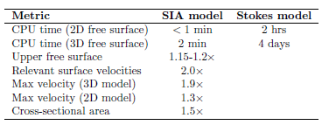
Prior Research
Shallow ice approximation (SIA) models generally perform worse than Stokes models
On large, flat glaciers and glaciers with low aspect ratios (thickness-to-extent ratios) SIA models can perform well [1]
SIA models have been used to model glacial runoff
One paper [2] using an SIA model and a coupled hydrological model overestimated the July flow by 13% and underestimated the August-September flow by 2%
[1]

Slide 4
Thesis Question
Can a simple SIA - Mass Balance model be used to calculate the water runoff of small mountain glaciers?
Expect that the mass balance will have a larger effect on the runoff than the ice dynamics
Compare SIA-Mass Balance with the Open Global Glacier Model (OGGM) [1]
Evaluate accuracy with measured runoff data for 91 months from 1992-2007 [2]

Slide 5
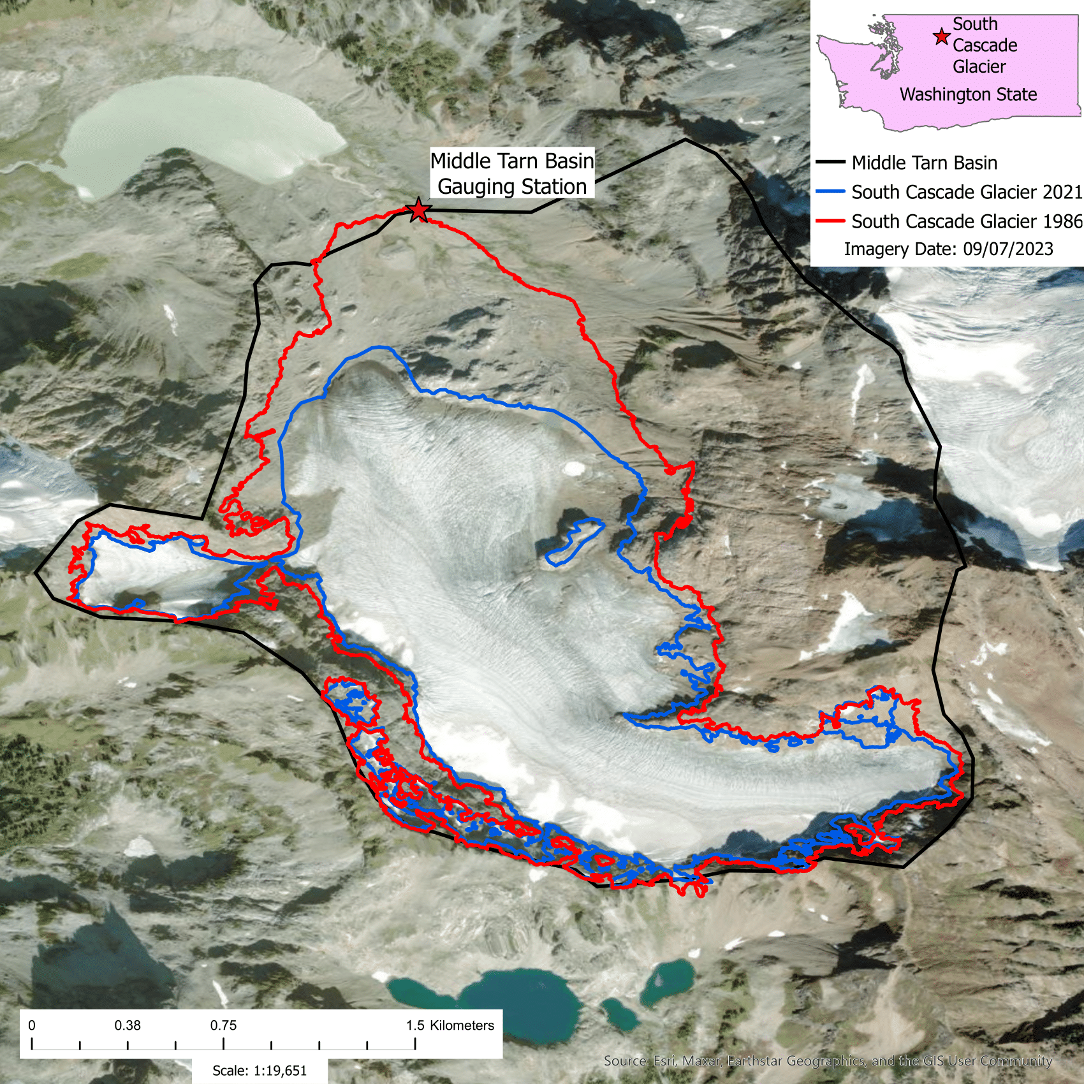
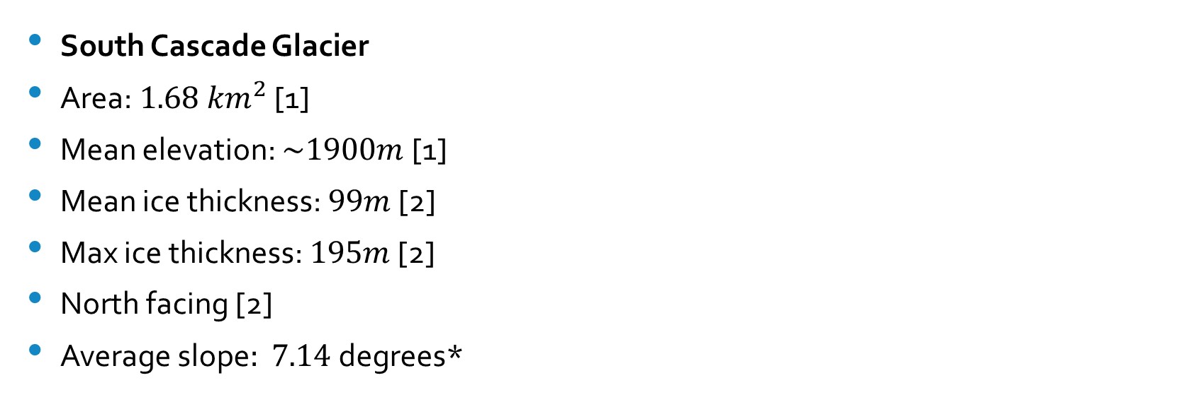
Study Site
South Cascade Glacier
Area:${ 1.68 km}^{2}$ [1]
Mean elevation: $\sim 1900m$[1]
Mean ice thickness: $99m$ [2]
Max ice thickness: $195m$ [2]
North facing [2]
Average slope$: 7.14$degrees*
* Along this studies centerline in 2021

Slide 6
Model Structure
SIA equations for ice dynamics
Temperature-degree day and precipitation mass balance model
Temperature-degree day and precipitation snow and rain model
Two sections to complete model run
Spinup run
Data driven run

Slide 7
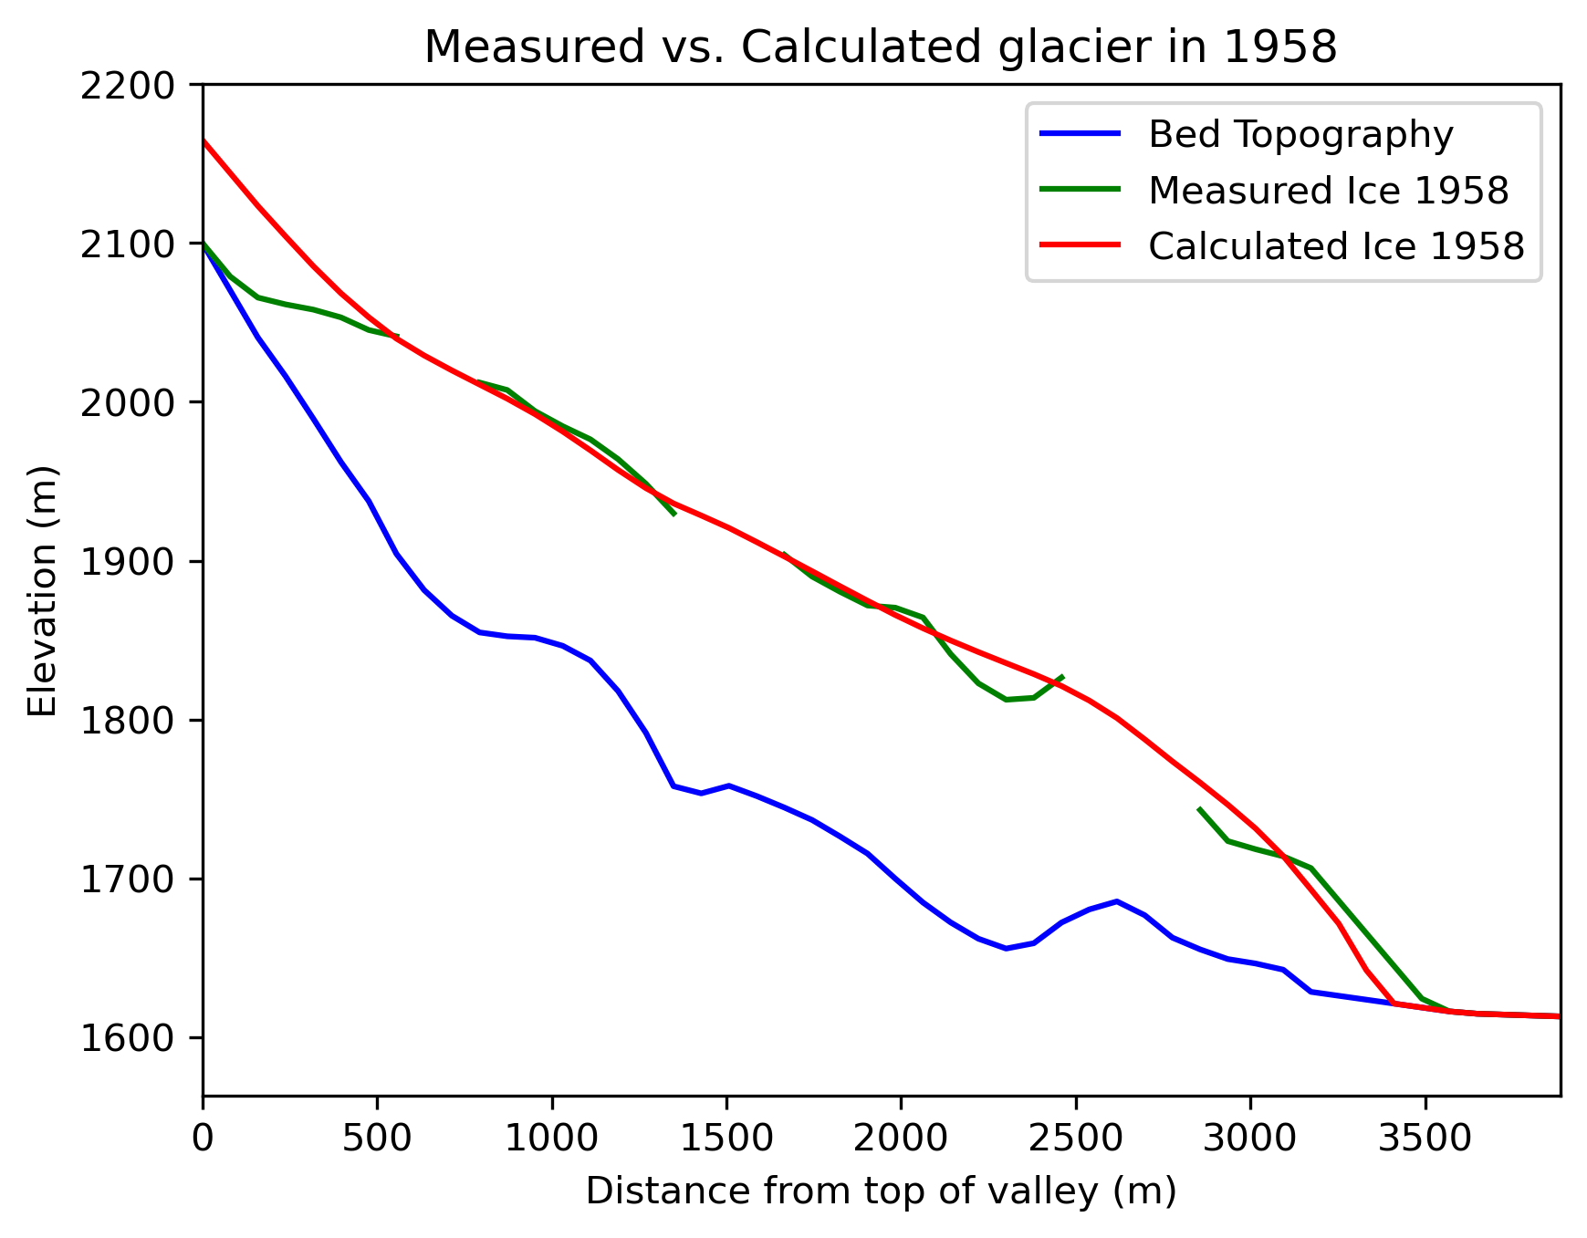
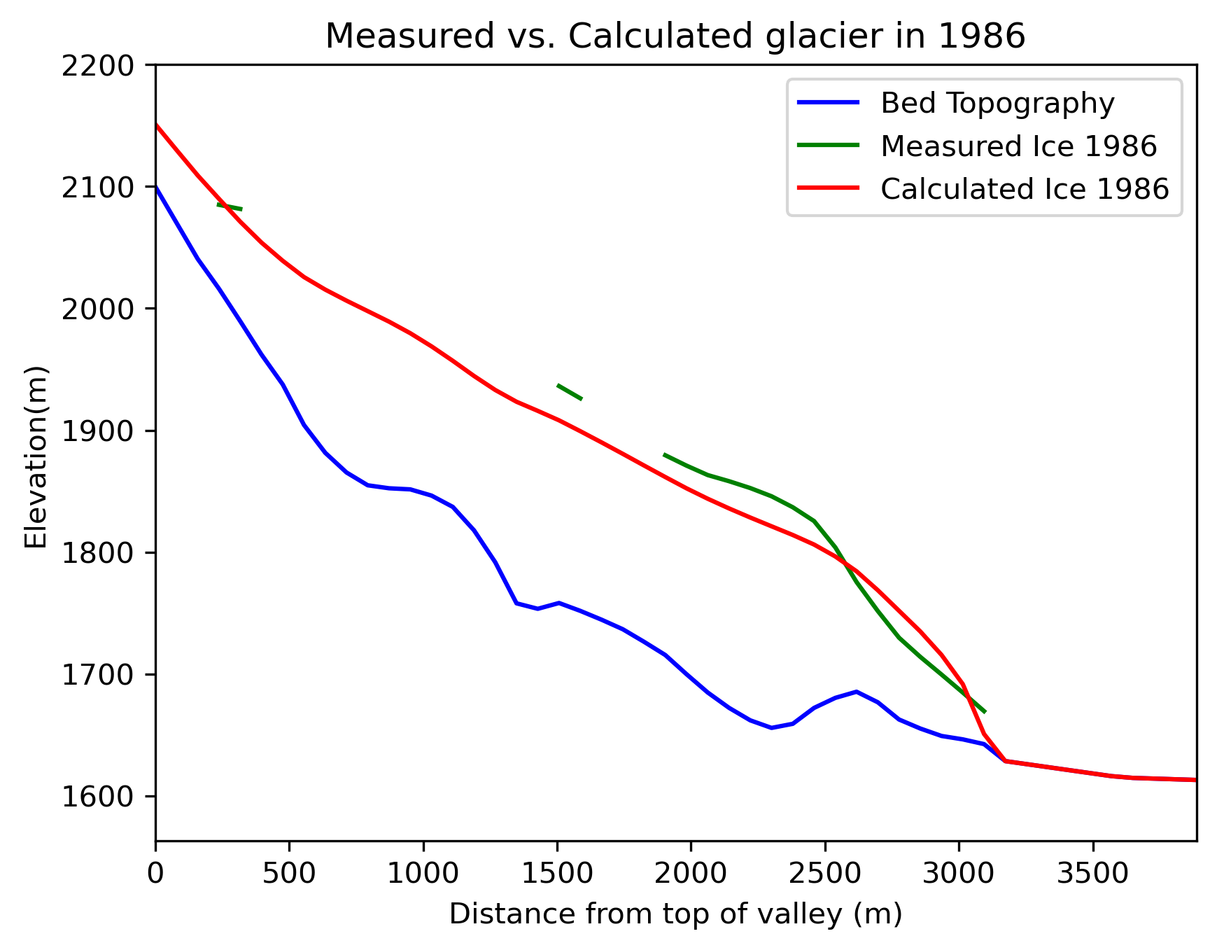
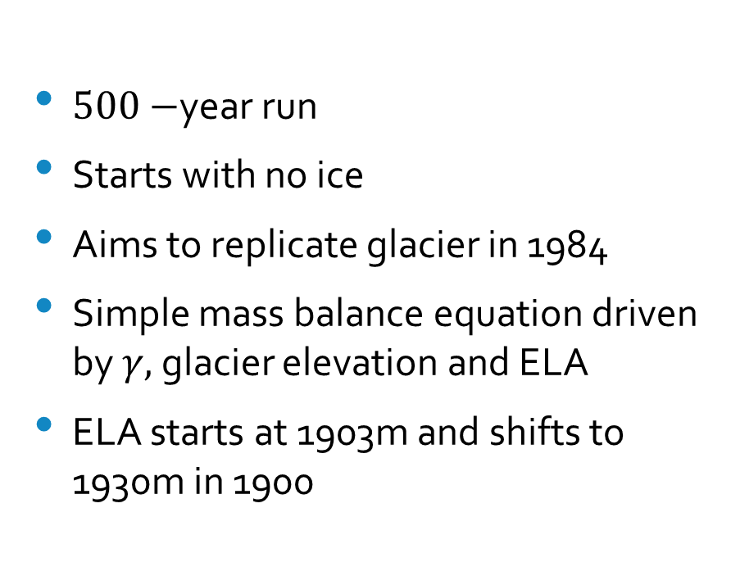
Spinup Run Overview
$500−$year run
Starts with no ice
Aims to replicate glacier in 1984
Simple mass balance equation driven by $γ,$ glacier elevation and ELA
ELA starts at 1903m and shifts to 1930m in 1900

Slide 8
Data Driven Run Overview
Uses temperature and precipitation data for mass balance model [1]
Requires seven input parameters to run: ice melt factor, snow melt factor, monthly temperature lapse rates, accumulation factor lower bound, accumulation factor upper bound, avalanche percentage and precipitation conversion factor
Runs from 1984-2024

Slide 9
Data Used for Model
Temperature and precipitation data from Diablo Dam weather station at 272m
Available from 1984-2024 and missing 298 days of temperature data and 292 days of precipitation data
Empirically calculated monthly temperature lapse rates calculated to adjust temperature
Precipitation conversion factor of 1.58 used to adjust precipitation [1]
Glacier area and mass balance data from the USGS
Centerline bed topography calculated from bed topography data from Robert Jacobel [2]

Slide 10
Ice Dynamics
SIA equations used to model ice dynamics
Assumptions:
One-dimensional
No basal sliding
Gravity is only driver of ice
Horizontal glacier dimensions are much larger than vertical dimensions

Slide 11
Mass Balance
Summer:
Above the ELA, calculated by temperature and snow melt factor
Below the ELA, calculated by temperature and melt factor that linearly increases from snow melt factor to ice melt factor
This assumes that the glacier surface above the ELA is always snow and transitions from snow to ice below the ELA
ELA calculated using previous year’s mass balance
Winter:
Calculated by precipitation, precipitation conversion factor and accumulation factor
Accumulation factor linearly increases from a lower bound to an upper bound by the end of model run

Slide 12
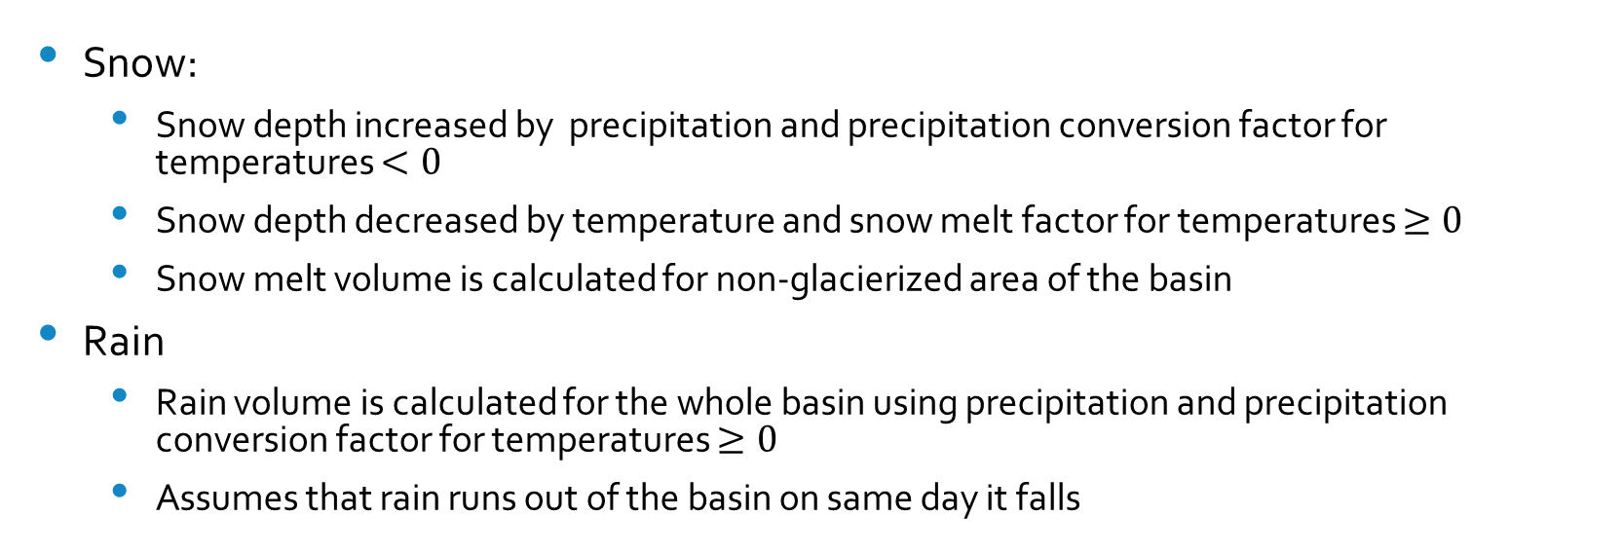
Precipitation Model
Snow:
Snow depth increased by precipitation and precipitation conversion factor for temperatures $<0$
Snow depth decreased by temperature and snow melt factor for temperatures $≥0$
Snow melt volume is calculated for non-glacierized area of the basin
Rain
Rain volume is calculated for the whole basin using precipitation and precipitation conversion factor for temperatures $≥0$
Assumes that rain runs out of the basin on same day it falls

Slide 13
Avalanche Model
Avalanches snow above 2123m on a randomly chosen date every year between January and March
Amount of snow controlled by avalanche percentage (32%)
Removes snow above 2123m and evenly distributes it below 1900m
Purpose: move snow from higher elevations to lower elevations where more can melt during the summer

Slide 14
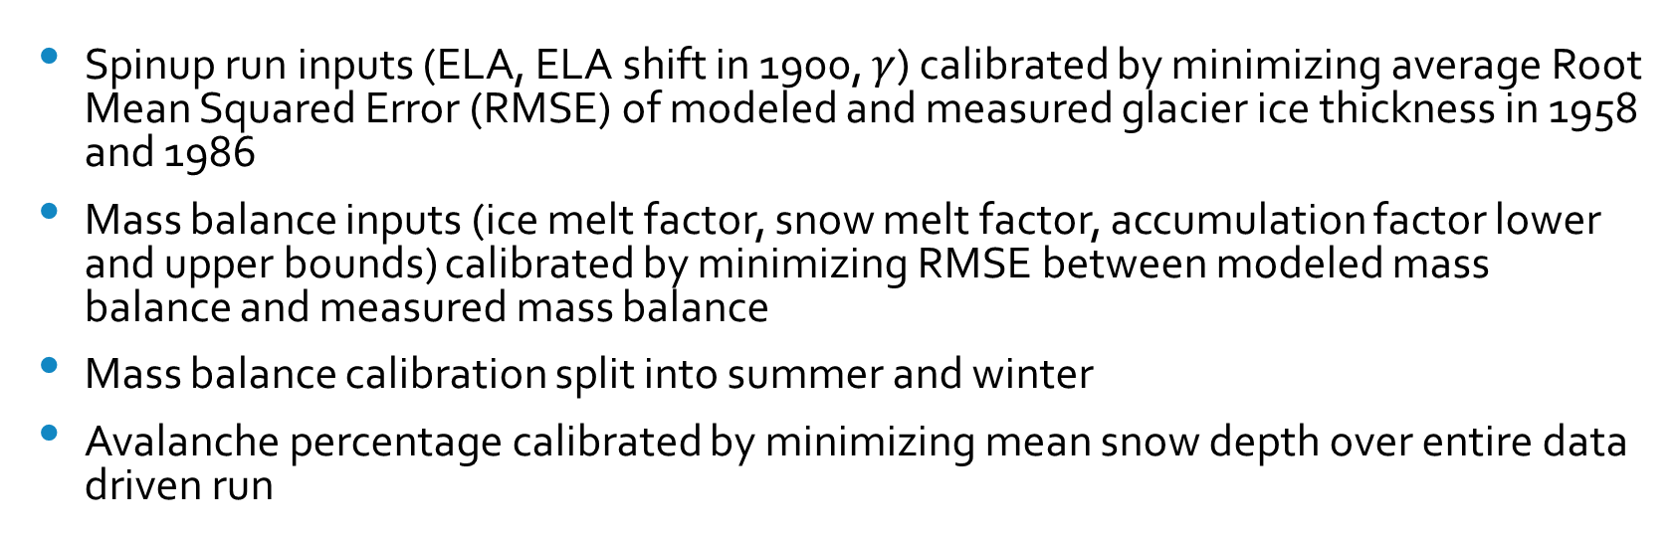
Calibration
Spinup run inputs (ELA, ELA shift in 1900, $γ$) calibrated by minimizing average Root Mean Squared Error (RMSE) of modeled and measured glacier ice thickness in 1958 and 1986
Mass balance inputs (ice melt factor, snow melt factor, accumulation factor lower and upper bounds) calibrated by minimizing RMSE between modeled mass balance and measured mass balance
Mass balance calibration split into summer and winter
Avalanche percentage calibrated by minimizing mean snow depth over entire data driven run

Slide 15
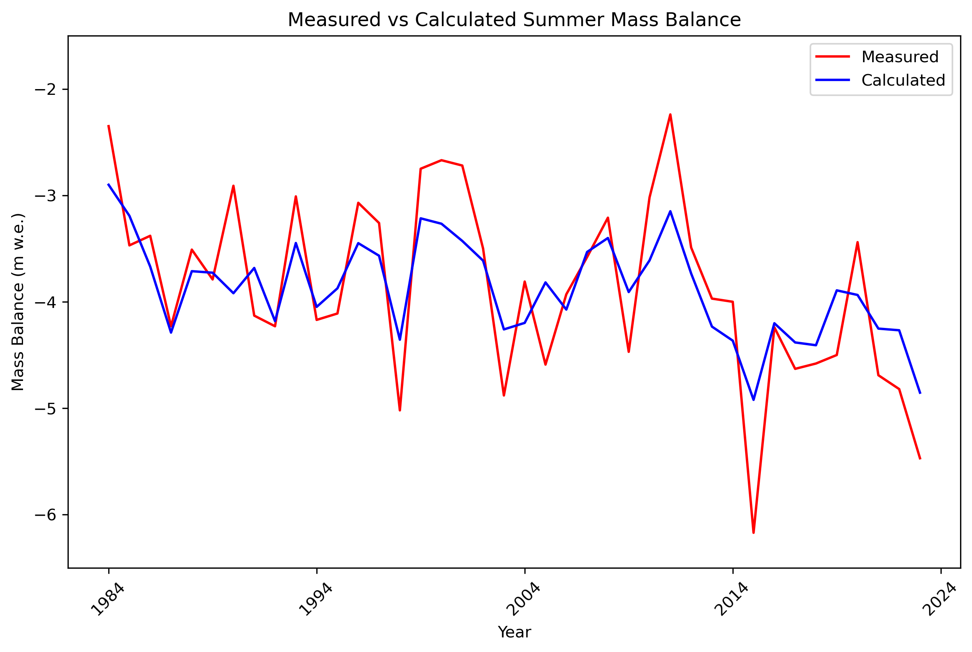
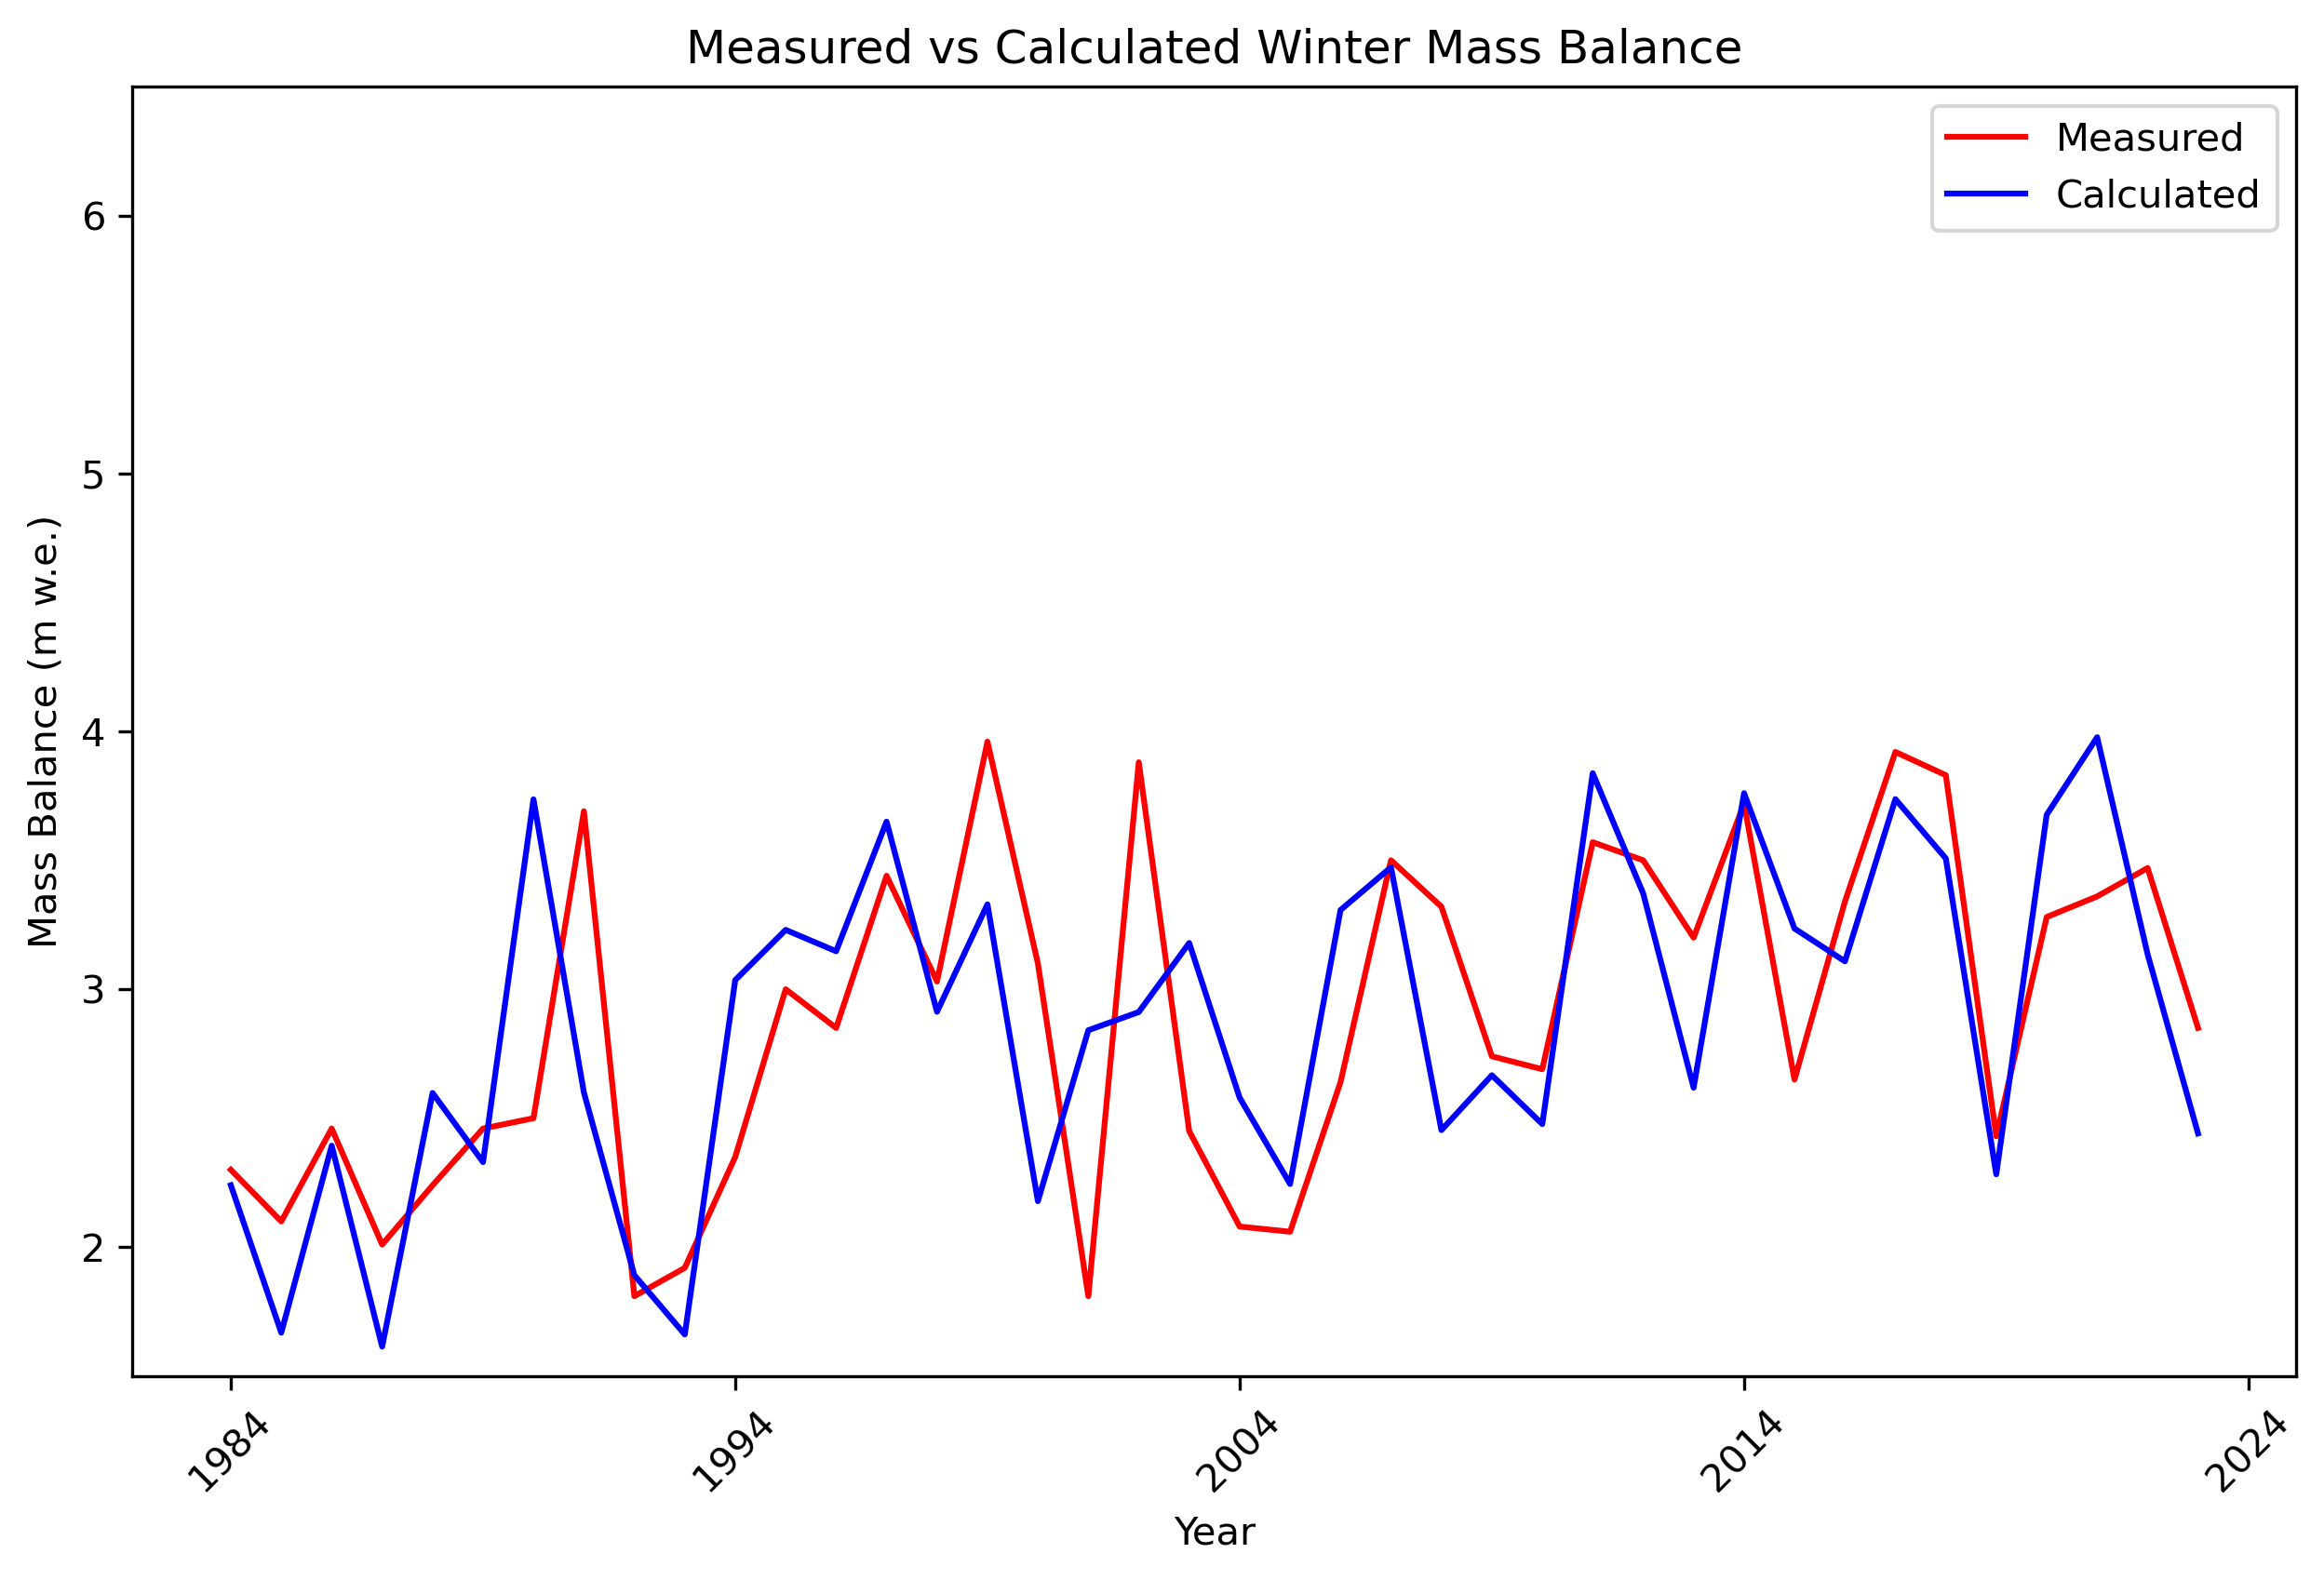
Mass Balance Model Accuracy
Summer mass balance RMSE: 0.50m
Winter mass balance RMSE: 0.53m

Slide 16
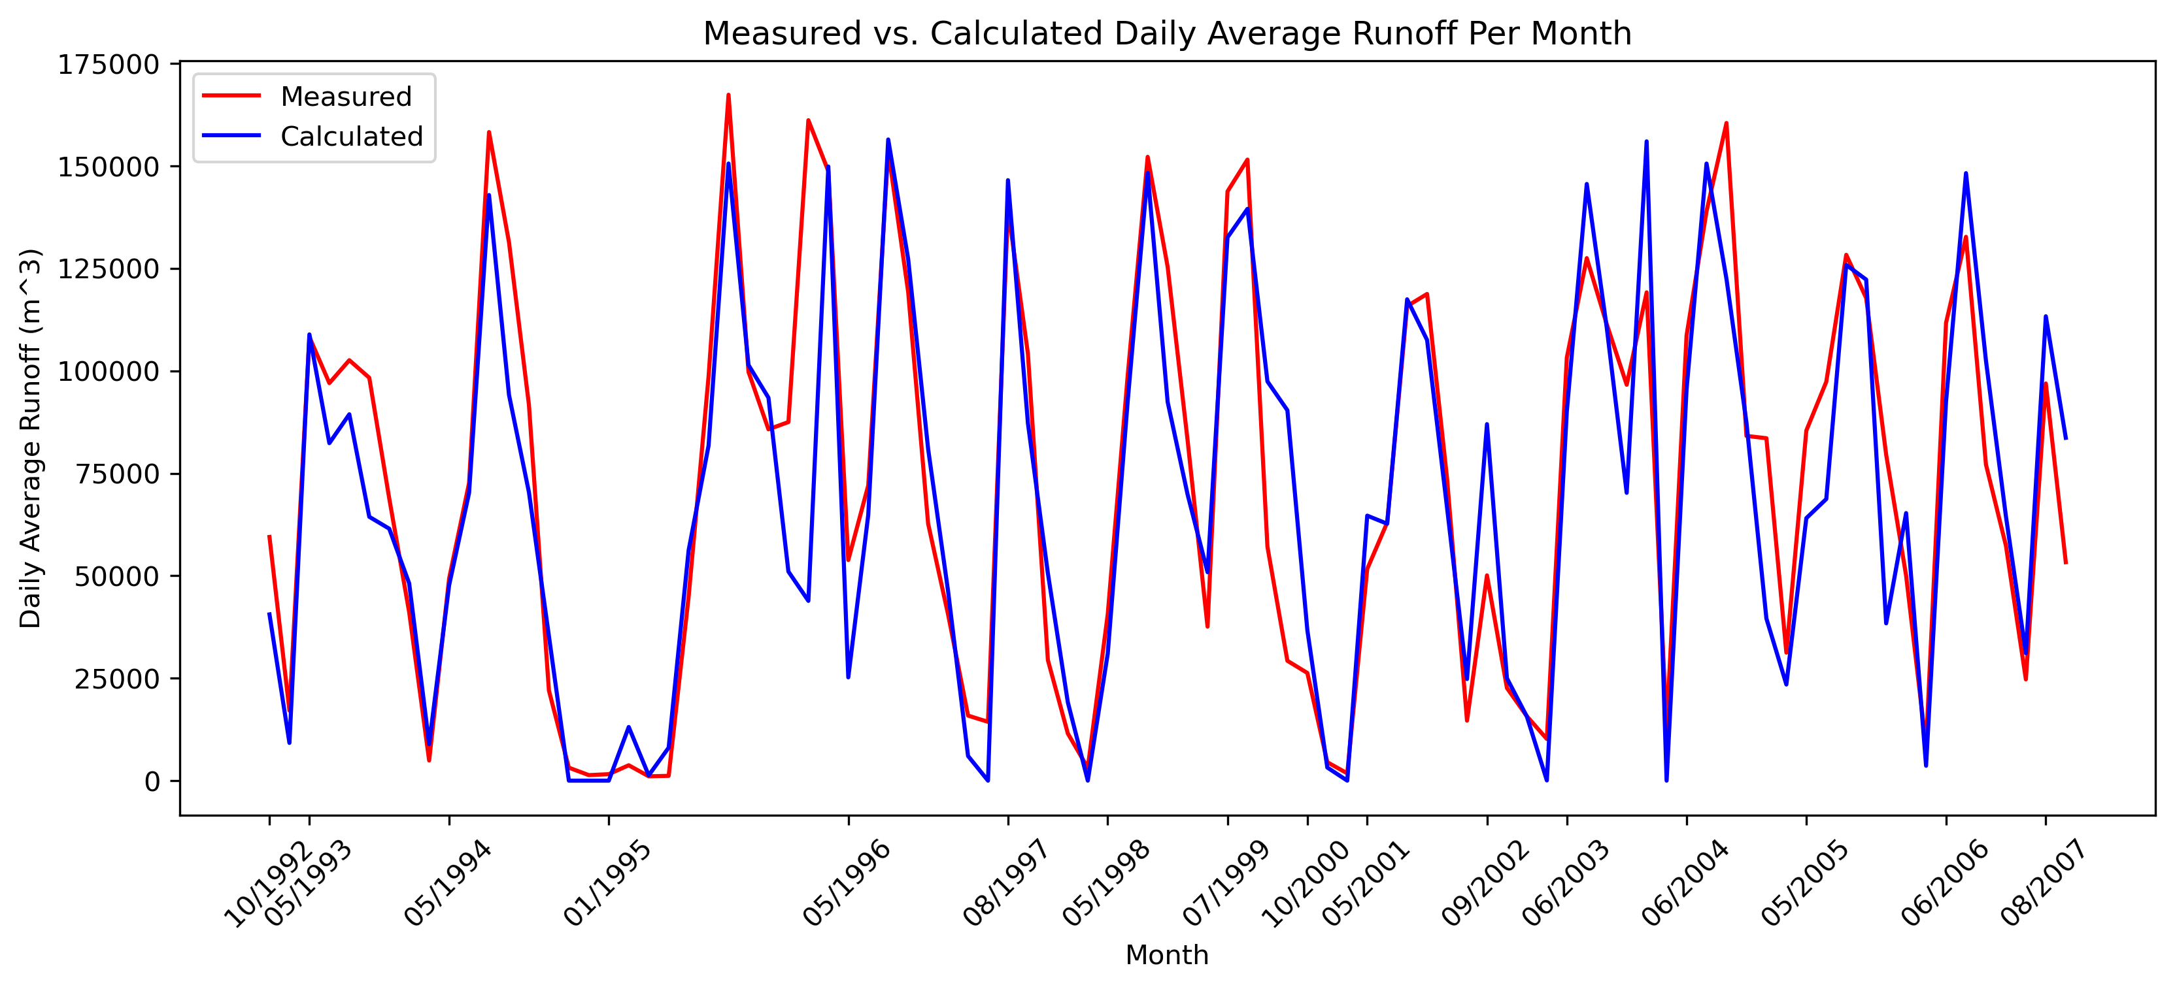
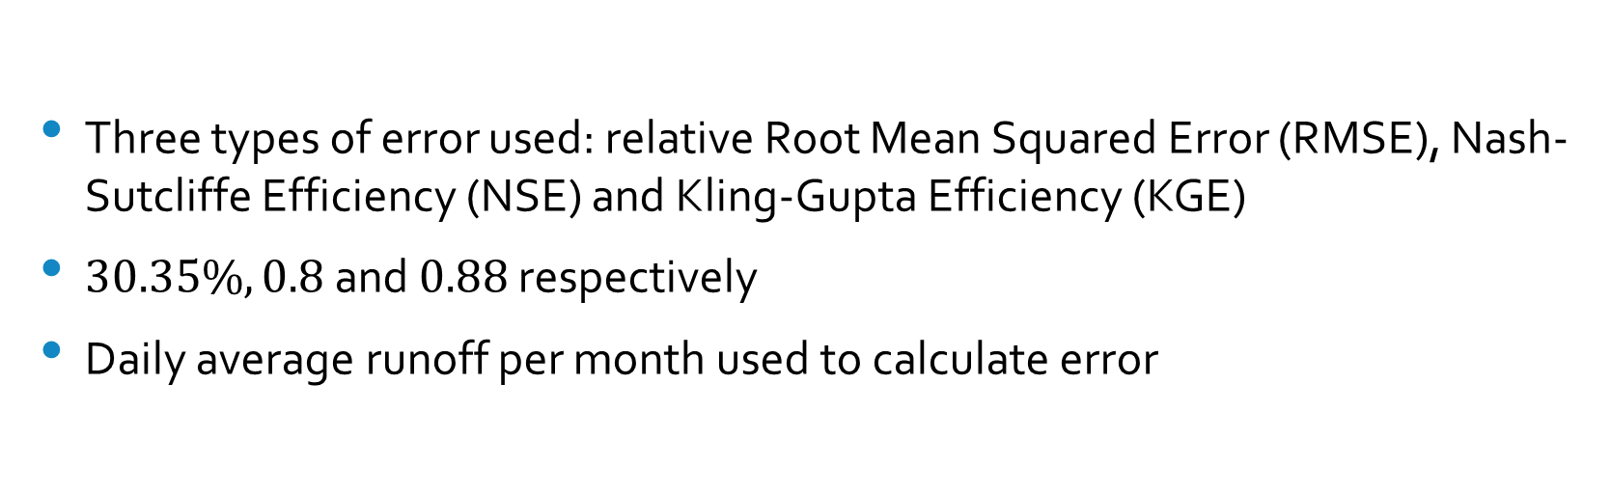
Runoff Model Accuracy
Three types of error used: relative Root Mean Squared Error (RMSE), Nash-Sutcliffe Efficiency (NSE) and Kling-Gupta Efficiency (KGE)
$30.35\%, 0.8$ and $0.88$ respectively
Daily average runoff per month used to calculate error

Slide 17
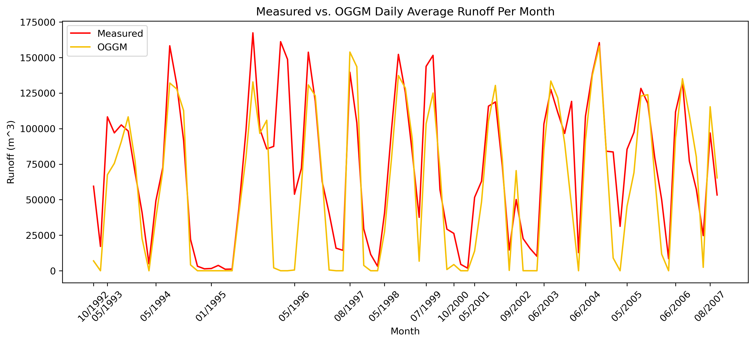
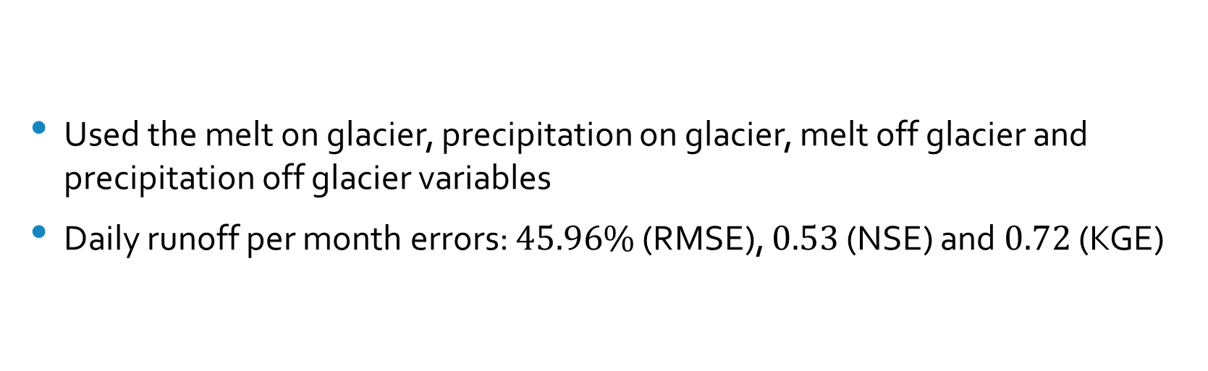
OGGM Accuracy
Used the melt on glacier, precipitation on glacier, melt off glacier and precipitation off glacier variables
Daily runoff per month errors: $45.96\%$ (RMSE), $0.53$ (NSE) and $0.72$ (KGE)

Slide 18
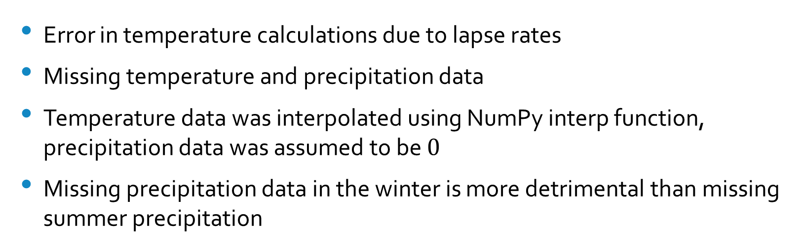
Reasons for Runoff Model Error
Error in temperature calculations due to lapse rates
Missing temperature and precipitation data
Temperature data was interpolated using NumPy interp function, precipitation data was assumed to be $0$
Missing precipitation data in the winter is more detrimental than missing summer precipitation
Notes:
November 1995 has very high error, not missing data. Most likely due to a large amount of precip falling and model calculating it falling as snow when it most likely fell as rain
September 1997, missing temp and precip data for the whole month. Error is ~29%, roughly the same as average rmse, probably due to not much precip falling and if precip did fall it was rain and the glacier melt would overshadow that

Slide 19
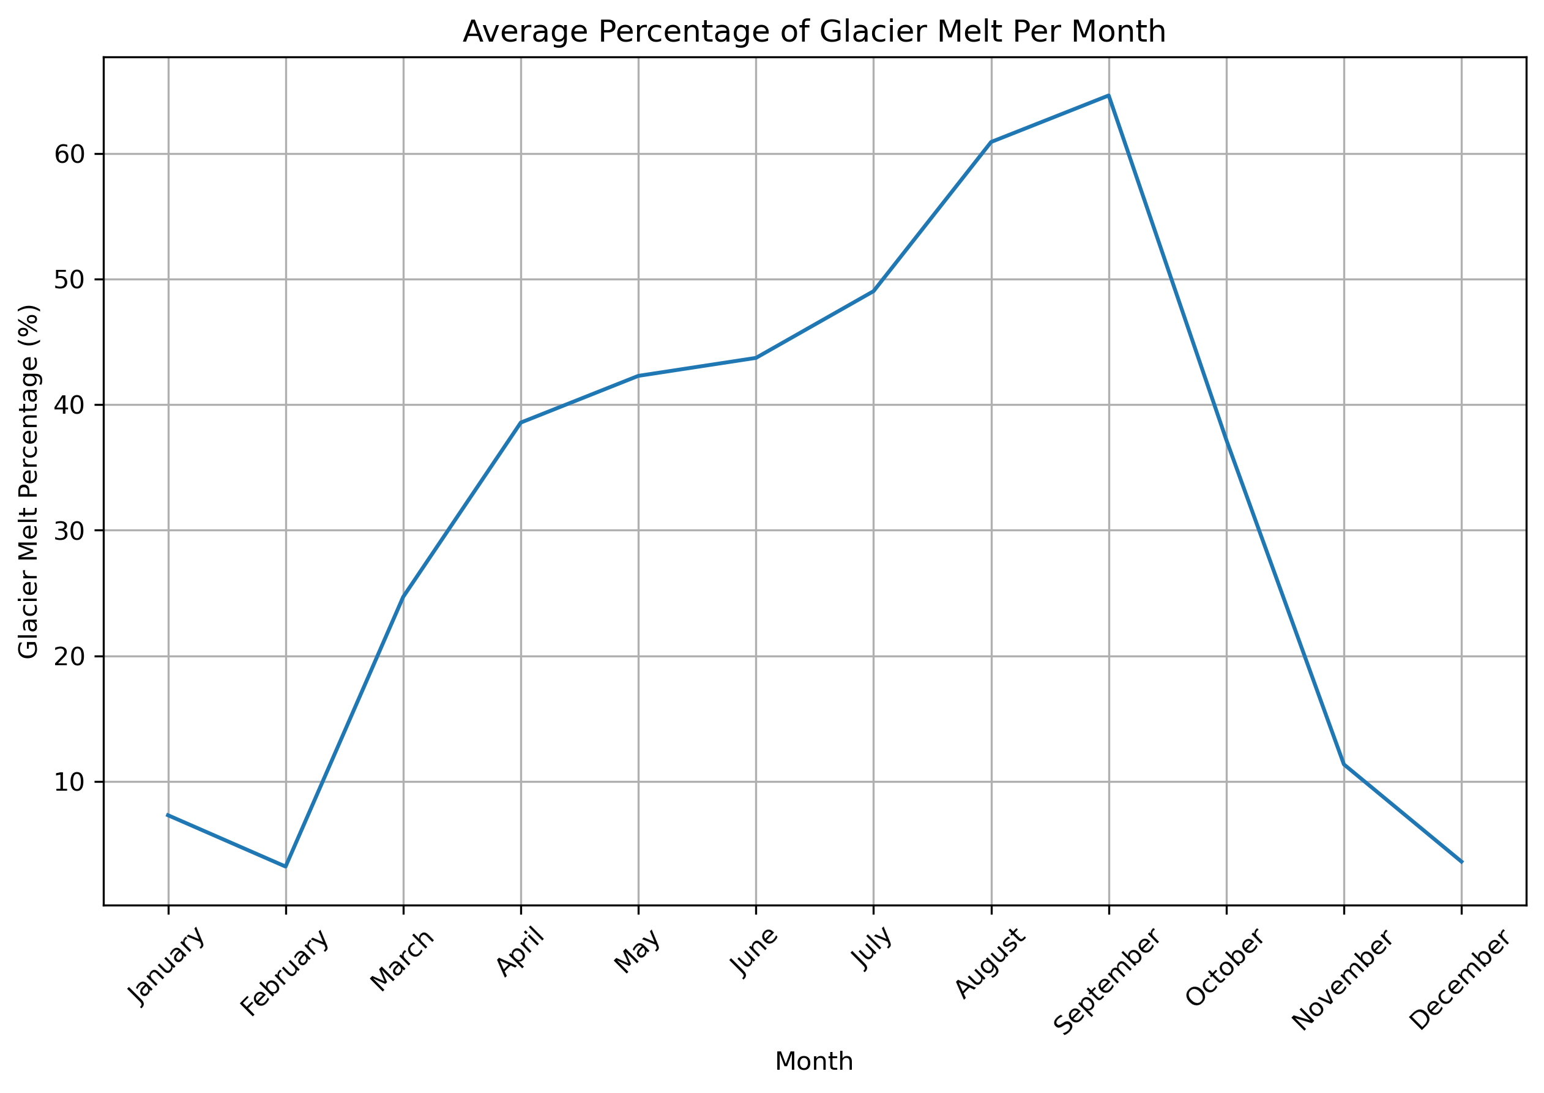
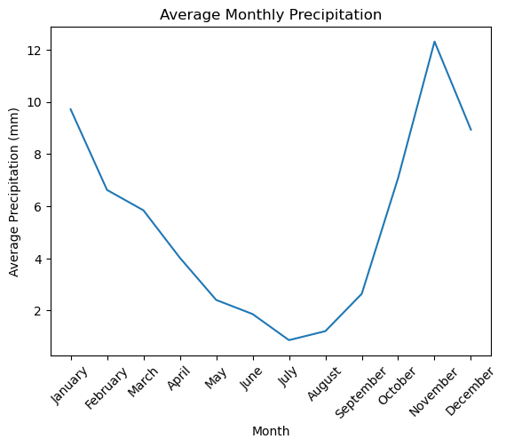
Interpretation of Model Results
Snow and ice melt from the glacier contributes roughly half (47.39%) of the total basin runoff throughout the year
This is much higher during the summer when the precipitation is lower

Slide 20
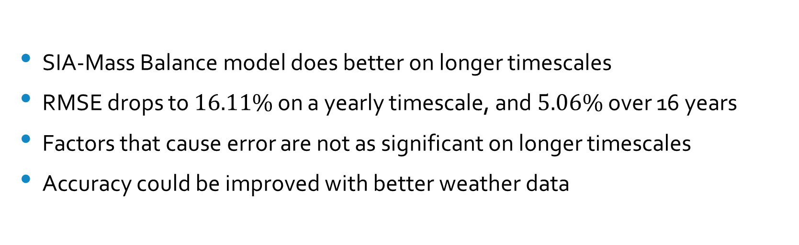
Overall Model Performance
SIA-Mass Balance model does better on longer timescales
RMSE drops to $16.11\%$ on a yearly timescale, and $5.06\%$ over 16 years
Factors that cause error are not as significant on longer timescales
Accuracy could be improved with better weather data

Slide 21
Implications of Research
Complicated and computationally intensive models are not required to model runoff on longer timescales
Ice dynamics do not matter for modeling runoff from small mountain glaciers
When ice flux set to zero, runoff error does not increase significantly

Slide 22
Applications
Less computationally intensive runoff models for glacier modeling or water resource management
Could be used to predict glacial outburst floods
Compare modeled and measured runoff, if measured is much lower than modeled, then water could be stored in the glacier.

Slide 23
Future Work
Improve precipitation model:
Dry and wet temperature lapse rates
Use monthly average precipitation when no precipitation data is available
Use supplementary precipitation data source
Run model for glacier near South Cascade Glacier with same input parameters to test how region or climate specific they are
Run the model into the future with modeled climate data to see how the glacier and basin runoff evolve

Slide 24
Conclusion
Yes, a simple SIA-Mass Balance model can be used to model the runoff from small mountain glaciers
Better accuracy on longer timescales, limited accuracy on shorter timescales
SIA-Mass Balance model does better than OGGM
Improvements could be made to precipitation model to increase accuracy

Slide 25
Acknowledgments
Thanks to the USGS for establishing the Benchmark Glacier Program that supported the collection of temperature, precipitation, mass balance, area and runoff data of the South Cascade Glacier
Thanks to Robert Jacobel for providing me with the bed topography data of the South Cascade Glacier
Thanks to my advisors: Professors Jed Brown, Robert Anderson and Bradley Markle and my parents Kevin and Eileen Stone for supporting me throughout this project

Slide 26

Questions?

Slide 27
References
Barnett, T. P., Adam, J. C., & Lettenmaier, D. P. (2005). Potential impacts of a warming climate on water availability in snow-dominated regions. Nature, 438(7066), 303–309. https://doi.org/10.1038/nature04141
Bidlake, W. R., Josberger, E. G., & Savoca, M. E. (2004). Water, ice, and meteorological measurements at South Cascade Glacier, Washington, balance year 2002 (Scientific Investigations Report 2004-5089). U.S. Geological Survey. https://doi.org/10.3133/sir20045089
Bidlake, W. R., Josberger, E. G., & Savoca, M. E. (2005). Water, ice, and meteorological measurements at South Cascade Glacier, Washington, balance year 2003 (Scientific Investigations Report 2005-5210). U.S. Geological Survey. https://doi.org/10.3133/sir20055210
Bidlake, W. R., Josberger, E. G., & Savoca, M. E. (2007). Water, ice, and meteorological measurements at South Cascade Glacier, Washington, balance years 2004 and 2005 (Scientific Investigations Report 2007-5055). U.S. Geological Survey. https://doi.org/10.3133/sir20075055
Bidlake, W. R., Josberger, E. G., & Savoca, M. E. (2010). Modeled and measured glacier change and related glaciological, hydrological, and meteorological conditions at South Cascade Glacier, Washington, balance and water years 2006 and 2007 (Scientific Investigations Report 2010–5143). U.S. Geological Survey. https://doi.org/10.3133/sir20105143
Eis, A., Bahr, D. B., O’Neel, S., & Elsberg, D. H. (2021). Reconstruction of past glacier changes with an ice-flow glacier model: Proof of concept and validation. Frontiers in Earth Science, 9, 595755. https://doi.org/10.3389/feart.2021.595755
Farinotti, D., Huss, M., Bauder, A., Funk, M., Truffer, M., & Gillet-Chaulet, F. (2020). Results from the Ice Thickness Models Intercomparison eXperiment Phase 2 (ITMIX2). Frontiers in Earth Science, 8, 571923. https://doi.org/10.3389/feart.2020.571923
Fountain, A. G., & Tangborn, W. V. (1985). The effect of glaciers on streamflow variations. Water Resources Research, 21(4), 579–586. https://doi.org/10.1029/WR021i004p00579
Fountain, A. G., & Jacobel, R. W. (1997). Advances in ice radar studies of a temperate alpine glacier, South Cascade Glacier, Washington, USA. Annals of Glaciology, 24, 303–308. https://doi.org/10.3189/S0260305500014292
GlaThiDa Consortium. (2020). Glacier Thickness Database 3.1.0 [Dataset]. World Glacier Monitoring Service. https://doi.org/10.5904/wgmsglathida-2020-10
GLIMS Consortium. (2005). GLIMS Glacier Database (Version 1) [Dataset]. National Snow and Ice Data Center. https://doi.org/10.7265/N5V98602
Krimmel, R. M. (1993). Mass balance, meteorological, and runoff measurements at South Cascade Glacier, Washington, 1992 balance year (Open-File Report 93-640). U.S. Geological Survey. https://doi.org/10.3133/ofr93640
Krimmel, R. M. (1994). Runoff, precipitation, mass balance, and ice velocity measurements at South Cascade Glacier, Washington, 1993 balance year (Water-Resources Investigations Report 94-4139). U.S. Geological Survey.
Krimmel, R. M. (1995). Water, ice, and meteorological measurements at South Cascade Glacier, Washington, 1994 balance year (Water-Resources Investigations Report 95-4162). U.S. Geological Survey.
Krimmel, R. M. (1996). Water, ice, and meteorological measurements at South Cascade Glacier, Washington, 1995 balance year (Water-Resources Investigations Report 96-4174). U.S. Geological Survey.
Krimmel, R. M. (1997). Water, ice, and meteorological measurements at South Cascade Glacier, Washington, 1996 balance year (Water-Resources Investigations Report 97-4143). U.S. Geological Survey.
Krimmel, R. M. (1998). Water, ice, and meteorological measurements at South Cascade Glacier, Washington, 1997 balance year (Water-Resources Investigations Report 98-4090). U.S. Geological Survey.
Krimmel, R. M. (1999). Water, ice, meteorological and speed measurements at South Cascade Glacier, Washington, 1998 balance year (Water-Resources Investigations Report 99-4049). U.S. Geological Survey.
Krimmel, R. M. (2001). Water, ice, meteorological, and speed measurements at South Cascade Glacier, Washington, 1999 balance year (Water-Resources Investigations Report 00-4265). U.S. Geological Survey.
Krimmel, R. M. (2002). Water, ice, and meteorological measurements at South Cascade Glacier, Washington, 2000–01 balance years (Water-Resources Investigations Report 02-4165). U.S. Geological Survey.
Le Meur, E., Gagliardini, O., Zwinger, T., & Ruokolainen, J. (2004). Glacier flow modelling: A comparison of the shallow ice approximation and the full-Stokes solution. Comptes Rendus Physique, 5(7), 709–722. https://doi.org/10.1016/j.crhy.2004.10.001
Maussion, F., Butenko, A., Champollion, N., Dusch, M., Eis, J., Fourteau, K., Gregor, P., Jarosch, A. H., Landmann, J., Oesterle, F., Recinos, B., Rothenpieler, T., Vlug, A., Wild, C. T., & Marzeion, B. (2019). The Open Global Glacier Model (OGGM) v1.1. Geoscientific Model Development, 12(3), 909–931. https://doi.org/10.5194/gmd-12-909-2019
Naz, B. S., Frans, C. D., Clarke, G. K. C., Burns, P., & Lettenmaier, D. P. (2014). Modeling the effect of glacier recession on streamflow response using a coupled glacio-hydrological model. Hydrology and Earth System Sciences, 18, 787–802. https://doi.org/10.5194/hess-18-787-2014
Rasmussen, L. A. (2009). South Cascade Glacier mass balance, 1935–2006. Annals of Glaciology, 50(50), 215–220. https://doi.org/10.3189/172756409787769755
U.S. Geological Survey Benchmark Glacier Program. (2020). USGS benchmark glacier project comprehensive data collection [Data release]. https://doi.org/10.5066/P9AGXQSR

