Slide 1

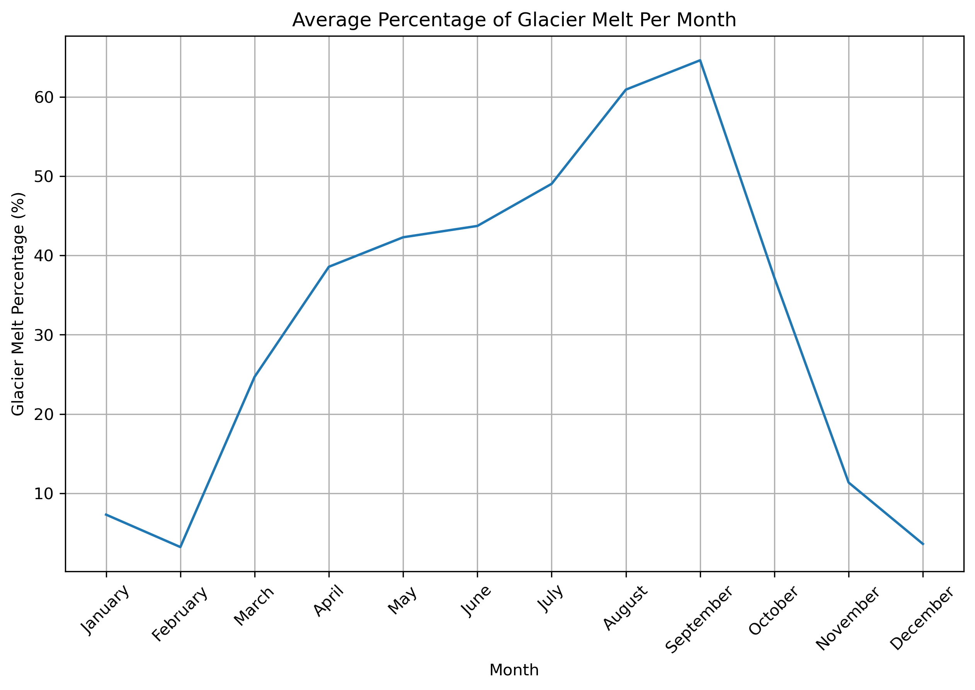
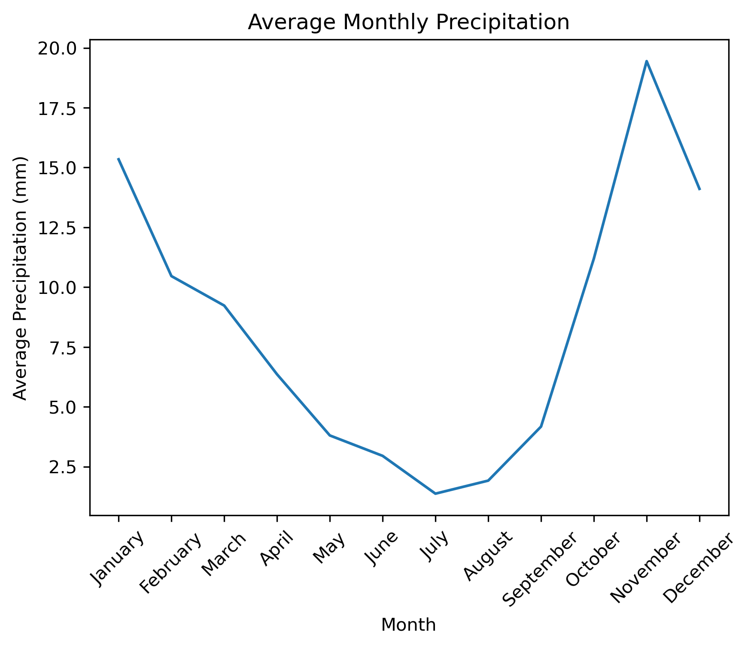
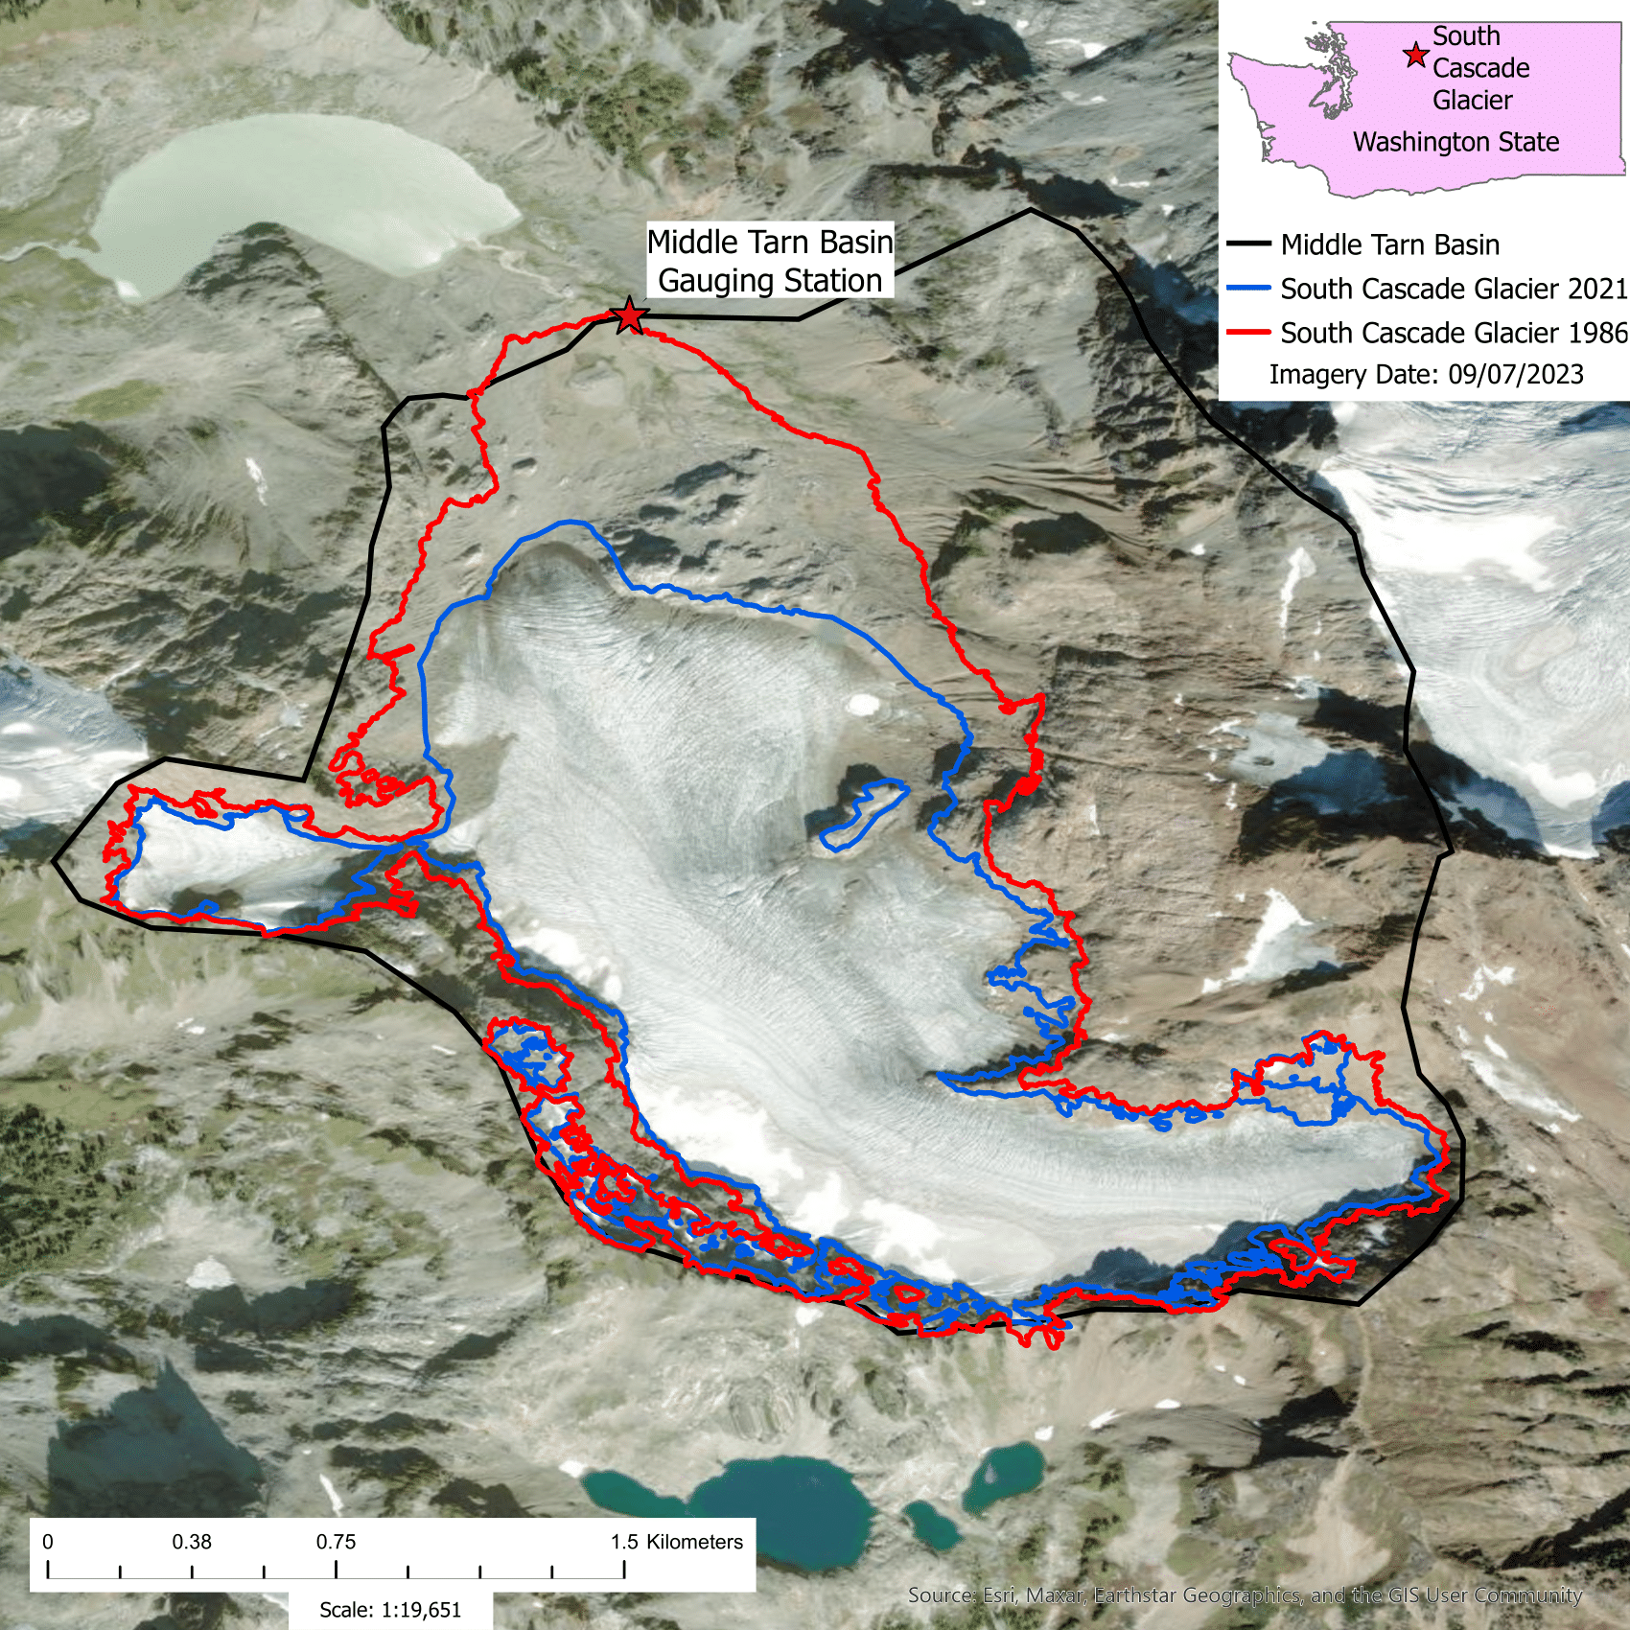
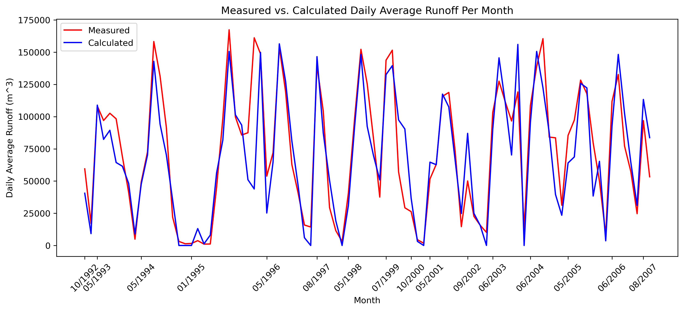
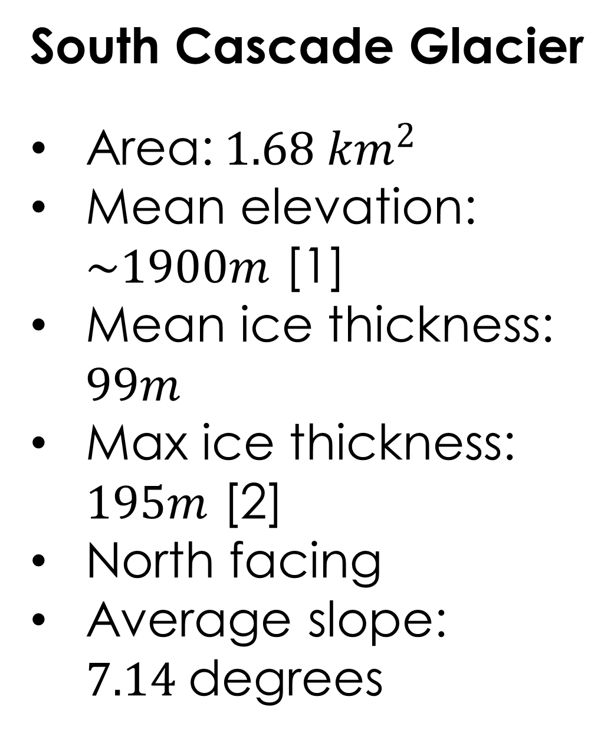
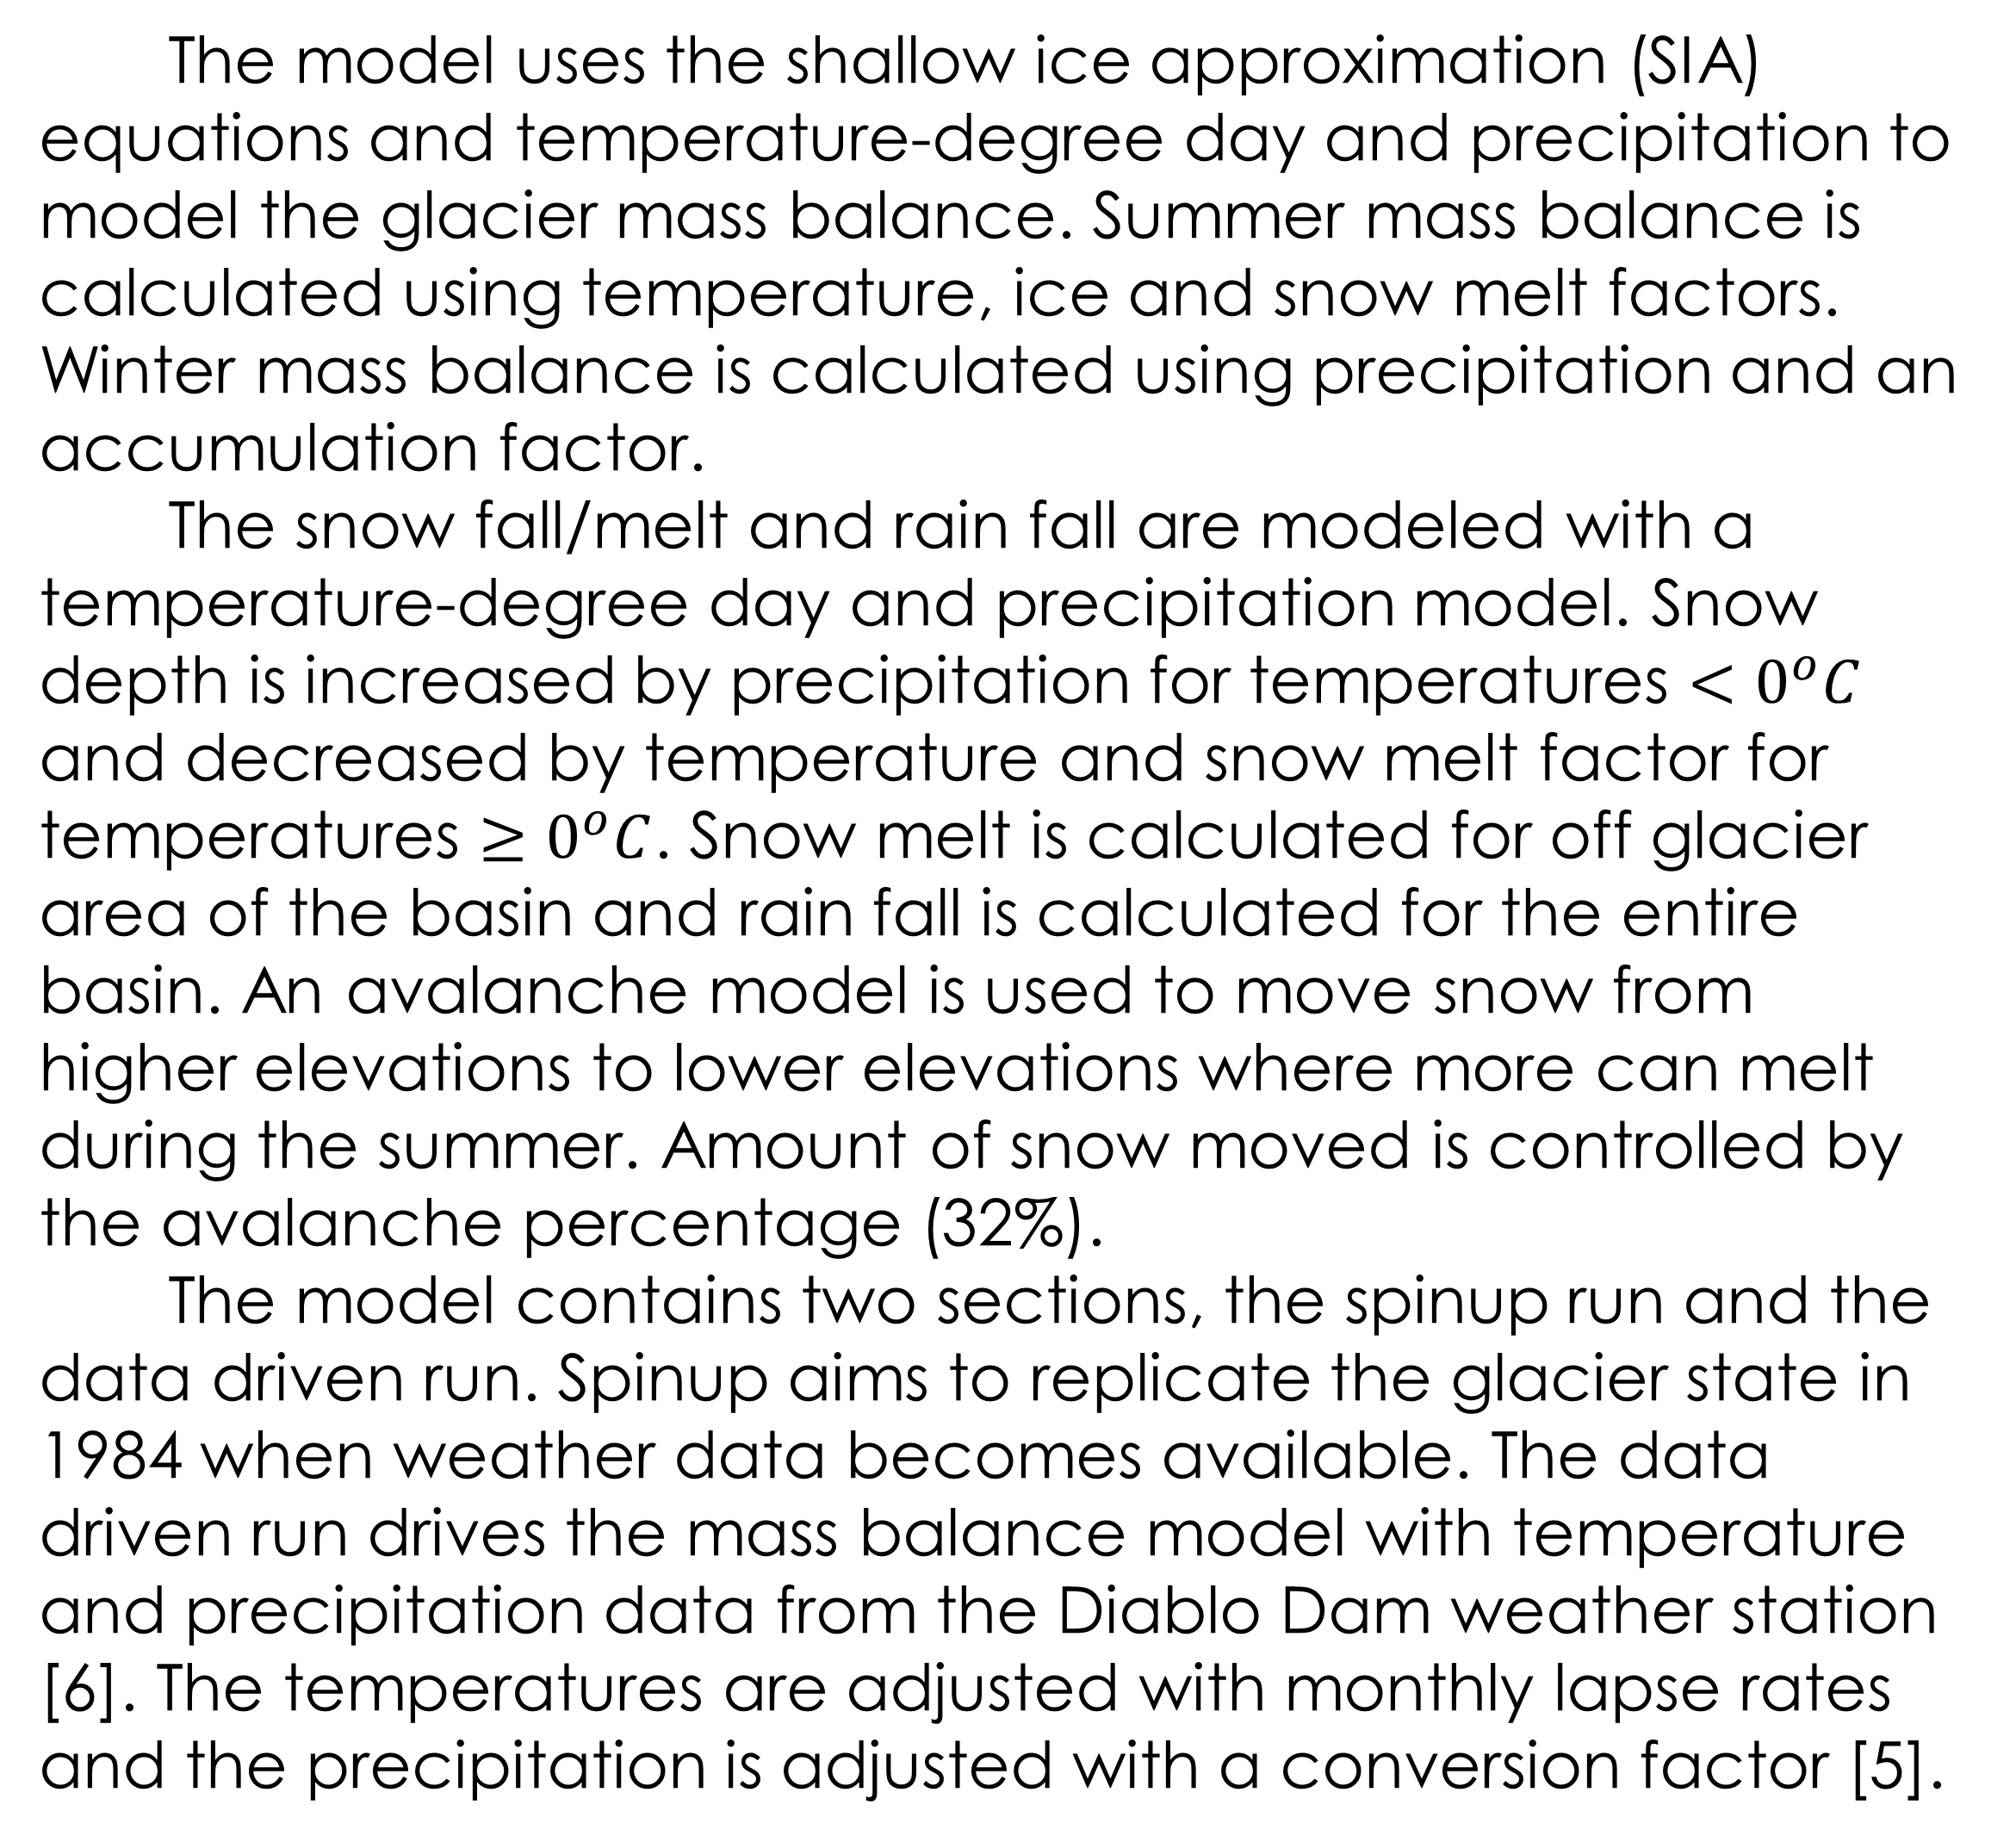
Can a Shallow Ice Approximation-Mass Balance Model Be Used to Calculate the Water Output of Alpine Glaciers
By Kieran Stone
Thesis advisors: Jed Brown, Robert Anderson and Bradley Markle
Overview
Methods
Improvements and Future Work
Glaciers play a significant role in the hydrology of mountain basins. The runoff from these basins is often used as a water source by downstream communities. To understand how these glaciers evolve over time, computer models are used and have proven very effective at modeling these glaciers, but they can get very complex and computationally intensive.
The model uses the shallow ice approximation (SIA) equations and temperature-degree day and precipitation to model the glacier mass balance. Summer mass balance is calculated using temperature, ice and snow melt factors. Winter mass balance is calculated using precipitation and an accumulation factor.
The snow fall/melt and rain fall are modeled with a temperature-degree day and precipitation model. Snow depth is increased by precipitation for temperatures $<0^{o}C$ and decreased by temperature and snow melt factor for temperatures $≥0^{o}C$. Snow melt is calculated for off glacier area of the basin and rain fall is calculated for the entire basin. An avalanche model is used to move snow from higher elevations to lower elevations where more can melt during the summer. Amount of snow moved is controlled by the avalanche percentage (32%).
The model contains two sections, the spinup run and the data driven run. Spinup aims to replicate the glacier state in 1984 when weather data becomes available. The data driven run drives the mass balance model with temperature and precipitation data from the Diablo Dam weather station [6]. The temperatures are adjusted with monthly lapse rates and the precipitation is adjusted with a conversion factor [5].
Introduce dry and wet temperature lapse rates to reduce error in temperature lapse rates
Use monthly average precipitation or supplementary data source for missing temperature data, currently assumed to be 0
Run model for glacier near South Cascade Glacier with same input parameters to test how region or climate specific they are
Run the model into the future with modeled climate data to see how the glacier and basin runoff evolve
Thesis Question
Can a simple SIA - Mass Balance model be used to calculate the water runoff of small mountain glaciers?
This was validated using 91 months of runoff data from 1992-2007 [3]
The SIA-Mass Balance model accuracy compared against Open Global Glacier Model (OGGM) [4]
Conclusions
Limited performance on shorter (monthly) timescales
Model works well on longer (yearly to decadal) timescales
RMSE drops to 16.11% on yearly timescales and 5.06% over the 16 years of runoff data
SIA – Mass Balance model performs better then OGGM
Results
The mass balance model was tuned using measured mass balance data from the USGS and achieved RMSE’s of 0.53m (winter) and 0.5m (summer)
The runoff model has errors of 30.35% (RMSE), 0.8 (NSE) and 0.88 (KGE). This is for the daily average runoff per month. The OGGM model has errors of 45.96% (RMSE), 0.53 (NSE) and 0.72 (KGE).
Study Site
South Cascade Glacier
Area:${ 1.68 km}^{2}$
Mean elevation: $\sim 1900m$ [1]
Mean ice thickness: $99m$
Max ice thickness: $195m$ [2]
North facing
Average slope: $7.14$degrees
References
GLIMS Consortium. (2005). *GLIMS Glacier Database (Version 1)* [Dataset]. National Snow and Ice Data Center. https://doi.org/10.7265/N5V98602
GlaThiDa Consortium. (2020). *Glacier Thickness Database 3.1.0* [Dataset]. World Glacier Monitoring Service. https://doi.org/10.5904/wgmsglathida-2020-10
Krimmel, 1993, 1994, 1995, 1996, 1997, 1998, 1999, 2000, 2001, 2002; Bidlake et al., 2004, 2005, 2007, 2010
Maussion, F., Butenko, A., Champollion, N., Dusch, M., Eis, J., Fourteau, K., Gregor, P., Jarosch, A. H., Landmann, J., Oesterle, F., Recinos, B., Rothenpieler, T., Vlug, A., Wild, C. T., & Marzeion, B. (2019). The Open Global Glacier Model (OGGM) v1.1. *Geoscientific Model Development, 12*(3), 909–931. https://doi.org/10.5194/gmd-12-909-2019
Rasmussen, L. A. (2009). South Cascade Glacier mass balance, 1935–2006. Annals of Glaciology, 50(50), 215–220. https://doi.org/10.3189/172756409787769755
U.S. Geological Survey Benchmark Glacier Program. (2020). USGS benchmark glacier project comprehensive data collection [Data release]. https://doi.org/10.5066/P9AGXQSR
Kieran.Stone@colorado.edu
Notes:
1

