Slide 1
Can a Shallow Ice Approximation Model be used to Model the Water Output of Alpine Glaciers
A Study on the Hochalmkees Glacier, Austrian Alps
By Kieran Stone
10/22/2024

Slide 2
Introduction
Glacial meltwater significantly affects the hydrology of mountain catchments (Fountain & Tangborn, 1985).
Runoff from glaciers contributes to river flow, especially during dry summer months.
Meltwater is crucial for downriver communities.

Slide 3
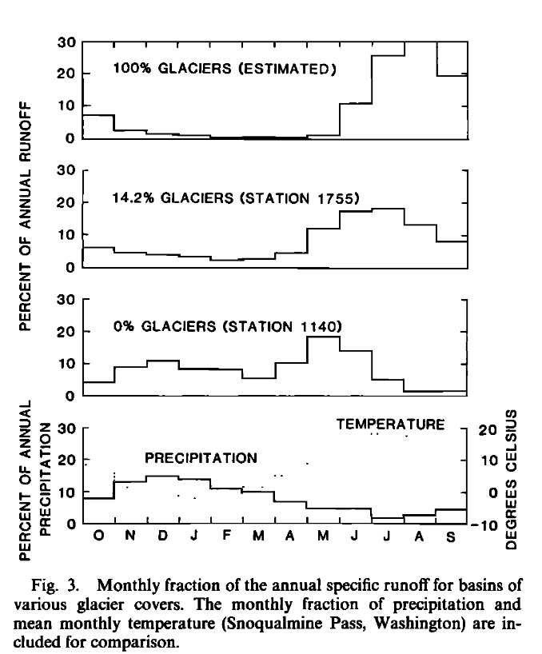
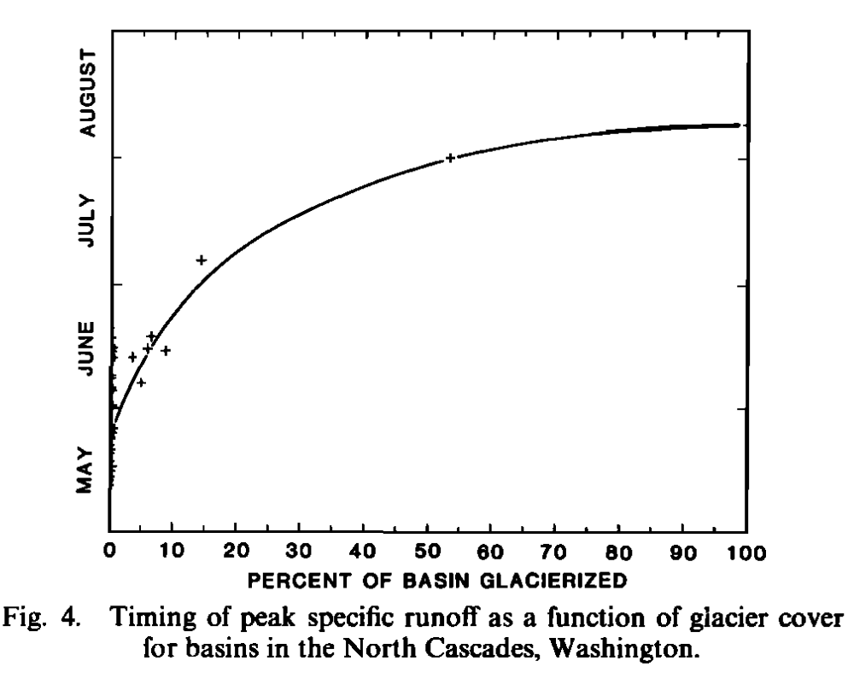
Fountain & Tangborn, 1985

Slide 4
Modeling glaciers
Computers have been used to model glaciers for several decades. (Iken, 1981).
Advanced Ice Sheet Models (AISMs) require significant computational resources (Larour et al., 2012).
AISMs are good at modeling ice dynamics
Notes:
Stokes equations

Slide 5
Shallow Ice Approximation (SIA) vs. Stokes Models
SIA Model:
Simplified model with less computational demand.
Best for glaciers with low aspect ratio (Le Meur et al., 2004).
Stokes Model:
Accurate but computationally expensive.
Crucial for glaciers with complex dynamics (Amaral et al., 2020).
Notes:
SIA makes a lot of assumptions, ignores horizontal stress gradients

Slide 6
Advantages of Using SIA Models
Fast computational time.
Easier to program and run
Suitable for glaciers with low aspect ratios (Le Meur et al., 2004).

Slide 7
Advantages of Stokes Model
More accurate modeling of ice dynamics
3-dimensional
Suitable for a larger range of glacier types

Slide 8
Research Question
Key Question:
How do ice dynamics affect the accuracy of mass balance predictions in small mountain glaciers?
Hypothesis:
Mass balance has a larger effect on output accuracy than ice dynamics for small alpine glaciers.

Slide 9
Case Study: Hochalmkees Glacier
Location: Carinthia region, Austrian Alps.
Size: 2.415 km².
Average elevation: 2936 meters.
Average slope: 18°. (Paul et al., 2020)
Average thickness: 53 meters
Max thickness: 155 meters (GlaThiDa Consortium, 2020)
Low aspect ratio

Slide 10
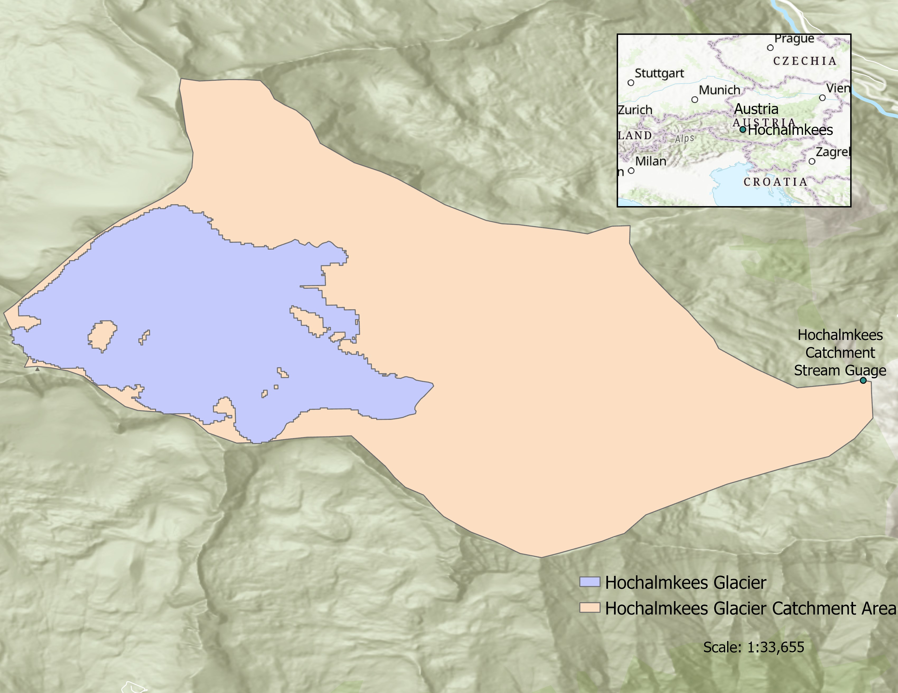

Slide 11
Modeling Approach
1D SIA-Mass Balance model written in Python.
Historical precipitation and temperature data used to calculate mass balance.
Ice dynamics approximated using SIA equations.
Outputs: Glacier water discharge (surface mass loss), compared with Stokes model and stream catchment data (Brunner et al., 2024) .

Slide 12
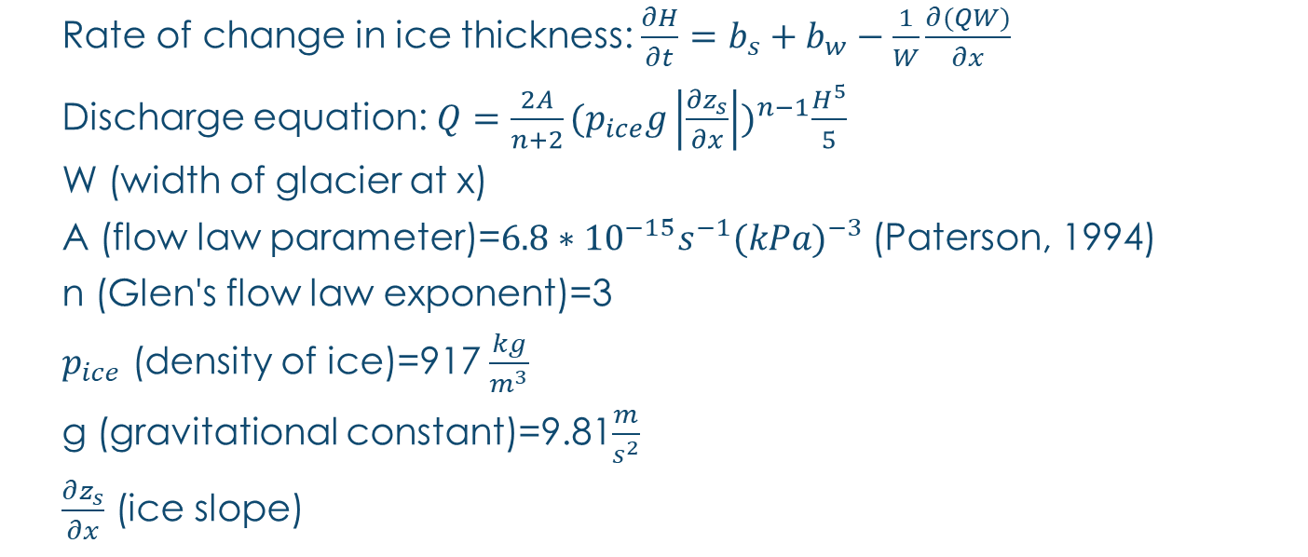
SIA Equations
Rate of change in ice thickness: $\frac{∂H}{∂t}=b_{s}+b_{w}−\frac{1}{W}\frac{∂(QW)}{∂x}$
Discharge equation: $Q=\frac{2A}{n+2}{(p_{ice}g\left|\frac{∂z_{s}}{∂x}\right|)}^{n−1}\frac{H^{5}}{5}$
W (width of glacier at x)
A (flow law parameter)=$6.8∗{10}^{−15}s^{−1}{(kPa)}^{−3}$ (Paterson, 1994)
n (Glen's flow law exponent)=3
$p_{ice}$ (density of ice)=917 $\frac{kg}{m^{3}}$
g (gravitational constant)=9.81$\frac{m}{s^{2}}$
$\frac{∂z_{s}}{∂x}$ (ice slope)

Slide 13
Stokes Model
Stokes equations used in the ISSM model (Larour et al., 2012).
Accounts for complex ice dynamics including stress gradients and basal sliding.
Will be used as a benchmark for SIA model performance.

Slide 14

Validation
Compare SIA model outputs with ISSM Stokes model and actual streamflow data (Brunner et al., 2024).
Calculate accuracy using: $Error=\frac{|measured−modeled|}{modeled}∗100$

Slide 15
Expected Results
SIA model should approximate water discharge with reasonable accuracy for small glaciers.
Stokes model expected to be more accurate but more computationally expensive.
Visualize water discharge per month over a year.
Hypothesis: SIA-Mass Balance model will predict glacial surface mass loss with an accuracy 10-15% of measured data.

Slide 16
Implications of Research
Faster models like SIA can allow for larger, more frequent simulations in hydrological studies.
SIA model may offer a balance between computational efficiency and accuracy.
Could lead to improved water management and better predictions of water availability for communities.

Slide 17
Conclusion
SIA models offer a computationally efficient way to predict water discharge of small mountain glaciers.
The research aims to validate the hypothesis that mass balance influences accuracy more than ice dynamics.
Implications for faster and more efficient glacier modeling.

Slide 18
References
Fountain, A. G., & Tangborn, W. V. (1985). The Effect of Glaciers on Streamflow Variations. Water Resources Research, 21(4), 579-586. https://doi.org/10.1029/WR021i004p00579
Iken, A. (1981). The Effect of the Subglacial Water Pressure on the Sliding Velocity of a Glacier in an Idealized Numerical Model. Journal of Glaciology, 27(97), 407-421. doi: https://doi.org/10.3189/S0022143000011448
E. Larour, H. Seroussi, M. Morlighem, and E. Rignot (2012), Continental scale, high order, high spatial resolution, ice sheet modeling using the Ice Sheet System Model, J. Geophys. Res., 117, F01022, doi: https://doi.org/10.1029/2011JF002140
Le Meur, E., Gagliardini, O., Zwinger, T., & Ruokolainen, J. (2004). Glacier flow modelling: a comparison of the Shallow Ice Approximation and the full-Stokes solution. Comptes Rendus Physique, 5(7), 709-722. https://doi.org/10.1016/j.crhy.2004.10.001.
Amaral, T., Bartholomaus, T. C., & Enderlin, E. M. (2020). Evaluation of Iceberg Calving Models Against Observations From Greenland Outlet Glaciers. Journal of Geophysical Research: Earth Surface, 125(6), e2019JF005444. https://doi.org/10.1029/2019JF005444
GlaThiDa Consortium (2020): Glacier Thickness Database 3.1.0. World Glacier Monitoring Service, Zurich, Switzerland. DOI: https://doi.org/10.5904/wgms-glathida-2020-10
Paul, F., Rastner, P., Azzoni, R. S., Diolaiuti, G., Fugazza, D., Le Bris, R., Nemec, J., Rabatel, A., Ramusovic, M., Schwaizer, G., & Smiraglia, C. (2020). Glacier shrinkage in the Alps continues unabated as revealed by a new glacier inventory from Sentinel-2. Earth Syst. Sci. Data, 12, 1805-1821. https://doi.org/10.5194/essd-12-1805-2020
Brunner, M. I., & Gilleland, E. (2024). Future changes in floods, droughts, and their extents in the Alps: A sensitivity analysis with a non‐stationary stochastic streamflow generator. Earth's Future, 12, e2023EF004238. https://doi.org/10.1029/2023EF004238
Paterson, W. S. B. (1994), The Physics of Glaciers, 3rd ed., 481 pp., Else-vier, New York.

