Slide 1
Can a Shallow Ice Approximation - Mass Balance Model Be Used to Model the Water Output of Alpine Glaciers?
By Kieran Stone
Advisors: Jed Brown, Robert Anderson and Bradley Markle

Slide 2
Background
Glacial melting plays a significant role in the hydrology of mountain basins [1]
Computer models of these glaciers are very effective at modeling these glaciers [2,3]
These models can get very complex and computationally expensive

Slide 3
Prior Research

Slide 4
Thesis Question
Can a simple SIA - Mass Balance model be used to model the water runoff of small mountain glaciers?
Expect that the mass balance will have a larger effect on the runoff than the ice dynamics
Compare SIA-Mass Balance with OGGM model [4]

Slide 5
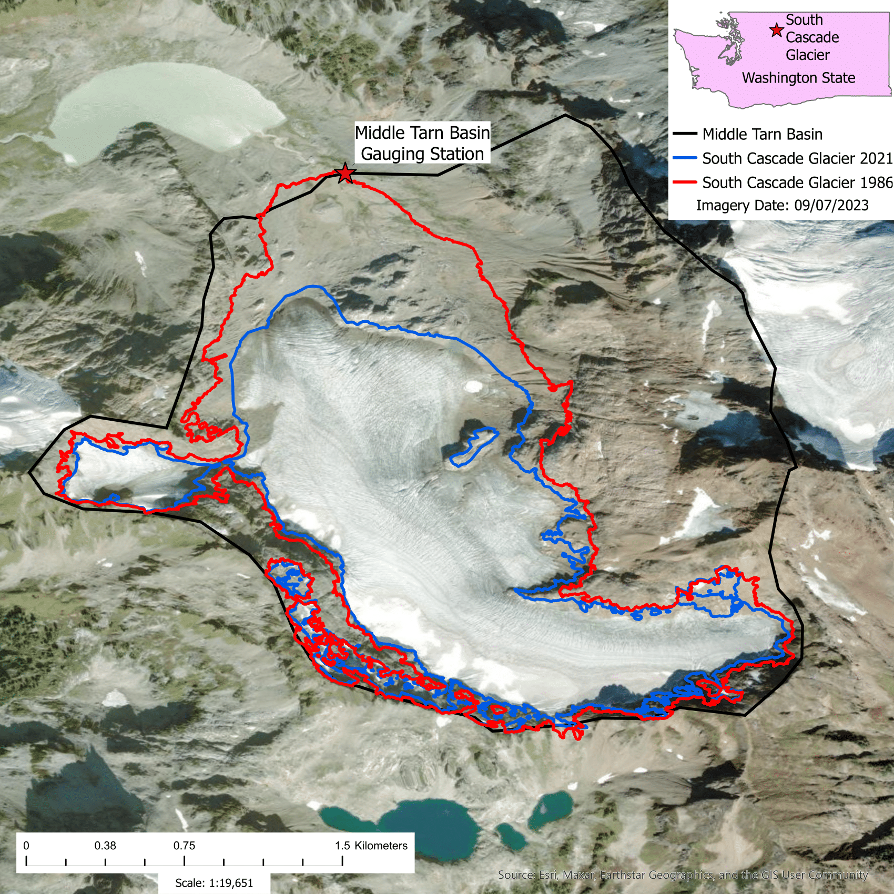

Study Site
South Cascade Glacier
Area: 1.68${ km}^{2}$ [5]
Mean elevation: ~1900m [5]
Mean ice thickness: 99m [6]
Max ice thickness: 195m [6]
North facing [6]
Average slope: 7.14 degrees$_{1}$
1: Along this studies centerline in 2021

Slide 6
Model Structure
SIA ice dynamics model
Temperature degree day and precipitation mass balance model
Temperature degree day and precipitation (snow fall/melt and rain) model
Two sections to model run
Spinup run
Data driven run

Slide 7
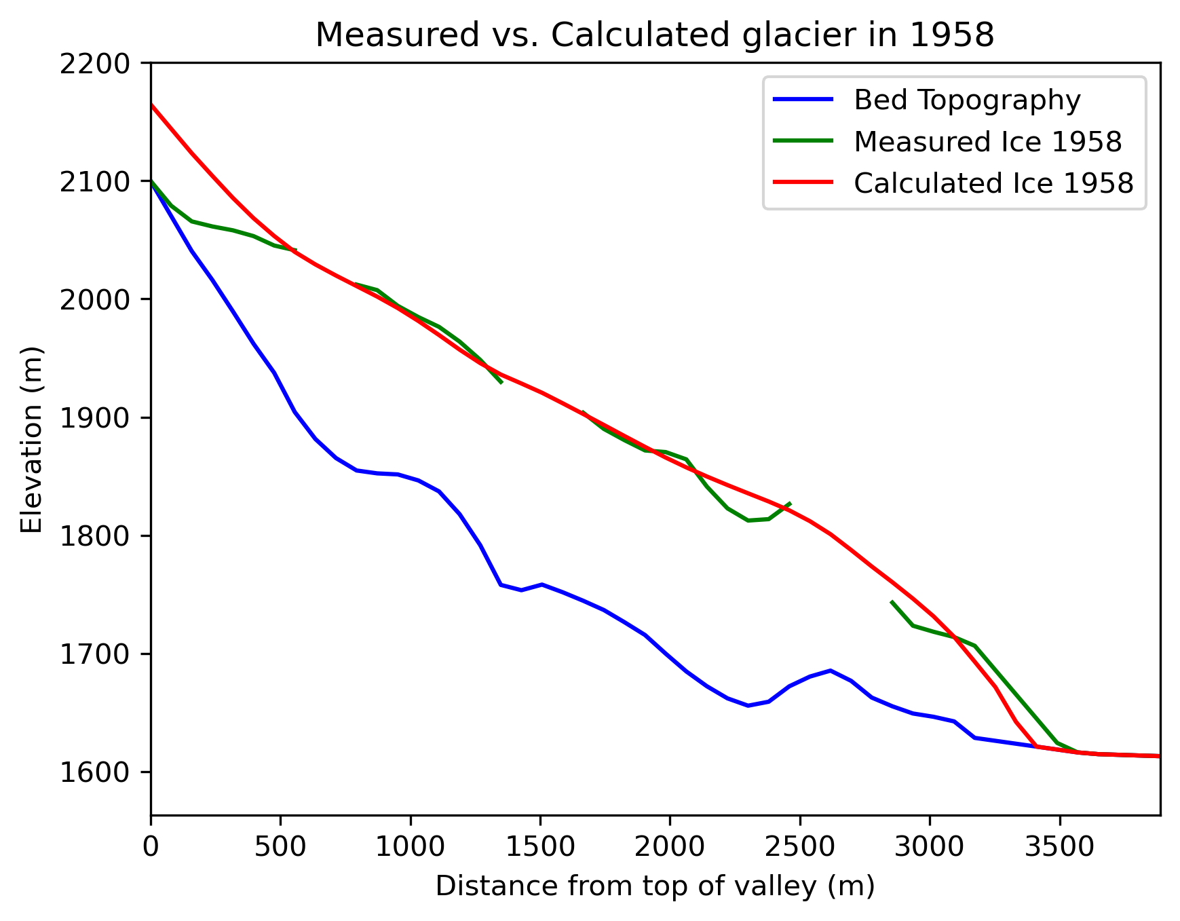
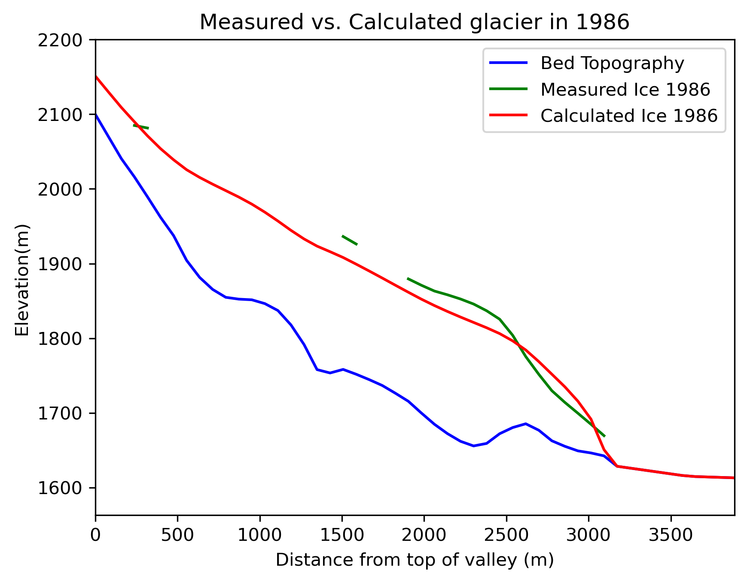
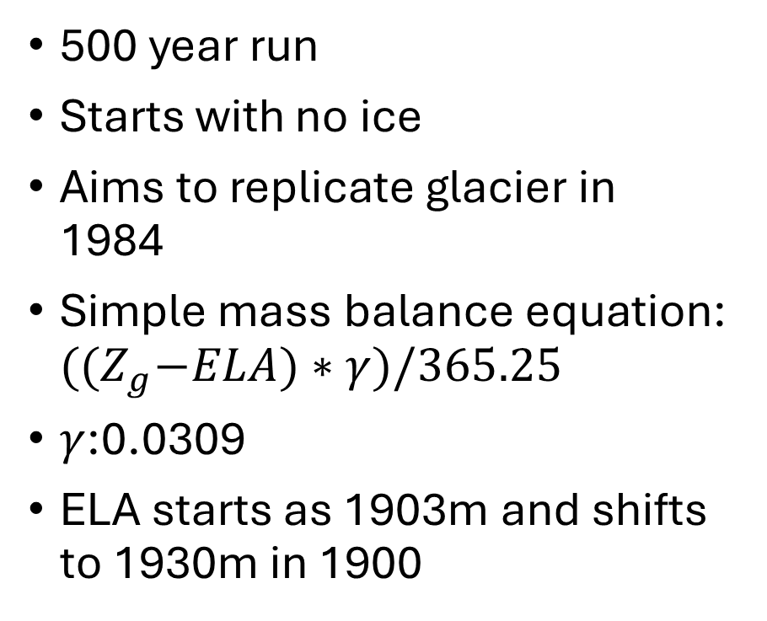
Spinup Run
500 year run
Starts with no ice
Aims to replicate glacier in 1984
Simple mass balance equation: ${((Z}_{g}−ELA)∗γ)/365.25$
$γ$:0.0309
ELA starts as 1903m and shifts to 1930m in 1900

Slide 8
Data Driven Run Overview
Uses temperature and precipitation data for mass balance model [7]
Requires seven input parameters to run: ice melt factor, snow melt factor, temperature lapse rate, lower accumulation factor, upper accumulation factor, avalanche percentage and precipitation conversion factor
Runs from 1984-2024
Three components: ice dynamics, glacier mass balance, precipitation (snow fall/melt and rain fall), avalanche

Slide 9
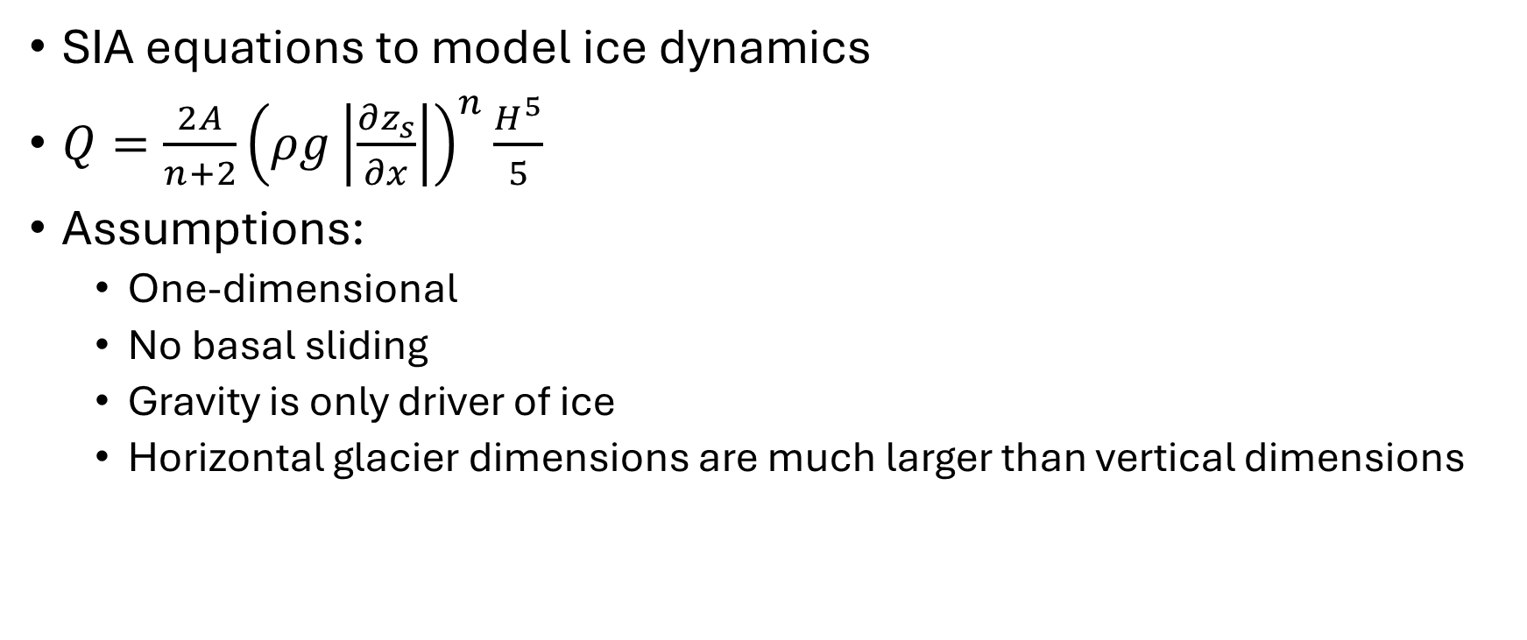
Ice Dynamics
SIA equations to model ice dynamics
$Q=\frac{2A}{n+2}{\left(ρg\left|\frac{∂z_{s}}{∂x}\right|\right)}^{n}\frac{H^{5}}{5}$
Assumptions:
One-dimensional
No basal sliding
Gravity is only driver of ice
Horizontal glacier dimensions are much larger than vertical dimensions

Slide 10
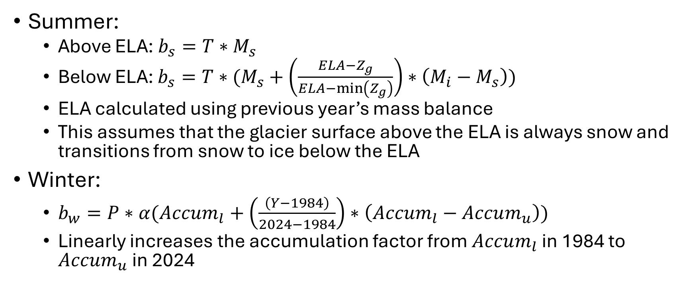
Mass Balance
Summer:
Above ELA: $b_{s}=T∗M_{s}$
Below ELA: $b_{s}=T∗(M_{s}+\left(\frac{ELA−Z_{g}}{ELA−\min\left(Z_{g}\right)}\right)∗\left(M_{i}−M_{s}\right))$
ELA calculated using previous year’s mass balance
This assumes that the glacier surface above the ELA is always snow and transitions from snow to ice below the ELA
Winter:
$b_{w}=P∗α(Accum_{l}+\left(\frac{\left(Y−1984\right)}{2024−1984}\right)∗\left(Accum_{l}−Accum_{u}\right))$
Linearly increases the accumulation factor from $Accum_{l}$ in 1984 to $Accum_{u}$ in 2024

Slide 11
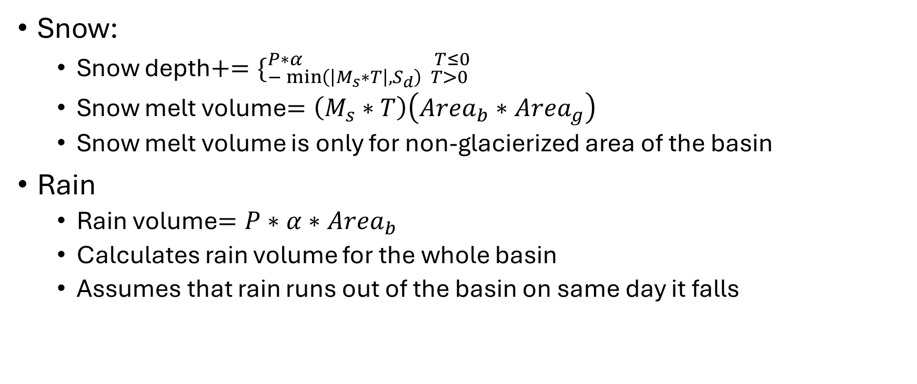
Precipitation Model
Snow:
Snow depth$+=\{_{−\min\left(\left|M_{s}∗T\right|,S_{d}\right) T>0}^{P∗α T≤0}$
Snow melt volume$=\left(M_{s}∗T\right)\left(Area_{b}∗Area_{g}\right)$
Snow melt volume is only for non-glacierized area of the basin
Rain
Rain volume$=P∗α∗Area_{b}$
Calculates rain volume for the whole basin
Assumes that rain runs out of the basin on same day it falls

Slide 12
Avalanche Model
Avalanches snow above 2123m on a randomly chosen date every year between January and March
Amount of snow controlled by avalanche percentage
Removes snow above 2123m and evenly distributes it below 1900m

Slide 13
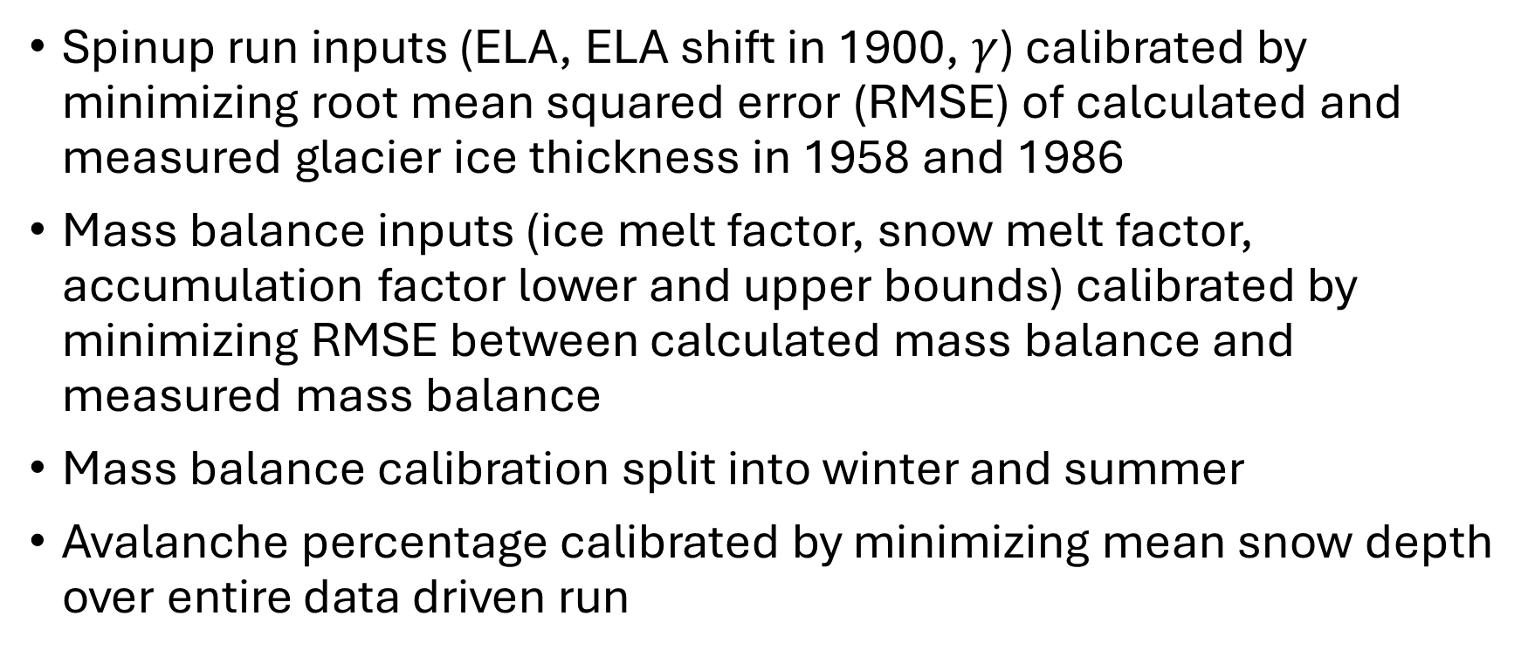
Calibration
Spinup run inputs (ELA, ELA shift in 1900, $γ$) calibrated by minimizing root mean squared error (RMSE) of calculated and measured glacier ice thickness in 1958 and 1986
Mass balance inputs (ice melt factor, snow melt factor, accumulation factor lower and upper bounds) calibrated by minimizing RMSE between calculated mass balance and measured mass balance
Mass balance calibration split into winter and summer
Avalanche percentage calibrated by minimizing mean snow depth over entire data driven run

Slide 14
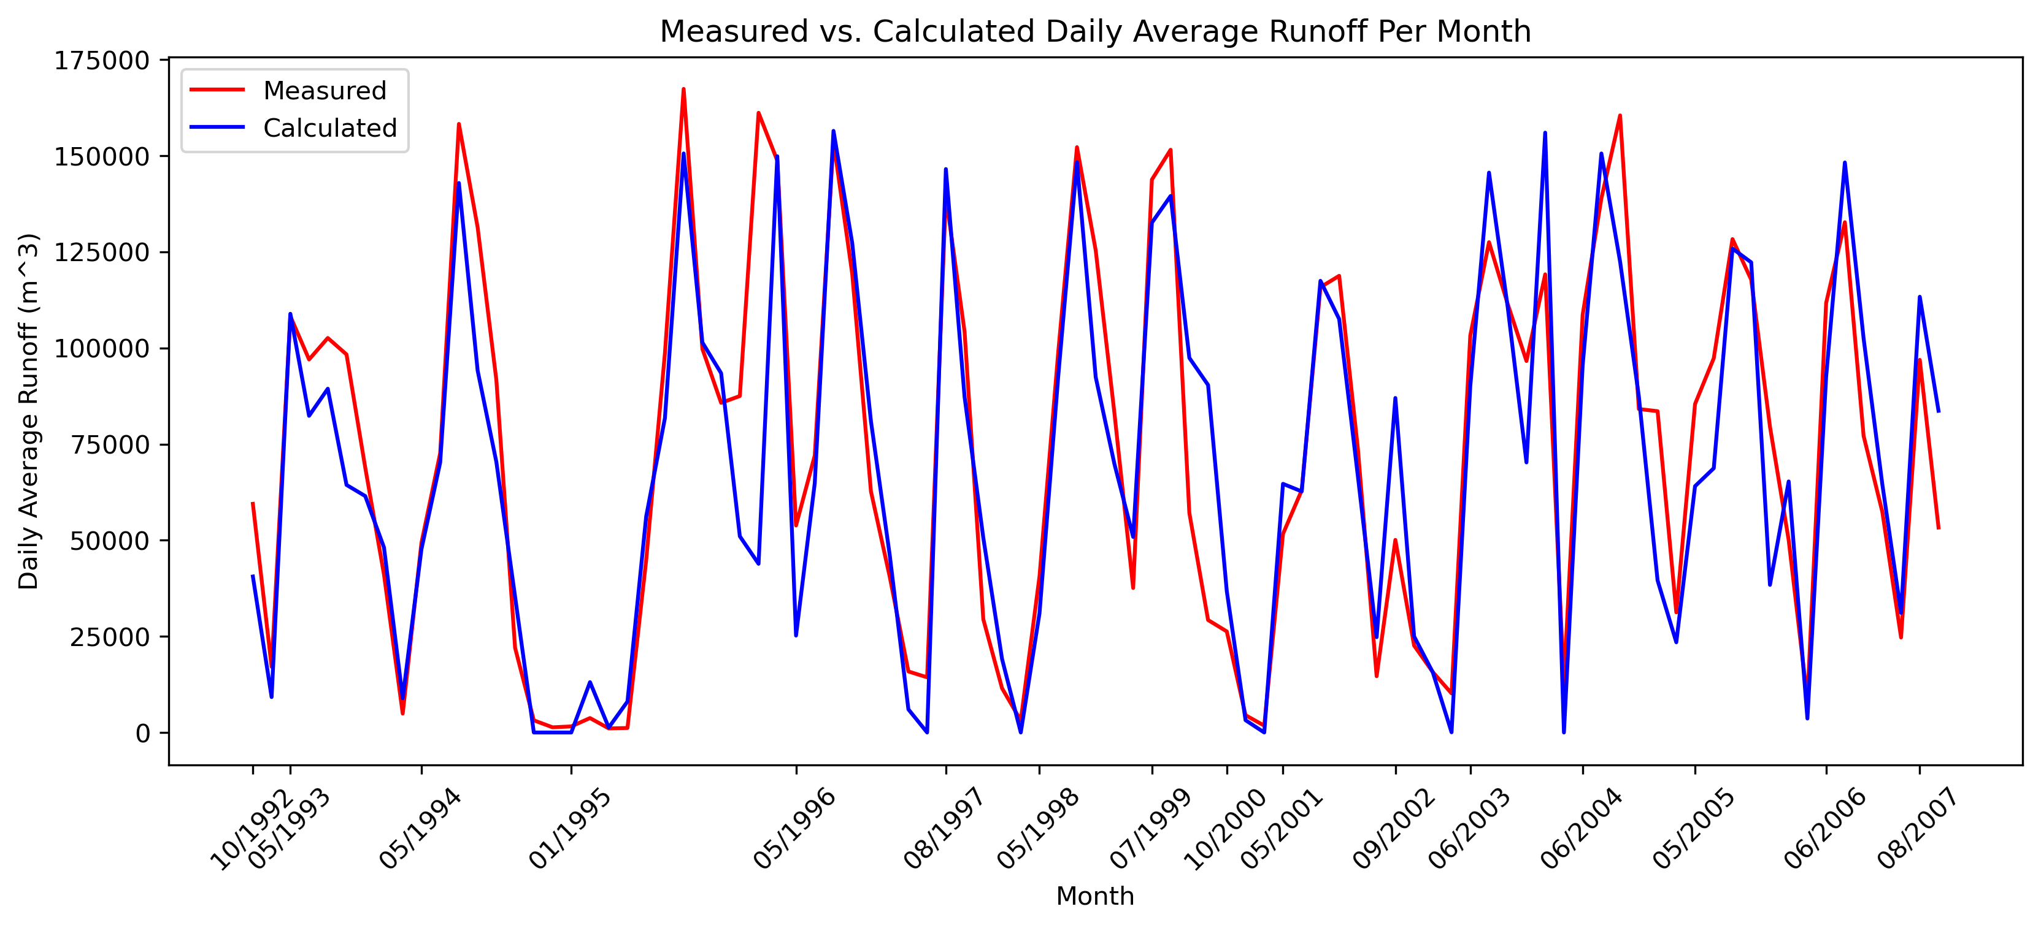
Runoff Model Accuracy
Three types of error used: root mean squared error (RMSE), Nash-Sutcliffe Efficiency (NSE) and Kling-Gupta Efficiency (KGE)
30.35%, 0.8 and 0.88 respectively
Daily average runoff per month used to calculate error

Slide 15
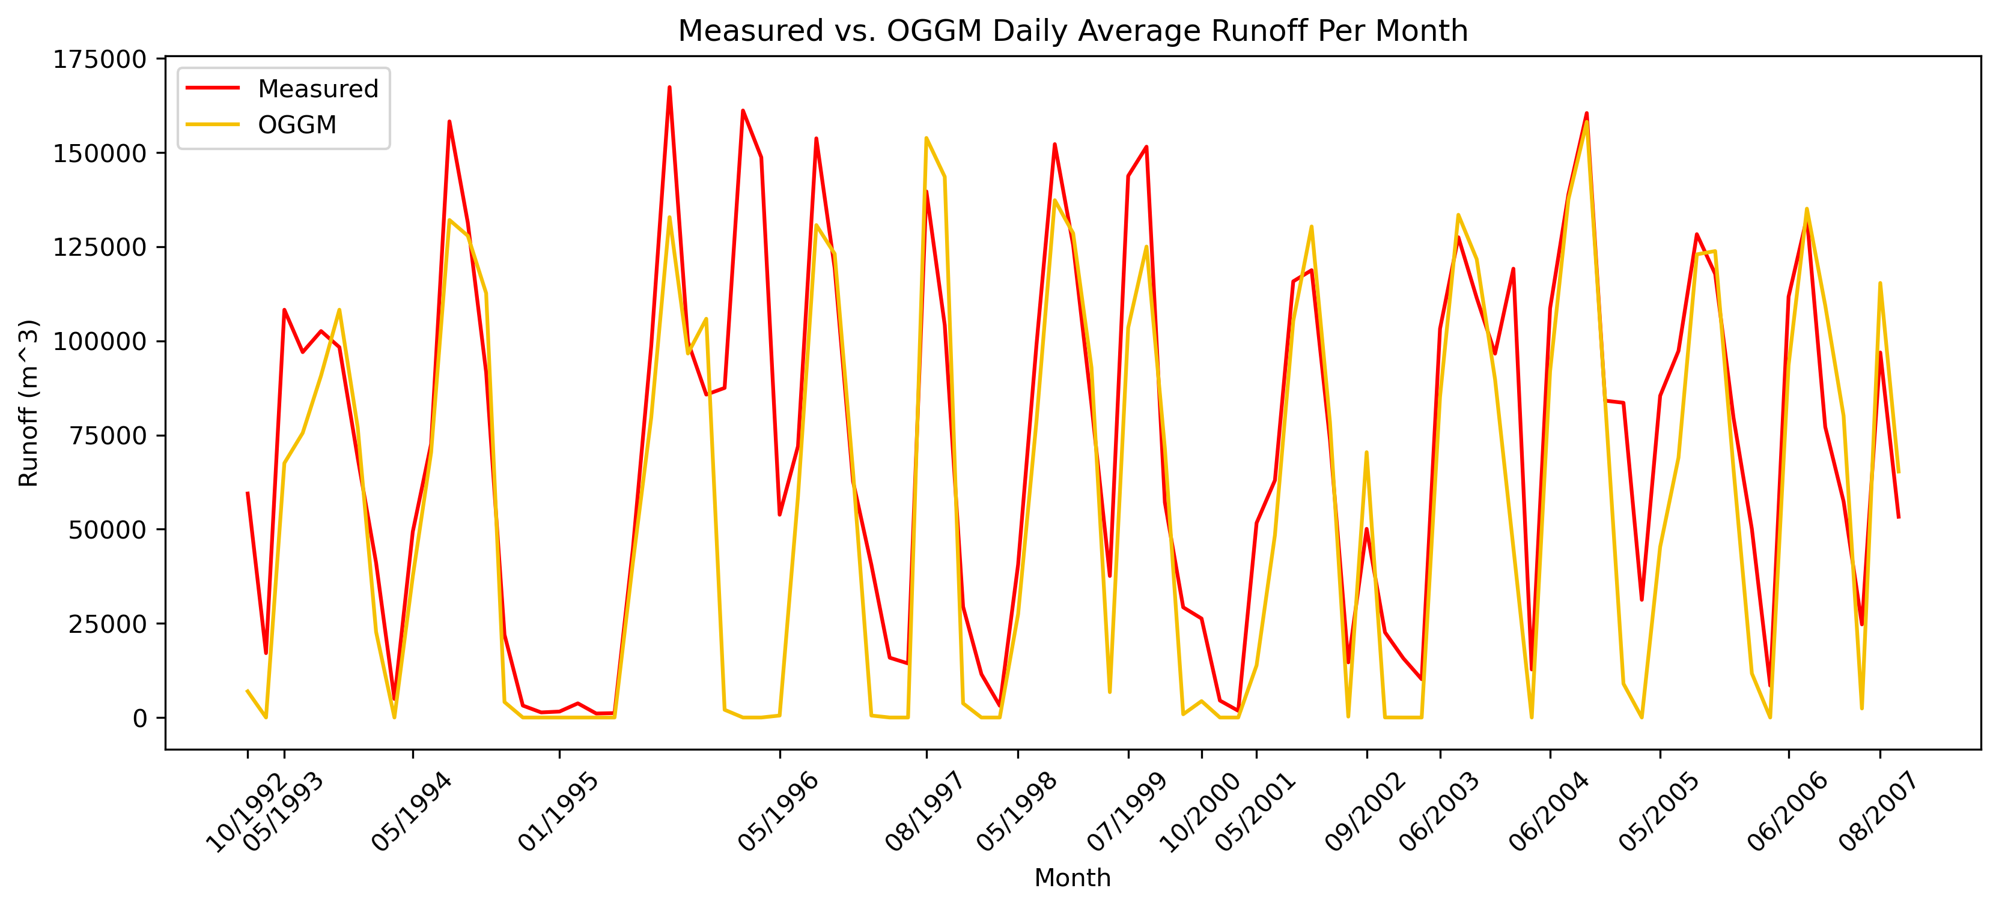
OGGM Accuracy
45.96% (RMSE), 0.53 (NSE) and 0.72 (KGE)

Slide 16
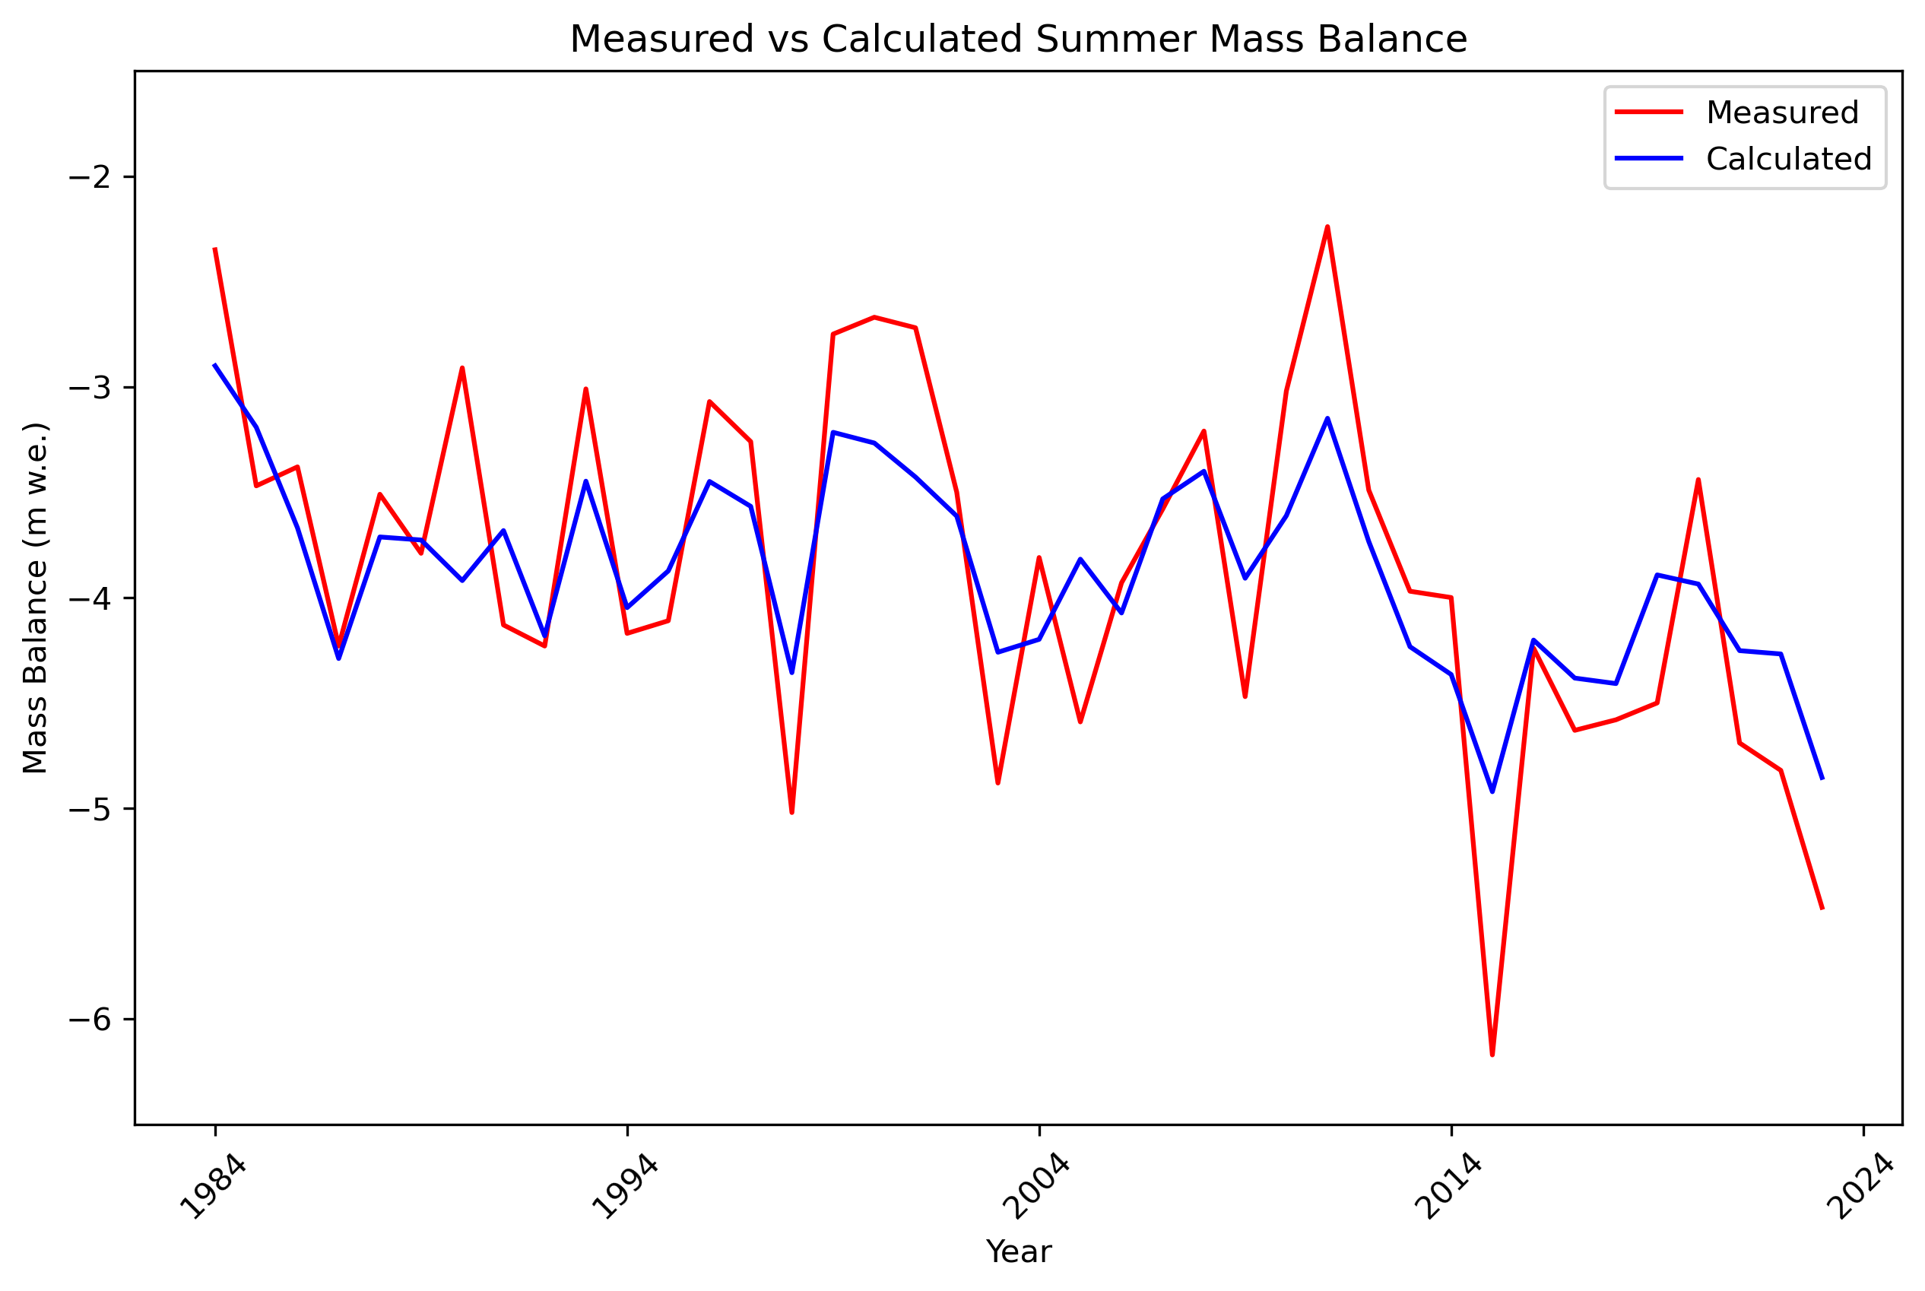
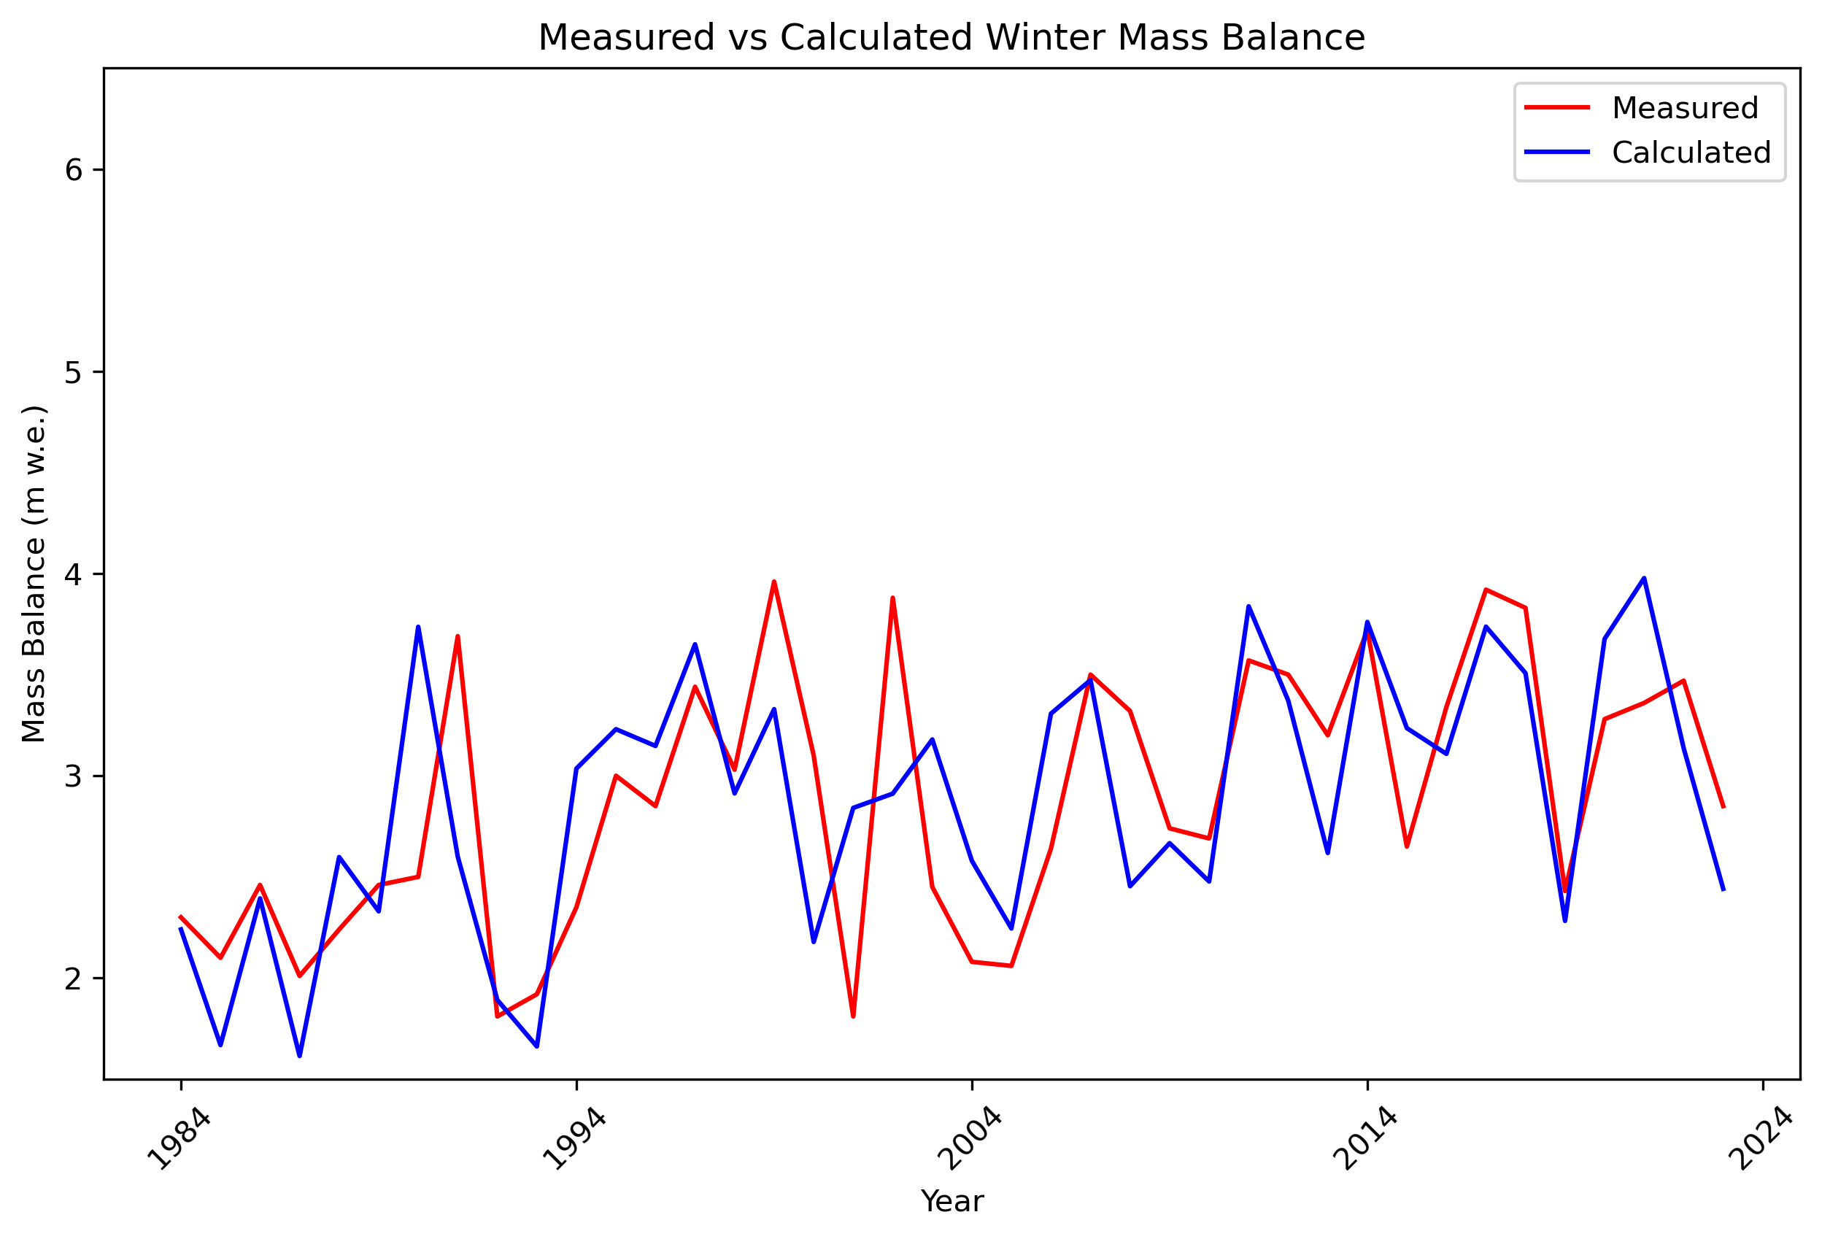
Mass Balance Model Accuracy
Winter mass balance RMSE: 0.54m
Summer mass balance RMSE: 0.5m

Slide 17
References
Fountain, A. G., & Tangborn, W. V. (1985). The effect of glaciers on streamflow variations. *Water Resources Research, 21*(4), 579–586. https://doi.org/10.1029/WR021i004p00579
Eis, A., Bahr, D. B., O’Neel, S., & Elsberg, D. H. (2021). Reconstruction of past glacier changes with an ice-flow glacier model: Proof of concept and validation. *Frontiers in Earth Science, 9*, 595755. https://doi.org/10.3389/feart.2021.595755
Farinotti, D., Huss, M., Bauder, A., Funk, M., Truffer, M., & Gillet-Chaulet, F. (2020). Results from the Ice Thickness Models Intercomparison eXperiment Phase 2 (ITMIX2). *Frontiers in Earth Science, 8*, 571923. https://doi.org/10.3389/feart.2020.571923
Maussion, F., Butenko, A., Champollion, N., Dusch, M., Eis, J., Fourteau, K., Gregor, P., Jarosch, A. H., Landmann, J., Oesterle, F., Recinos, B., Rothenpieler, T., Vlug, A., Wild, C. T., & Marzeion, B. (2019). The Open Global Glacier Model (OGGM) v1.1. *Geoscientific Model Development, 12*(3), 909–931. https://doi.org/10.5194/gmd-12-909-2019
GLIMS Consortium. (2005). *GLIMS Glacier Database (Version 1)* [Dataset]. National Snow and Ice Data Center. https://doi.org/10.7265/N5V98602
GlaThiDa Consortium. (2020). *Glacier Thickness Database 3.1.0* [Dataset]. World Glacier Monitoring Service. https://doi.org/10.5904/wgmsglathida-2020-10
U.S. Geological Survey Benchmark Glacier Program. (2020). USGS benchmark glacier project comprehensive data collection [Data release]. https://doi.org/10.5066/P9AGXQSR

