Slide 1
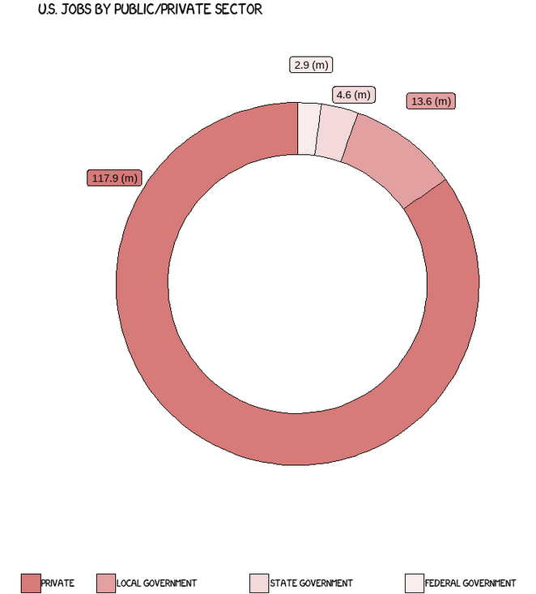
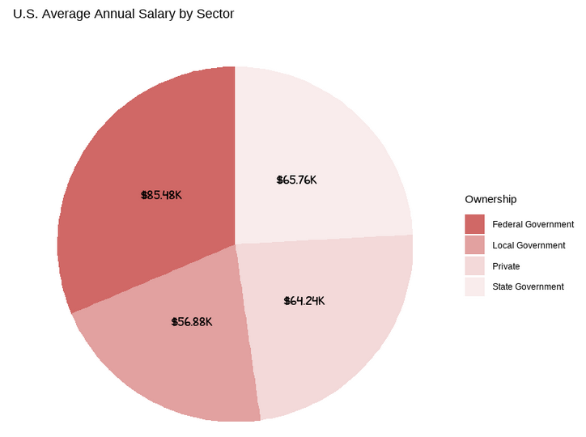
Bureau of Labor Statistics:
2020 Quarterly Census of Economics and Wages
On average state jobs pay slightly better than the private sector
Working for the Federal government pays well, if you can find a job.
There is a common narrative that the federal government is too big. Actually, the federal government on employs a small portion of the total workforce. Local governments employ nearly twice as much as state and federal governments combined. The power really distributed locally.
Local governments comprise the largest public sector, but they pay the least
“R” Visualizations

Slide 2
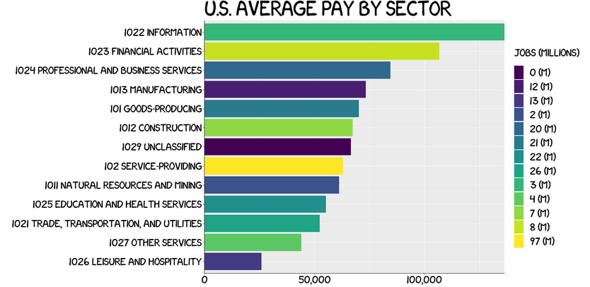
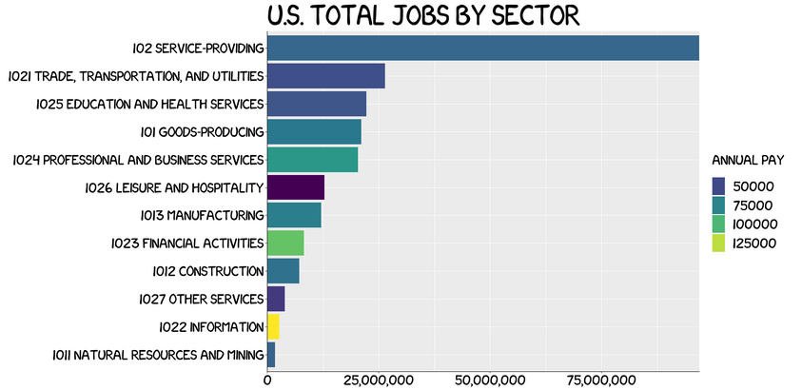
Bureau of Labor Statistics:
2020 Quarterly Census of Economics and Wages
The best paying jobs are in the Information industry and the financial sector. These jobs represent a small portion of the national workforce.
A Masters Degree in Data science from Bellevue university is an excellent way to pursue a career in a competitive high paying job sector.
“R” Visualizations

Slide 3
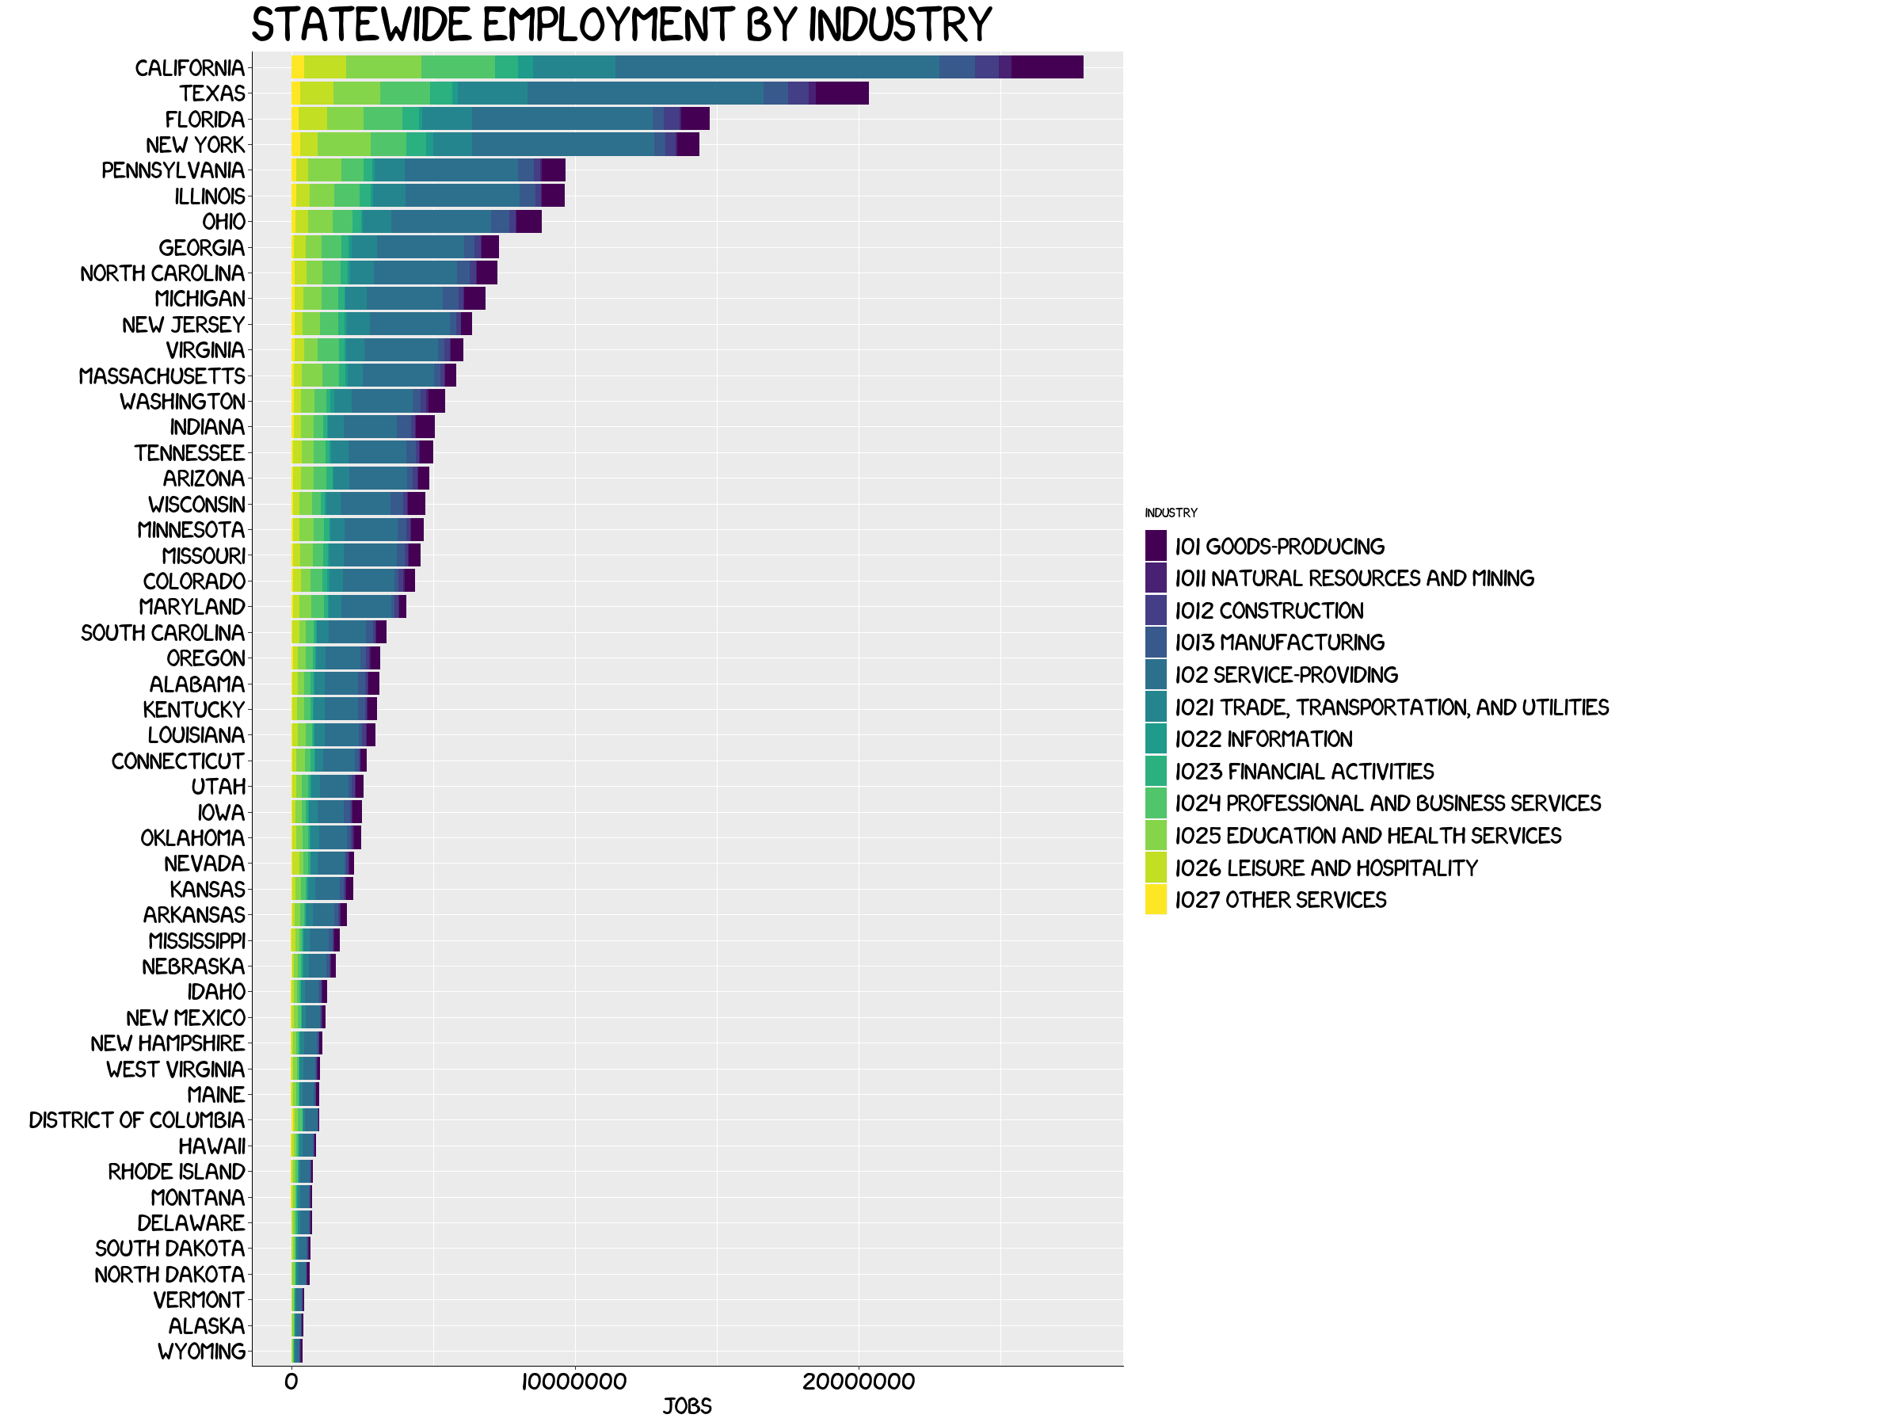
Bureau of Labor Statistics:
2020 Quarterly Census of Economics and Wages
Of the Top 5 States with the most Jobs California has the greatest opportunity for jobs in the high paying sectors of Information and Financial Activities.
Information and Financial Services
“R” Visualizations

Slide 4
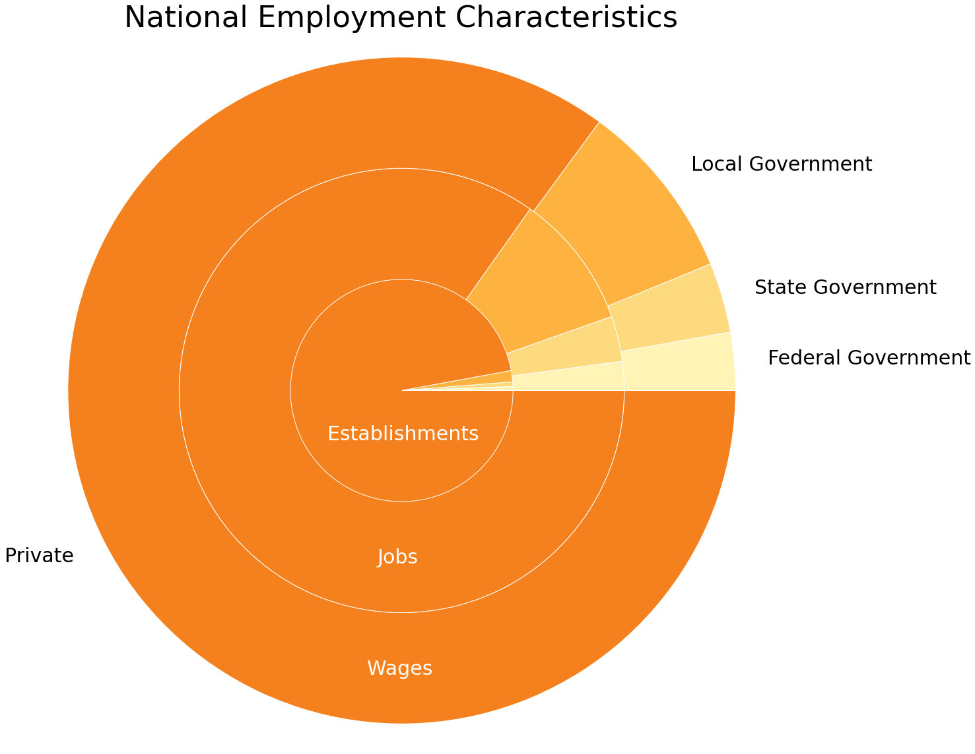
Bureau of Labor Statistics:
2020 Quarterly Census of Economics and Wages
Is Big Government Really all that Big?
The number of private sector businesses greatly outweighs the relatively few Federal, State, and Local agencies
Local governments employ more people than State and Federal agencies combined.
State worker wages are roughly equivalent to their share of the labor market. On average, these workers are paid appropriately for their portion of the workforce.
Federal employee wages proportionally more than their share of the labor market. It’s good work if you can get it.
Local government employees are paid less than their labor share. This is the largest public sector employer and the least well paid. Local governments are likely underfunded relative to the services they perform
Note: This is a combined pie and donut graph.
“Python” Visualizations

Slide 5
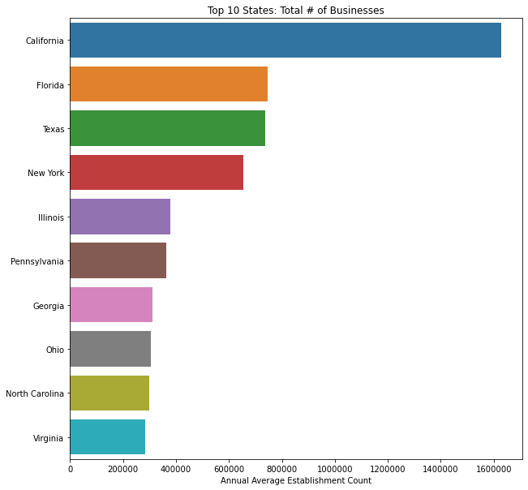
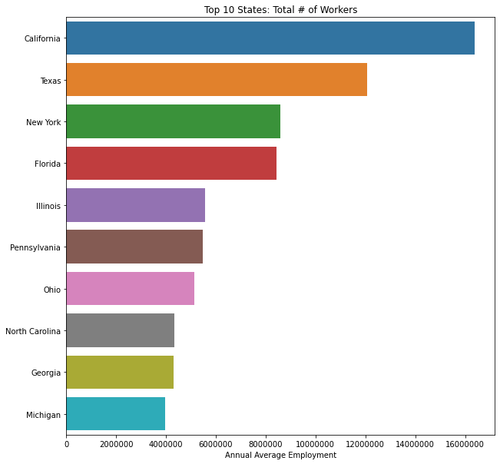
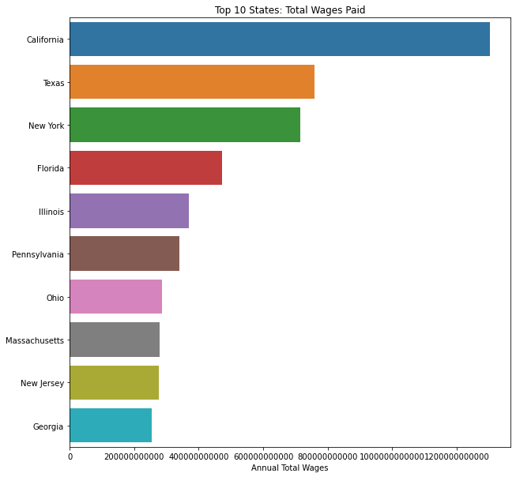
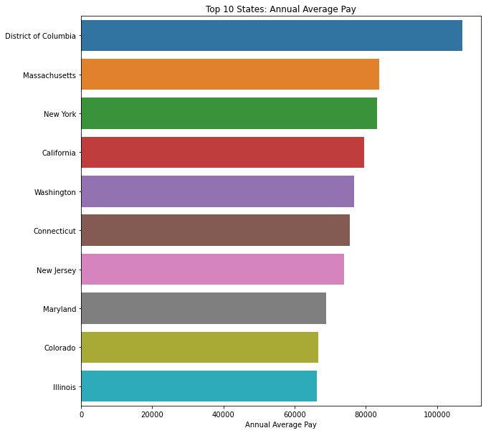
Top 10 States: Economic Characteristics
California leads the way in all categories except in Annual Average Pay. It is unclear as why the District of Columbia has such a high average pay. This may attack the big government myth or more likely, it’s a small desirable city that is close to the halls of power.
Bureau of Labor Statistics: 2020 Quarterly Census of Economics and Wages
“Python” Visualizations

Slide 6
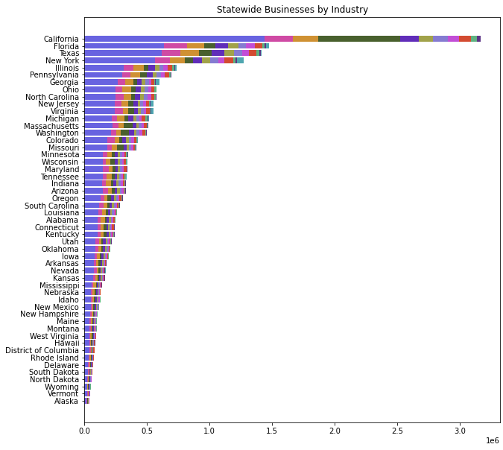
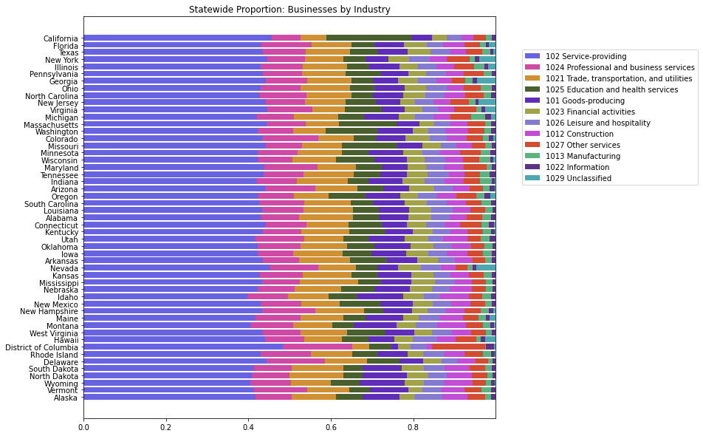
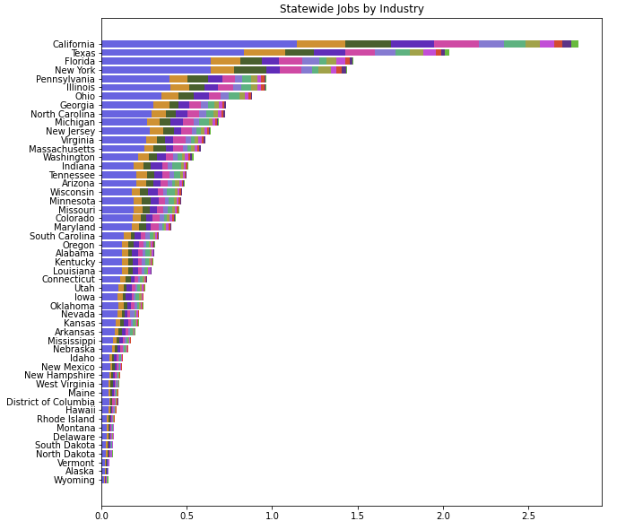
Top 10 States: Economic Characteristics
Bureau of Labor Statistics: 2020 Quarterly Census of Economics and Wages
“Python” Visualizations

Slide 7
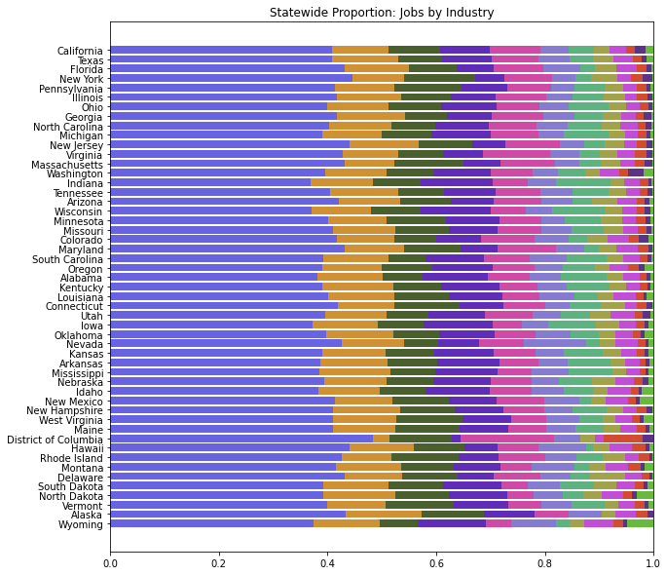
Top 10 States: Economic Characteristics
Bureau of Labor Statistics: 2020 Quarterly Census of Economics and Wages
“Python” Visualizations

Slide 8
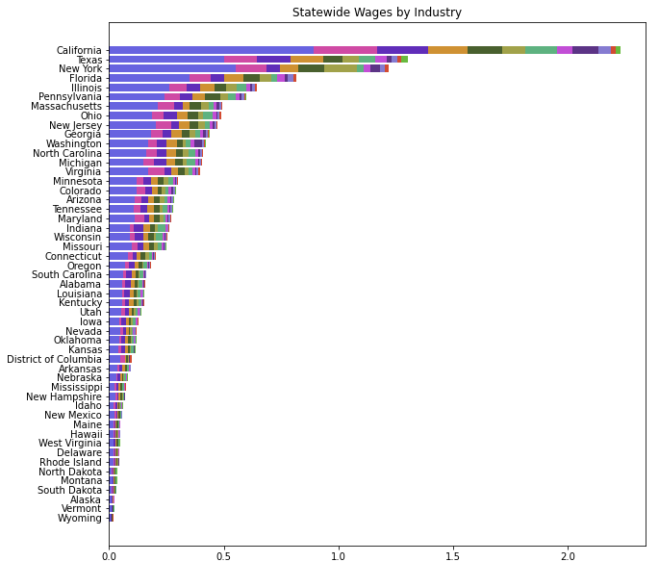
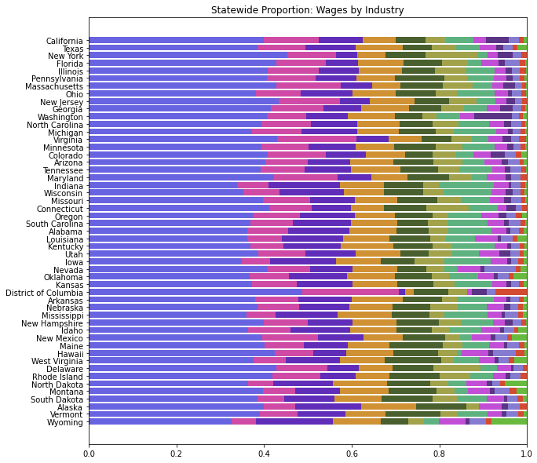
Top 10 States: Economic Characteristics
Bureau of Labor Statistics: 2020 Quarterly Census of Economics and Wages
“Python” Visualizations

Slide 9
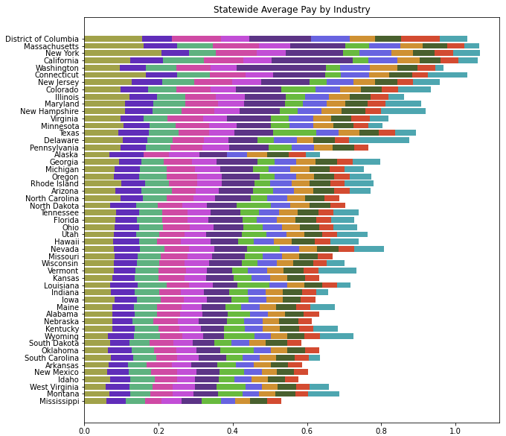
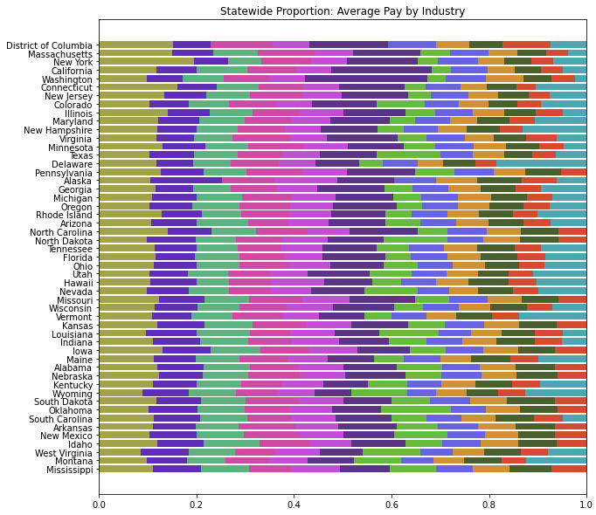
Top 10 States: Economic Characteristics
Bureau of Labor Statistics: 2020 Quarterly Census of Economics and Wages
“Python” Visualizations

Slide 10
Top 10 States: Economic Characteristics
Bureau of Labor Statistics: 2020 Quarterly Census of Economics and Wages
“Python” Visualizations

Slide 11
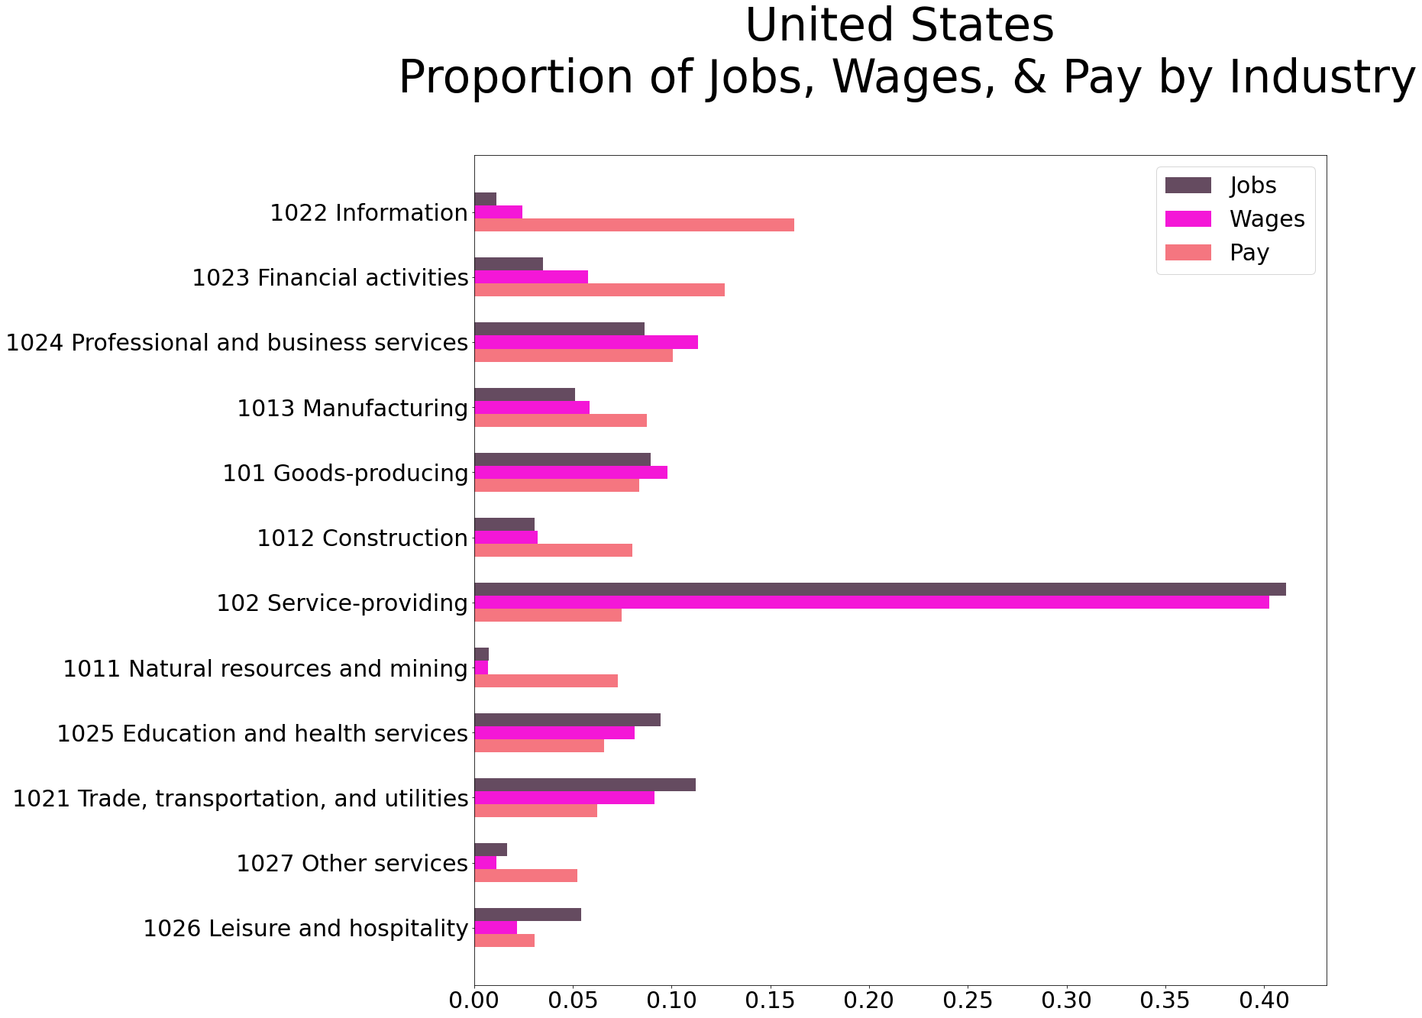
This is the I really want to tell. The highest paying jobs are awarded to the few. There is a greater story in here about wealth concentration, but this was the best I could tease out.
The service sector is the most telling. Wages and jobs represented as roughly equal proportions. It is also at the middle of the pay scale.
Bureau of Labor Statistics: 2020 Quarterly Census of Economics and Wages
“Python” Visualizations

Slide 12
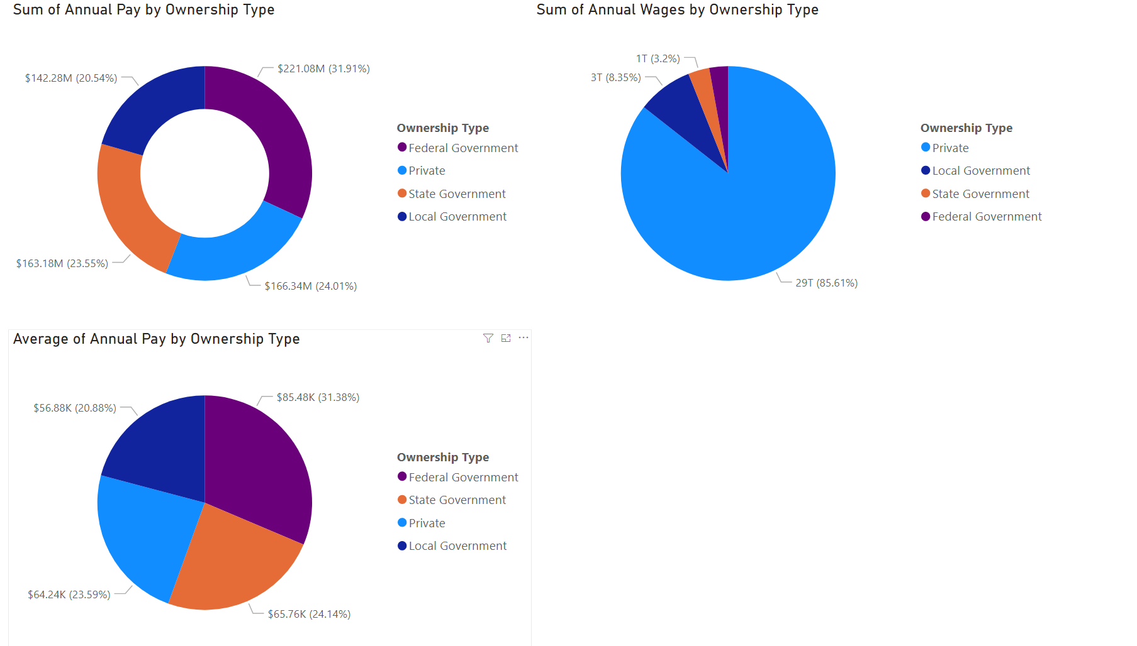
Bureau of Labor Statistics: 2020 Quarterly Census of Economics and Wages
“PowerBI” Visualizations

Slide 13
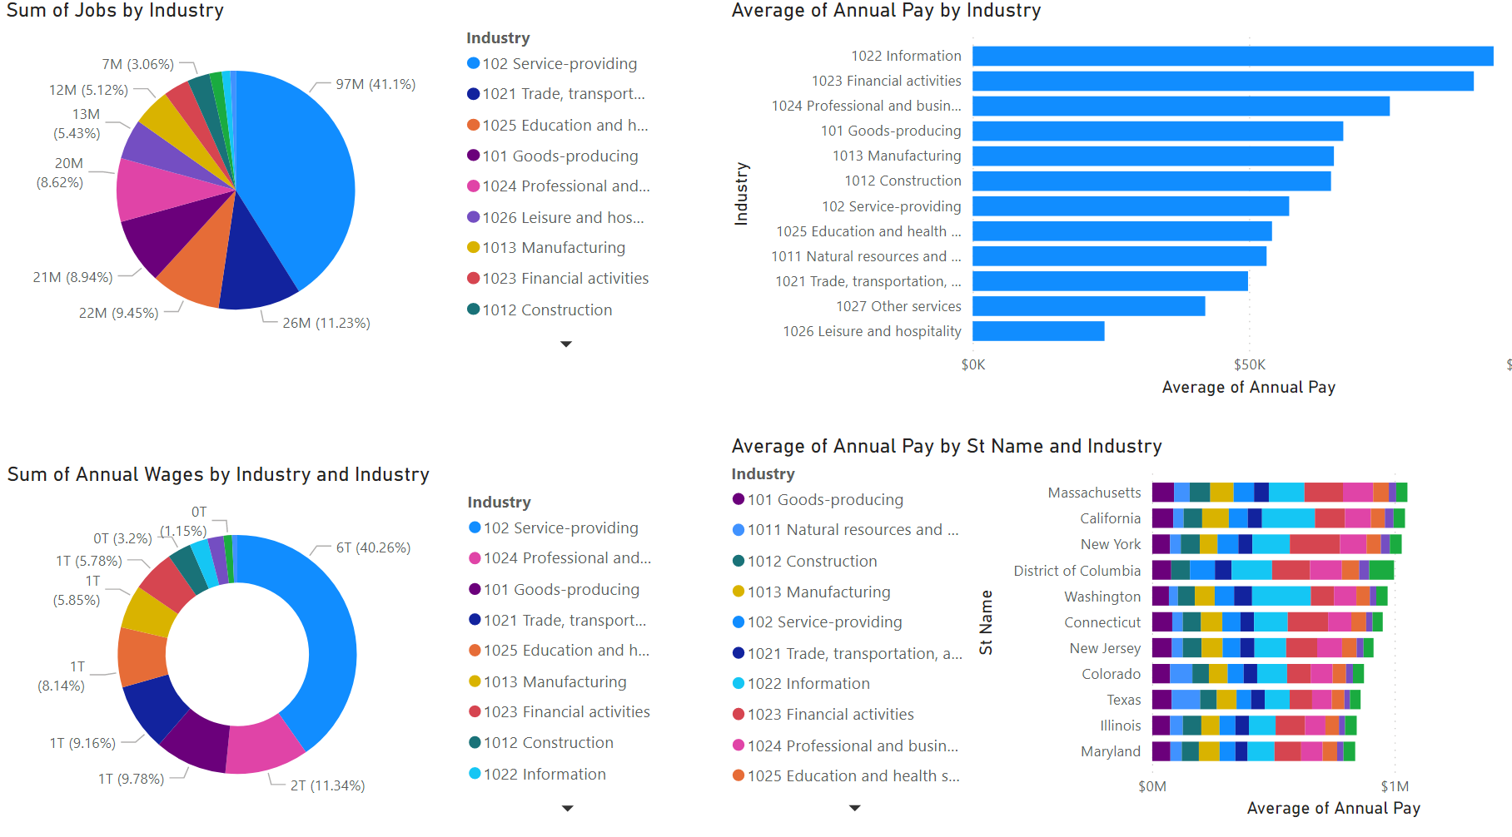
Bureau of Labor Statistics: 2020 Quarterly Census of Economics and Wages
“PowerBI” Visualizations

Slide 14
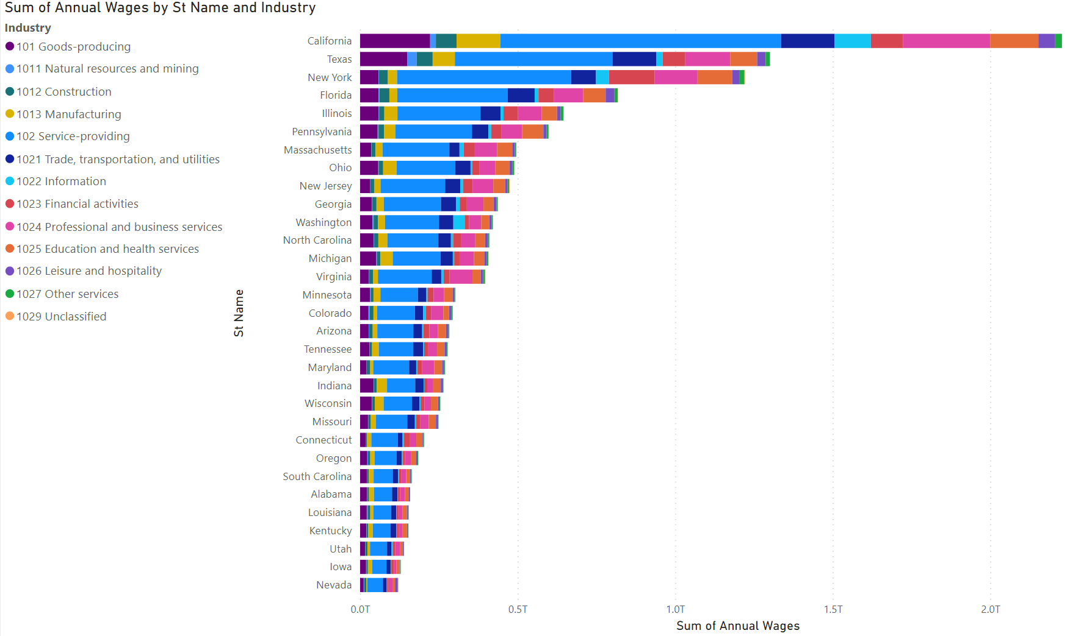
Bureau of Labor Statistics: 2020 Quarterly Census of Economics and Wages
“PowerBI” Visualizations

