Slide 1
A Comparative Analysis of Machine Learning Approaches to Song Classification by Genre
A comparison of various methods to automate the classification of songs by genre
Kyle Stoudt
Springboard – Data Science Career Track

Slide 2

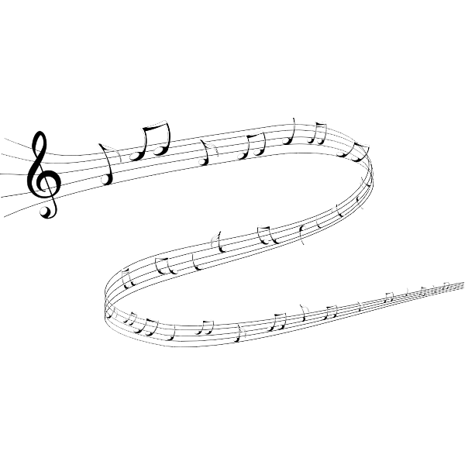
The Problem
During a streamed Spotify event in February 2021, the company’s Co-Head of Music, Jeremy Erlich, confirmed that over 60,000 tracks are being uploaded to Spotify every day.
That’s a 50% increase in less than two years, when compared to an April 2019 quote of 40,000 daily uploads.^{[1]}
At this volume, it would take an incredible amount of human effort to classify these songs into genres.
Machine learning provides the opportunity for us to automate this process by analyzing audio signal data to classify songs into their respective genres on upload.
Without the the ‘Genre’ tag as a guiding signpost for those trying to find new music, it would become a tireless effort for listeners to sift through potentially millions of songs before finding what they want.
Among many other benefits, this would give music streaming platforms the ability to understand, in real-time, the distribution of genres uploaded.
The aim of this project is to provide a comparative analysis of different machine learning approaches which results in actionable recommendations for model usage and future refinement.

Slide 3
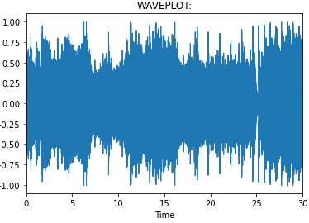
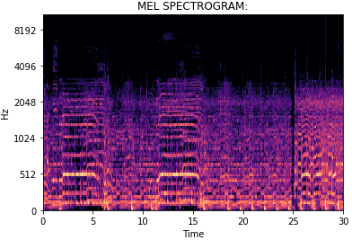
The GTZAN Dataset^{[2]}
‘rock.00005.wav’
The most-used public dataset for machine learning applications in music genre recognition.
Collected in 2000-2001 from a variety of sources including personal CDs, radio, microphone recordings, in order to represent a variety of recording conditions.
1000 30-second audio files evenly distributed across 10 genres.
Mel-scaled Spectrograms (Mel Spectrograms) in PNG format which act as a visual representation of each audio file.
Enables the use of Convolutional Neural Networks (CNNs), as they typically take data in some sort of image format.
This is an example of what a CNN ‘sees’ when classifying songs by genre.
The GTZAN dataset contains CSV files containing tabularized data extracted via the Librosa library for each song sample.
These were not used in this project, as the tabularized data was manually extracted with Librosa.

Slide 4
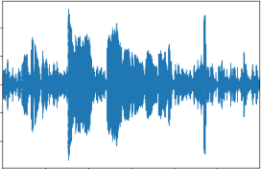
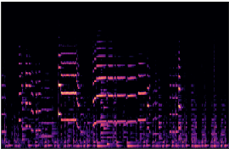
The GTZAN Dataset
Note: The file ‘jazz.00054.wav’ was unable to load properly, and was replaced with another Jazz song provided in the ‘Discussion’ tab on Kaggle:
‘jazz.00054.wav’
‘jazz.00054.png’

Slide 5
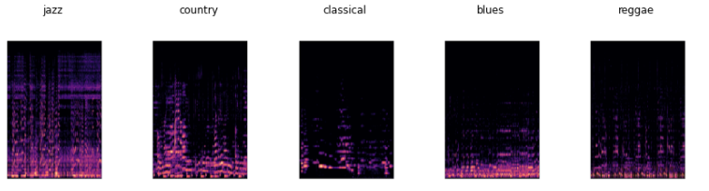
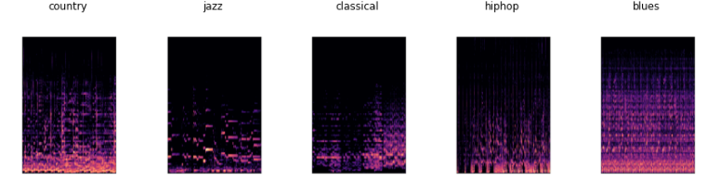
The GTZAN Dataset
Sample of Mel Spectrograms from Different Genres

Slide 6
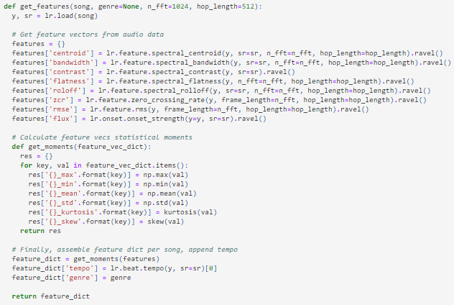
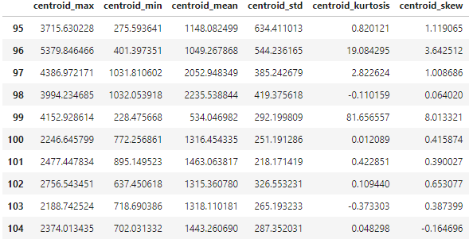
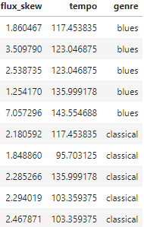
Feature Extraction with Librosa
Librosa for extraction of multiple numerical features from audio data.
Labeled, tabular data generated for all 1000 songs.

Slide 7
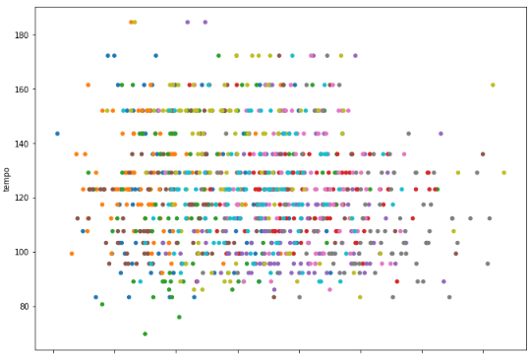
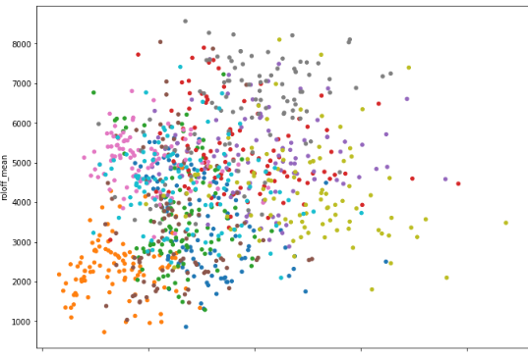
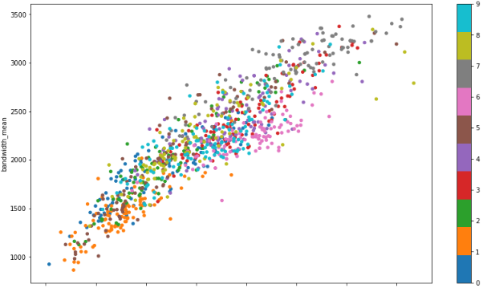
EDA - What Can We See?
Adequately visualizing 10 classes across 48 dimensions is a difficult task without some kind of data transformation.
Initially, 2D scatter plots were produced to find obvious correlations in the dataset.
Some of the generated 2D visualizations for the ‘raw’ tabular dataset:
Tempo vs. Centroid_Mean
Roloff_Mean vs. Flux_STD
Bandwidth_Mean vs. Centroid_Mean

Slide 8
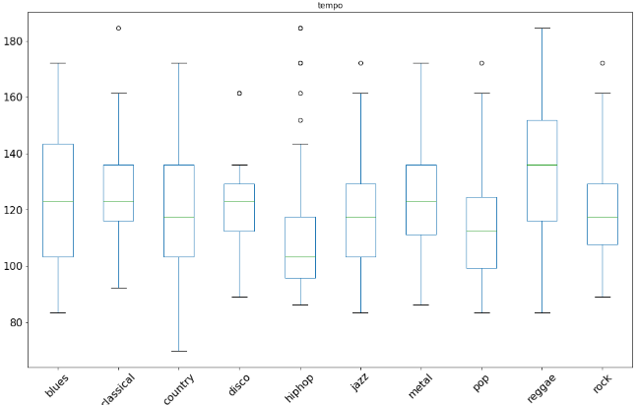
EDA
EDA - What Can We See?
BoxPlot of Tempos by Genre:
You can see ‘reggae’ has the highest mean tempo, and ‘hiphop’ has four outliers in the 140+ bpm range. Additionally, ‘blues’, ‘country’, and ‘reggae’ all have pretty wide-spanning Interquartile Ranges (IQRs). This could certainly have an impact on predictive power for those genres.

Slide 9
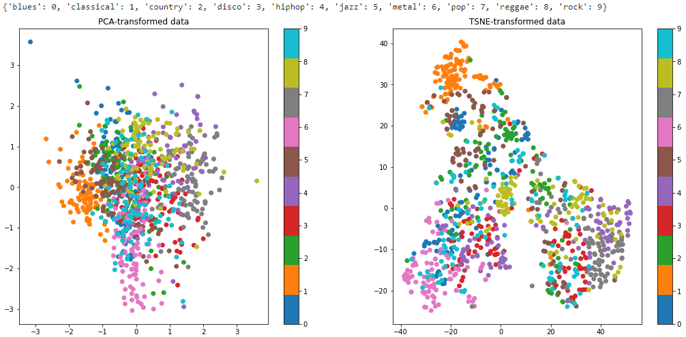
EDA - The Best View
Principal Component Analysis (PCA) and t-Distributed Stochastic Neighbor Embedding (t-SNE) were used to visualize the tabularized dataset in 2-Dimensions. This produced the best class separation in a visual format, though the ambiguity of the axes doesn’t provide much for actionable insights, just a rough idea of class separation.
f

Slide 10
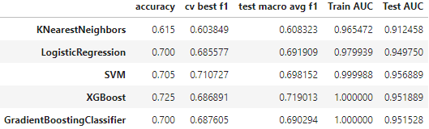
Classical ML
5 Classical Machine Learning Algorithms were tested after an 80-20 train-test split of the standard-scaled, tabularized data:
K-Nearest Neighbors
Logistic Regression
Support Vector Machine
XGBoost Classifier
Gradient Boosting Classifier
GridSearchCV() was used to perform 5-fold cross-validation for hyperparameter optimization. The performance metrics for these models are stored in their own table for now, to be compared with the other approaches later.

Slide 11
A Note on Neural Network Evaluation:
For the following image-recognition models, a 90-10 train-test split was performed. This is due to the fact that 1000 images is actually quite a small dataset for training a CNN. In the aim of optimizing model accuracy after convergence, the train split comprised as much data as possible without drastically reducing validation precision during training.
Additionally, the testing accuracy and testing macro-averaged F1 score for each Deep Learning model was stored and appended to the final metrics summary table for all models. This metrics table is saved in the metrics folder of the project repository as “All_Metrics.csv”

Slide 12
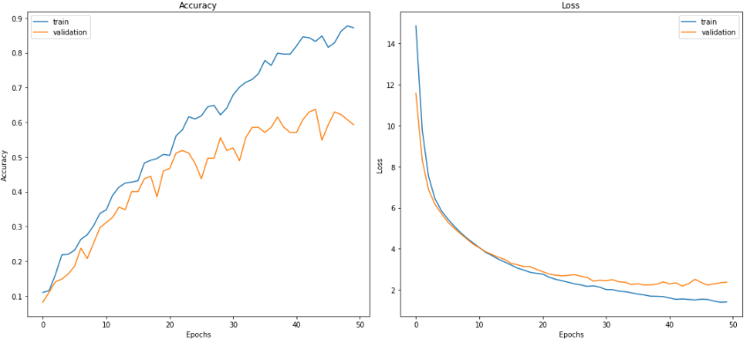
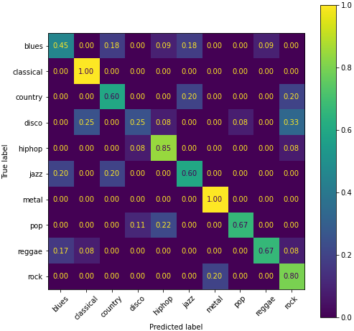
Custom CNN
A Custom CNN was built in the following configuration:
A Rescaling Layer
5 Convolutional Blocks with Max Pooling and 2 light dropout layers
A Flattening Layer
4 Dense, L2-Regularized layers with intermittent light dropout layers
10-class decision layer with ‘Softmax’ activation function.
Compiled with Adam optimizer (lr=0.0002)
Loss function of Sparse Categorical Crossentropy
EarlyStopping and ReduceLROnPlateau callback functions to reduce overfitting

Slide 13
Custom CNN Results:
The Accuracy vs Epochs and Loss vs Epochs plots show the model is slightly overfitting, converging after 50 epochs.
The normalized Classification Report shows the Custom CNN is strong with ‘classical’, ‘metal’, and ‘hiphop’, but struggles with ‘disco’ and ‘blues’

Slide 14
Transfer Learning Approaches
ResNet50
MobileNetV2
VGG16
Input Layer, Preprocessing Function, ResNet50, Global Average Pooling, Dense Decision Layer
80 epoch outer layer training
10 epoch fine-tuning of entire model
Input, Resizing, Preprocessing Function, MobileNetV2, Global Average Pooling, 0.2 Dropout, Dense Decision Layer
80 epoch outer layer training
10 epoch fine-tuning
Input, Resizing, Preprocessing Function, VGG16, Flattening Layer, Dense Layer, 0.5 Dropout, 2 Dense Layers, Dense Decision Layer
15 epoch outer layer training
10 epoch fine-tuning
See https://github.com/kstoudt/Springboard/blob/main/Final_Capstone/Notebooks/Final_Capstone_CNN_Modeling_%26_Evaluation.ipynb for the full summary of all deep learning models

Slide 15
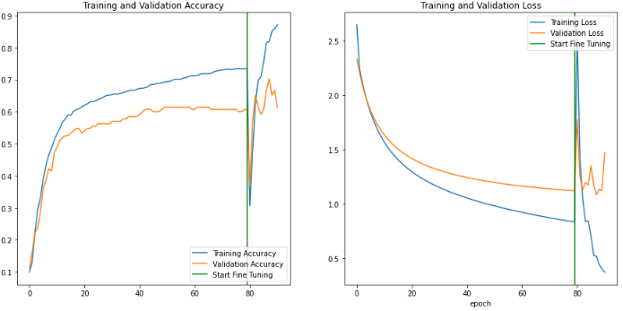
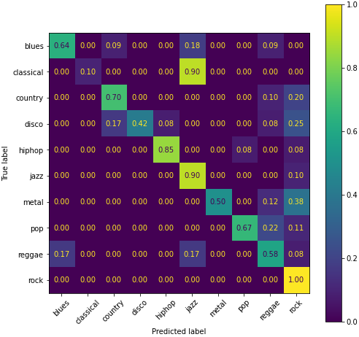
ResNet50 Results:
The Accuracy vs Epochs and Loss vs Epochs plots show the model begins to overfit prior to fine-tuning. The volatility seen after fine-tuning begins is most likely due to the limited size of our dataset.
The normalized Classification Report shows the ResNet50 model does well with the genres of ‘rock’, ‘jazz’ and ‘hiphop’, while struggling with ‘classical’, ‘disco’, ‘metal’, and ‘reggae’. Note too that this run of the ResNet50 model resulted in the confusion of ‘classical’ and ‘jazz’. The lack of data is likely responsible for this volatility, which would probably stabilize with more data, meritting further investigation, should the classifier still confuse these labels.

Slide 16
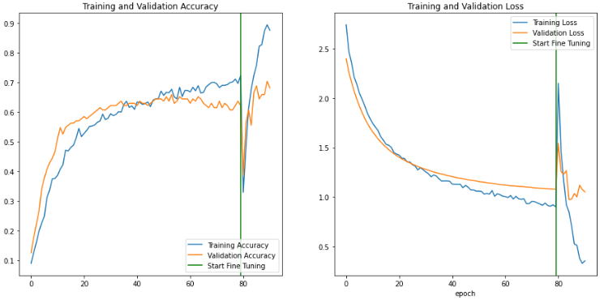
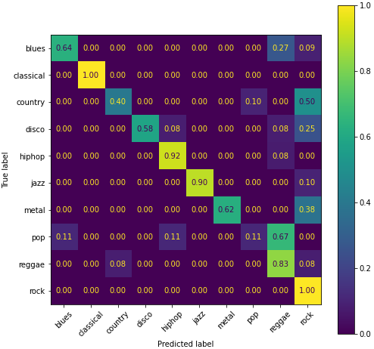
MobileNetV2 Results:
The Accuracy vs Epochs and Loss vs Epochs plots show the model begins to overfit prior to fine-tuning. Again, the volatility seen after fine-tuning begins is most likely due to the limited size of our dataset.
The normalized Classification Report shows that the MobileNetV2 model is performing well with the ‘classical’, ‘rock’, ‘hiphop’ and ‘jazz’ genres, while struggling with ‘pop’, ‘country’, ‘disco’, and ‘metal’.

Slide 17
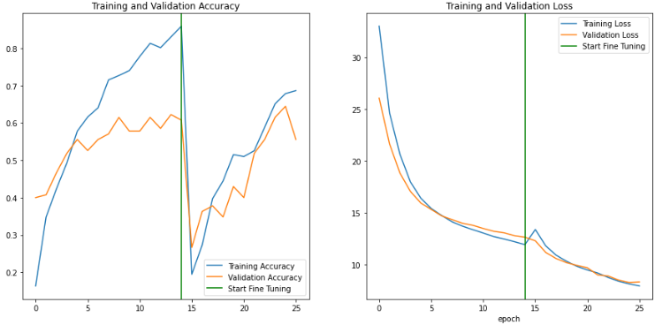
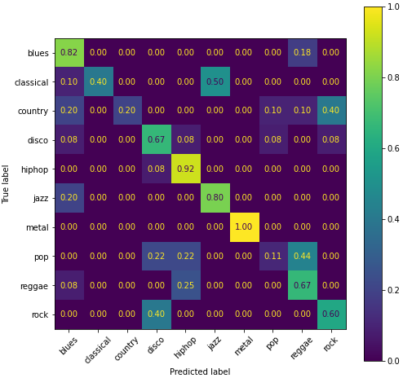
VGG16 Results:
The Accuracy vs Epochs and Loss vs Epochs plots show the model begins to overfit prior to fine-tuning. Again, the volatility seen after fine-tuning begins is most likely due to the limited size of our dataset.
The normalized classification report shows this model does well with the genres of ‘metal’, ‘hiphop’, ‘blues’, and ‘jazz’, while struggling with ‘pop’, ‘country’, and ‘classical’ songs.

Slide 18
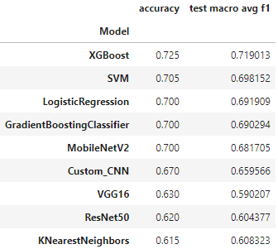
Conclusions / Recommendations
Final Metrics Summary for All Models:
The final testing results were compiled in a table and sorted by accuracy for easy comparison (Fig. 8.1). It should be noted here that the results seen in Figure 8.1 are approximately consistent with other runs of the training and testing stages for the deep learning models. For example, some runs of ResNet50’s training achieved a testing accuracy of >72%, but in others it would yield ~62%, as seen in Figure 8.1. The lack of data is likely responsible for the volatility in results, especially in regard to the fine-tuning stages of the transfer learning models. With the addition of more data, one could expect these results to become much more stable.
On average, the deep learning models performed a little worse than the best classical models, with some transfer learning models occasionally testing in the 70-75% accuracy range. MobileNetV2 and ResNet50 were frequently jumping up in testing accuracy and would therefore be my main suggestions for models to train with more data. The custom CNN was performing more consistently than the others, due to the lack of a fine-tuning stage as with the transfer learning models. The accuracy of the custom CNN would therefore probably continue to improve steadily with the addition of more data and may prove to be a helpful addition to an ensemble approach, depending on results. The XGBoost and Support Vector Machine classifiers should be trained on more data as well, in order to serve as a baseline for comparison with deep learning models as they are developed. Finally, the deployed model(s) should be continually updated, training on new data when available.

Slide 19
Future Refinement
Certainly the main restriction in performance for these models is the lack of available data. Particularly for the neural networks, 1000 samples is not enough data to train on to develop a comprehensive model which can sufficiently classify songs across 10 genres. In the 20+ years since the GTZAN dataset was collected, the amount of genre-labeled music available online has increased exponentially. If a music-streaming platform were to develop deep learning models for this purpose, they would have access to millions of songs, rather than 1000. So, in practice, the CNN or transfer learning approaches would probably prove most effective. Specifically, if a number of models are trained, each performing better than the others on certain genres, an ensemble method which classifies by a weighted majority vote across models would most likely be the optimal solution.
Aside from gathering more data, the project could be improved simply by splitting the data we do have into smaller samples which would be trained on, then classified by majority vote in prediction. One way of doing this would be to split the 30-second song clips into smaller, 10-second clips in preprocessing stages. This process would triple the amount of available samples to train and predict on, which would almost definitely result in more accurate predictions.

Slide 20
Thank You
Kyle Stoudt
Springboard Data Science Career Track
Sources:
[1] Tim Ingham, “OVER 60,000 TRACKS ARE NOW UPLOADED TO SPOTIFY EVERY DAY. THAT’S NEARLY ONE PER SECOND.”, musicbusinessworldwide.com, Feb. 20, 2021 [https://www.musicbusinessworldwide.com/over-60000-tracks-are-now-uploaded-to-spotify-daily-thats-nearly-one-per-second/]
[2] Andrada Olteanu, “GTZAN Dataset - Music Genre Classification Audio Files | Mel Spectrograms | CSV with extracted features”, kaggle.com [https://www.kaggle.com/datasets/andradaolteanu/gtzan-dataset-music-genre-classification]

