Slide 1
Predicting Diabetic Patient Readmissions
Investigating the potential for Machine Learning to improve resource management and occupancy forecasting in regard to diabetic patients.
Kyle Stoudt
Springboard – Data Science Career Track
Notes:
This project is meant to be a proof-of-concept for a Machine Learning model that could assist Hospital staff in identifying and treating patients (in this case, diabetic patients) who are at-risk for readmission, as well as provide some context for how many patients may be returning within a 30 day period.

Slide 2
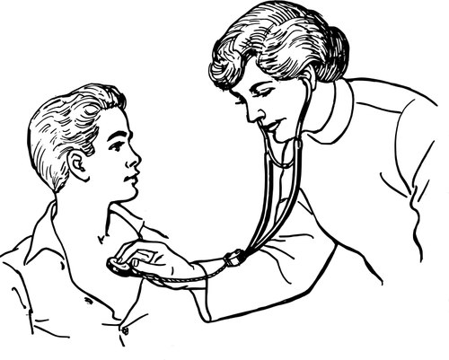
The Problem
~8.4% readmitted in the ‘clean’ diabetic patient dataset.
A readmission can lead to the DOUBLING of hospital resources (including time) invested into the patient.
Notes:
Doctors/Nurses – Seeing patients again keeps them from helping first-time-visiting patients in a timely manner → more readmissions
Billing – <30 days is going to cost the hospital in insurance payouts

Slide 3
The Problem
~8.4% readmitted in the ‘clean’ diabetic patient dataset.
A readmission can lead to the DOUBLING of hospital resources (including time) invested into the patient.
← Imbalanced dataset
More to come on that…
Notes:
Doctors/Nurses – Seeing patients again keeps them from helping first-time-visiting patients in a timely manner → more readmissions
Billing – <30 days is going to cost the hospital in insurance payouts

Slide 4
The Problem
Though 8.4% isn’t the worst statistic, the impact on the individual patients and hospital staff per readmission is substantial.
Readmissions can also have a cascading effect in which one readmission reduces the effectiveness of healthcare provided to other patients, which can lead to more readmissions.
Notes:
Doctors/Nurses – Seeing patients again keeps them from helping first-time-visiting patients in a timely manner → more readmissions
Billing – <30 days is going to cost the hospital in insurance payouts

Slide 5
Stipulations of the ‘Clean’ Dataset^{[1]}
10 years of patient data (1999-2008)
130 US Hospitals
First inpatient encounters only
Diabetic encounters only
14 day maximum stay
Lab tests performed / Medications administered
Notes:
Stipulated by the authors of an academic article that utilized machine learning (multivariate logreg)

Slide 6
The Target Variable
100,000 records and 55 fields, including a column containing NO, >30, or <30 to indicate if the patient was not readmitted, readmitted after 30 days, or readmitted within 30 days.
This column was adjusted down to two categories: ‘<30’ and ‘Other’, in conjunction with the academic article, preparing the dataset for use in a binary classification algorithm.
Notes:
This adjustment performed for insurance billing purposes and represents the specific situation of interest to these hospitals.

Slide 7
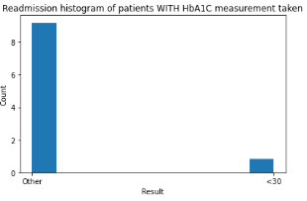
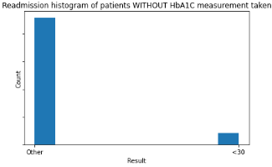

High-level EDA: Our first actionable insight
For diabetic patients, the HbA1C measurement can be of great importance, as it correlates with blood sugar levels. Despite this, 83.3% of the values in the ‘A1Cresult’ column were ‘None’, indicating the measurement is rarely taken at all.
With measurement: 8.18% readmitted within 30 days.
Without measurement: 8.48% readmitted within 30 days
Notes:
Here exists the argument that simply by taking this measurement everytime a diabetic patient is visiting for their first inpatient visit in some time (adjustable window), their readmission odds drop by 0.3%.
The article claims a ‘dramatic decrease’ in readmission risk associated with this test. This is roughly in line with that.
Let us keep in mind, the data is SEEN on a regular basis by doctors/nurses/hospital staff. There would be a HUGE problem if we saw blatantly obvious contributors to these readmissions that the healthcare professionals are somehow missing.

Slide 8
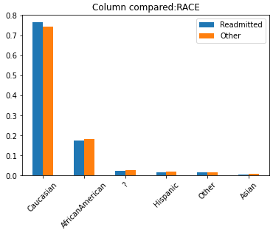
What does EDA tell us about…
…Demographics?
Notes:
Race doesn’t seem to be a huge factor. Though the disproportion in Caucasisan vs African American is interesting
Let us keep in mind, the data is SEEN on a regular basis by doctors/nurses/hospital staff. There would be a HUGE problem if we saw blatantly obvious contributors to these readmissions that the healthcare professionals are somehow missing.

Slide 9
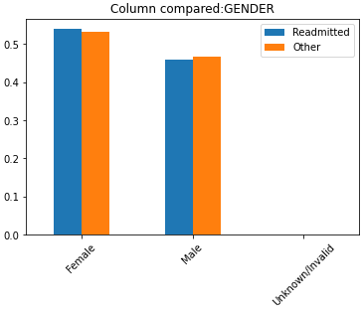
What does EDA tell us about…
…Demographics?
Notes:
Gender doesn’t seem to be as huge of a factor either. Though more females than males being readmitted is something to pay attention to.
Let us keep in mind, the data is SEEN on a regular basis by doctors/nurses/hospital staff. There would be a HUGE problem if we saw blatantly obvious contributors to these readmissions that the healthcare professionals are somehow missing.

Slide 10
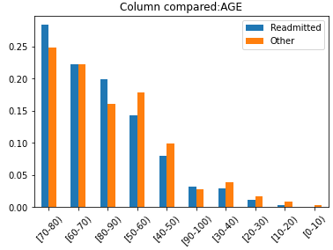
What does EDA tell us about…
…Demographics?
Notes:
The correlation with age could be due to the fact that older people tend to have more conditions, all of which are made more impactful by the patient’s age.
Let us keep in mind, the data is SEEN on a regular basis by doctors/nurses/hospital staff. There would be a HUGE problem if we saw blatantly obvious contributors to these readmissions that the healthcare professionals are somehow missing.

Slide 11
What does EDA tell us about…
…Demographics?
90-100
80-90
70-80
50-60
40-50
30-40
20-30
10-20
← Not very surprising
Notes:
The correlation with age could be due to the fact that older people tend to have more conditions, all of which are made more impactful by the patient’s age.
Let us keep in mind, the data is SEEN on a regular basis by doctors/nurses/hospital staff. There would be a HUGE problem if we saw blatantly obvious contributors to these readmissions that the healthcare professionals are somehow missing.

Slide 12
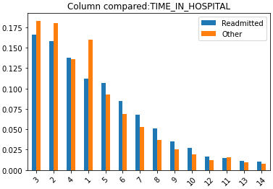
What does EDA tell us about…
…Time spent with us?
Notes:
The correlation with age could be due to the fact that older people tend to have more conditions, all of which are made more impactful by the patient’s age.
Let us keep in mind, the data is SEEN on a regular basis by doctors/nurses/hospital staff. There would be a HUGE problem if we saw blatantly obvious contributors to these readmissions that the healthcare professionals are somehow missing.

Slide 13
What does EDA tell us about…
…Time spent with us?
Our second (somewhat actionable) insight:
4+ days? Might start to worry.
Notes:
4+ days? Seems to be a factor.
Let us keep in mind, the data is SEEN on a regular basis by doctors/nurses/hospital staff. There would be a HUGE problem if we saw blatantly obvious contributors to these readmissions that the healthcare professionals are somehow missing.

Slide 14
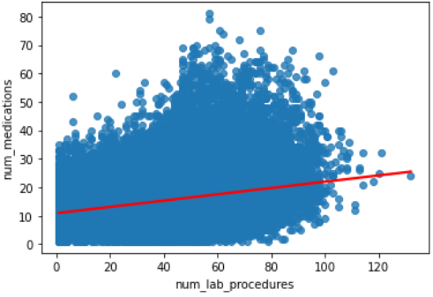
What does EDA tell us about…
…Time spent with us?
or… Engagement
Correlation in the dataset between num_medications and num_lab_procedures
Many such expected correlations present in the dataset →
Notes:
4+ days? Seems to be a factor.
Let us keep in mind, the data is SEEN on a regular basis by doctors/nurses/hospital staff. There would be a HUGE problem if we saw blatantly obvious contributors to these readmissions that the healthcare professionals are somehow missing.

Slide 15
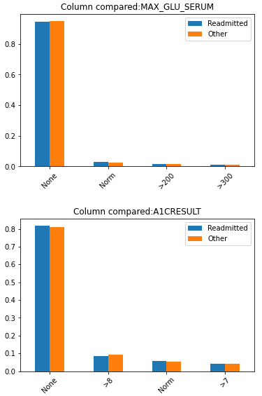
What does EDA tell us about…
…What’s in the blood?
Notes:
A slight increase in readmissions when No HbA1C measurement is taken
Oddly, these ‘flagpole’ features don’t clearly tell us what’s going on.
Let us keep in mind, the data is SEEN on a regular basis by doctors/nurses/hospital staff. There would be a HUGE problem if we saw blatantly obvious contributors to these readmissions that the healthcare professionals are somehow missing.

Slide 16
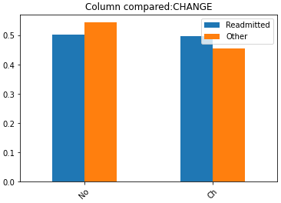
What does EDA tell us about…
…What’s in the blood?
…Our intervention?
Notes:
A slight increase in readmissions when No HbA1C measurement is taken
Oddly, these ‘flagpole’ features don’t clearly tell us what’s going on.
Let us keep in mind, the data is SEEN on a regular basis by doctors/nurses/hospital staff. There would be a HUGE problem if we saw blatantly obvious contributors to these readmissions that the healthcare professionals are somehow missing.

Slide 17
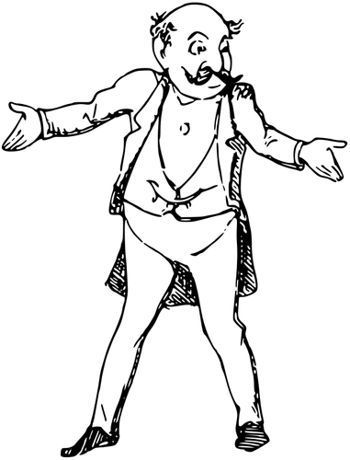
What does EDA tell us about…
…What’s in the blood?
…Our intervention?
Notes:
A slight increase in readmissions when No HbA1C measurement is taken
Oddly, these ‘flagpole’ features don’t clearly tell us what’s going on.
Let us keep in mind, the data is SEEN on a regular basis by doctors/nurses/hospital staff. There would be a HUGE problem if we saw blatantly obvious contributors to these readmissions that the healthcare professionals are somehow missing.

Slide 18
What do we DO ?
Problem: Many factors may contribute and equate to a small difference in a patient’s odds of readmission. It would be impossible to manually identify and appropriately-treat at-risk patients.
Solution: Machine Learning enables us to predict readmission probabilities utilizing all present data. With a specific-enough model, we could flag at-risk patients, and identify the factors contributing to this risk. The patient’s data is all that is needed.
Notes:
Let us keep in mind, the data is SEEN on a regular basis by doctors/nurses/hospital staff. There would be a HUGE problem if we saw blatantly obvious contributors to these readmissions that the healthcare professionals are somehow missing.

Slide 19
What do we DO ?
Problem: Many factors may contribute and equate to a small difference in a patient’s odds of readmission. It would be impossible to manually identify and appropriately-treat at-risk patients.
Solution: Machine Learning enables us to predict readmission probabilities utilizing all present data. With a specific-enough model, we could flag at-risk patients, and identify the factors contributing to this risk. The patient’s data is all that is needed.
← A wild actionable insight appears!
Notes:
THIRD ACTIONABLE INSIGHT: Fidelity in data culture!
Let us keep in mind, the data is SEEN on a regular basis by doctors/nurses/hospital staff. There would be a HUGE problem if we saw blatantly obvious contributors to these readmissions that the healthcare professionals are somehow missing.

Slide 20
What do we DO ?
Problem: Many factors may contribute and equate to a small difference in a patient’s odds of readmission. It would be impossible to manually identify and appropriately-treat at-risk patients.
Solution: Machine Learning enables us to predict readmission probabilities utilizing all present data. With a specific-enough model, we could flag at-risk patients, and identify the factors contributing to this risk. The patient’s data is all that is needed.
← A wild actionable insight appears!
Notes:
THIRD ACTIONABLE INSIGHT: Fidelity in data culture!
Let us keep in mind, the data is SEEN on a regular basis by doctors/nurses/hospital staff. There would be a HUGE problem if we saw blatantly obvious contributors to these readmissions that the healthcare professionals are somehow missing.

Slide 21
Pre-Processing and Initial Models
All categorical data transformed via One Hot Encoding
StandardScaler() used on numeric data
pd.get_dummies(drop_first=True) # Ignores numerical columns
SEVEN initial models compared
Model | Weighted F1-Score
Logistic Regression | 0.87463
K-Nearest Neighbors | 0.87507
Decision Tree | 0.85490
Random Forest | 0.87582
Support Vector Machine | 0.86730
Gradient Boosting | 0.87458
XGBoost Classification | 0.87653
Notes:
HIGHLY IMBALANCED DATA – 8.4% is the makeup of our target class.
DummyClassifier achieving a weighted f1-score of ~0.8758 while predicting ‘Other’ exclusively. Therefore it is possible that some of these other algorithms could perform better with more imbalance-focused pre-processing and hyperparameter tuning

Slide 22
Pre-Processing and Initial Models
Top 3 Models compared after 5-fold RandomizedSearchCV()
Random Forest has overfit.
K-NN Accuracy not looking too promising either…
Model | Accuracy Score | Best Hyperparameters | Training AUC
K-Nearest Neighbors | 91.608% | {'p': 1, 'n_neighbors': 28, 'leaf_size': 41} | 0.7211
Random Forest | 91.598% | {'n_estimators': 1800, 'max_depth': 90} | 1.0
XGBoost | 91.600% | {'scale_pos_weight': 10.0, 'n_estimators': 600, 'max_depth': 7, 'learning_rate': 0.1} | 0.8822
Notes:
HIGHLY IMBALANCED DATA – 8.4% is the makeup of our target class.
DummyClassifier achieving a weighted f1-score of ~0.875 while predicting ‘Other’ exclusively. Therefore it is possible that some of these other algorithms could perform better with more imbalance-focused pre-processing and hyperparameter tuning

Slide 23
Pre-Processing and Initial Models
Top 3 Models compared after 5-fold RandomizedSearchCV()
Random Forest has overfit.
K-NN Accuracy not looking too promising either…
Model | Accuracy Score | Best Hyperparameters | Training AUC
K-Nearest Neighbors | 0.915982299063497 | {'p': 1, 'n_neighbors': 28, 'leaf_size': 41} | 0.721088731825609
Random Forest | 0.915982299063497 | {'n_estimators': 1800, 'max_depth': 90} | 1.0
XGBoost | 0.916002881547803 | {'scale_pos_weight': 10.0, 'n_estimators': 600, 'max_depth': 7, 'learning_rate': 0.1} | 0.882231034570797
Notes:
HIGHLY IMBALANCED DATA – 8.4% is the makeup of our target class.
DummyClassifier achieving a weighted f1-score of ~0.875 while predicting ‘Other’ exclusively. Therefore it is possible that some of these other algorithms could perform better with more imbalance-focused pre-processing and hyperparameter tuning

Slide 24
Pre-Processing and Initial Models
Top 3 Models compared after 5-fold RandomizedSearchCV()
Random Forest has overfit.
K-NN Accuracy not looking too promising either…
Model | Accuracy Score | Best Hyperparameters | Training AUC
K-Nearest Neighbors | 0.915982299063497 | {'p': 1, 'n_neighbors': 28, 'leaf_size': 41} | 0.721088731825609
Random Forest | 0.915982299063497 | {'n_estimators': 1800, 'max_depth': 90} | 1.0
XGBoost | 0.916002881547803 | {'scale_pos_weight': 10.0, 'n_estimators': 600, 'max_depth': 7, 'learning_rate': 0.1} | 0.882231034570797
This is our first indication that the highly-imbalanced data is causing problems for most of the out-of-the-box models. The XGBoost algorithm can compensate for imbalanced classes by setting ‘scale_pos_weight’ = # of majority / # of minority
Notes:
HIGHLY IMBALANCED DATA – 8.4% is the makeup of our target class.
DummyClassifier achieving a weighted f1-score of ~0.875 while predicting ‘Other’ exclusively. Therefore it is possible that some of these other algorithms could perform better with more imbalance-focused pre-processing and hyperparameter tuning

Slide 25
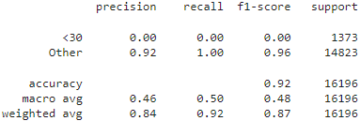
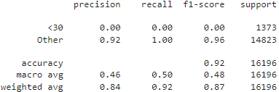
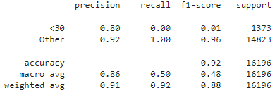
Top 3 Classification Report Comparison:
K-Nearest Neighbors
Random Forest
*XGBoost*
Notes:
HIGHLY IMBALANCED DATA – 8.4% is the makeup of our target class.
DummyClassifier achieving a weighted f1-score of ~0.875 while predicting ‘Other’ exclusively. Therefore it is possible that some of these other algorithms could perform better with more imbalance-focused pre-processing and hyperparameter tuning

Slide 26
Top 3 Classification Report Comparison:
K-Nearest Neighbors
Random Forest
*XGBoost*
Notes:
The only non-zero f1-score…
XGBoost Classifier clearly the only one that is able to (sort-of) accurately identify our target class

Slide 27
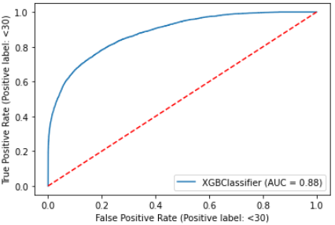
The XGBoost Classifier:
roc_auc_score = ~0.8822
Chosen for the only non-zero f1-score
0.01 → not the best
How can we improve?
Notes:
The only non-zero f1-score…
XGBoost Classifier clearly the only one that is able to (sort-of) accurately identify our target class

Slide 28
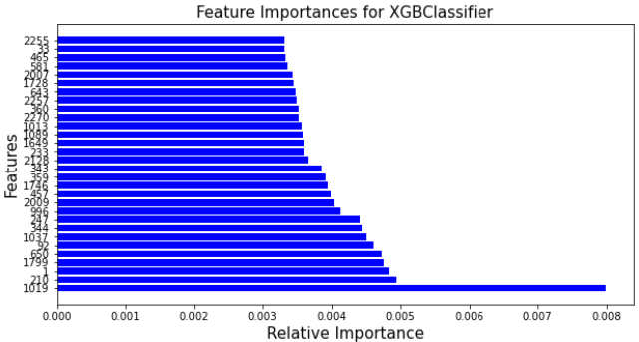
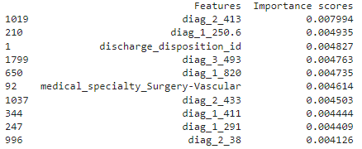
XGBoost Classifier – Feature Importances
As mentioned previously, we would have a huge problem with these 130 US Hospitals (c. 1999-2008) if we could clearly see features that are making major contributions to a patient’s risk of readmission.
Notes:
The only non-zero f1-score…
XGBoost Classifier clearly the only one that is able to (sort-of) accurately identify our target class

Slide 29
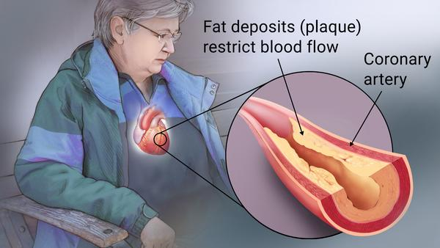
XGBoost Classifier – Feature Importances
Angina Pectoris – diag_x_413
In regard to feature importances, there are upwards of 2,000 features and so the visualizations don’t tell us too much.
However, it makes sense to see the diagnosis codes playing a larger role, as well as ‘surgery’ and ‘discharge_disposition_id’ as they indicate the intensity of the visit and the patients’ nature of departure, respectively.
*diag_2_413 – indicates a secondary diagnosis of Angina Pectoris, an ischemic heart disease that results from narrowed arteries
*diag_1_250.6 – indicates a primary diagnosis that is diabetes mellitus-related
Notes:
The only non-zero f1-score…
XGBoost Classifier clearly the only one that is able to (sort-of) accurately identify our target class

Slide 30
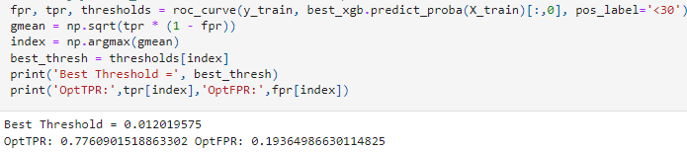
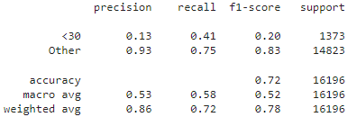
XGBoost Classifier – Now with Thresholding
Optimizing the geometric mean of true-positive-rate and false-positive-rate
A TPR of 0.776 and FPR of 0.194 is the most optimized result yet. The model is honing in on a better understanding of the target class.
Notes:
The only non-zero f1-score…
XGBoost Classifier clearly the only one that is able to (sort-of) accurately identify our target class

Slide 31
XGBoost Classifier – Now with Thresholding
Without Thresholding
With Thresholding
→
Notes:
Compensating for the imbalanced classes in the dataset with thresholding to an optimized probability makes a substantial improvement in the predicting power of the model.

Slide 32
Conclusions
XGBoost is the winner!
‘scale_pos_weight’ provides an elegantly simple method for adjusting to class imbalances
Precision v. Recall?
We will want to optimize the model’s True-Positive-Rate (TPR). This correlates to an optimization of the model’s precision (TP / TP + FN)
To incorrectly flag a patient as ‘at-risk’ would be to work against our own goal, which is to reduce hospital resource investment (time and physical resources) per patient.
Further optimization techniques for thresholding should be explored to increase precision score.
While the performance at this stage isn’t necessarily production-ready, it certainly has room to improve due to the concrete improvements seen with thresholding and the potential of oversampling the minority class to manufacture a less-skewed class ratio.

Slide 33
Conclusions
The Use Case:
This model would be best-used as a tool that flags individuals who are at a high-risk for readmission and can show the features that correspond to this increased risk. The information provided would be supplemental to the treatment plan of the individual and may provide insight into what causes their readmission risk to increase, as well as how many beds the hospital can expect to be filled in the following month due to readmissions. Such a tool would need to be regularly fed new data, to keep up with the dynamically changing landscape of healthcare practices as time ticks on.

Slide 34

What can we do?
Simply the taking of the HbA1C measurement decreases the risk of a patient’s readmission by 0.3%
A big one: DATA CULTURE!
Data Prep: Separate categorical and numerical data for use with One Hot Encoding and Scaling, respectively.
One, generally, would expect improvement of the model with more intensive feature selection/engineering through techniques like PCA and chi-squared tests for dimensionality reduction.
Some finer hyperparameter tuning could yield better results with Decision Trees / Random Forest (both overfit in initial modeling), but it would not be surprising to still see XGBoost as the most robust of the group.
Imblearn’s RandomOverSampler for manufacturing more-balanced classes.
8.4%
Readmissions
0%

Slide 35
What can we do?
Simply the taking of the HbA1C measurement decreases the risk of a patient’s readmission by 0.3%
A big one: DATA CULTURE!
Data Prep: Separate categorical and numerical data for use with One Hot Encoding and Scaling, respectively.
One, generally, would expect improvement of the model with more intensive feature selection/engineering through techniques like PCA and chi-squared tests for dimensionality reduction.
Some finer hyperparameter tuning could yield better results with Decision Trees / Random Forest (both overfit in initial modeling), but it would not be surprising to still see XGBoost as the most robust of the group.
Imblearn’s RandomOverSampler for manufacturing more-balanced classes.
8.4%
Readmissions
0%

Slide 36
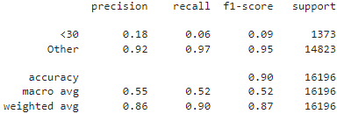
A brief look at oversampling
XGBoost Classifier with ‘scale_pos_weight’=10.0
The method of oversampling the minority (or target) class to a 1:1 ratio with the majority class was briefly explored:
The classification report for this XGBoost Classifier with oversampling shows a slight improvement over the base model.
The improvement seen by this simple oversampling hints that an even better model could be produced with the combination of multiple methods to handle class imbalance.
The best model would most likely be an XGBClassifier with the use of thresholding and oversampling of the minority class.
A balance could also be struck between ‘scale_pos_weight’ and the oversampling in order to reduce the impact of each transformation independently.
XGBoost Classifier with oversampling to 1:1 class ratio
A good improvement for simply oversampling to a 1:1 ratio on a roughly-tuned XGBClassifier model.

Slide 37
Thank You
Kyle Stoudt
Springboard Data Science Career Track
Sources:
^{[1]}Beata Strack, Jonathan P. DeShazo, Chris Gennings, Juan L. Olmo, Sebastian Ventura, Krzysztof J. Cios, and John N. Clore, “Impact of HbA1c Measurement on Hospital Readmission Rates: Analysis of 70,000 Clinical Database Patient Records,” BioMed Research International, vol. 2014, Article ID 781670, 11 pages, 2014. [https://www.hindawi.com/journals/bmri/2014/781670/]

