Slide 1
Linear Regression, ANOVA
MCB 293S:
Foundations of Biostatistical Practice
Week 3
Kelly Street
PhD Candidate
Division of Biostatistics
Dr. Sandrine Dudoit
Department of Statistics
Division of Biostatistics

Slide 2
Multiple Linear regression
Most problems are not 2-dimesional

Slide 3
Multiple Linear Regression
We are often interested in how multiple factors correlate with the outcome or controlling for “uninteresting” factors in our analysis of a single predictor.
Multiple linear regression refers to the simultaneous estimation of several slopes (beta values).
Cell Type
Animal
Batch
Total Counts
Expression
Y
X
n
1
p

Slide 4
Multiple Linear Regression
We are often interested in how multiple factors correlate with the outcome or controlling for “uninteresting” factors in our analysis of a single predictor.
Multiple linear regression refers to the simultaneous estimation of several slopes (beta values).
Cell Type
Animal
Batch
Total Counts

Slide 5
Multiple Linear Regression
“Classical”
We are often interested in how multiple factors correlate with the outcome or controlling for “uninteresting” factors in our analysis of a single predictor.
Multiple linear regression refers to the simultaneous estimation of several slopes (beta values).
> fit <- lm(expression ~ cellType + animal + batch + totalCount, data = df)
> summary(fit)

Slide 6
Multiple Linear Regression
“Classical”
Call:
lm(formula = expr ~ cellType + animal + batch + totalCount)
Residuals:
Min 1Q Median 3Q Max
-2.43075 -0.66132 0.09466 0.69111 2.14370
Coefficients:
Estimate Std. Error t value Pr(>|t|)
(Intercept) 2.050e+00 1.148e+01 0.178 0.8587
cellTypeB 2.057e+00 2.081e-01 9.886 3.21e-16 ***
animaly 9.281e-02 2.767e-01 0.335 0.7381
animalz -6.344e-02 2.558e-01 -0.248 0.8047
batchRun2 4.539e-01 2.077e-01 2.186 0.0313 *
totalCount 8.814e-07 2.297e-06 0.384 0.7020
---
Signif. codes: 0 ‘***’ 0.001 ‘**’ 0.01 ‘*’ 0.05 ‘.’ 0.1 ‘ ’ 1
Residual standard error: 1.035 on 94 degrees of freedom
Multiple R-squared: 0.5237, Adjusted R-squared: 0.4984
F-statistic: 20.67 on 5 and 94 DF, p-value: 7.106e-14

Slide 7
Multiple Linear Regression
“Modern”
Bootstrap it.
Animal = “y”
Animal = “z”
Cell Type = “B”
Batch = “Run2”
Total Counts

Slide 8
Caveats
Linearity and Homoscedasticity
Relationships between variables can be nonlinear. Additionally, there is often a relationship between the mean and the variance.
Cell Type
Batch
Z
Confounding
If two variables are highly similar, it can be difficult (or impossible) to separate their respective relationships with the outcome.
X
Y

Slide 9
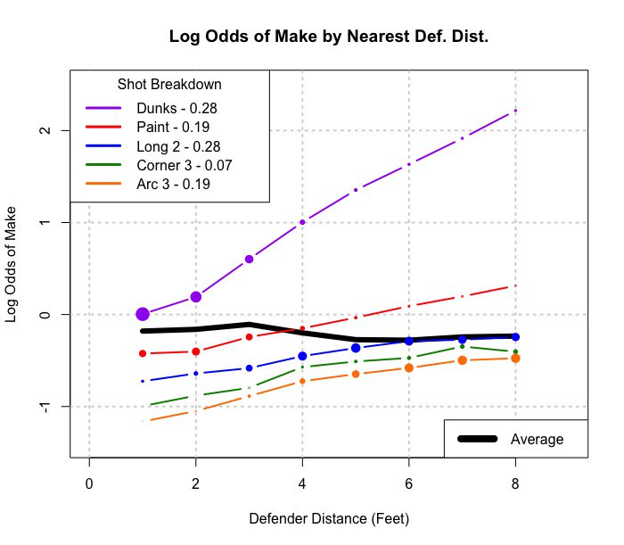
Caveats
Transformations
Sometimes the relationship between variables is linear on the log scale, or with respect to the square (root) of one of the variables.
Interaction
It is possible for variables to have complicated interdependencies, making it difficult to estimate a single coefficient for each.
https://twitter.com/LukeBornn/status/917835676095148032

Slide 10
Analysis of variance (ANOVA)
Handling categorical predictors

Slide 11
Setup
Sometimes we want to treat a categorical variable as a single variable, rather than splitting it into multiple, binary comparisons. ANOVA allows us to test for any difference between the means of multiple groups.

Slide 12
The F-statistic

Slide 13
The F-test
“Classical”
F-distributions are indexed by two parameters: the numerator degrees of freedom and the denominator degrees of freedom.
For ANOVA, these values are K-1 and N-K, respectively.
F-distribution with
(2, 97) degrees of freedom
Observed F-statistic
p-value = 2.037*10⁻⁷

Slide 14
The “F-test”
“Modern”
Use the Permutation Test!
As before, we preserve the ratio of group sizes by permuting labels rather than resampling
Value
Label
10.1
14.5
8.5
12.8
.
.
.
11.2
15.8
14.0
17.1
“A”
“B”
“A”
“C”
.
.
.
“C”
“A”
“B”
“B”
Distribution of 10,000
F-statistics, permuting labels
Observed F-statistic
p-value = 0
p-value < .01

Slide 15
The “F-test”
“Modern”
Still works for any statistic!
Larger K means bigger differences between groups!

Slide 16
The “K-test”
“Modern”
Larger K means bigger differences between groups!
Distribution of 10,000
K-statistics, permuting labels
Observed K-statistic
p-value < .01

Slide 17
Clustering
L

Slide 18
T-distributions
This

Slide 19
Principal components analysis (PCA)
Dimensionality reduction and/or summarization

Slide 20
Why?
Regression, along with most of classical statistics, was designed for cases where n > p. A lot of these methods will have identifiability issues or otherwise break when p >> n.
Today’s world produces a ton of data. Statisticians need to be able to analyze it without throwing away everything we did before 1995.
While high-dimensional data can be very useful, it is difficult for humans to conceptualize a 500-dimensional space. Additionally, most real-world conclusions will be relatively simple compared to the datasets used to obtain them.

Slide 21
When?
As with most statistical techniques, dimensionality reduction is not always appropriate. It will come with certain trade-offs and assumptions and it is our job to determine whether or not these are acceptable.
Pros
Cons
Allows us to fit complicated, high-dimensional data into a classical statistics framework
Provides useful summaries for visualization or quick, “informal inference”
Can reduce complexity in multiple ways, such as breaking inconvenient covariance structures
Simpler is not always better
Losing data almost always means losing information
Must be careful not to accidentally assume the conclusion
It can be easy to over-interpret a low-dimensional representation of your data
Bottom line: You have to understand the method and the assumptions before drawing conclusions.

Slide 22
Dimensionality Reduction
Consider a setting with many potential covariates (e.g. genes).
How can we summarize the data in a smaller number of dimensions, while losing as little information as possible?
X
X’
n
n
p
2 or 3

Slide 23
Principal Components Analysis
Principal Component Analysis (PCA) is probably the most common method for dimensionality reduction, but it is not always well defined or well understood.
PCA creates a new set of variables called principal components that are linear combinations of the variables in the original data set. The principal components are orthogonal and have successively maximal variance.
This approach links the ideas of variance and information. PCA attempts to preserve as much structure in the data as possible by spreading it out as much as possible.
PCA, like correlation, is deterministic but can be motivated from a modeling standpoint. It will always return something, you have to decide whether or not it is useful.

Slide 24

Principal Components Analysis
PC1
PC2
PC3
Find direction of maximal variance
Collapse that dimension
Repeat
What are the principal components of a surfboard?
Source: Global Surf Industries, www.surfindustries.com/

Slide 25
PCA as a Least Squares Estimator

Slide 26
PCA-thagorean Theorem
Recall that if a and b are the legs of a right triangle with hypotenuse c, then
Therefore, given a dataset with center (mean) , for any line through the center, , and orthogonal projections onto that line, , we have:
for all i = 1, …, n.

Slide 27
PCA-thagorean Theorem
Recall that if a and b are the legs of a right triangle with hypotenuse c, then
Therefore, given a dataset with center (mean) , for any line through the center, , and orthogonal projections onto that line, , we have:
for all i = 1, …, n.
Summing these equations over all i, you get:
Fixed
Squared Error
1-D Variance

