Slide 1
Linear Regression, ANOVA
MCB 293S:
Foundations of Biostatistical Practice
Week 4
Kelly Street
PhD Candidate
Division of Biostatistics
Dr. Sandrine Dudoit
Department of Statistics
Division of Biostatistics

Slide 2
Multiple Linear regression
Most problems are not 2-dimesional

Slide 3
Multiple Linear Regression
We are often interested in how multiple factors correlate with the outcome or controlling for “uninteresting” factors in our analysis of a single predictor.
Multiple linear regression refers to the simultaneous estimation of several slopes (beta values).
Cell Type
Animal
Batch
Total Counts
Expression
Y
X
n
1
p
MCB 293S
Multiple Linear Regression
ANOVA
Week 4

Slide 4
Multiple Linear Regression
We are often interested in how multiple factors correlate with the outcome or controlling for “uninteresting” factors in our analysis of a single predictor.
Multiple linear regression refers to the simultaneous estimation of several slopes (beta values).
Cell Type
Animal
Batch
Total Counts
MCB 293S
Multiple Linear Regression
ANOVA
Week 4

Slide 5
Multiple Linear Regression
“Classical”
We are often interested in how multiple factors correlate with the outcome or controlling for “uninteresting” factors in our analysis of a single predictor.
Multiple linear regression refers to the simultaneous estimation of several slopes (beta values).
> fit <- lm(expression ~ cellType + animal + batch + totalCount, data = df)
> summary(fit)
MCB 293S
Multiple Linear Regression
ANOVA
Week 4

Slide 6
Multiple Linear Regression
“Classical”
Call:
lm(formula = expr ~ cellType + animal + batch + totalCount)
Residuals:
Min 1Q Median 3Q Max
-2.43075 -0.66132 0.09466 0.69111 2.14370
Coefficients:
Estimate Std. Error t value Pr(>|t|)
(Intercept) 2.050e+00 1.148e+01 0.178 0.8587
cellTypeB 2.057e+00 2.081e-01 9.886 3.21e-16 ***
animaly 9.281e-02 2.767e-01 0.335 0.7381
animalz -6.344e-02 2.558e-01 -0.248 0.8047
batchRun2 4.539e-01 2.077e-01 2.186 0.0313 *
totalCount 8.814e-07 2.297e-06 0.384 0.7020
---
Signif. codes: 0 ‘***’ 0.001 ‘**’ 0.01 ‘*’ 0.05 ‘.’ 0.1 ‘ ’ 1
Residual standard error: 1.035 on 94 degrees of freedom
Multiple R-squared: 0.5237, Adjusted R-squared: 0.4984
F-statistic: 20.67 on 5 and 94 DF, p-value: 7.106e-14
MCB 293S
Multiple Linear Regression
ANOVA
Week 4

Slide 7
Multiple Linear Regression
“Modern”
Bootstrap it.
Animal = “y”
Animal = “z”
Cell Type = “B”
Batch = “Run2”
Total Counts
MCB 293S
Multiple Linear Regression
ANOVA
Week 4

Slide 8
Caveats
Linearity and Homoscedasticity
Relationships between variables can be nonlinear. Additionally, there is often a relationship between the mean and the variance.
Cell Type
Batch
Z
Confounding
If two variables are highly similar, it can be difficult (or impossible) to separate their respective relationships with the outcome.
X
Y
MCB 293S
Multiple Linear Regression
ANOVA
Week 4

Slide 9
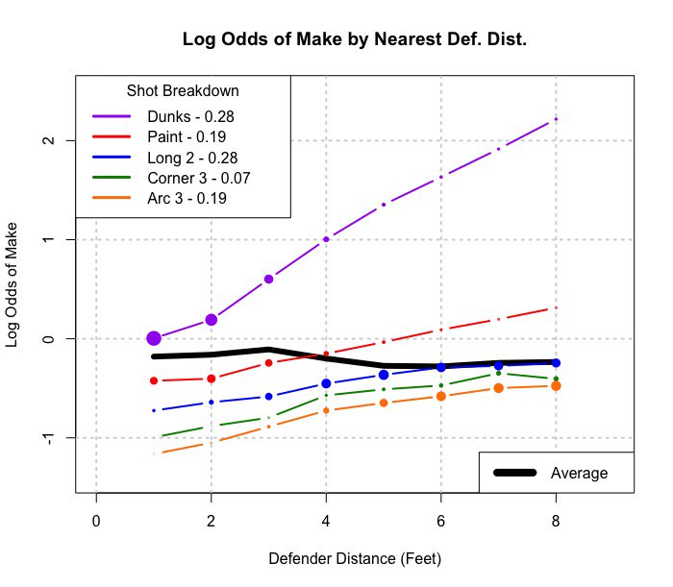
Caveats
Transformations
Sometimes the relationship between variables is linear on the log scale, or with respect to the square (root) of one of the variables.
Interaction
It is possible for variables to have complicated interdependencies, making it difficult to estimate a single coefficient for each.
https://twitter.com/LukeBornn/status/917835676095148032
MCB 293S
Multiple Linear Regression
ANOVA
Week 4

Slide 10
Analysis of variance (ANOVA)
Handling categorical predictors

Slide 11
Setup
Sometimes we want to treat a categorical variable as a single variable, rather than splitting it into multiple, binary comparisons. ANOVA allows us to test for any difference between the means of multiple groups.
MCB 293S
Multiple Linear Regression
ANOVA
Week 4

Slide 12
The F-statistic
MCB 293S
Multiple Linear Regression
ANOVA
Week 4

Slide 13
The F-test
“Classical”
F-distributions are indexed by two parameters: the numerator degrees of freedom and the denominator degrees of freedom.
For ANOVA, these values are K-1 and N-K, respectively.
F-distribution with
(2, 97) degrees of freedom
Observed F-statistic
p-value = 2.037*10⁻⁷
MCB 293S
Multiple Linear Regression
ANOVA
Week 4

Slide 14
The “F-test”
“Modern”
Use the Permutation Test!
As before, we preserve the ratio of group sizes by permuting labels rather than resampling
Value
Label
10.1
14.5
8.5
12.8
.
.
.
11.2
15.8
14.0
17.1
“A”
“B”
“A”
“C”
.
.
.
“C”
“A”
“B”
“B”
Distribution of 10,000
F-statistics, permuting labels
Observed F-statistic
p-value = 0
p-value < .01
MCB 293S
Multiple Linear Regression
ANOVA
Week 4

Slide 15
The “F-test”
“Modern”
Still works for any statistic!
Larger K means bigger differences between groups!
MCB 293S
Multiple Linear Regression
ANOVA
Week 4

Slide 16
The “K-test”
“Modern”
Larger K means bigger differences between groups!
Distribution of 10,000
K-statistics, permuting labels
Observed K-statistic
p-value < .01
MCB 293S
Multiple Linear Regression
ANOVA
Week 4

