Slide 1
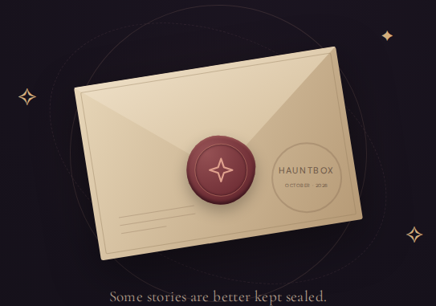
Hauntbox
A haunted post office for private stories
and optional curator rewards.
What it is designed to do
Why it matters
1 Seal a story
Private entries with verifiable arrival.
Useful for creative contests and
community feedback.
Encrypt a submission in the browser for the curator.
2 Prove it arrived
Why it fits Spooky Secrets
Record the encrypted envelope’s fingerprint on Ootle.
Haunted letters make privacy tangible.
Original Ootle receipt logic and Tari
stealth rewards give the theme a
practical technical purpose.
3 Reward a contribution
The curator may send a stealth testnet reward.
Working mock today. Live encryption, chain receipts and stealth rewards pending testnet verification.
Notes:
Suggested spoken pitch: Hauntbox is a haunted post office for stories people want to share with a curator without publishing them. The planned live workflow encrypts a story in the browser, records a fingerprint of its sealed envelope on Ootle, and lets the curator choose a native stealth testnet reward. This gives creative contests and community feedback a private submission process with independently verifiable arrival. It fits Spooky Secrets because the haunted-letter experience makes privacy understandable and connects the theme to original Ootle receipt logic and Tari native privacy capabilities.
Current status as of October 2, 2026: M1 frontend mock is complete. The mock does not encrypt, upload, authenticate the curator, anchor real receipts or transfer funds. M2 wallet/network preflight and receipt WASM compilation exist. Live privacy and payment proofs remain pending testnet verification and funding.
Privacy boundaries: the curator can decrypt on arrival. The operator wallet service sees a selected recipient and amount. Fees, public output keys, signatures, timing and transaction structure remain visible or inferable. A receipt proves inclusion of encrypted bytes, not authorship or payment. Rewards are discretionary and use operator-custodied testnet funds.
Sources: PROJECT_PLAN.md, README.md, PRIVACY.md and docs/evidence/m2/capabilities.md in this repository. The artwork comes from docs/evidence/m1/01-entrance-1440.png. Official theme source: https://community.tari.com/t/october-build-contest-thread-spooky-secrets/396 (October 1, 2026). The contest asks for spooky secret submissions and demonstrations of Tari privacy capabilities. The fit described on this slide is a product assessment, not an official judging rubric or prediction.

