Slide 1


MACHINE LEARNING SIMULATION
Evaluating the Importance of Word Content Versus Capitalization in Spam Email Classification
What does a model need to spot spam?
Dataset: UCI Spambase | Tool: ML Console
Beltran, Jon Emanuel V.
COM241ML
Notes:
Hi everyone! My project is about spam email detection. I wanted to find out what a model really needs in order to recognise spam.

Slide 2




The Problem
Spam is more than annoying.
A lot of it is scams and phishing.
What does a model need to recognise spam?
Scams and phishing
The actual words and symbols?
Filters must catch spam without throwing away real email
Or is it the style, like CAPITAL LETTERS?
Notes:
Spam is more than annoying. A lot of it is scams and phishing, and filters have to catch it without throwing away real email. My question was simple: what does a model need to recognise spam? The actual words, or is the style enough, like writing in capital letters?

Slide 3
The Data: UCI Spambase
4,601
emails, labeled spam or not spam
39.4%
of them are spam
Notes:
I used the UCI Spambase dataset: 4,601 emails, and 39.4% of them are spam. Here is the baseline: 60.6% of the emails in the dataset are not spam. That means a dummy model that simply guesses 'not spam' every single time already scores 60.6%. That is the bar to beat.

Slide 4
Each Email Became 57 Numbers
48
6
3
word counts
character counts
capital-letter measures
How often certain words appear, like free, money, and business.
How often characters like ! and $ appear.
How much of the email is written in capital letters.
The emails were already turned into numbers for us. Thanks to the dataset
Notes:
The emails had already been converted into 57 numbers each. That conversion is called feature engineering. 48 columns count how often certain words appear, like free, money, and business. 6 columns count characters like an exclamation mark and a dollar sign. And 3 columns measure how much of the email is in capital letters.

Slide 5

The Experiment: Two Runs
1
Run 1: all 57 features
Same settings both times
Words, symbols, and capital letters.
A small neural network in ML Console, default settings
Hidden layers
1
2
Run 2: only 3 features
Units per layer
64
Only the capital-letter numbers. No words.
Optimizer
adagrad
Learning rate
0.04
The bar to beat: 60.6%
Batch size
16
Always guessing “not spam”.
Max epochs
150
Notes:
I trained a small neural network in ML Console twice, using default settings: one hidden layer of 64 units. I kept the settings identical both times. First, using all 57 features. Second, using only the 3 capital-letter features.

Slide 6
What I Found
+32.2
points above the bar to beat, with all 57 features
+10.3
points above the bar to beat, with capital letters only
Notes:
One: with all 57 features, the model catches spam very well, reaching 92.78%. That is more than 32 points above the baseline. Two: with only the capital-letter features, the accuracy was 70.87%. That is about 10 points above the baseline, so capital letters help a little, but far less than the words and symbols.

Slide 7
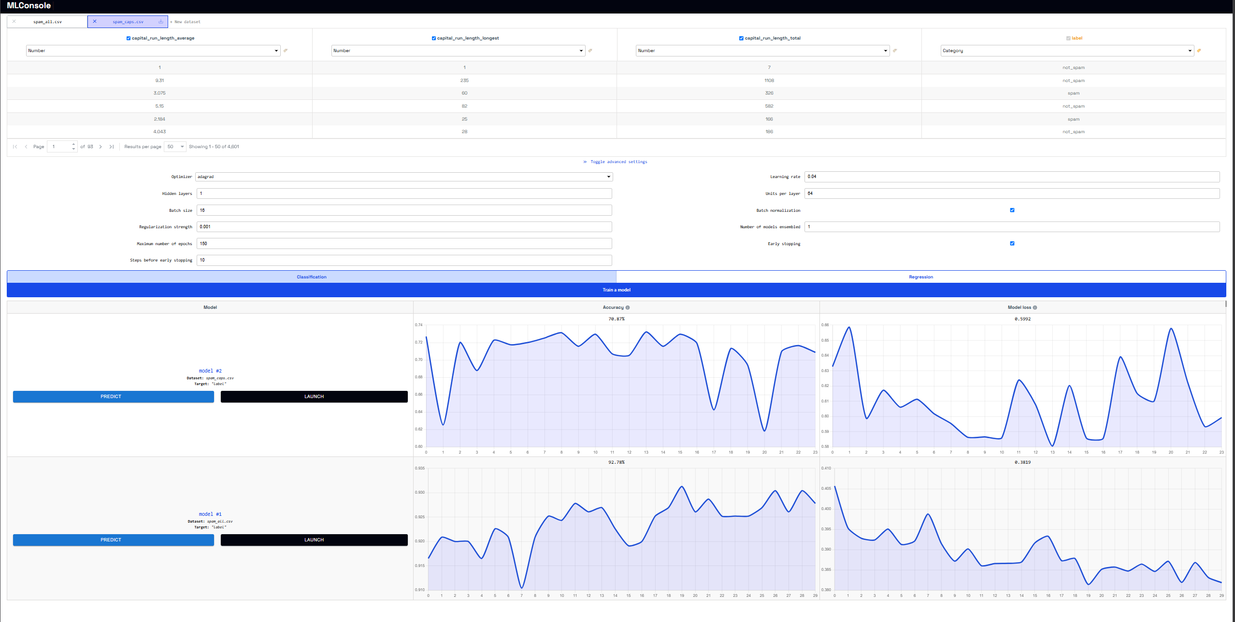
Proof: My ML Console Results
Top row: model #2, capital letters only (70.87%). Bottom row: model #1, all 57 features (92.78%).
Notes:
This is the real screen from ML Console. The top row is model #2, trained on the capital-letter file, and it ended at 70.87%. The bottom row is model #1, trained on all 57 features, and it ended at 92.78%. The settings in the middle were the same for both runs.

Slide 8


Why Are Capital Letters Not Enough?
Real rows from the capital-letter data
Style alone lacks context
average | longest | total | label
1 | 1 | 7 | not_spam
9.31 | 235 | 1108 | not_spam
3.075 | 60 | 326 | spam
5.15 | 82 | 582 | not_spam
2.184 | 25 | 166 | spam
4.043 | 28 | 186 | not_spam
A real email can have lots of capitals (like an urgent work project), and spam can be written in lowercase. Without trigger words or symbols, the model misses key clues.
The numbers are extreme (a likely reason)
A typical email has about 95 capital letters, but some have over 15,000. A neural network multiplies raw numbers, so huge unscaled values make it harder to train cleanly.
Look how much the totals jump around, from 7 to 1108 in just six rows.
Notes:
Why did capitals do so much worse on their own? Two main reasons. First, style alone lacks context. A legitimate email can have lots of capital letters, like an urgent work project, and spam can be written in lowercase. Without trigger words or symbols, the model lacks critical clues. Second, the capital-letter values are extreme. An average email has about 95 capitals, but some reach over 15,000. Because a neural network relies on multiplying raw numbers, huge unscaled values like that make it harder for the model to train cleanly without preprocessing.

Slide 9
The Answer
To spot spam, a model needs the actual content: the specific words and symbols.
92.78%
with words and symbols
70.87%
with capital letters only
Capital letters can hint at spam, but they are not enough to build a reliable filter.
Notes:
Effective spam detection requires the actual content: the specific words and symbols, which reached 92.78%. Capital letters alone only managed 70.87%, showing that while formatting might hint at spam, it isn't enough on its own to build a reliable filter.

Slide 10

Thank you!
Any questions?
Notes:
LIKELY QUESTIONS AND ANSWERS
Why did the capital-letter model score so low? Two reasons: formatting doesn't provide enough context without the actual vocabulary, and the numbers are extreme (ranging from under 10 to over 15,000). Small neural networks without normalized data struggle with those massive spikes.
How could you improve the capital-letter model in the future? Feature scaling or applying a logarithm would compress those extreme values into a normal range, making it much easier for the neural network to learn from them.
Why a neural network? It's the model architecture used in ML Console, so keeping the architecture identical allowed a direct, fair comparison between the two feature sets.
Where did you get 60.6%? 60.6% of the emails in the dataset are legitimate, so a model that simply defaults to 'not spam' every single time would score 60.6% automatically.

