Slide 1

Loop Invariants
Computational Core

Slide 2
Loops
Treat loops like mini-methods
Preconditions
Postconditions
Loop invariant
Notes:
When trying to understand what a method does, we can use preconditions and postconditions to explain exactly what it does.
We can use these same concepts to define exactly what loops are doing. Every loop has a precondition and a postcondition. However, we also introduce a new concept called a loop invariant.

Slide 3
Loops
Treat loops like mini-methods
Preconditions
Postconditions
Loop invariant
A condition that must be true after each iteration of the loop, provided the precondition is true.
Notes:
A loop invariant is a condition that is true after each iteration of the loop. Of course, the invariant is only required to hold if the loop precondition is true.
We can use loop invariants to help us in writing loops as well as showing that our loops will run correctly and produce the required loop postcondition. They can also be helpful in debugging our code when things go wrong.

Slide 4
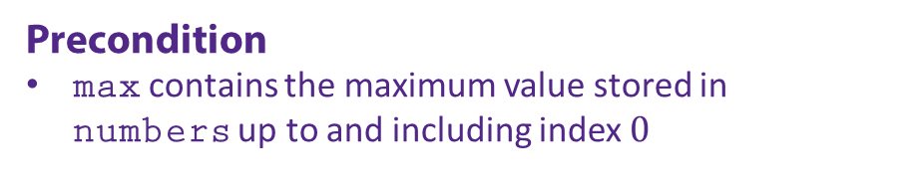
function maximum(numbers) max = numbers[0] loop i from 1 to length of numbers if numbers[i] > max max = numbers[i] end if end loop return max end function
Precondition
max contains the maximum value stored in numbers up to and including index $0$
Notes:
To demonstrate these concepts, we will use the ‘maximum’ function, which finds the maximum number in an array called ‘numbers’.
Here we show the precondition for the ‘maximum’ function. It states that the variable ‘max’ must be initialized to the first value in the ‘numbers’ array. The precondition is vital to ensuring that the loop will actually produce its desired result.
Like a method, if the loop precondition is not true, we cannot guarantee what the output will be.

Slide 5
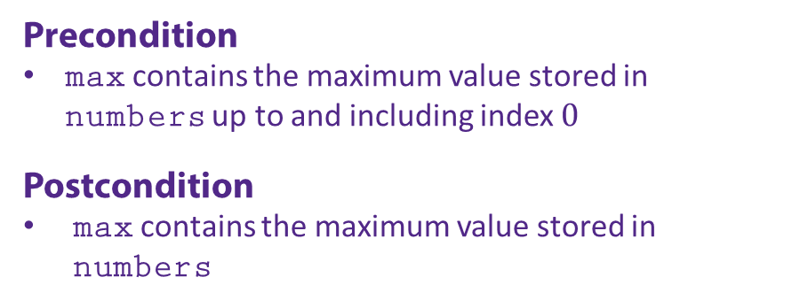
function maximum(numbers) max = numbers[0] loop i from 1 to length of numbers if numbers[i] > max max = numbers[i] end if end loop return max end function
Precondition
max contains the maximum value stored in numbers up to and including index $0$
Postcondition
max contains the maximum value stored in numbers
Notes:
Next, we have the postcondition. The postcondition tells us what will be true after the loop exits.
Here the postcondition states that the value stored in the variable ‘max’ will be the largest number stored in the ‘numbers’ array.
The postcondition tells us what the overall purpose of the loop is.

Slide 6
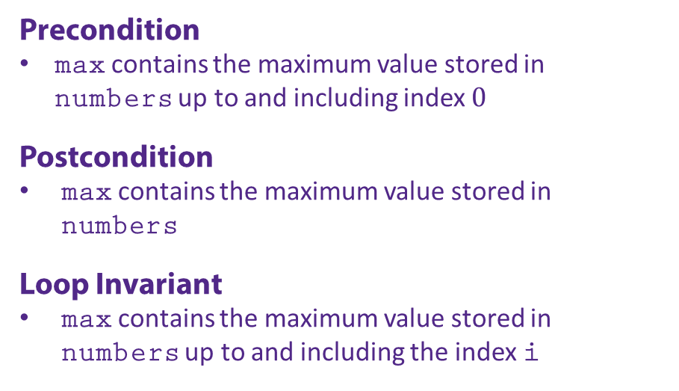
function maximum(numbers) max = numbers[0] loop i from 1 to length of numbers if numbers[i] > max max = numbers[i] end if end loop return max end function
Precondition
max contains the maximum value stored in numbers up to and including index $0$
Postcondition
max contains the maximum value stored in numbers
Loop Invariant
max contains the maximum value stored in numbers up to and including the index i
Notes:
Finally, we will look at the loop invariant. While the definition of the loop invariant as “a condition that is true after each iteration of the loop”, it is often hard to define on real examples.
However, if we know the loop postcondition, we can use that to help us define the invariant since the loop postcondition and the loop invariant are usually closely related.
In fact, since the loop invariant is true every time through the loop, it will also hold at the end of the loop.
Here our postcondition states that max contains the maximum value stored in the ‘numbers’ array.
To convert this to an invariant, you might think about what part of that postcondition is true each time through the loop. Since we use the index ‘i’ to check each value in the array in order, the loop invariant should ensure that ‘max’ contains the maximum value stored in the ‘numbers’ array up to where we have currently checked.
To state that more precisely, we would say that ‘max’ contains the maximum value stored in ‘numbers’ up to and including the index ‘i’.

Slide 7
function maximum(numbers) max = numbers[0] loop i from 1 to length of numbers if numbers[i] > max max = numbers[i] end if end loop return max end function
Invariants help us to prove our method is correct!
Precondition
max contains the maximum value stored in numbers up to and including index $0$
Postcondition
max contains the maximum value stored in numbers
Loop Invariant
max contains the maximum value stored in numbers up to and including the index i
Notes:
The real power of loop invariants comes when trying to prove that the method that contains our loop is correct. In the next section of this module, we will show how to use preconditions, postconditions, and loop invariants to prove a method is correct. Or, in other words, that the method will produce what is guaranteed by its postcondition, assuming its precondition is true.

