Slide 1

max-min Linear Algorithm
Computational Core

Slide 2
i
List[1]
3
List[2]
2
min
List[3]
6
List[4]
1
9
max
List[5]
List[6]
0
Notes:
Throughout this section, we will develop two different algorithms for finding the maximum and minimum numbers from a list of in numbers. First, we will investigate an algorithm that looks at each number individually and keeps track of the minimum and maximum found so far in the list.
To perform this algorithm, we will need to have our list as shown on the left. In this example, our list has 6 numbers in it. We also need an index variable ‘i’ to keep track of where we are in the list, and 'min' and 'max' variables to keep track of the minimum and maximum values we have found so far in the list.

Slide 3
i
List[1]
3
1
List[2]
2
min
List[3]
6
List[4]
1
9
max
List[5]
List[6]
0
Notes:
We initialize our algorithm by setting our index ‘I’ to 1. Effectively, this points at the first item in our list.

Slide 4
i
List[1]
3
1
List[2]
2
min
List[3]
6
3
List[4]
1
9
max
List[5]
3
List[6]
0
Notes:
The first step of the algorithm is to look at the value of item 1 in the ‘List’ and store it in both the 'min' and 'max' variables.

Slide 5
i
List[1]
3
2
List[2]
2
min
List[3]
6
3
List[4]
1
9
max
List[5]
3
List[6]
0
Notes:
Next, we increment 'i' to 2 and then compare the value of item 2 in the ‘List’ to 'min' and 'max'.
If that value is less than 'min', we replace the current value of 'min' with the value of item 2 in the ‘List’.
If the value of item 2 in the list is greater than 'max', we replace the value of 'max' with the value in item 2 of ‘List’.

Slide 6
i
List[1]
3
2
List[2]
2
min
List[3]
6
2
List[4]
1
9
max
List[5]
3
List[6]
0
Notes:
In this case, 2 is less than 3, so we store the value of item 2 in the list into 'min'.

Slide 7
i
List[1]
3
3
List[2]
2
min
List[3]
6
2
List[4]
1
9
max
List[5]
3
List[6]
0
Notes:
Once that step is completed, we increment 'i' again. Now 'i' is 3 and we compare the value in item 3 of the List against both 'min' and 'max'.

Slide 8
i
List[1]
3
3
List[2]
2
min
List[3]
6
2
List[4]
1
9
max
List[5]
6
List[6]
0
Notes:
In this case, the value of item 3 in List - 6 - is greater than the value of 'max’, which is 3. Thus, we store the value 6 into 'max' and continue to the next item in the list.

Slide 9
i
List[1]
3
4
List[2]
2
min
List[3]
6
2
List[4]
1
9
max
List[5]
6
List[6]
0
Notes:
Next, we increment ‘i’ to 4 and, since item 4 in List has the value of 1, we can see that it will be less than the current value of 'min'.

Slide 10
i
List[1]
3
4
List[2]
2
min
List[3]
6
1
List[4]
1
9
max
List[5]
6
List[6]
0
Notes:
So we replace 'min' with the value 1.

Slide 11
i
List[1]
3
5
List[2]
2
min
List[3]
6
1
List[4]
1
9
max
List[5]
6
List[6]
0
Notes:
Now, we increment 'i' to 5 and compare item 5 in the List against 'min' and 'max'.

Slide 12
i
List[1]
3
5
List[2]
2
min
List[3]
6
1
List[4]
1
9
max
List[5]
9
List[6]
0
Notes:
In this case, the value in item 5 of the List is 9, which is greater than the old value of 'max', which was only 6. We store the value 9 in 'max' and move on.

Slide 13
i
List[1]
3
6
List[2]
2
'min'
List[3]
6
1
List[4]
1
9
max
List[5]
9
List[6]
0
Notes:
Finally, we increment 'i' to 6, which is our last item in List.

Slide 14
i
List[1]
3
6
List[2]
2
min
List[3]
6
0
List[4]
1
9
max
List[5]
9
List[6]
0
Notes:
Since the value of item 6 is 0, we replace 'min' with 0.

Slide 15
i
List[1]
3
6
List[2]
2
min
List[3]
6
0
List[4]
1
9
max
List[5]
9
List[6]
0
Notes:
Thus, we have effectively stepped through each item in the list and saved the minimum and maximum values from the list.

Slide 16
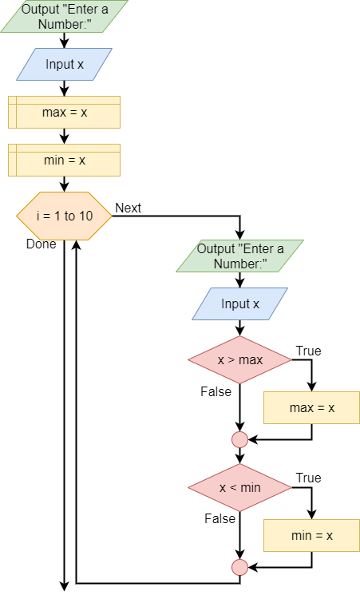
Notes:
Here we have a flowchart depicting the algorithm we just used to find the min and max values.

Slide 17
Output: “Enter a number.”
Input x
max = x
min = x
Notes:
We’ll break the algorithm into two parts. The first, which we see here, is the initialization part of the algorithm that comes before the loop.
Here, we prompt the user for a number, which represents the first number in our list.
After reading the input and storing it in variable ‘x’, we set ‘min’ and ‘max’ to be equal to the value in ‘x’.

Slide 18
i = 1 to 10
Next
Done
Output: “Enter a number.”
Input x
x > max
max = x
x < min
min = x
Notes:
Now we enter the loop. For this example, we will go through the loop exactly 10 times, so we use a ‘for’ loop from 1 to 10.

Slide 19
i = 1 to 10
Next
Done
Output: “Enter a number.”
Input x
x > max
max = x
x < min
min = x
Notes:
Our first step is to get the next number in our list from the user.

Slide 20
i = 1 to 10
Next
Done
Output: “Enter a number.”
Input x
x > max
max = x
x < min
min = x
Notes:
Next, we check to see if the value in ‘x’ is greater than our current ‘max’. If it is, we set ‘max’ to the value in ‘x’. If ‘x’ is less than or equal to ‘max’, we simply do nothing.

Slide 21
i = 1 to 10
Next
Done
Output: “Enter a number.”
Input x
x > max
max = x
x < min
min = x
Notes:
Now we will check to see if ‘x’ is less than ‘min’. If it is, we set ‘min’ to the value in ‘x’. If ‘x’ is greater than or equal to ‘min’, we again do nothing.

Slide 22
i = 1 to 10
Next
Done
Output: “Enter a number.”
Input x
x > max
max = x
x < min
min = x
Notes:
Finally, we loop back to the top of the our loop and increment 'i'.

Slide 23
i = 1 to 10
Next
Done
Output: “Enter a number.”
Input x
x > max
max = x
x < min
min = x
Notes:
After we have looped through each item in the List – setting 'min' and 'max' as appropriate – we are done, and our algorithm exits.
[pause]
In this video, we have seen how we can step through items in a list in a linear fashion to find the minimum and maximum values in the list. We also converted that process to an algorithm we can use to create a program to do that automatically for us.

