Slide 1

Max-Min Pairs Algorithm
Computational Core

Slide 2
i
List[1]
3
List[2]
2
lastmin
min
List[3]
6
List[4]
5
4
lastmax
max
List[5]
List[6]
0
Notes:
Now we are going to look at the problem of finding the minimum and maximum values in a list using a different algorithm. Instead of looking at each number in the list separately, we will look at them in pairs. We will use this algorithm and the linear version covered earlier to investigate how the differences lead to differences in performance.
Like the linear algorithm, we will have an index 'i' that keeps track of where we are in the list. Except in this algorithm, we will increment it by 2 instead of 1.
We will also keep track of the Min and Max values that we have seen like in the linear algorithm. However, we will relabel the variables as min and max for clarity.
Finally, we will add two new variables to keep track of the minimum and maximum of the pair of numbers from the list that we are currently looking at. These variables are called 'lastmin' and 'lastmax'.
The flow of the algorithm is pretty straightforward. We will look at two numbers at a time from the list. We will put the smallest of those two numbers in the 'lastmin' variable, and the largest of those numbers in the 'lastmax' variable.
Next, we will compare 'lastmin' with the min and the 'lastmax' with the max. If either of the last 2 numbers are larger or smaller than the min or larger than the max, we will update the values of min and max.

Slide 3
i
List[1]
3
1
List[2]
2
lastmin
min
List[3]
6
List[4]
5
4
lastmax
max
List[5]
List[6]
0
Notes:
The first step is initiated by setting our index 'i' to 1. This will allow us to look at the first two numbers in the list.

Slide 4
i
List[1]
3
1
List[2]
2
lastmin
min
List[3]
6
2
List[4]
5
4
lastmax
max
List[5]
3
List[6]
0
Notes:
Since these are the first two numbers, we automatically store the smaller of the two, 2, in 'lastmin' and store the larger, 3, in 'lastmax'.

Slide 5
i
List[1]
3
1
List[2]
2
lastmin
min
List[3]
6
2
2
List[4]
5
4
lastmax
max
List[5]
3
3
List[6]
0
Notes:
Likewise, we store 'lastmin' in min and 'lastmax' in max.

Slide 6
i
List[1]
3
3
List[2]
2
lastmin
min
List[3]
6
2
2
List[4]
5
4
lastmax
max
List[5]
3
3
List[6]
0
Notes:
Next, we increment our index by 2 and thus skip down in the list to the third entry.

Slide 7
i
List[1]
3
3
List[2]
2
lastmin
min
List[3]
6
5
2
List[4]
5
4
lastmax
max
List[5]
6
3
List[6]
0
Notes:
Again, we compare the numbers in the third and fourth places in our list and store the smaller in 'lastmin' and the larger in 'lastmax'.
In this case, we store 5 in 'lastmin' and 6 in 'lastmax'.

Slide 8
i
List[1]
3
3
List[2]
2
lastmin
min
List[3]
6
5
2
List[4]
5
4
lastmax
max
List[5]
6
6
List[6]
0
Notes:
Finally, we compare 'lastmin' against min. Since 5 is not smaller than the min, which is 2, we do not change min.
However, when we compare 'lastmax' against the max, we find that 6 is greater than the current max, which is 3, so we update max with the content of 'lastmax'.

Slide 9
i
List[1]
3
5
List[2]
2
lastmin
min
List[3]
6
5
2
List[4]
5
4
lastmax
max
List[5]
6
6
List[6]
0
Notes:
We increment our index ‘i' by 2 again and look at entries 5 and 6 in the list.

Slide 10
i
List[1]
3
5
List[2]
2
lastmin
min
List[3]
6
0
2
List[4]
5
4
lastmax
max
List[5]
4
6
List[6]
0
Notes:
After comparing the entry values, we store 0 in 'lastmin' and 4 in 'lastmax'.

Slide 11
i
List[1]
3
5
List[2]
2
lastmin
min
List[3]
6
0
0
List[4]
5
4
lastmax
max
List[5]
4
6
List[6]
0
Notes:
We again compare the 'lastmin' and the 'lastmax' against min and max. In this case 'lastmin' is smaller than min, so we update min with the value 0. But, we have no changes to Global Max.
As we can see from a quick inspection, we have found both the minimum and maximum numbers from our list.

Slide 12
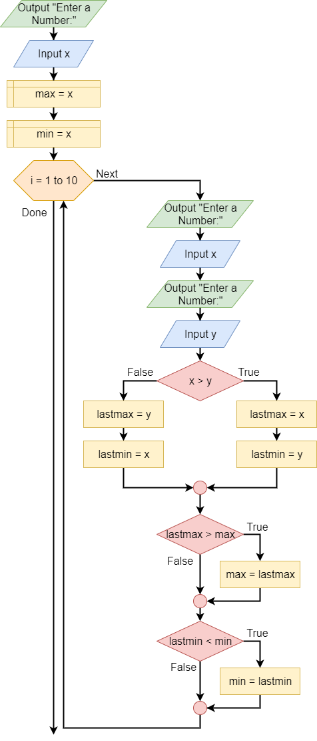
Notes:
Next, we put our algorithm into a flowchart, which is basically identical to the one in your textbook. Again, the only difference is that in the video we assume that the list of numbers is already stored in an array, while the textbook version prompts the user to input the numbers one at a time.

Slide 13
Output: “Enter a number.”
Input x
max = x
min = x
Notes:
We’ll break the algorithm into two parts. The first, which we see here, is the initialization part of the algorithm that comes before the loop.
Here, we prompt the user for a number, which represents the first number in our list.
After reading the input and storing it in variable ‘x’, we set ‘min’ and ‘max’ to be equal to the value in ‘x’.

Slide 14
i = 1 to 10 step 2
Next
Output: “Enter a number.”
Done
Input x
Output: “Enter a number.”
Input y
False
x > y
True
lastmin = x
lastmin = y
lastmax = y
lastmax = x
lastmax > max
max = lastmax
lastmin < min
min = lastmin
Notes:
Now we enter the loop. For this example, we have 10 items to look at, so we use a ‘for’ loop from 1 to 10. However, since we will be comparing pairs, we will include a ‘step 2’ to our loop.

Slide 15
i = 1 to 10 step 2
Next
Output: “Enter a number.”
Done
Input x
Output: “Enter a number.”
Input y
False
x > y
True
lastmin = x
lastmin = y
lastmax = y
lastmax = x
lastmax > max
max = lastmax
lastmin < min
min = lastmin
Notes:
Each time through the loop, we will prompt the user for two number, which we store in 'x' and 'y'.
We then compare whether ‘x’ is greater than 'y'.

Slide 16
i = 1 to 10 step 2
Next
Output: “Enter a number.”
Done
Input x
Output: “Enter a number.”
Input y
False
x > y
True
lastmin = x
lastmin = y
lastmax = y
lastmax = x
lastmax > max
max = lastmax
lastmin < min
min = lastmin
Notes:
If 'x' is greater, then we follow the true branch and set 'lastmin' to 'y' and 'lastmax' to 'x'.

Slide 17
i = 1 to 10 step 2
Next
Output: “Enter a number.”
Done
Input x
Output: “Enter a number.”
Input y
False
x > y
True
lastmin = x
lastmin = y
lastmax = y
lastmax = x
lastmax > max
max = lastmax
lastmin < min
min = lastmin
Notes:
However, if 'y' is greater, we follow the false branch and set 'lastmin' to 'x' and 'lastmax' to 'y'.

Slide 18
i = 1 to 10 step 2
Next
Output: “Enter a number.”
Done
Input x
Output: “Enter a number.”
Input y
False
x > y
True
lastmin = x
lastmin = y
lastmax = y
lastmax = x
lastmax > max
max = lastmax
lastmin < min
min = lastmin
Notes:
Once we have determined the minimum and maximum of ‘x’ and ‘y’, we check to see if 'lastmax' is greater than the global maximum stored in ‘max’.
If it is, we update the value of max. If not, we do nothing.

Slide 19
i = 1 to 10 step 2
Next
Output: “Enter a number.”
Done
Input x
Output: “Enter a number.”
Input y
False
x > y
True
lastmin = x
lastmin = y
lastmax = y
lastmax = x
lastmax > max
max = lastmax
lastmin < min
min = lastmin
Notes:
Next, we check if the value of 'lastmin' is less than the global minimum stored in ‘min’.
If it is, then we update the value of min. If not, we again do nothing.

Slide 20
i = 1 to 10 step 2
Next
Output: “Enter a number.”
Done
Input x
Output: “Enter a number.”
Input y
False
x > y
True
lastmin = x
lastmin = y
lastmax = y
lastmax = x
lastmax > max
max = lastmax
lastmin < min
min = lastmin
Notes:
Finally, we follow our loop back up to the top of our for loop and increment index 'i'. If the updated value of ‘i' is less than or equal to 10, we go through the loop again.
Notice that with the ‘step 2’, we will go through the loop exactly 5 times.

Slide 21
i = 1 to 10 step 2
Next
Output: “Enter a number.”
Done
Input x
Output: “Enter a number.”
Input y
False
x > y
True
lastmin = x
lastmin = y
lastmax = y
lastmax = x
lastmax > max
max = lastmax
lastmin < min
min = lastmin
Notes:
Once our index 'i' gets incremented past 10, we exit the loop and we are done. We have our minimum and maximum values from the list.
[pause]
In this video, we looked at how we can loop through our list two at a time, with the goal of increasing the efficiency of our algorithm. We also converted our process to an algorithm we can use to create a real program.
In the next section, we will compare the linear and pairwise algorithms to see which is actually better in terms of performance.
.

