Slide 1

Using Stacks
Computational Core

Slide 2

This Photo by Unknown Author is licensed under CC BY-SA
Notes:
Now we want to take a look at how we might use queues in a real world application. One area where queues are used is to control the order in which certain tasks are performed. These tasks can be computational or, as in our application, be real world tasks in places like factories.

Slide 3






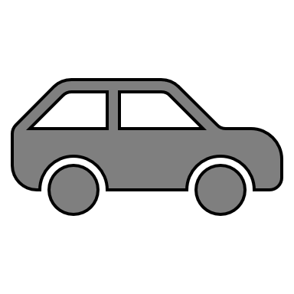
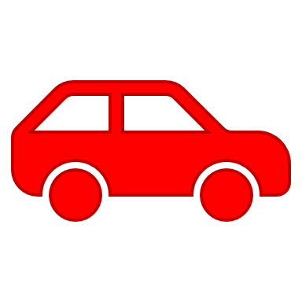
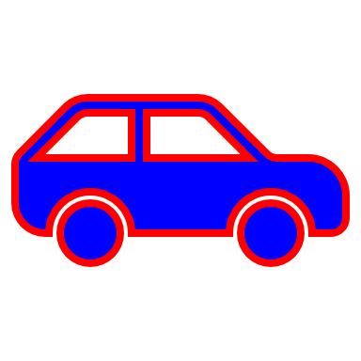
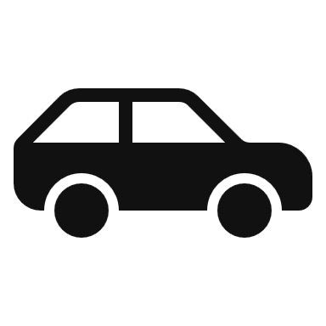

Windshield Stations
Notes:
The application we will look at today involves the assembly of automobiles in a factory. Specifically we want to organize and control which cars go first when putting on their windshields. We assume we have a single station where we put on the windshield. However, cars can come from several locations to get their windshield installed.
Without any type of mechanism to control which car gets serviced first, mass chaos could be the result.
[ADVANCE – wait until animation ends]
Clearly this is not a good situation!

Slide 4
Windshield Stations
Notes:
What we need is a way to organize this process. But the question is, how?
Aha!, you say! I've just been studying this great new data structure called a queue. In a queue, items are placed in the queue one at a time and then taken out in a first in first out order. It would be perfect for this application.

Slide 5
Windshield Stations
Notes:
And you would be correct. A queue would create order from chaos and would neatly organize the process of ordering and selecting the next car for service.
Unfortunately, there is one hitch. In all the chaos, we forgot that we wanted to institute a priority system where higher priority cars got to be served before all lower priority cars.
Does this mean that a queue will not work after all?

Slide 6
High
Windshield Stations
Medium
Low
Notes:
Fortunately no! While a single queue will not meet our needs exactly multiple queues can be used to help us out. If we have 3 priorities - say high, medium, and low – we will need to use 3 queues, one for each priority.
When a car comes to get their windshield installed, they will be placed in the appropriate queue based on their priority. Then, when the windshield station is ready for a new car, we can give them a car from the highest priority queue that has a car in it.

Slide 7
High
Windshield Stations
Medium
Low
Notes:
This process is actually pretty simple. In our example, we have cars in each of our three queues waiting to get their windshields installed.

Slide 8
High
Windshield Stations
Medium
Low
Notes:
If the windshield station calls asking for the next car, we go to the high priority queue and select the next car – the purple car - and send it to the station.

Slide 9
High
Windshield Stations
Medium
Low
Notes:
When the windshield station finishes working on the purple car, it sends it to the next station and calls to get the next car.
So, once again, we check the high priority queue first. However, this time, the queue is empty, so we move to the medium queue.

Slide 10
High
Windshield Stations
Medium
Low
Notes:
We then take the first car – the yellow car – out of the medium queue and send it the windshield station for installation.

Slide 11
High
Windshield Stations
Medium
Low
Notes:
The same thing happens with the yellow car is finished. The windshield station calls for the next car and we first check the high priority queue. However, it is still empty, so we go the medium priority queue where we select the gray car and send it the windshield station.

Slide 12
High
Windshield Stations
Medium
Low
Notes:
When the gray car is finished, the windshield station calls again for another car. So, like the last couple of times, we check the high priority queue and find it empty. So, we check the medium priority queue. However, this time the medium queue is also empty, so we check the low priority queue. Of course there are cars waiting there, so we send the red car to the windshield station for its service.
Now, while the red car is getting its windshield installed, a new purple car arrives to get its windshield installed.

Slide 13
High
Windshield Stations
Medium
Low
Notes:
Since all purple cars are high priority, the purple car is placed in the high priority queue.

Slide 14
High
Windshield Stations
Medium
Low
Notes:
When the red car is finished, we start our process again. We first look at the high priority queue and, since it is no longer empty, we select the purple car [ADVANCE] and send it to the windshield station to get its windshield installed ahead of all the other cars in the low priority queue.

Slide 15
class Controller
declare high as a Queue
declare medium as a Queue
declare low as a Queue
function Controller()
high = new Queue(4)
medium = new Queue(6)
low = new Queue(8)
end function
Notes:
Now, the software we are interested in creating is the software that controls the cars coming into and out of our prioritizing system. We will create a class called Controller, which will contain the three queues and the operations that allow cars to enter and exit the system.
As shown here, at the class level, we simply declare three queues: high, medium, and low.
Next, we have our constructor. In the constructor we actually create the new queues with specific capacities. Since we expected to have more low priority cars than medium priority cars, and more medium priority cars than high priority cars, we initialize the queues with different capacities based on our estimate of the maximum number of cars that might be waiting in any one queue at a given time.

Slide 16
function receiveCar(car, priority)
case (priority)
high:
high.enqueue(car)
medium:
medium.enqueue(car)
low:
low.enqueue(car)
else
raise exception
end case
end function
Notes:
The first operation that we will provide to access our controller is the receiveCar function, which is designed to be to insert cars into our control system. When some other station along the assembly line finishes their work on a car, that station will call the receiveCar operation to send that car to the windshield station.
The inputs to the operation are the car and its priority. The operation itself is rather simple. We use a case statement with three cases - high, medium, and low – obviously corresponding to the high, medium, and low queues. For example, if the priority of the incoming car is medium, the medium case will be selected and the car will be enqueued onto the medium queue. Recall, that if there is no space in the queue, the queue will raise an exception. Instead of trying to catch that exception in this function, we choose to simply let it automatically get returned to the calling function where it can be dealt with.
If, for some reason, the priority of the incoming car is not high, medium, or low, then the receiveCar function will raise its own exception in the else case.

Slide 17
function getCar()
if not high.isEmpty()
return high.dequeue()
else not medium.isEmpty()
return medium.dequeue()
else not low.isEmpty()
return low.dequeue()
else
raise exception
end if
end function
Notes:
The other operation we will provide to access our controller is the getCar function. The getCar is designed for the windshield station to call when it is ready for another car. In this case, we use a set of nested if – else statement to check which queues have any cars in them, which is check in code as an "if not isEmpty" condition. Of course, we do this in priority order so we first check to see if the high priority queue has any cars in it and return the first car in the high priority queue if it does. If the high priority queue is empty, we then check the medium priority queue, and then finally the low priority queue. If all three queues are empty, control will fall through to the else statement where we raise an exception. In this case, with any luck, the workers on the windshield station will get to go home early!

Slide 18
High
Windshield Stations
Medium
Low
Notes:
In this video, we have presented a real world scenario where the use of queues can help create order out of chaos. We actually used three queues to create a priority system where the highest priority cars will always get serviced before any lower priority cars, but all cars within specific priority will be serviced in a first in first out order. We then showed code to implement such a system, which relied heavily on the queue operations we have been studying.

