Slide 1

Linear Data Structures
Computational Core

Slide 2
Linear data structures
Stores data in a linear structure
Order is important
c
a
s
d
e
g
j
Notes:
All computer programs are used to manipulate data. In fact, that is all they really can do. That’s why a course on data structures in programming is so important. Your choice of the structure of your data can either make your program very easy or very difficult to write. It can also make your program very efficient, or dreadfully slow.

Slide 3
Linear Data Structures
Array (finite size)
Linked list (infinite size)
List
Set
List
Set
Stack
Queue
Stack
Queue
Notes:
We will start with what we call “linear” data structures. As you might guess, linear data structures have something to do with a line. We have already seen the most basic linear data structure, an array or list.
Actually, an array is a finite size structure that is the basis for more specific linear data structures such as lists, stacks, queues, and sets.
However, we can also create infinite size data structures using linked lists. While they are actually limited by the physical capabilities of the computer we are working on, infinite sized data structures can grow and shrink and are not limited by a predefined “size” parameter. We can also create lists, stacks, queues, and sets.

Slide 4
Lists
insert
remove
find
get
size
c
a
s
d
e
g
j
Notes:
Lists are the simplest form of linear data structures, whether they are created from arrays or linked lists. One of the key concepts of a list is that the items in the list have a specific order. This order is captured in an index of each item. A good example of a list is a string.
There are several useful operations that we use on lists. Like any data structure, we need to be able to insert items into a list and remove items from a list. This insertion and removal can take place at the front, back, or middle of the list.
We also need to be able to find items in the list. In our example here, if I do a find on the list for the letter s, the find operation will return s’s index, in this case 2. We also typically have an operation to get the item at a specific index in the list as well as an operation to return the size of the list.
Lists are useful in applications where you need to keep data in order, but you also need to be able to insert and remove data from any point in the list.

Slide 5
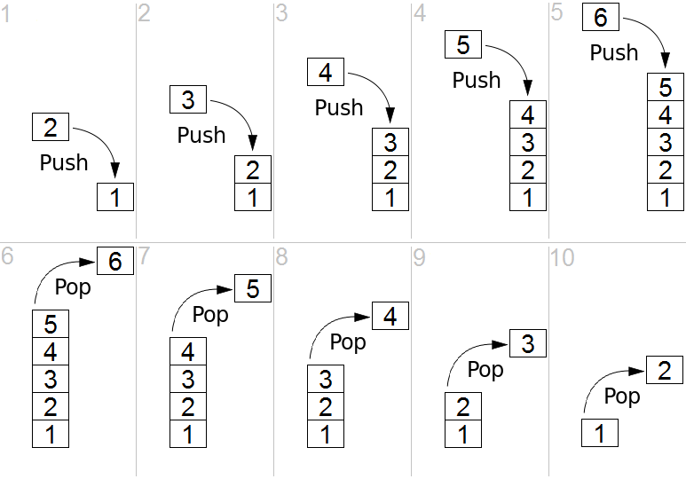
Stacks
push
pop
peek
Last In, First Out (FIFO)
Notes:
A stack is a version of a list that restricts where you can insert and remove items from, in this case from the end of the list. By inserting and removing items from the same end, it implements what we call a last in, first out – or LIFO - data structure.
We call the insertion operation push, while the removal operation is called pop. As shown in the diagram, when we push a number onto the stack, it is placed on top of the previous number that was pushed onto the stack. Then, as shown in the bottom half of the diagram, when we pop numbers off the stack, they all come off the same end of the stack, which we call the top.
There are several other useful operations on stacks, one in particular called peek, that lets you look at the contents of the item on the top of the stack without having to pop it off the stack.
Stacks are very useful when we want to keep a list of items in the order that they were put on the list, while ensuring that we cannot manipulate the list from the bottom or the middle.

Slide 6
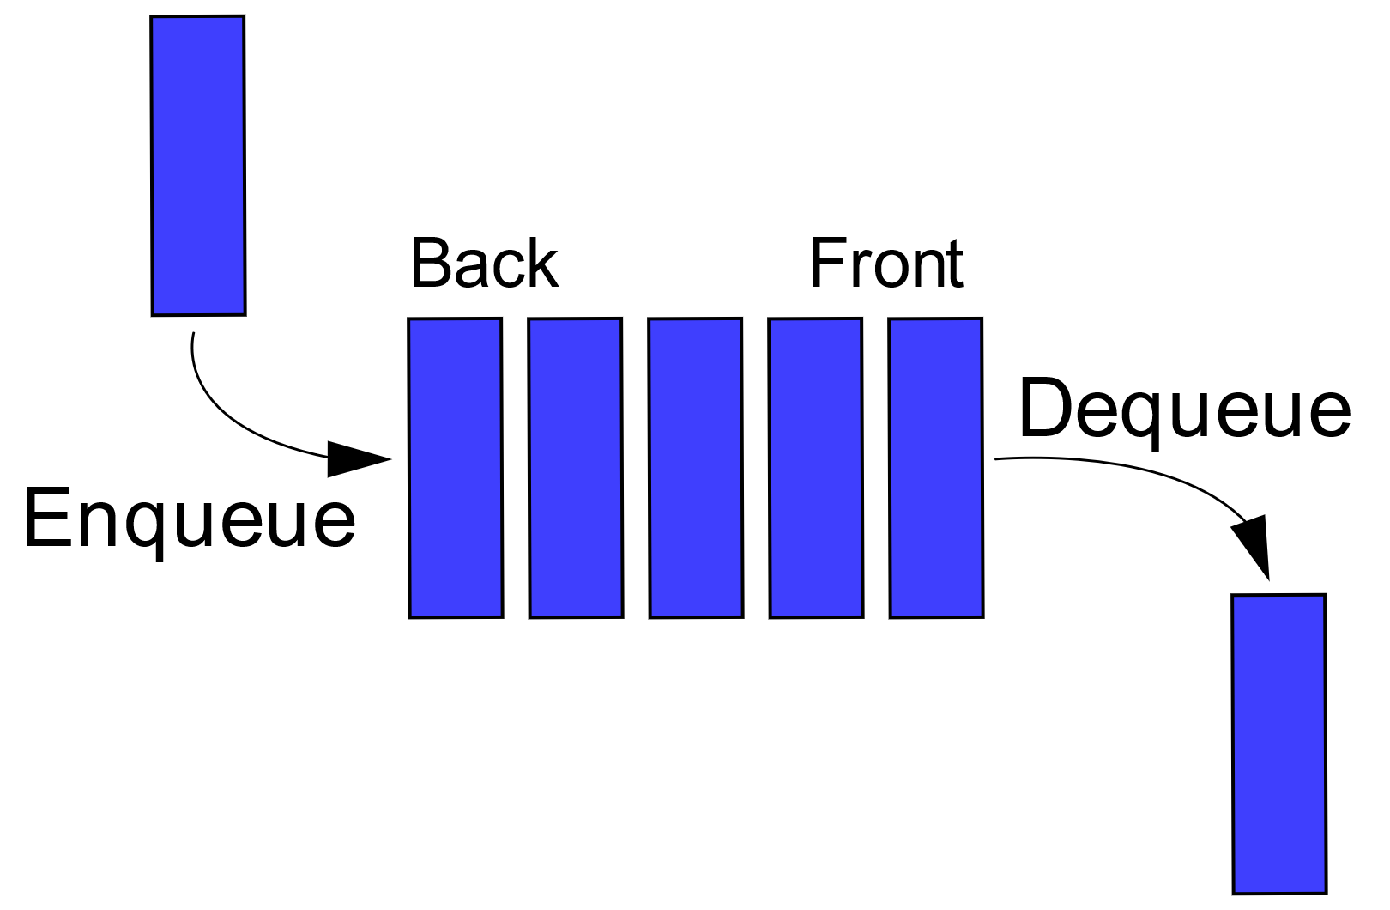
Queues
enqueue
dequeue
First In, First Out (FIFO)
Notes:
Queues are similar to stacks except we always put data onto the list at one end and take data off of the list at the other end. In this way, a queue is much more like standing in line to get tickets at a box office. Instead of being last in, first out, a queue is first in, last out – or FIFO. You can also think of FIFO as being first come, first served.
The name of the insertion and removal operations for a queue are easy to remember – enqueue and dequeue. The enqueue operation put data onto the queue at the beginning of the list, while the dequeue operation takes data off the list at the end.
The choice between using a stack or a queue really comes down to how you intend to use your data structure. If you want first in, first out , you use a queue. If you need last in, first out, you use a stack.

Slide 7
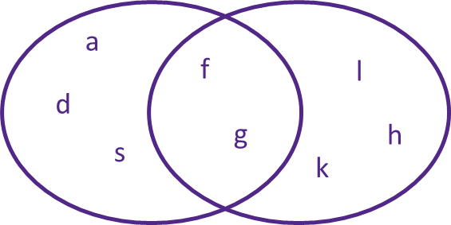
Sets
union
intersection
difference
subset
Notes:
Sets are a linear data structure that is very similar to a list, with a couple of differences. First, a set cannot contain duplicate items. Each item must be unique. Second, a set is generally unordered, that is we do not need to keep track of the order in the data structure.
Sets are based on the mathematical concept of sets and we therefore use many of the same basic math operators. Besides a simple insert and remove for the set items, we can also perform set union, intersection, difference, and subset.

Slide 8
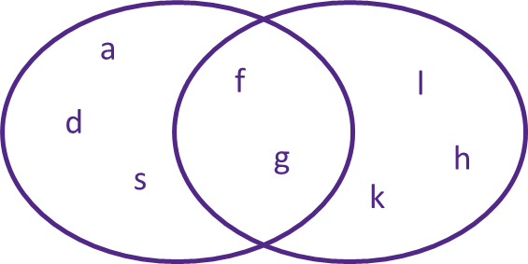
Sets
union
intersection
difference
subset
{a, s, d, f, g}
{f, g, h, k, l}
Notes:
Set union is simply the combining of all the elements in two sets into a new larger set. The only tricky part to this operation is ensuring that there are no duplicates in the union of the sets.

Slide 9
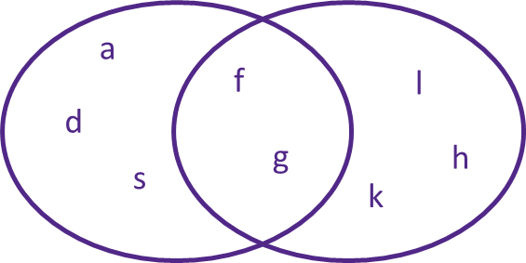
Sets
union
intersection
difference
subset
{a, s, d, f, g}
{f, g, h, k, l}
Notes:
The intersection creates a new set from only those items found in both sets.

Slide 10
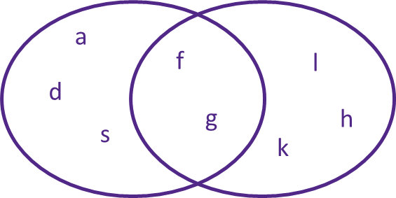
Sets
union
intersection
difference
subset
{a, s, d, f, g}
{f, g, h, k, l}
Notes:
And set difference removes all the elements of one set from a second set.

Slide 11
Sets
union
intersection
difference
subset
{a, s, d, f, g}
{f, g, h, k, l}
Notes:
Finally, the subset operation determines of all the items in one set are in the other set. As we see in our example the subset operation would return false for these two sets.
Sets are useful if we want to make sure we do not have duplicate items in our data structure. It is also useful if we need to use some of the set specific operations we’ve just discussed here.

Slide 12
Linear Data Structures
Array (finite size)
Linked list (infinite size)
List
Set
List
Set
Stack
Queue
Stack
Queue
Notes:
We have looked at four different linear data structures, each with their own specific strengths. The key to finding and using the best data structure for your application is knowing how you will be using the data. While lists are very general, we can use them to build more specific types of data structures that enforce certain characteristics that allow us to optimize the insertion, storage and retrieval of the data.

