Slide 1

Maps
Computational Core

Slide 2
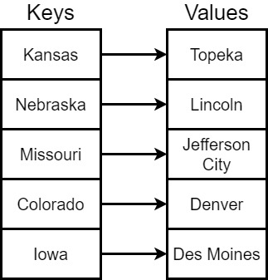
Maps
put
get
entries
keys
containsKey
containsValue
Notes:
Basic maps are fairly simple. They are what we call a key – value pair. You might also hear these referred to as an associative array, a dictionary, or a lookup table. Keys act like an array index. You give the map a key and it returns the value associated with that key.
The insertion operation for a map is called put, while the get operation actually returns a value for a given key. The entries and keys operations return the set of values and keys from the map. And the containsKey and containsValue oerations determines if a given key or value is stored in the map.
In our example we would use the get operation to lookup a particular value. For instance, the operation call get(Colordado) would return the value Denver.

Slide 3
Get(Colorado)
→ Denver
Notes:
In our example we would use the get operation to lookup a particular value. For instance, the operation call get(Colorado) would return the value Denver.

Slide 4
keys(Texas)
→ False
Notes:
Likewise, if we looked up to see if the key “Texas” was in our set of keys, the keys operation would return false.

Slide 5
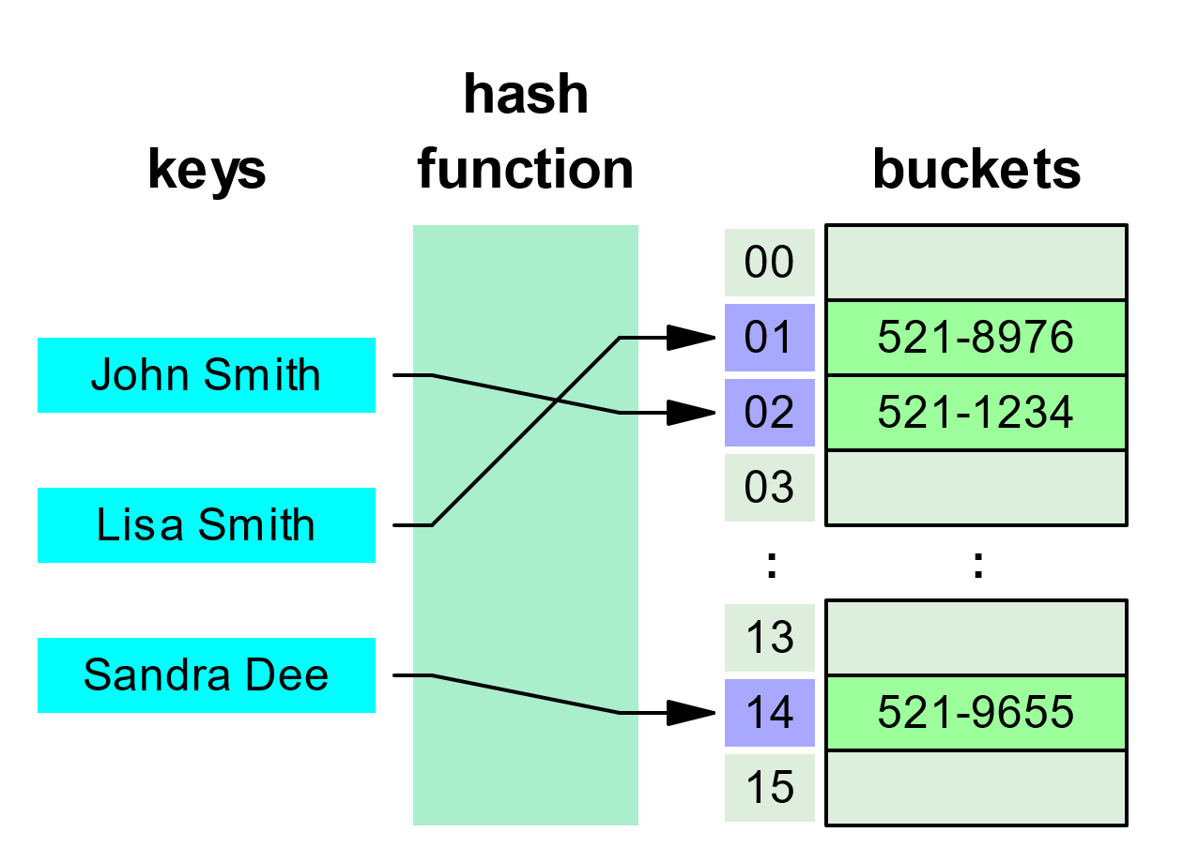
Hash Tables
array (buckets)
Notes:
To implement maps more efficiently, we often use what are call “hash tables”. A hash table stores the map values in an array and uses a special hash function to convert any valid key to an index into the array to find the associated value.
The reason we use a hash function instead of doing a lookup in a simple map is efficiency. Instead of loop through each possible key and doing costly comparison operations, you simply call a function and then use the index to access the array directly.

Slide 6
Hash Tables
array (buckets)
hash(“John Smith”) → 02
Notes:
For example, if we input “John Smith” to our hash function, we should get an index into our array. In this case, the hash of “John Smith” returns the value 2, which we use to lookup the value 521-1234.
Maps work great for applications where you need to find information based on a specific type of data or key. However, it is helpful to keep the keys unique.

Slide 7
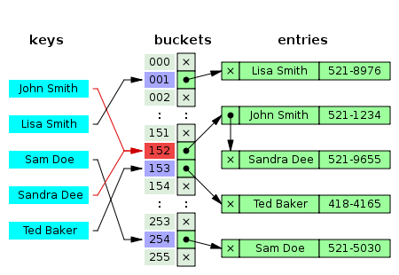
Notes:
Unfortunately, it is extremely difficult to find hash functions that return unique values for all possible inputs. Therefore, we generally have to provide additional logic to handle these “collisions”.
In this example, Sandra Dee and John Smith both get mapped to index 152. So, in this case we just create a list of all the data that maps to the same index. Of course to find the right piece of data, we will need to search the list.

Slide 8
Notes:
In this video, we have looked at basic map data structures that make looking up data based on keys much more efficient. In simple maps, we have a set of keys that map directly to values and we have to search through the list of keys to find the value we are looking for.
To make this process more efficient, we can use hash functions that map our keys to the index of an array. However, we often have to provide additional logic to handle collisions where the hash function mays two keys to the same index.
We will learn more about maps in future modules.

