Slide 1

Non-Linear Data Structures
Computational Core

Slide 2
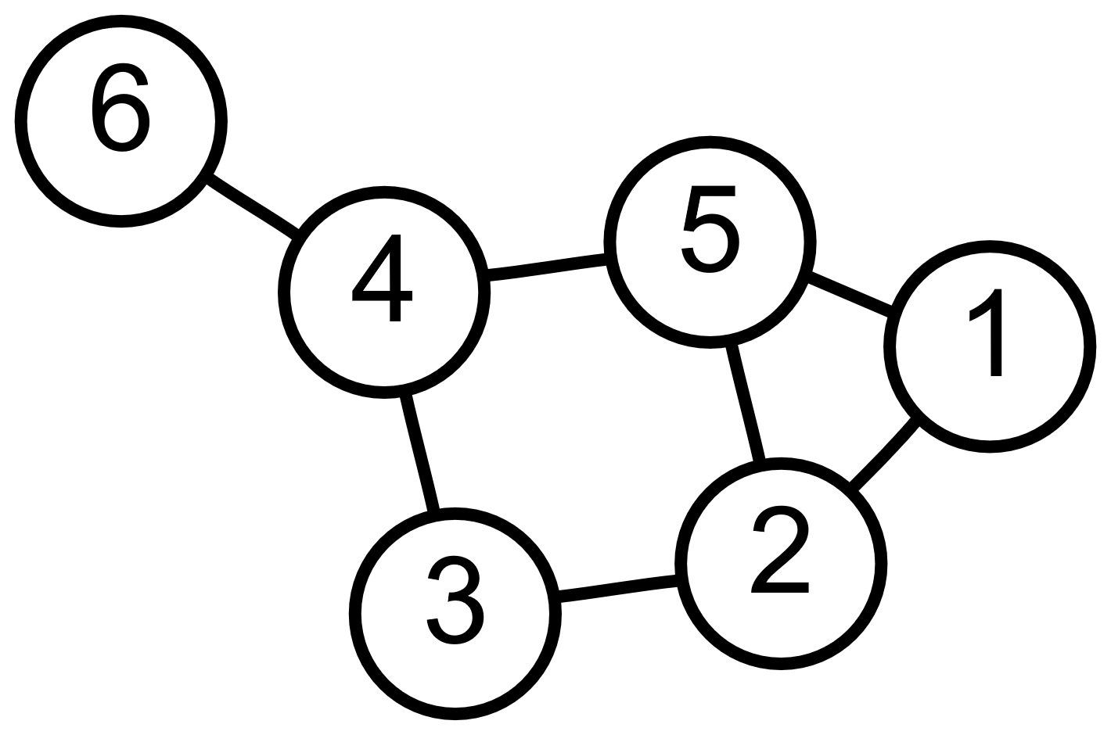
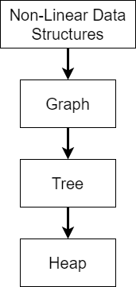
Non-linear data structures
Graph-based
Notes:
Non-linear data structures allow us to store data using multiple dimensions. One of the key elements of non-linear structures is that we can use them to capture relationships beyond that of a simple ordering. In fact, the relationships between the data stored in these types of data structures are often as important and sometimes even more important than the data we actually store in them.
Like linear data structures, there are several different non-linear data structures we can use, each with their own set of strengths and weaknesses.

Slide 3
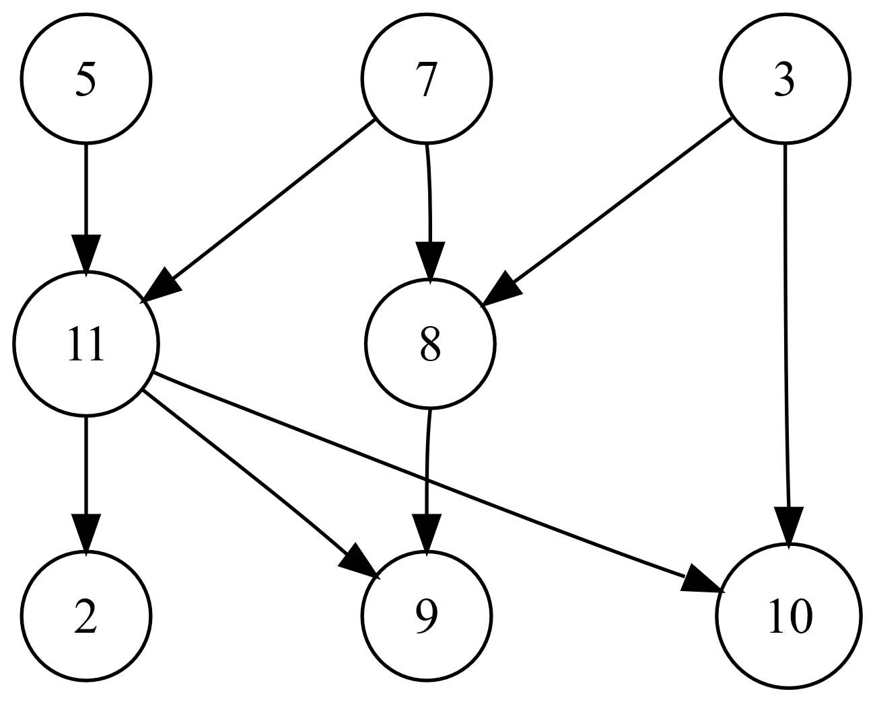
Graphs
Notes:
The most general version of a non-linear data structure is the graph, as shown in this diagram. Formally, a graph is a set of nodes that are connected by a set edges. Data is generally the main data storage, although edges may also contain data.
Graphs excel at storing data that also have important relationships. For example, graphs are often used to capture structures such as city maps or social networks.
We typically use graphs when the relationships between the data are important and there are no well-defined requirements for those relationships should look like. It is extremely general and flexible.

Slide 4
Trees
2
7
5
2
10
6
9
5
11
4
Notes:
A tree is a graph with special constraints that we can use to increase the efficiency of data storage and retrieval.
These constraints require that each tree be a graph with a single root node with one or more child nodes. Child nodes can also be parent nodes that have their own children as well. The parent-child relationship is the key relationship in a tree and what produces its hierarchical structure.
Trees are very useful for storing data that has been or needs to be sorted in some way. Such trees generally have efficiency advantages over storing and retrieving data over simple linear structures.
Trees are also tailored made to store hierarchical data such as family trees or class inheritance structures. These trees can make answering questions like “Who was John Adams’ great-grandmother?” a fairly straightforward and efficient process.

Slide 5
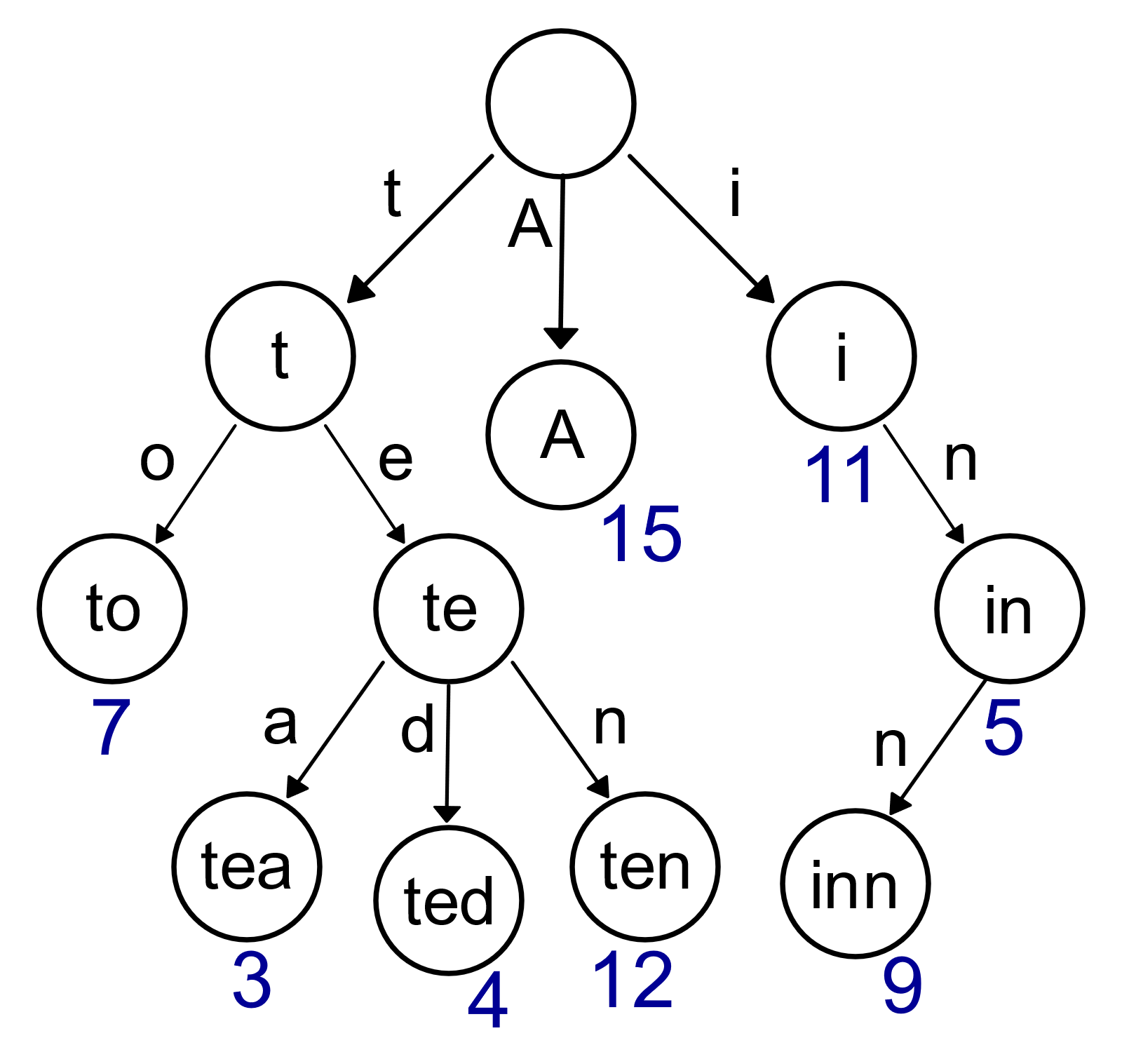
Trie
Notes:
A special kind of tree is called a trie, which is typically used to represent textual data. While their scope of use is narrow – generally limited to things like a spell-checker or word or keyword completion – the fact that those applications are embedded in so many other applications makes tries a very important data structure.
Essentially tries are trees where the edges represent the next letter to be added to a word. In our example, you can see how you start at the root node, which starts with no letters. You then walk down the tree following the first letters in the word to find complete words. If you follow this trie and the user has input the letters “t” and ”e” into the text editor, your word completion application could suggest “tea”, “ted” and “ten” as possible completions. The key to trie’s is how little computation is required to produce these results.

Slide 6
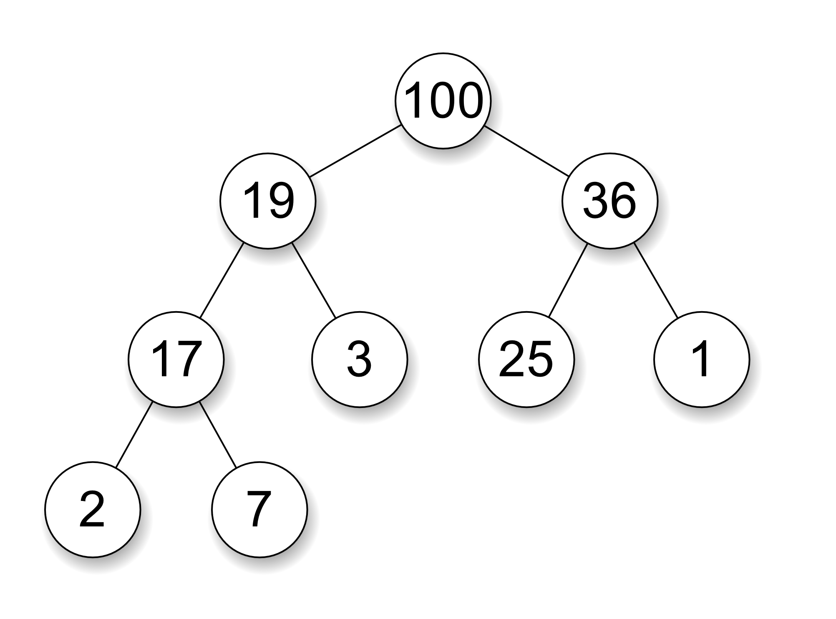
Root is largest/smallest
All parents are larger/smaller than children
Tree height is minimized
Heap
Notes:
Finally, we come to a heap. A heap is a specialized version of a tree whose goal is to always be able to quickly retrieve either the smallest or largest element in the data structure.
A heap has some specific rules we have to follow, but first you need to know whether your goal is to return the smallest or largest element the quickest.
Assuming we want to access the largest number the fastest, we would store the largest element at the root node and require that each parent node be larger than all of its children. We also attempt to minimized the height of the tree, which is the number of level in the tree.
These rules allow a heap to be the most efficient data structure for managing priority queues, where we always want to retrieve the highest (or lowest) priority item each time we retrieve an item from the heap. Because of this, heaps are very important in creating efficient algorithms that deal with ordered data.
Heaps are a special type of a tree that is concerned with efficiency over everything else. But, because they are so specialized, they only have a few applications.

Slide 7
Non-linear data structures
Notes:
Non-linear structures are generally much more flexible than linear structures. We can use the edges between data nodes to capture a wide variety of relationships. The most general form of a non-linear structure is a graph. Graphs can be designed to be very specific to a specific application domain and captures a lot of different data and relationships.
However, we also looked at some specialized data structures, that while they sacrifice generality, they provide very efficient data storage and retrieval for applications that fit within their constraints.
It should also be pointed out that linear data structures can also be defined in terms of a non-linear structure such as a graph. If you think about it, a list is nothing more than a graph where each node can have at most one child node. While this works theoretically, think of lists and graphs separately is generally easier since the ways we manipulate lists is typically much more straightforward than the way graphs work.

