Slide 1

Algorithms
Computational Core

Slide 2
function findPath(maze[][], startCell, goalCell) returns Boolean
myStack.push(startCell);
while !myStack.empty() do
topCell = myStack.peek()
if topCell equals goalCell
return true
if topCell.getDirection() = done then
myStack.pop()
else
nextCell = getNextCell(maze, topCell)
incrementDirection(topCell)
if valid(maze, nextCell) then
if myStack.isFull() then
myStack.doubleCapacity();
end if
myStack.push(nextCell)
end if
end if
end while
return false
end function
Notes:
To use data structures effectively, we must have a set of operations on those structures. These operations are often complex and require an algorithm to implement the operation. We also use algorithms when we use the data structure operations to perform an even larger function, such as finding our way through a maze as captured in our example.
An algorithm is best defined as a “finite list of specific instructions for performing a task.” In the real world, we see algorithms all the time. A recipe for cooking your favorite dish, instructions for how to fix a broken car, or a method for solving a complex mathematical equation can all be considered examples of an algorithm.

Slide 3
Algorithmic techniques
Brute force
Divide and conquer
Greedy
Recursion
Notes:
Next, we’ll look at some of the algorithmic techniques that we use to design algorithms. You can think of an algorithmic technique as a basic approach to solving a problem. Our list is not exhaustive, but does include some of the more common approaches, including brute force, divide and conquer, greedy, and recursion.

Slide 4
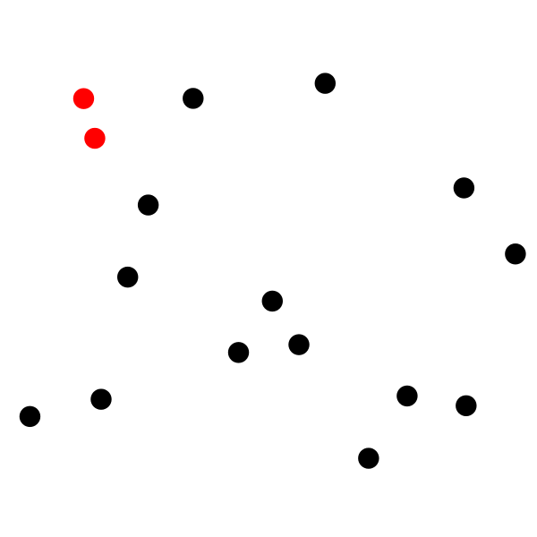
Brute Force
Notes:
If we solve a problem by “brute force” we generally mean that we don’t think about it much, we just apply whatever force is needed to solve the problem. In algorithms this is captured by simply trying all possible solutions and either taking the first one we find or doing a complete search and taking the very best solution.
For example, if our problem is to find the closest two points among a set of points, the brute force approach would be to simply compute the distance between every pair of points and select the pair with the smallest distance.

Slide 5
Brute Force
MINIMUM = infinity POINT1 = none POINT2 = none loop each POINTA in POINTS loop each POINTB in POINTS if POINTA != POINTB DISTANCE = COMPUTE_DISTANCE(POINTA, POINTB) if DISTANCE < MINIMUM MINIMUM = DISTANCE POINT1 = POINTA POINT2 = POINTB end if end if end loop end loop
Notes:
Our resulting algorithm will look something like this. We have an outside loop and an inside loop. In both loops, we loop through all possible points and compute the distance. If the distance is less than our minimum, then we save the pair and the distance.
While this algorithm will find the minimum pair, it is not very efficient. Looking at the code, if we have $N$ points, it would take $N^{2}$ steps to solve the problem!

Slide 6
Divide and Conquer
Big Problem
Smaller Problem
Smaller Problem
Little Problem
Little Problem
Little Problem
Little Problem
Little Problem
Easy Problem
Easy Problem
Easy Problem
Easy Problem
Easy Problem
Easy Problem
Easy Problem
Easy Problem
Easy Problem
Easy Problem
Easy Problem
Notes:
Another common algorithmic technique is divide and conquer. A divide and conquer algorithm first divides the problem into at least two smaller problems. Then it solves each of those problems individually. Generally, we keep subdividing the subproblems until they get small enough to solve easily.

Slide 7
Divide and Conquer – Binary Search
Notes:
A great example of divide and conquer is the binary search algorithm. If we have an array of sorted data as shown in our example, we can easily find any value array using a divide and conquer process.
The process is pretty simple. We take the entire array and look at the middle item, in this case 23. If the value we are looking at is less than 23, we look at the middle item between the begging of the array and item 23. We keep doing this until we find our item, it in fact it exists.
So, for example, if we want to find the value 42, we look first at the item in the middle of the list – 23. This is not what we’re looking for.

Slide 8

Divide and Conquer – Binary Search
Notes:
So, since 42 is greater than 23, we look at the part of the array between 23 and the end of the list. We pick the middle point in the part of the list, which is 56, which again is not our number.

Slide 9

Divide and Conquer – Binary Search
Notes:
Since this is not the value we are looking for, we simply repeat our with the array between 23 and 56, which includes only one item. Luckily, that is our desired number 42.
Notice that the total number of comparisons we performed was only 3, while if we had searched from the beginning of the array, we would have had to search through 5 different numbers before finding 42.
If we were to compute the efficiency in terms of time complexity, we would come out with the time complexity of log(N), while a linear search would yield a time complexity of N. **[advance]** By the way, log(n) is much better than n in terms of time complexity as illustrated by this graph.

Slide 10
Greedy
Notes:
The greedy approach is a strategy that simply makes decisions one at a time based on the data it has available, without trying to look ahead to avoid potential problems. By not searching for the best possible like brute force, and not trying to divide the problem like divide and conquer, greedy solutions tend to come very fast.
For example, we can use a greedy algorithm to determine the fewest number of coins needed to give change for $36$ cents, given that we have coins worth $20$ cents, $10$ cents, $5$ cents and $1$ cent. Our greedy approach says to choose the largest coin that is less than the amount still owed. Thus, if we owe 36 cents, we choose our 20 cent coin.

Slide 11
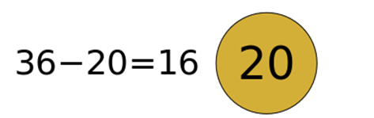
Greedy
Notes:
Thus, if we owe 36 cents, we choose our 20 cent coin, which would leave owing 16 cents.

Slide 12
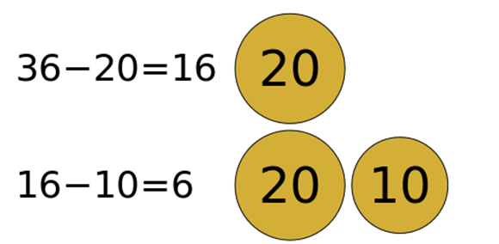
Greedy
Notes:
Next, we would choose our 10 cent coin, leaving only 6 cents.

Slide 13
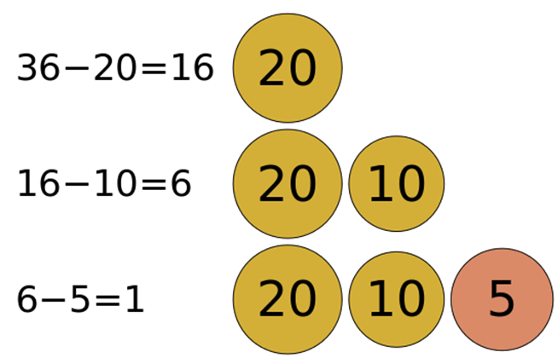
Greedy
Notes:
Next, we would choose the 5 cent coin and then the 1 cent coin.

Slide 14
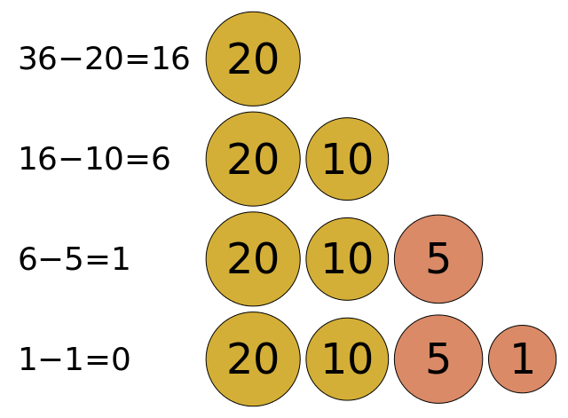
Greedy
Notes:
However, it should be noted that while this works on our example using 20, 10, 5, and 1 cent coins, it will not work on just any set of coins. For example, if we add an 18 cent coin to our existing set of coins, the minimum needed would be two 18 cent coins and not the 4 our algorithm would produce.
And, while greedy algorithms work quickly, they may or may not give you good answers, if they can find one at all.

Slide 15
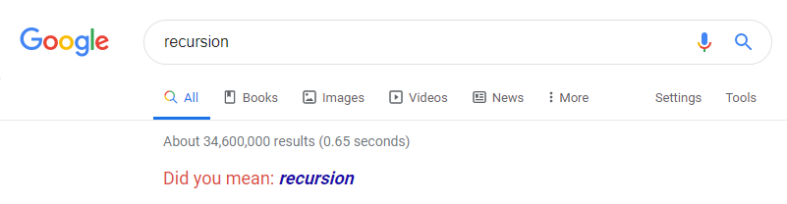
Recursion
Notes:
Our next technique is recursion. Recursion is similar to the divide and conquer method we discussed earlier. However, recursion itself is a very complicated and is often one of the most challenging concepts for a novice programmer to learn. However, we’ll take it slow and spend an entire module on recursion later in the course.
Essentially, recursion refers to an operation calling itself inside its own code, which may seem a little strange at first. However, if you think of like divide and conquer where we are trying to solve smaller and smaller problems it makes more sense.
Google tries to mess with you a little when you type in the search term “recursion” as shown in the figure. Usually, when Google says “Did you mean:”, it gives you a similar word to what you typed in (usually the correct spelling). However, in this case, it actually provides the same word you typed in “recursion”, which, if you click on it, brings you back to this same page. That’s kind of how recursion works.

Slide 16
Recursion
function ITERATIVE_FACTORIAL(N) RESULT = 1 loop I from 1 to N: RESULT = RESULT * I end loop return RESULT end function
Notes:
So let’s look at a quick example. First we’ll show how to compute the factorial function using a loop.
Its fairly straightforward, we simply multiply our result by our loop index I and each time through the loop. The end result returns N factorial.

Slide 17
Recursion
function RECURSIVE_FACTORIAL(N) if N == 1 return 1 else return N * RECURSIVE_FACTORIAL(N - 1) end if end function
Notes:
The recursive version of the factorial function computes the same value, it just replaces the loop with a recursive call to itself.
A recursive function has two basic parts: the base case and a recursive case. The base case occurs when we are ready to stop calling the recursive function. It is usually a very simple case in which the answer is known directly. Once we get to the base case, the recursive calls stop and we begin returning the values need to compute our final solution. So for the factorial function, we know by definition that 1 factorial is equal to 1. Thus, if N equals 1, we simply return the answer 1.
The second part, the recursive case, reduces our problem to a smaller version of itself. In this case, we reduce N factorial to N * (N – 1) factorial. We then call our function again to solve the problem N – 1 factorial and multiply the result by N to find the solution to N factorial
So, if we have a problem that can be reduced to a smaller instance of itself, we may be able to use recursion to solve it!

Slide 18
Graph Traversal
Notes:
Non-linear data structures such as graphs allow for a wide variety of techniques and algorithms, depending on your specific needs. We typically refer to these algorithms as graph traversal algorithms.
A graph traversal algorithms construct their answers by moving along the edges of a graph, from node to node. A good example of this is finding the fastest route in a map application, where the edges are streets and roads and the nodes are the intersections between the roads.
One example of such an algorithm is Dijkstra’s Algorithm, which can be used to find the shortest path between two selected nodes in a graph as shown in our example. Here you see the algorithm running and find the shortest path between node a and node b.

Slide 19
Algorithmic Techniques
Notes:
In this video we explored a number of algorithmic techniques we can use to develop algorithms that use take advantage of data structures to solve complex problems. Throughout the rest of this course, as well as a subsequent course, we’ll explore these algorithmic techniques in more detail so you will be well versed in their appropriate use.

