Slide 1

Stacks
Computational Core

Slide 2
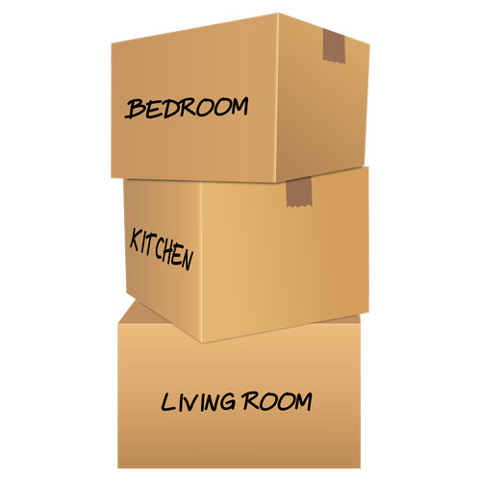
Notes:
When you think about a stack, you probably think about this such as a stack of boxes – as we see here – or a stack of coins, or poker chips, or chairs. But today we are going to look at stacks as data structures that are very useful in computer science.
Now, there are several similarities between stack in the real world and stacks in programming.
For example, look at our stack of boxes here. If you've worked with a stack of boxes, you know that in general we only put boxes on top of a stack and we only take boxes off the top as well. And, if you've ever tried to pull a box out of the middle of stack, you'll understand why we do it that way.
Whether we are talking about a stack of boxes or a stack of chairs, the fact that we only put items on the top of the stack or remove items from the top of the stack means that stacks are a list in first out structure. The last box we put onto the top of the stack will be the first box we pull off of the stack.

Slide 3
bottom
top
Notes:
In programming, we think of a stack as a data structure made up of a set of sequential data storage locations. These locations start at a specific location that we will call the _bottom_ of the stack. As we store data in the stack, we grow the stack upwards, putting one piece of data on top of the previous one. We keep track of the top of the stack with a variable called _top_. Before we store anything in the stack, we initialize _top_ to point one location below the bottom location.

Slide 4
push(W)
W
top
bottom
Notes:
For example, if we store a *W* on the stack, we increment _top_ and store the *W* at that location. We call the operation used to store data on a stack as the _push_ operation. You can think of the operation as pushing at item onto the stack.

Slide 5
push(1)
1
top
W
bottom
Notes:
We can continue to push items on the as long as we do not run out of room in the stack. So, if we _push_ the value *1* onto the stack, we simply increment _top_ and then store the *1* at that location.

Slide 6

push( )
top
1
W
bottom
Notes:
Next, we will push a piano onto the stack using the _push(piano)_ operation. Once again, we increment _top_ and store the *piano* there.

Slide 7
pop()
top
1
W
bottom
Notes:
So what do we do to get data off of the stack? To do that, we have a similar operation to _push_ called _pop_. When we call the _pop_ operation *[advance]*, we decrement _top_ and then return the item at the old _top_ location to the calling function.

Slide 8
push(A)
A
top
1
W
bottom
Notes:
By pushing and popping, we can use the same stack locations over and over. Here we have performed another _push_ operation, this time pushing an *A* onto the stack.

Slide 9
pop()
1
top
W
bottom
Notes:
Here, we do another _pop_ by decrementing _top_ and return the value *A* to the calling function.

Slide 10
pop()
W
top
bottom
Notes:
If we do yet another _pop_, we only have one value left on the stack, *W*. Now, _top_ equals _bottom_.

Slide 11
pop()
bottom
top
Notes:
And if we _pop_ the stack again, the stack becomes empty and we are back where we started.

Slide 12
pop()
Error!
bottom
top
Notes:
But what if we try to do a pop on an empty stack? *[advance]* In this case, we will get an error because the stack is empty. The error can be signified to the calling function, but for this module, we assume we will raise an exception any time an error occurs.
The other important error we will have to handle with a stack is if we try to push an element onto a full stack. We will talk about how to deal with situation in future videos.

Slide 13
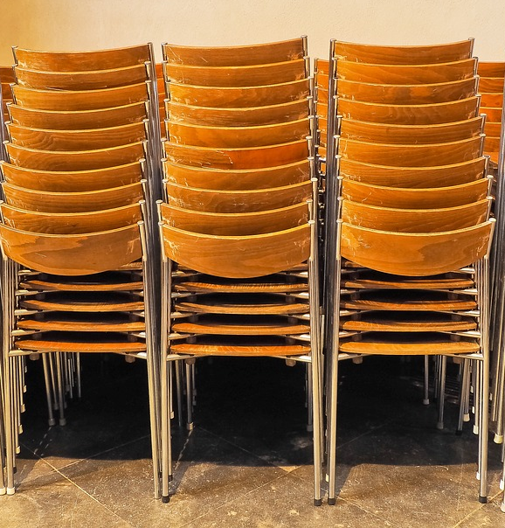
Notes:
In this video, we have discussed the concept of a stack and how it works in general. We also talked about the two main operations we perform on stacks, _push_ and _pop_. We use _push_ to put items into a stack, while we use _pop_ to remove items from the stack. Finally, we talk about potential errors conditions in stacks, we we try to push items onto a full stack or remove items from an empty stack.

