Slide 1

Stacks in Code
Computational Core

Slide 2


Slide 3
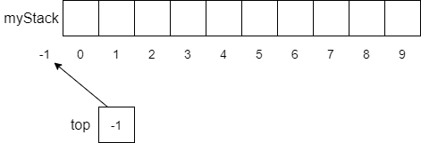
Notes:
There are several ways to store stacks in a computer. In this module we will focus on stacks that store their data in arrays. There are also other, more dynamic methods such as linked-lists that we can use as well.
Using an array to store a stack requires us to keep track of the top of the stack. To do this, we use a _top_ variable to hold the index of the current top of the array. When the stack is empty, we typically set _top_ equal to -1.
To encapsulate the functionality of our stack, we typically put everything in a class, where the stack and _top_ variable are protected. We then provide a few basic methods that allow a user to effectively use the stack. In this video, we will discuss the two main operations on stacks, _push_ and _pop_.

Slide 4
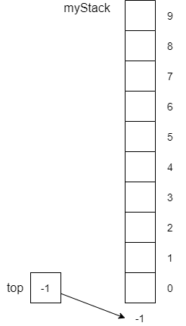
Notes:
Since we are using an array to store our stack, in this video we will show our stack horizontally, similar to how we show an array. In this case, the stack grows from left to right. *[advance]* However, this is easily translated to a more common view of stack as a vertical structure. In this case, the stack grows from bottom to top. You should really be able to understand either of these views of stacks.

Slide 5
function push(item)
if myStack is full then
throw exception
end if
top = top + 1
myStack[top] = item
end function
Notes:
The nice thing about stacks is the simplicity of its code. Here is code for the _push_ operation. Since we are adding an item to the stack and we are using an array – meaning our storage in the array is limited – we must always check to make sure the stack is not full. If it is, we throw and exception.
Assuming we have space on the stack, the rest of the code is straightforward. First, we increment _top_ by one to point to the next unused location in the stack and then store the item in that spot in the array.

Slide 6

function push(item)
if myStack is full then
throw exception
end if
top = top + 1
myStack[top] = item
end function
Notes:
An example of pushing an *a* onto the stack is shown here. First, we increment _top_ to 0, which is the first location in the array.

Slide 7
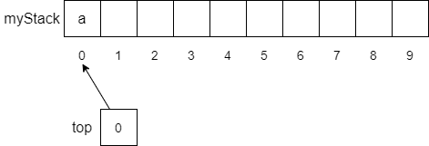
function push(item)
if myStack is full then
throw exception
end if
top = top + 1
myStack[top] = item
end function
Notes:
We then store the *a* into the array location indexed by _top_. Pretty simple.

Slide 8

push("b")
push("c")
push("d")
push("e")
Notes:
If we continue on and push *b*, *c*, *d*, and *e* onto the stack, our array will look like this. Notice that each item is stored in the order it is pushed onto the stack, and that _top_ has been incremented to 4, which points at the *e* on top of the stack.

Slide 9
Notes:
Of course the question you have now is how do we get the data out of the stack.

Slide 10
function pop()
if top == -1 then
throw exception
end if
top = top - 1
return myStack[top+1]
end function
Notes:
Once again, the code for the _pop_ operation is also nice and simple. We first check to see if the stack is empty, which is denoted by the _if top == -1_ statement at the beginning of the function.

Slide 11

function pop()
if top == -1 then
throw exception
end if
top = top - 1
return myStack[top+1]
end function
Notes:
Assuming there is something on the stack to pop off, we continue, this time decrementing _top_.

Slide 12

function pop()
if top == -1 then
throw exception
end if
top = top - 1
return myStack[top+1]
end function
Notes:
Finally, we return the item stored where the previous top of the stack was – at location _top + 1_ in the array and we are done.

Slide 13

pop()
pop()
Notes:
Now, if we perform two more _pop_ operations the stack would end up looking like this. Again, _top_ has been decremented by 2 – once for each _pop_ operation.

Slide 14
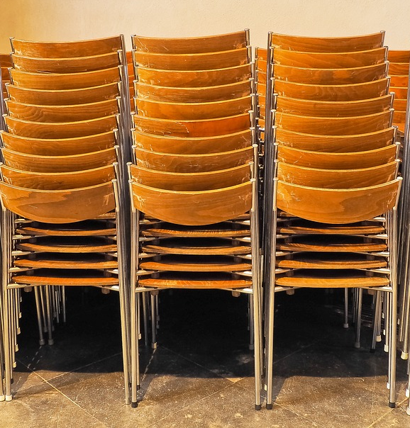
Notes:
In this video, we have looked at how we can use an array to implement a stack. Besides the array, the only other variable we need is a _top_ variable to keep track of where the current top of the stack is. There are several other operations that can make using stacks much easier such as _isFull_ and _isEmpty_ as well as the _peek_ function, which allows us to look at the item on top of the stack without actually popping it off the stack.

