Slide 1

Recursion
Computational Core

Slide 2
Recursion
Recursion
Recursion
Recursion
Recursion
Recursion
Recursion
Recursion
Recursion
Notes:
Recursion is a very powerful technique for solving complex problems in a few, understandable lines of code. In general, recursion is another way to implement loops.

Slide 3
What is recursion?
the repeated application of a recursive definition
Notes:
So let's look at the definition of recursion. Here is a definition from a dictionary that is, well, not really all that useful. As you can see, it is a recursive definition that uses the term recursive definition to define recursion. Let’s try another one.

Slide 4

What is recursion?
the repeated application of a recursive definition
when a thing is defined in terms of itself
Notes:
Ah, this is much better and way more useful! It is a “thing that is defined in terms of itself”. That’s a little better. But what does that mean in programming?
Basically, recursion occurs when a function calls itself.
The goal of recursion is to break a problem down into a simpler subproblem of itself until you get to the point where the solution is trivial, or at least straightforward.

Slide 5
function REVERSE() (1)
read CHARACTER (2)
if CHARACTER == '*' then (3)
return (4)
else (5)
REVERSE() (6)
write CHARACTER (7)
return (8)
end if (9)
end function (10)
Notes:
So here’s an example of a recursive function. The goal of this function is to read in a sequence of characters and print them out in reverse order until we get read an asterisk.
You’ll notice that the function REVERSE calls itself in line 6. While this is where the recursion happens, there are other parts of the function that we need to understand in order to appreciate what the recursion actually does for us.

Slide 6
function REVERSE() (1)
read CHARACTER (2)
if CHARACTER == '*' then (3)
return (4)
else (5)
REVERSE() (6)
write CHARACTER (7)
return (8)
end if (9)
end function (10)
base case
Notes:
The first thing we need to understand is the concept of a “base case”. Remember I said that the goal of recursion is to decompose a problem into smaller subproblems of itself until we get to the point where the subproblem is easy to solve. Well, that occurs in the base case.
In the REVERSE function, the base case occurs when we read in an asterisk character in line 2. In this case, the asterisk character should cause us to stop reading in characters and to start printing out the characters we have read in, in reverse order.
Thus, we don’t really do anything with the asterisk other than to stop reading in additional characters. So, we simply return from the function call without doing anything.

Slide 7
function REVERSE() (1)
read CHARACTER (2)
if CHARACTER == '*' then (3)
return (4)
else (5)
REVERSE() (6)
write CHARACTER (7)
return (8)
end if (9)
end function (10)
recursion
Notes:
So what happens when we don’t read in an asterisk? In the REVERSE function, we simply want to read in another character over and over until we do read an asterisk and execute our base case. We do this by recursively calling the REVERSE function again in line 6.
When we recursively call REVERSE, you can think of it as creating a completely new version of the REVERSE function, complete with new parameters and variables. In this way, a recursive call is really just like a normal function call from the computer’s perspective.
So, when call REVERSE again, it simply starts like the previous version of REVERSE and reads in a new character in line 2. And, since we have a new set of parameters and variables in the new REVERSE function, the old REVERSE function will remember its variable values as well.

Slide 8
function REVERSE() (1)
read CHARACTER (2)
if CHARACTER == '*' then (3)
return (4)
else (5)
REVERSE() (6)
write CHARACTER (7)
return (8)
end if (9)
end function (10)
computation
Notes:
Eventually REVERSE will stop calling itself once it reads in an asterisk. This starts the return process. Notice that immediate after a call to REVERSE returns, the function writes in the character that was read in line 2 of this instance of the function and then returns itself. In the REVERSE function, this will continue to occur until every character has that was read in is written out in reverse order.

Slide 9
function REVERSE() (1)
read CHARACTER (2)
if CHARACTER == '*' then (3)
return (4)
else (5)
REVERSE() (6)
write CHARACTER (7)
return (8)
end if (9)
end function (10)
recursion
computation
This is an example of head recursion because the recursion occurs before the computation
Notes:
This particular type of recursion is called “head recursion” since we call the recursive function before doing computation to solve our problem. Here, line 7 – the write character statement – is considered the computation.

Slide 10
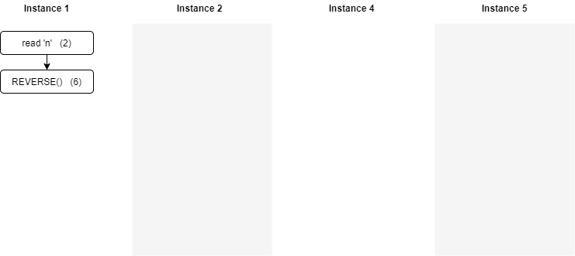
function REVERSE() (1)
read CHARACTER (2)
if CHARACTER == '*' then (3)
return (4)
else (5)
REVERSE() (6)
write CHARACTER (7)
return (8)
end if (9)
end function (10)
Notes:
Now let’s try to look at a little more detail concerning just how recursion works. In our example, we have called REVERSE for the first time. We assume we have performed line 2 to read in a character, which is was an “n”. Then, since the character was not an asterisk, the REVERSE function is called in line 6.

Slide 11
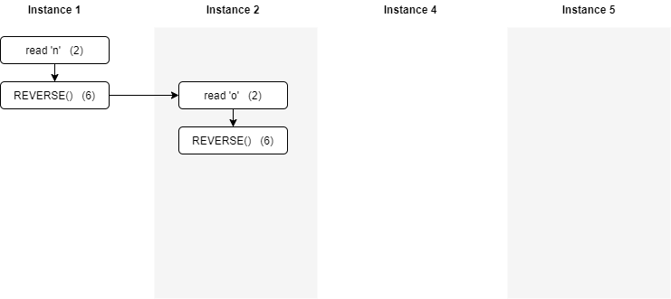
function REVERSE() (1)
read CHARACTER (2)
if CHARACTER == '*' then (3)
return (4)
else (5)
REVERSE() (6)
write CHARACTER (7)
return (8)
end if (9)
end function (10)
Notes:
Next, we create a new version, or instance of the REVERSE function and start execution from the start. In this case, we read in an “o” character, which again cause us to call REVERSE recursively.

Slide 12
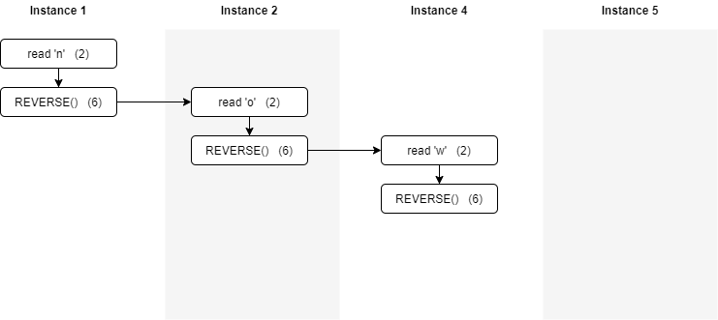
Instance 3
function REVERSE() (1)
read CHARACTER (2)
if CHARACTER == '*' then (3)
return (4)
else (5)
REVERSE() (6)
write CHARACTER (7)
return (8)
end if (9)
end function (10)
Notes:
A new REVERSE call causes us to create a new instance of the function and start execution at line 2. Here we read in another character, this time “w”, and then call REVERSE yet again.

Slide 13

Instance 3
Instance 4
function REVERSE() (1)
read CHARACTER (2)
if CHARACTER == '*' then (3)
return (4)
else (5)
REVERSE() (6)
write CHARACTER (7)
return (8)
end if (9)
end function (10)
Notes:
Finally, we create a new instance of REVERSE and this time we actually read in an asterisk. Of course the asterisk is our base case and will cause the function to return immediately.

Slide 14
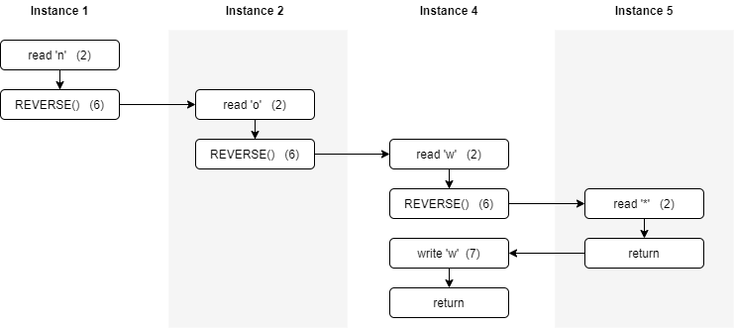
Instance 3
Instance 4
function REVERSE() (1)
read CHARACTER (2)
if CHARACTER == '*' then (3)
return (4)
else (5)
REVERSE() (6)
write CHARACTER (7)
return (8)
end if (9)
end function (10)
w
Notes:
When instance 4 returns, instance 3 then call line 7, the write character statement. The character “w” is printed, which is the character that was read earlier in this function instance. One written, the function returns.

Slide 15
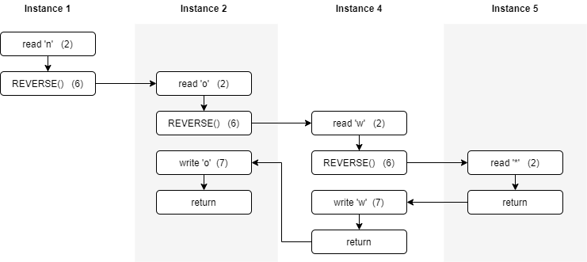
Instance 3
Instance 4
function REVERSE() (1)
read CHARACTER (2)
if CHARACTER == '*' then (3)
return (4)
else (5)
REVERSE() (6)
write CHARACTER (7)
return (8)
end if (9)
end function (10)
wo
Notes:
In instance 2, the same thing happens again. This time we write character “o” and return.

Slide 16
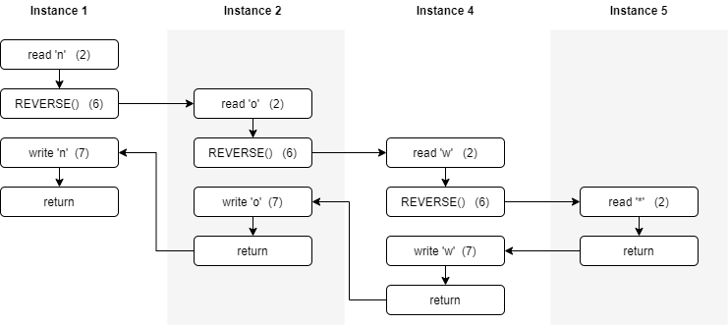
Instance 3
Instance 4
function REVERSE() (1)
read CHARACTER (2)
if CHARACTER == '*' then (3)
return (4)
else (5)
REVERSE() (6)
write CHARACTER (7)
return (8)
end if (9)
end function (10)
won
Notes:
Finally, we have returned all the way to instance 1 of REVERSE. When execution returns to instance 1, we pick up in line 7 and print out the character “n” and return to the original calling program.
Therefore, while we read in the characters “n”, “o”, and “w”, we printed them out in reverse order as “won”.
Of course, one of the main benefits of writing REVERSE as a recursive function is that we did not have to know ahead of time how many characters we would be reading in. The other real option is to use an array, or some other data structure to save the characters as we read them, and then write them out in reverse order once we read an asterisk. If we had chosen to use an array, we would have been out of luck if we had read in more characters than there were spots to hold them in the array.

Slide 17
function REVERSE() (1)
read CHARACTER (2)
if CHARACTER == '*' then (3)
return (4)
else (5)
REVERSE() (6)
write CHARACTER (7)
return (8)
end if (9)
end function (10)
What if we swap?
recursion
computation
Notes:
So, what do you think would happen if we swapped the order of lines 6 and 7?

Slide 18
function REVERSE() (1)
read CHARACTER (2)
if CHARACTER == '*' then (3)
return (4)
else (5)
write CHARACTER (6)
REVERSE() (7)
return (8)
end if (9)
end function (10)
What if we swap?
computation
recursion
This is an example of tail recursion because the recursion occurs after the computation
Notes:
In this case, instead of implementing “head recursion”, we would be implementing “tail recursion”, which puts all computation ahead of the recursive function call.
Tail recursion can be very useful since all we do after executing our base case it to perform several function returns. The benefit to tail recursion lies in that fact that it can be optimized by good compilers. If we know we are performing tail recursion, then there is no additional computation to be performed once we call the recursive function, so there is really no use in storing all the variables and parameters from the earlier recursive calls. Once a tail recursive function calls itself again, we can basically throw away the current instance and just keep track of the currently executing instance.

Slide 19

Instance 3
Instance 4
function REVERSE() (1)
read CHARACTER (2)
if CHARACTER == '*' then (3)
return (4)
else (5)
write CHARACTER (6)
REVERSE() (7)
return (8)
end if (9)
end function 10)
Notes:
While optimization might be nice, you probably want to know what the effect of swapping the computation and the recursive call is on the output?
Here is this example, we show the same sequence of three recursive calls to REVERSE after reading in the same character “n”, “o”, and “w”.

Slide 20
function REVERSE() (1)
read CHARACTER (2)
if CHARACTER == '*' then (3)
return (4)
else (5)
write CHARACTER (6)
REVERSE() (7)
return (8)
end if (9)
end function 10)
now
Notes:
Since we will write the character before call REVERSE again, the characters will print out in the order in which they were input.
Tail recursion basically produces of first in first out ordering of the computation. This makes sense since tail recursion requires all the computation to take place before call the recursive function.
Head recursion, on the other hand, produces a last in first out ordering of the computation. This is evident by the fact that the original REVERSE function wrote out characters in reverse order.

Slide 21
Recursion
Recursion
Recursion
Recursion
Recursion
Recursion
Recursion
Recursion
Recursion
Notes:
We have looked at the concept of recursion and shown one simple example of its use. We showed how each instance of the function call keeps track of its own variables so that it can complete its computation once control has been returned to it.
Finally, we talk about the difference between head and tail recursion and how they relate to first in first out and last in first out ordering.

