Slide 1

Tree Recursion
Computational Core

Slide 2
Recursion
Recursion
Recursion
Recursion
Recursion
Recursion
Recursion
Recursion
Recursion
Notes:
Oftentimes problems that look like they are tailor made for recursive function may not work quite as well as what we assumed. Computing Fibonacci numbers is one of those problems.
However, there are some techniques we can use to help optimize our recursive algorithms.

Slide 3
Fibonacci numbers
f _{n} = f _{n-1} + f _{n-2}
0, 1, 1, 2, 3, 5, 8, 13, 21, 34, 55, 89, 144, 233, 377, 610, 987, 1597, 2584, 4181, 6765, 10946, 17711, 28657, 46368, 75025, 121393, 196418, 317811, ...
Notes:
Fibonacci numbers form a series of number in which each number is the sum of the previous two numbers in the series. As you can see this leads to the numbers in the series growing very rapidly.

Slide 4
Fibonacci numbers
f _{n} = f _{n-1} + f _{n-2}
2 base cases:
- f₀ = 0
- f₁ = 1
Notes:
The nice thing about computing Fibonacci numbers is that the equation is quite simple and elegant. A Fibonacci number is simply the sum of the two Fibonacci number preceding it.
For our purposes in studying recursion it is perfect. We just sum the result from two recursive calls.
Of course, its important to know the base cases, which are also well defined. F0 = 0 while f1 = 1. This when coupled with the definition allows us to easily compute f2 as 0 + 1, or 2.

Slide 5
Fibonacci numbers
f _{n} = f _{n-1} + f _{n-2}
function f(N)
if N == 0 return 0 else if N == 1
return 1
else
end function
Notes:
Given the nice simple definitions, creating the function “f” to compute Fibonacci numbers is straightforward.
First, we include our two base cases. If our input number N is 0, we return 0. If N is 1, we return 1.

Slide 6
Fibonacci numbers
f _{n} = f _{n-1} + f _{n-2}
function f(N)
if N == 0 return 0 else if N == 1
return 1
else
return f(N-1) + f(N-2)
end if
end function
Notes:
Next, we then include the basic definition as our recursive case. In this case, we simply return f(N-1) + f(n-2).
I think we would all agree that this is a very elegant and straightforward application of recursion that should work very well for us.

Slide 7
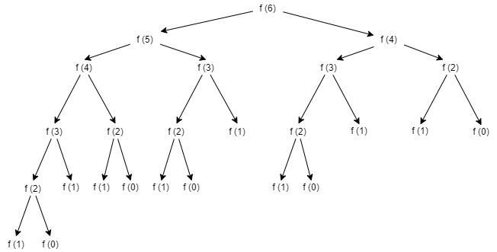
Fibonacci numbers
f _{n} = f _{n-1} + f _{n-2}
function f(N)
if N == 0 return 0 else if N == 1
return 1
else
return f(N-1) + f(N-2)
end if
end function
Notes:
So, if we execute our function to compute the 6th Fibonacci number, we get the following tree that illustrates the calls made to “f”.
As you can see f(6) makes calls to f(5) and f(4), while f(5) makes calls to f(4) and f(3), etc. on down to the base cases of f(0) and f(1).

Slide 8
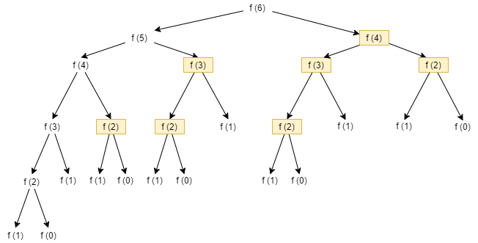
Fibonacci numbers
f _{n} = f _{n-1} + f _{n-2}
function f(N)
if N == 0 return 0 else if N == 1
return 1
else
return f(N-1) + f(N-2)
end if
end function
Notes:
However, as we look at the calling tree more closely, we see that there are several calls that are made multiple times. If we look closely, you’ll see that f(2) is called five separate times, which means that we recompute the value of f(4) four additional times after we had already computed it. Obviously, these are wasted computations. Imagine if we wanted to compute the 10th Fibonacci number. There would be a huge number of extract computations going on.

Slide 9
Fibonacci numbers
f _{n} = f _{n-1} + f _{n-2}
function f(N)
if N == 0 return 0 else if N == 1
return 1
else
return f(N-1) + f(N-2)
end if
end function
Notes:
The problem lies in the recursive definition of Fibonacci numbers and our straightforward implementation of that definition.
If we look at the line with the recursive definition, it computes f(n-1) and then calls f(n-2). This causes f(N-2) to be computed twice, once within the f(n-1) computation and then again separately.
Surely there has to be a better approach.

Slide 10
Memoization
goal – save results in an array
Notes:
Of course the obvious solution would be to compute values only once and then save them so we don’t have to recompute them.
This is the basis of a technique called “memoization”. Essentially, any time we do a computation, we will save the result into an array. Then, if we need to compute a result, we will check our array to see if it has been computed before.

Slide 11
Memoization
- introduce array FA
function f'(N)
if N == 0 return 0 else if N == 1
return 1
else if FA[N] == -1
FA[N] = f'(N-1) + f'(N-2)
return FA[N]
else
return FA[N]
end if
end function
Notes:
So let’s modify our algorithm a little. We will introduce an array called FA to save our computed results. We initialize FA so that every item has the value of -1. Since Fibonacci numbers are all greater than 0, we know that if the value of FA[N] is -1 then we have not yet computed that Fibonacci number.
Then, if we are not in a base case, we simply check to see if anything has been stored in the array at that position, or if FA[N] is equal to -1. If it is, we compute the value of f(N) using the traditional recursive formula. We then save that value in the array and return.
However, if FA[N] does not equal -1, that means that the value in FA[N] is the Nth Fibonacci number and we can just return it directly and eliminated a lot of extra computation.

Slide 12
Memoization
function f'(N)
if N == 0 return 0 else if N == 1
return 1
else if FA[N] == -1
FA[N] = f'(N-1) + f'(N-2)
return FA[N]
else
return FA[N]
end if
end function
Notes:
With our memoized algorithm, all the highlighted function calls will not have to be recomputed. But, its even better than that.

Slide 13
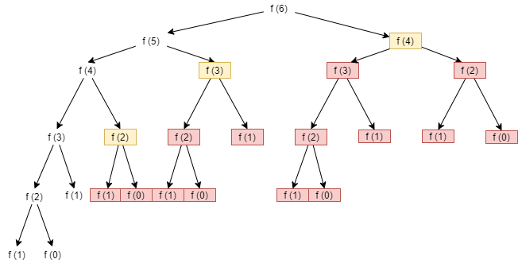
Memoization
function f'(N)
if N == 0 return 0 else if N == 1
return 1
else if FA[N] == -1
FA[N] = f'(N-1) + f'(N-2)
return FA[N]
else
return FA[N]
end if
end function
Notes:
In reality, when the yellow highlighted function calls are made, none of the red highlighted function calls will need to be made. This is due to the fact that the yellow highlighted Fibonacci numbers have already been computed and stored in FA and thus no additional calls are needed.

Slide 14
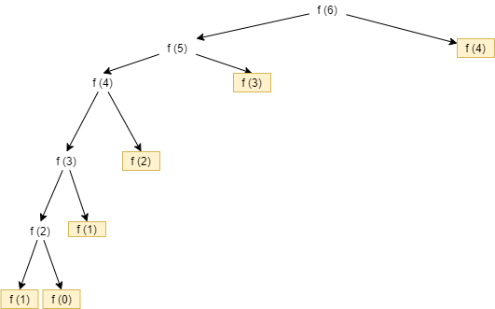
Memoization
function f'(N)
if N == 0 return 0 else if N == 1
return 1
else if FA[N] == -1
FA[N] = f'(N-1) + f'(N-2)
return FA[N]
else
return FA[N]
end if
end function
Notes:
Now, if we look at the real call tree, we see that only 11 of the original 25 functions are actually made. Obviously this is a significant savings in terms of computation. And, as we attempt to compute the really large Fibonacci numbers, the savings will become equally large.

Slide 15
Recursion
Recursion
Recursion
Recursion
Recursion
Recursion
Recursion
Recursion
Recursion
Notes:
So, we have looked at the effect that a straightforward implementation of recursive definition can have. However, the effect really depends on the type of definition you are dealing with.
In this case, the tree recursive calls ended up recomputing the same values over and over again. This is particularly common on tree recursion where you are performing multiple recursive calls within the same function. If we can decompose our problems so that the subproblems are unique, then we will be OK. However, if the subproblems overlap, then we have the potential for doing extra computations.
Of course the good news is that we have found a technique that can be used to shortcut excessive computation by storing values as we compute them and then simply looking them up instead of recomputing them.

