Slide 1

Hash Tables
Computational Core

Slide 2
The ideal data structure:
Constant time insertion
Constant time retrieval

Slide 3
The ideal data structure:
Unsorted array - retrieval is order N
Sorted array – retrieval is lg N time (binary search)
Insertion is order N
Linked lists – insertion is constant time
Retrieval is order N time

Slide 4
A hash table consists of three components:
An array
A set of buckets
A hash function

Slide 5
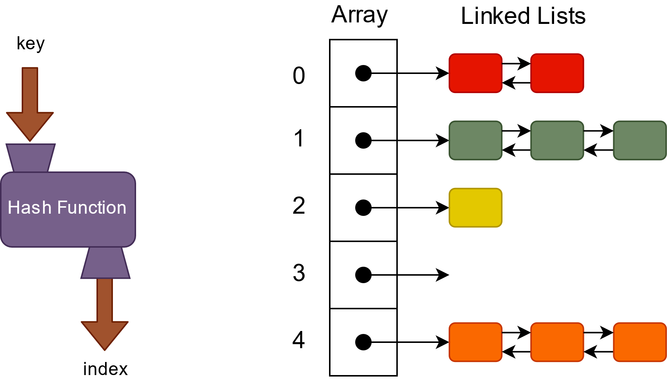
Bucket (linked list)

Slide 6
Bucket (linked list)

Slide 7
Index = key % 4
0
1
2
3

Slide 8
16
Index = key % 4
0
1
2
3

Slide 9
16
Index = key % 4
0
0
1
2
3

Slide 10
16
Index = key % 4
0
0
1
2
3

Slide 11
16
Index = key % 4
0
16
0
1
2
3

Slide 12
7
Index = key % 4
0
16
1
2
3

Slide 13
7
Index = key % 4
0
16
3
1
2
3
7

Slide 14
13
Index = key % 4
0
16
1
2
3
7

Slide 15
13
Index = key % 4
0
16
1
1
13
2
3
7

Slide 16
12
Index = key % 4
0
16
1
13
2
3
7

Slide 17
12
Index = key % 4
0
16
0
1
13
2
3
7

Slide 18
12
Index = key % 4
0
16
12
0
1
13
2
3
7

Slide 19
Retrieve
7
Index = key % 4
0
16
12
1
13
2
3
7

Slide 20
Retrieve
7
Index = key % 4
0
16
12
3
1
13
2
3
7

Slide 21
Retrieve
7
Index = key % 4
0
16
12
3
1
13
2
3
7

Slide 22
Retrieve
12
Index = key % 4
0
16
12
1
13
2
3
7

Slide 23
Retrieve
12
Index = key % 4
0
16
12
0
1
13
2
3
7

Slide 24
Retrieve
12
Index = key % 4
0
16
12
0
1
13
2
3
7

Slide 25
Retrieve
12
Index = key % 4
0
16
12
0
1
13
2
3
7

Slide 26
Retrieve
12
Index = key % 4
0
16
12
0
1
13
2
3
7

Slide 27
What to do with a crowded hash table?
Index = key % 4
0
16
12
1
13
2
3
7
Notes:
As we store more key-value pairs in a hash table, the number of collisions will increase. The more collisions we have, the less efficient our hash table will become. It won't take long to erase all the benefits of having a hash table in the first place. So, what can we do?

Slide 28
Right! We double the capacity …
Index = key % 8
0
16
12
1
13
2
3
7
Update our index computation!
4
5
6
7
Notes:
Right! At some point, it makes sense to increase the capacity of the array, much like we did with stacks and queues that we implemented using arrays.
Notice too that we have to update our hash function to computes index values that cover the entire range of our new array. In this case from index 0 to index 7.

Slide 29
13
Right! We double the capacity …
Index = key % 8
0
16
12
1
13
5
2
3
7
4
5
6
7
Notes:
Of course, this creates a real problem. What if we want to retrieve item 13?
If we run 13 through our new hash function, we get an index of 5, which is not where 13 was stored. So, how do we solve this?

Slide 30
Right! We double the capacity and "rehash"!
Index = key % 8
0
16
1
2
3
4
12
5
13
6
7
7
Notes:
The solution is to rehash our table every time we increase or decrease the size of the array. When we rehash our table, we simply compute new indexes for all key-value pairs and add them into the new array at the appropriate location as we have done here. Now, if we want to retrieve 13, it will be right where we stored it, at index 5.
Notice how much room we now have to store new key-value pairs. There is a 50-50 chance that the next item we will store will not cause a collision and, if it does, there will be at most one other key-value pair in the same bucket.
Now that we know what to do when we have a crowded hash table, the question is, when do we need to do it?

Slide 31
Index = key % 4
0
16
12
1
13
2
3
7
The capacity of the array
The size of the hash table
The load factor (size / capacity)
Notes:
There are three key things we use when making this decision. First, there is the capacity of the current array. Here we have an array of capacity 4. Next, we have the size of the hash tables in terms of the number of key-value pairs stored in the table. In this example, we also have 4 key-value pairs: 16, 12, 13, and 7. And finally, there is the load factor (or ratio) between the size of the hash table and its capacity, ‘size / capacity’.
Typically, when the load factor reaches a specified threshold, we double the capacity of the array and then rehash the table using the new array. The load factor threshold we choose is a tradeoff between space and time. The larger the array, the more memory you use, but you have fewer collisions. And obviously, the smaller array you use, the more collisions you will have and the greater the time required to retrieve key-value pairs from the table. Through research and experience, it has been shown that a load factor of 0.75 generally works best.
Thus, each time we add a key-value pair to the hash table, we should check to see if the load factor of the table has exceeded our threshold of 0.75. In the example given, the size of the table is 4 key-value pairs and the capacity of the array is 4. This yields a load factor of 1.0 which is clearly greater than our threshold of 0.75. We should definitely increase the size of our array and rehash the table.

